Slide 1
Title o the presentation
Author

Slide 2
This is the slide title
This is $LATEX_{text}$ and an equation:
$$f\left(k\right)=\left({n \atop k}\right)p^{k}{\left(1−p\right)}^{n−k}$$

Slide 3
This is slide
This is a reference to an article [1] and a book [2].

Slide 4
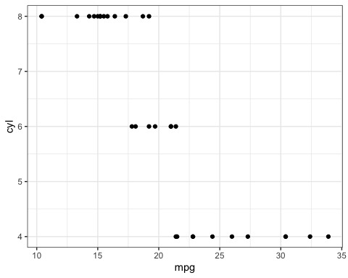
I create a new slide with a plot
This is a caption for a figure

Slide 5
References
More information here: https://bookdown.org/yihui/rmarkdown/powerpoint-presentation.html
[1] Doe & Doe. ‘An article title’. Journal of Templates 90, (2022). DOI: 10.1103/physrevb.90.054105
[2] Ashcroft & Mermin. ‘Solid state physics’. (Holt Saunders, New York, 1976).

