Slide 1
QuarRC
Real-time control of hardware devices

Slide 2
Background
Set of real-time Matlab and Simulink tools
Teleoperation/Streaming data
Data Acquisition

Slide 3
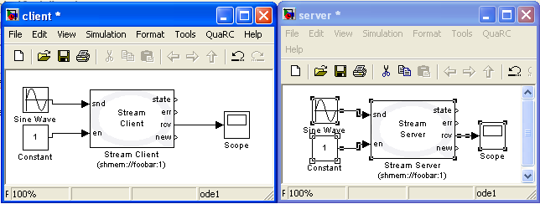
Communication: Basic
Send data
Connection State
Error?
Receive data
Enabled?
Is there new data?

Slide 4
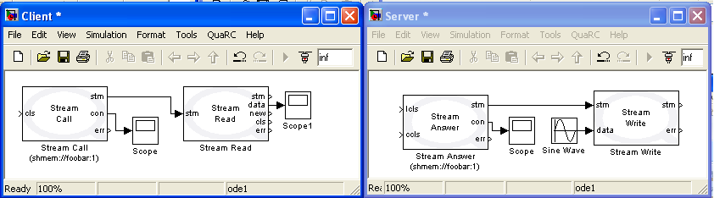
Communication: Intermediate
Data stream
Receive data
Stop Listening?
New data?
Connection Closed?
Close Connection?
Error?

Slide 5
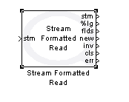
Communication: Intermediate
Can connect to HyperTerminal
Parsed data
# Fields read
Invalid?

Slide 6
Communication demo
(Intermediate)

Slide 7
Devices
Game controllers (Wii, generic, mouse/keyboard)
Robotic Arms
Haptic controllers (Novint Falcon, Quanser)
Sensors (accelerometers, force-torque, camera)

Slide 8
Data Acquisition
Immediate
Buffered
Timebase

Slide 9
Features
Universal Resource Identifier
Dynamic Reconfiguration
Multi and Asynchronous threading
C, .NET, Java APIs

Slide 10
Dynamic Reconfiguration demo

Slide 11
URI demo

Slide 12
Safety
Watchdog
Remote Stop
Error Handling

Slide 13
Other included blocks
Math (Rotations, discrete state space, …)
Outputs (FIFO, plots)
Image Processing

