Slide 1
Revealed Attack / Discovered Attack
When a piece moves one piece out of the way to reveal a previously blocked attack by another piece
Especially powerful when the moving piece results in a check
Because the check forces your opponent to deal with the check, meaning they may not save the other piece

Slide 2
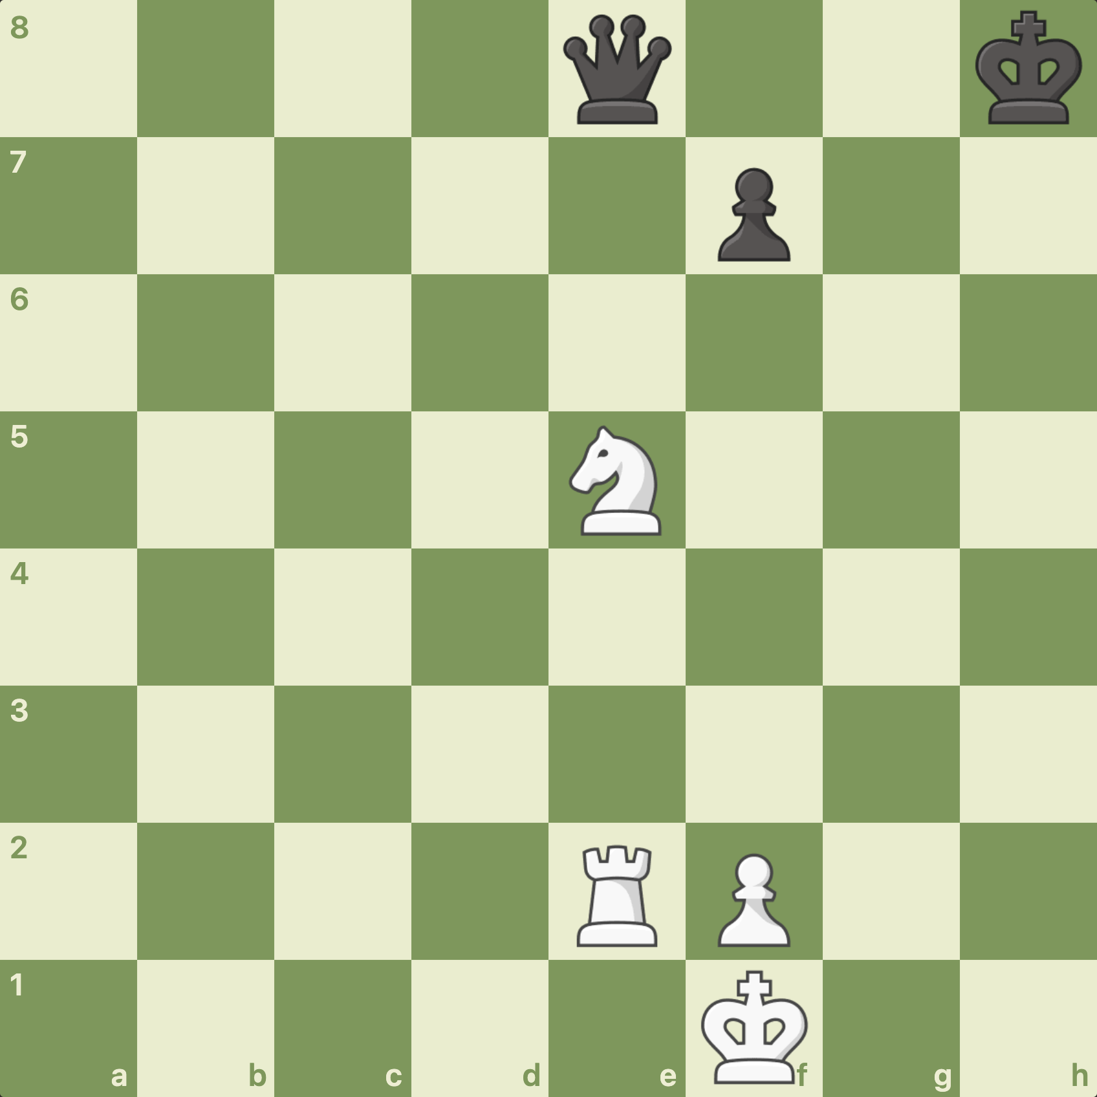

Slide 3
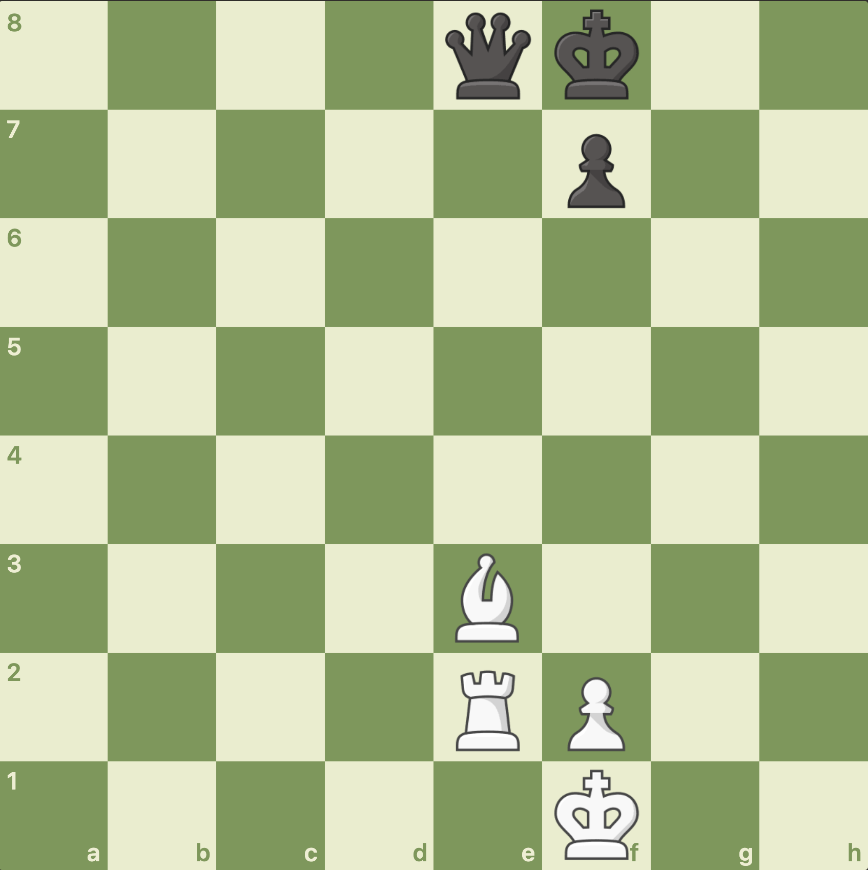

Slide 4
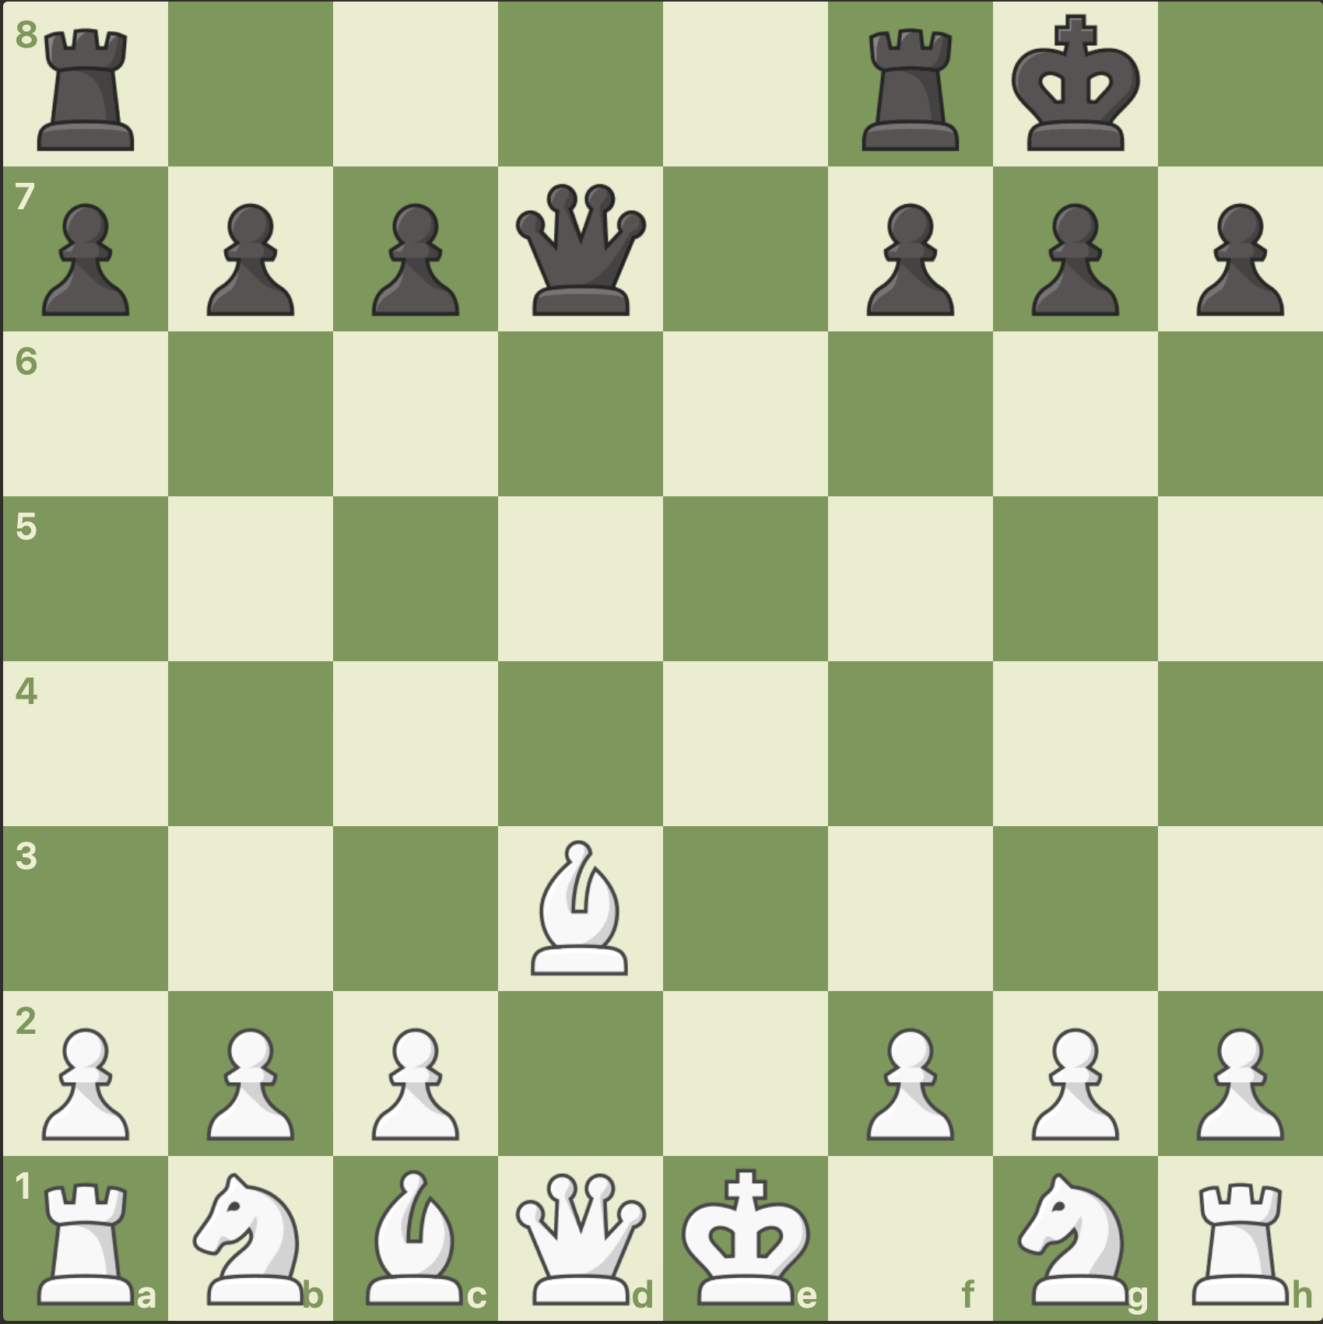

Slide 5
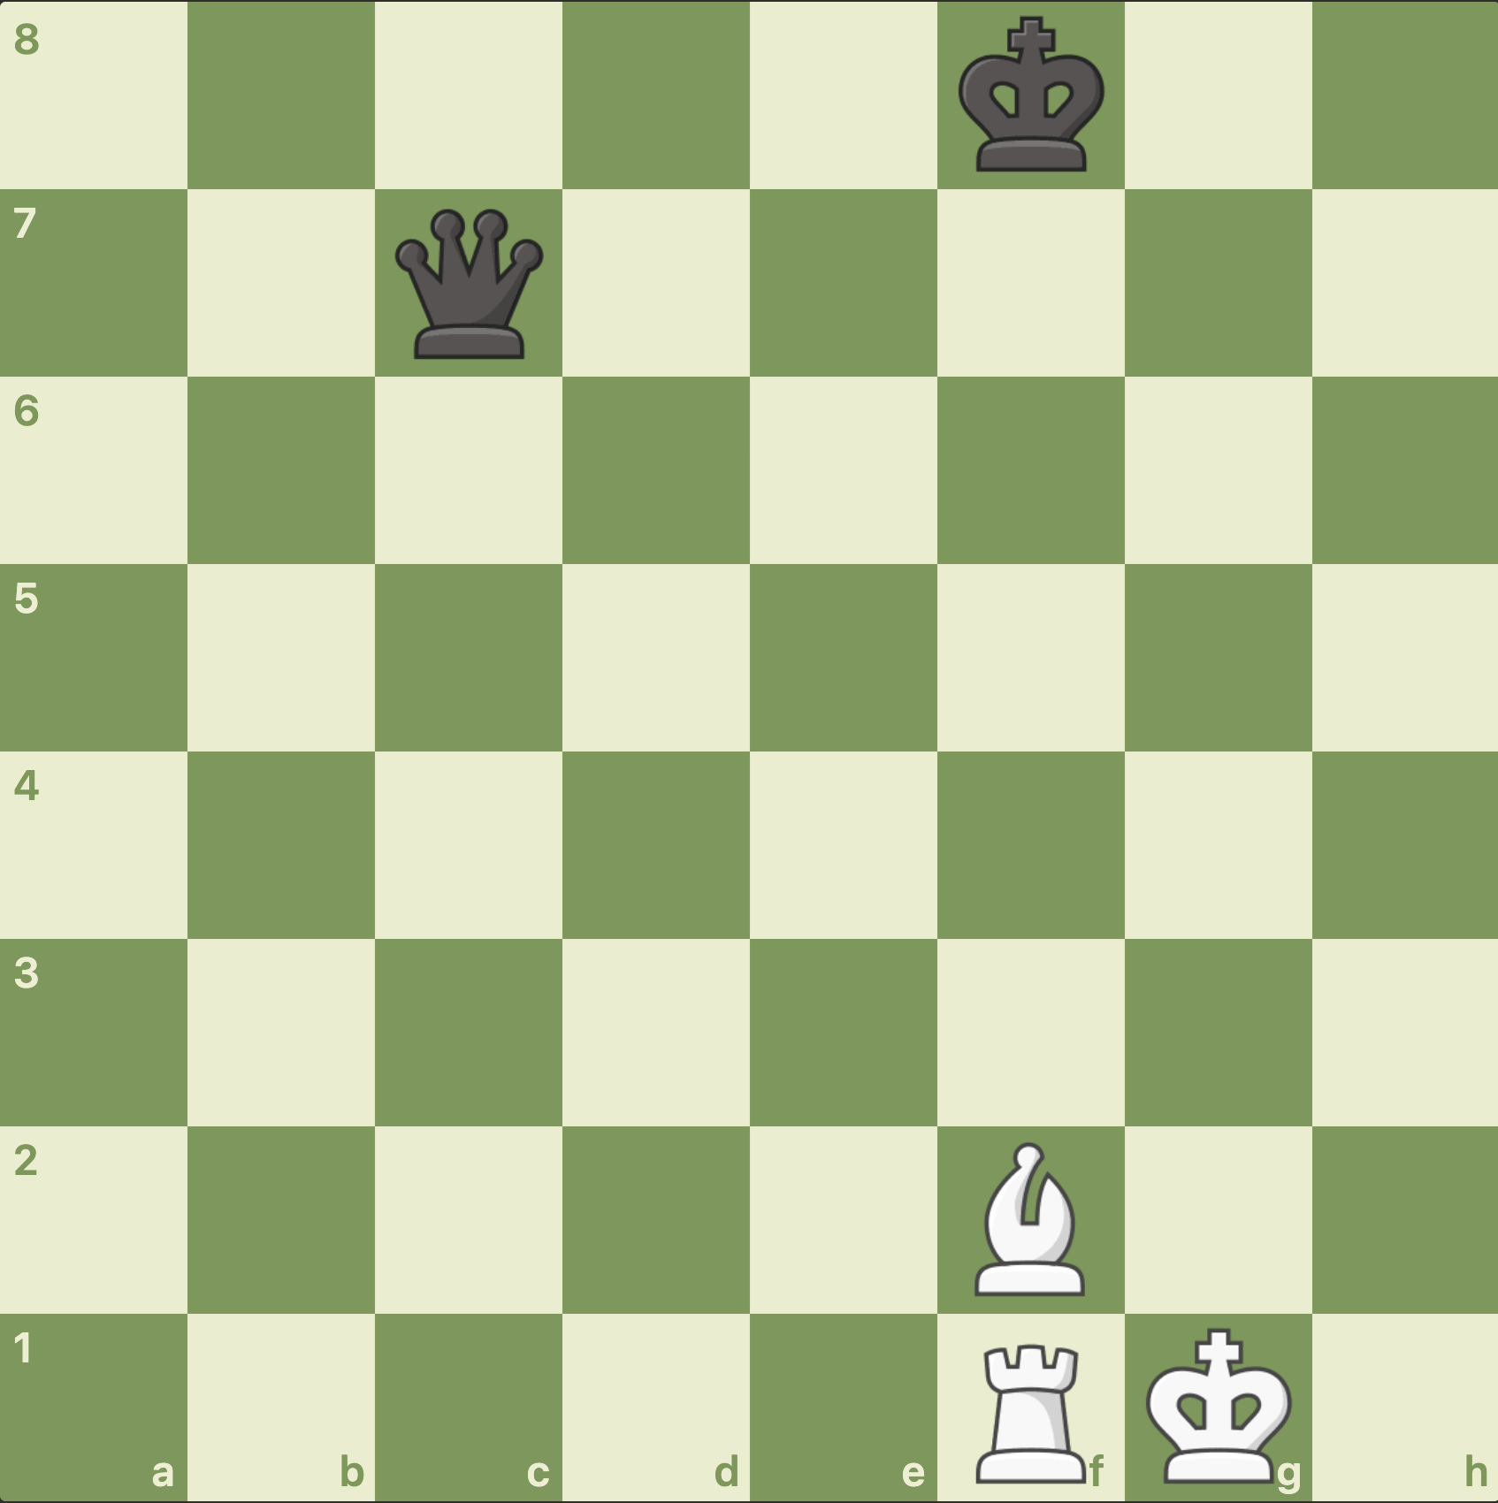

Slide 6
What can we do to avoid them?
Keeping our pieces defended / protected may help
Keeping our King safe may help
… we have to watch the board for defence as well as attack

