Slide 1
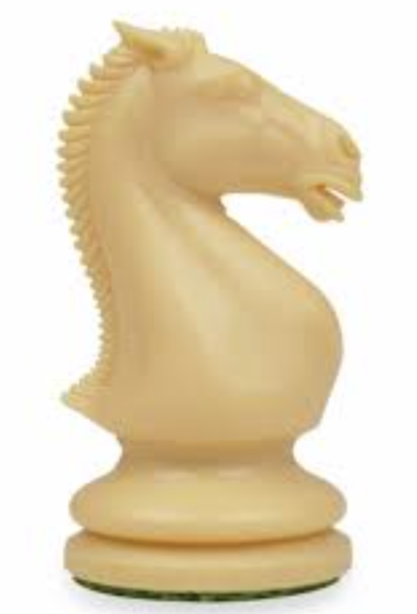
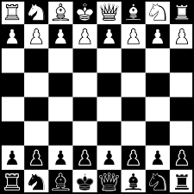
Highfield Priory Chess Club
MVP Award
is the Most Valuable Player in a simultaneous chess match against Natalie
C. Greenwood
Lancashire Junior Coach
June 2024

Slide 2
Highfield Priory Chess Club
MVP Award
is the Most Valuable Player in a chess match against Our Ladies & St Edward’s
C. Greenwood
Lancashire Junior Coach
June 2024

