Slide 1
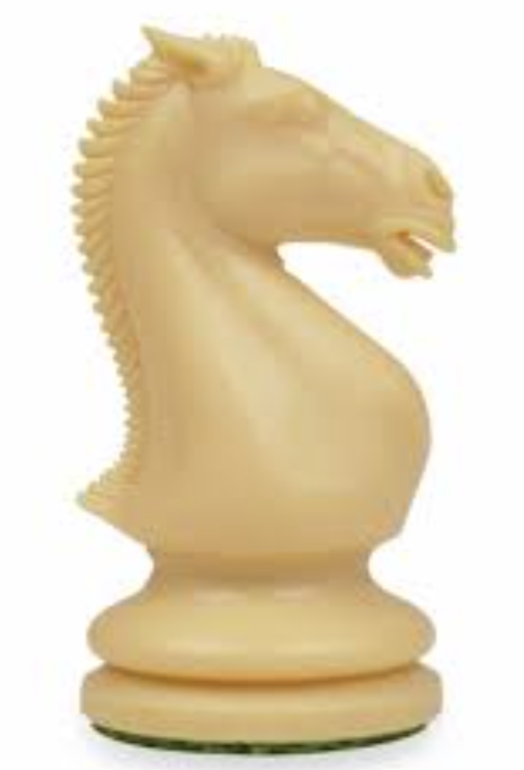
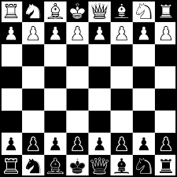
Our Ladies & St Edward’s Primary School chess club
This is to certify that
Represented school in a chess match against Highfield Priory
June 2024
Colin - Lancs Junior Coach

Slide 2
Our Ladies & St Edward’s Primary School chess club
This is to certify that
Represented school in a chess match against Highfield Priory
June 2024
Colin - Lancs Junior Coach

