Slide 1
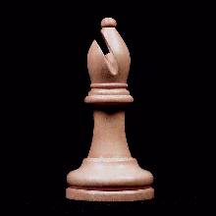
LANCASHIRE CHESS ASSOCIATION
This is to certify that
L
C
A
Nathan Redman
Has achieved the Bishop Standard in the LCA Junior Players Course
Dave Gaston - LCA Coach 9th January 2008

