Slide 1

MobileDataUK
MDUK Mobile Jobs
Overview for UU Electricity
Colin Greenwood
MobileDataUK

Slide 2
Agenda
Company overview
Client portfolio
Technology overview
Demonstration
Questions & answers
Way Forward ?

Slide 3
Company overview
We specialise in Mobile Solutions
Our roots are in Integration, Security and Mobile Consultancy
We have focussed more on Mobile Applications over the past 3 years
We have clients using our Mobile Solutions on PDA and Mobile Phones
We are growing based on recommendation

Slide 4
Client portfolio
Reed Professional Services
CHL
Southern Water
Northern Gas Networks
Touch Logistics
United Utilities
NGT Fulcrum

Slide 5
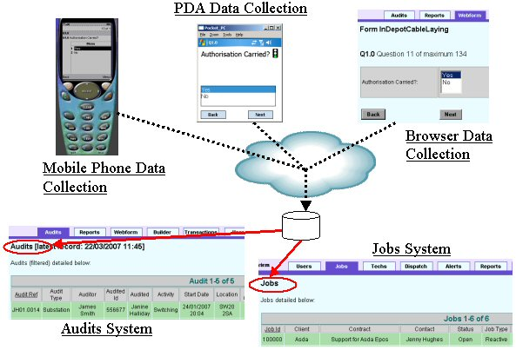
Mobile Applications

Slide 6
Demonstration
Form Creation
Form Completion and Submit
Viewing / Updating Jobs
Reporting / Exporting
Alerting

Slide 7
MDUK Jobs Capabilities
Flexible form completion using Web, PDA, Phone
Complete control of Question Sets through Forms
Data Quality through Cached Lists of data on mobile devices reducing text entry
Wide range of data capture options including Attachments, Signatures, Sketches, GPS, Barcode, RFID, Address
Graphical reporting engine
Scheduling Tool to auto generate and email reports

Slide 8
Why Choose MDUK Jobs ?
Proven capability – We specialise in the provision of Mobile Audit Solutions
Hosted solution hence fast implementation and low capital outlay
Low risk solution – MDUK Provide several Utility Solutions with glowing references, including UU
We continually extend our Product to include new features such as Charting, Email Client, Job Based Auditing, Multi-Client Partitioning
We already interface with MAMS for Jobs and can easily interface with any UU System such as Estimating or CIFMS

Slide 9
Questions & Answers

Slide 10
Way Forward ?
UU further discuss requirements with MDUK
MDUK Provide UUE Targeted Demonstration using UU Jobs and Status Flows
MDUK Provide UUE with a costed outline proposal and specification
UUE Raise Purchase Order
Project Initiation
Project pilot likely within 8 weeks of project initiation
Project rollout running over x weeks dependent on number of users

