Slide 1
Pin
A pin in chess is a tactic that occurs when a piece is attacked, and if it moves, it exposes a more valuable piece behind it

Slide 2
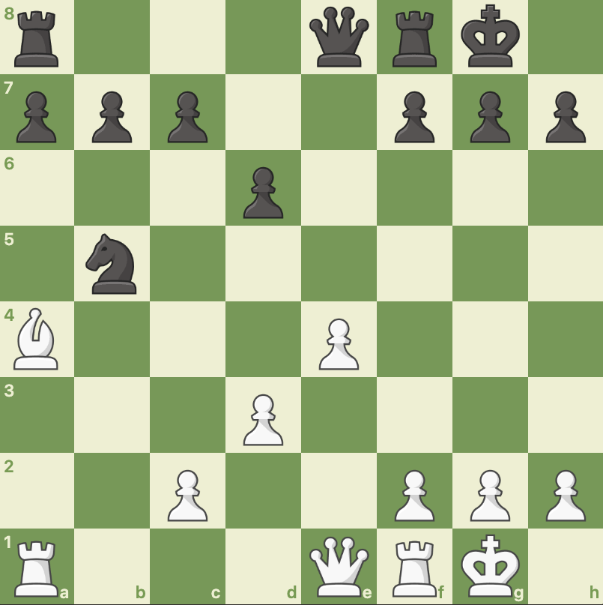

Slide 3
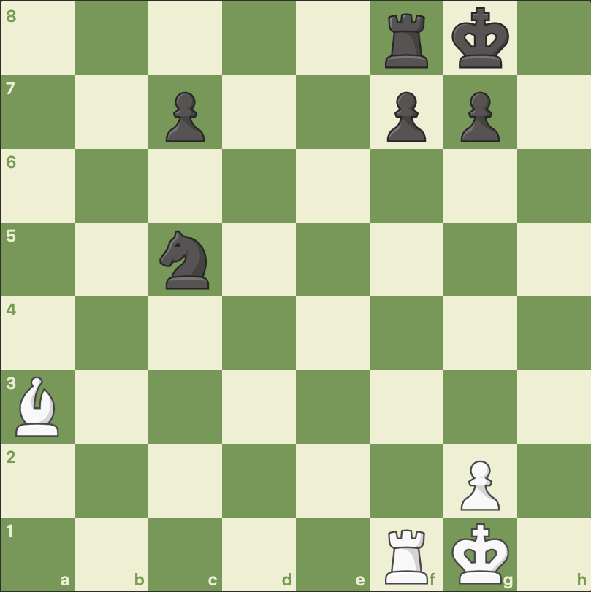

Slide 4
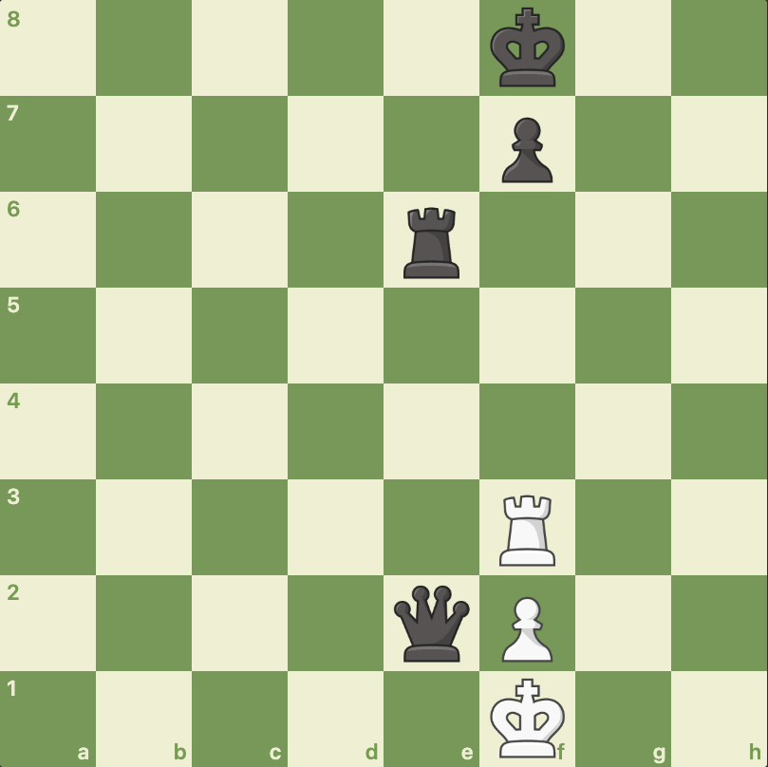

Slide 5
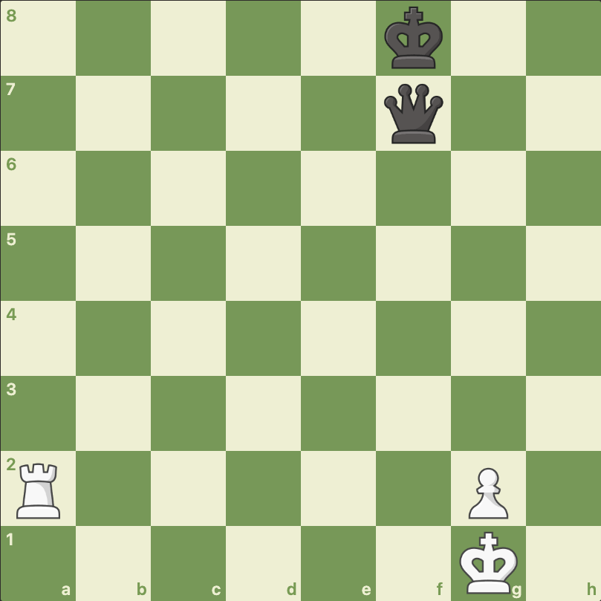

Slide 6
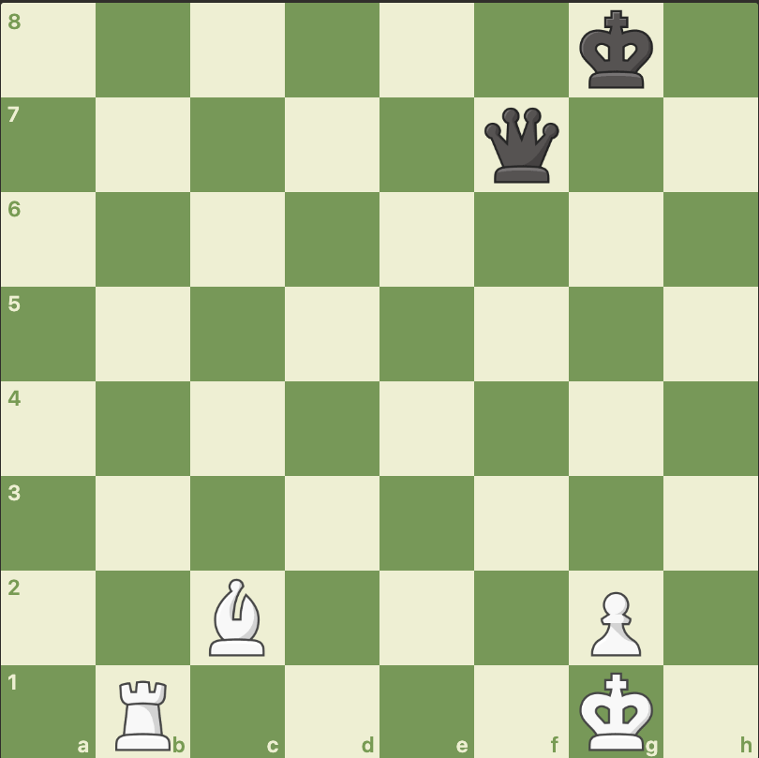

Slide 7
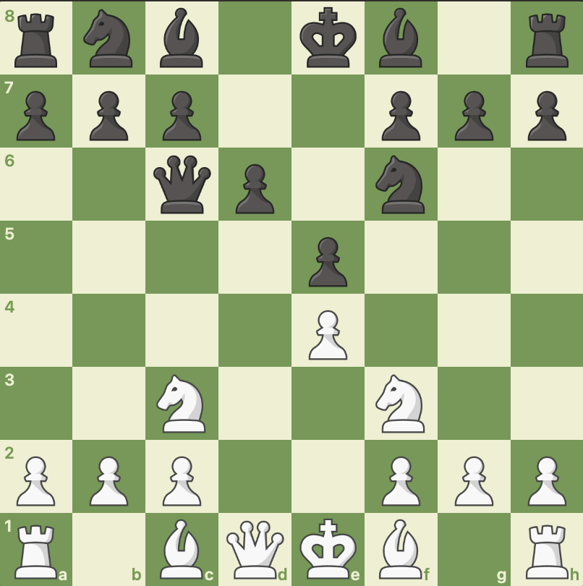

Slide 8
