Slide 1
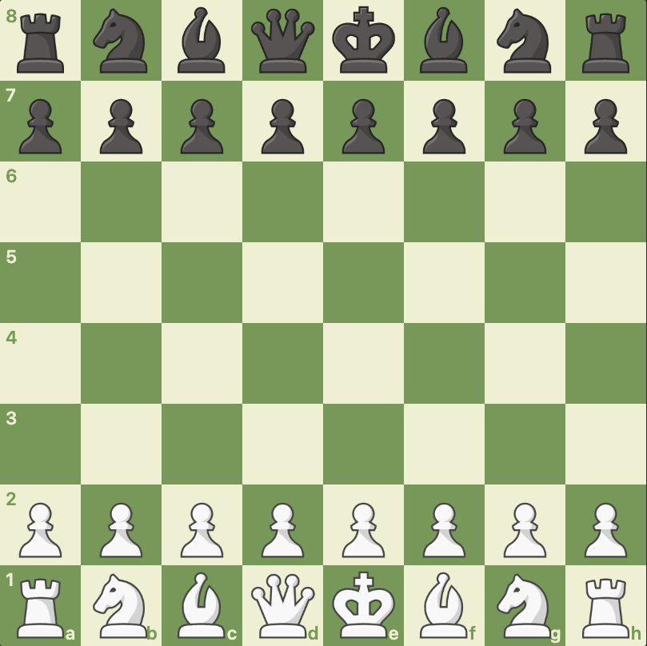
Scholars Mate
Attack the pawn that’s only defended by JUST THE KING
( With 2 pieces )

Slide 2
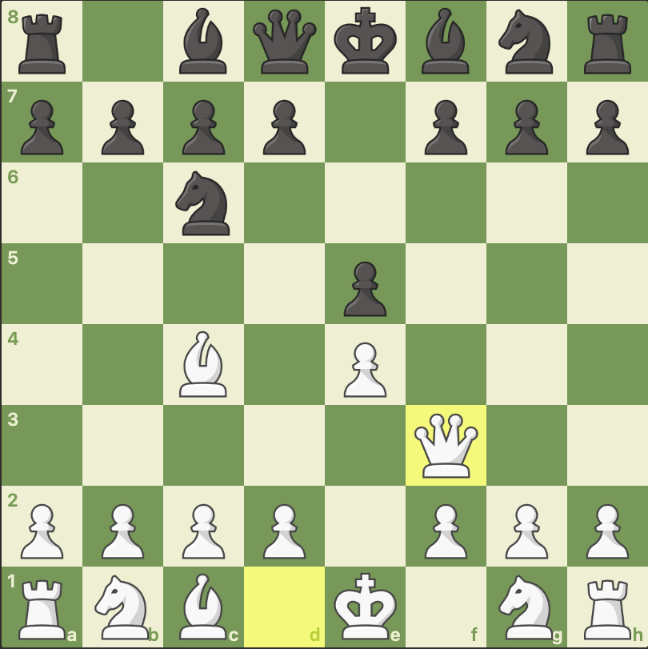
Just 4 moves
Kings Pawn
Bishop
Queen
Queen CHECKMATE !!!
Queen is “defended” or “protected” by the Bishop

Slide 3
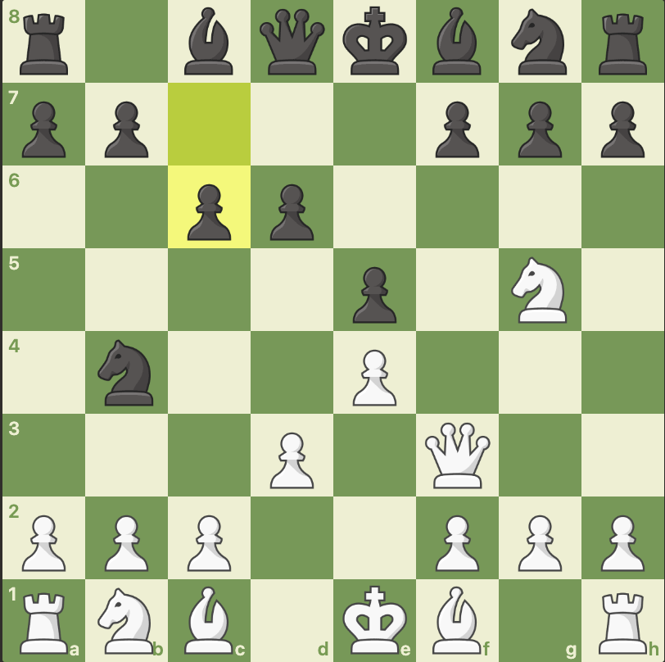
Scholars Mate (similar / variation )
Demonstrates Good opening principles !
Move a central pawn
Get Knights and Bishops out
Pieces are working together … as a TEAM or ARMY

Slide 4
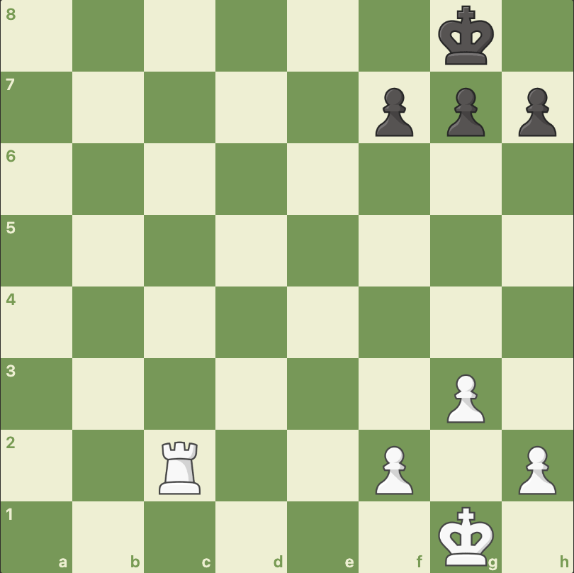
Bank Rank Mate

Slide 5
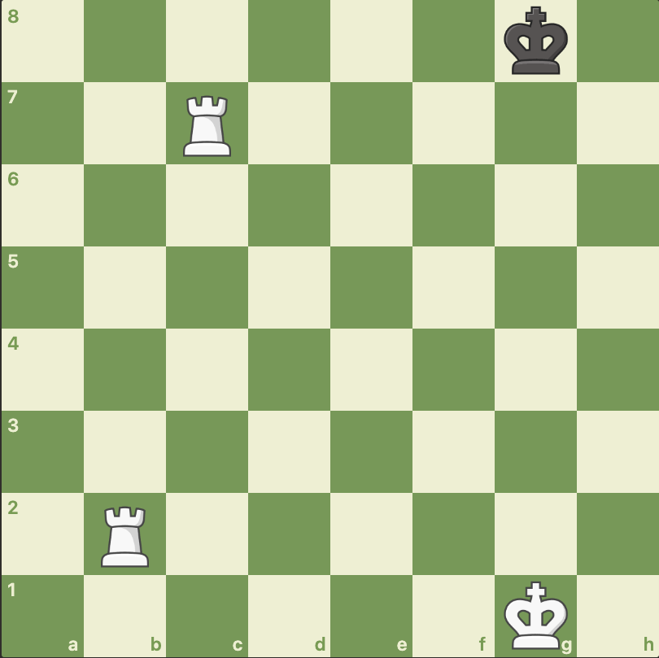
Lawnmower Mate / Rolling Rooks / Ladder Mate
Using 2 Rooks ( or Rook and Queen or 2 Queens )
The 2 pieces work together to push the King to the edge of the board for an easy checkmate
We gradually reduce the number of rows the King has available. Till its ZERO ! ☺

Slide 6
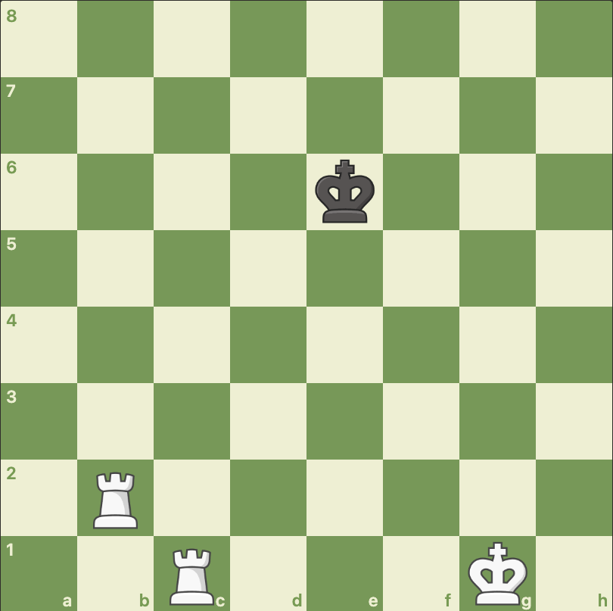
Lawnmower Mate
1) Choose a side to push the King towards
2) Block the King ( not Check !!)
3) Use the other piece to Check and push the King to the side)
4) Repeat till King is trapped against the edge of the board and checkmated

Slide 7
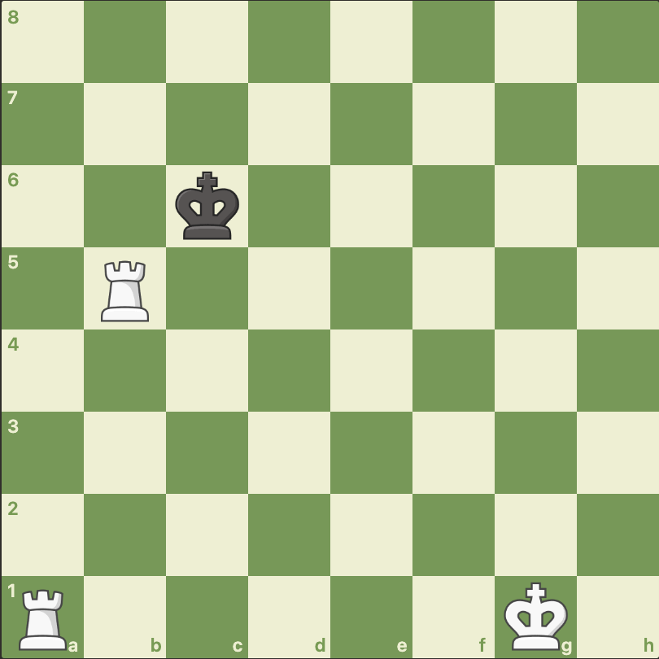
Lawnmower Mate – DON’T LOSE THE ROOKS
The King may approach / try to attack your Rooks ?
If so, leave the fence in place and move the Rook under attack away from the King
… towards the other side of board ( no Check on this move)
The King still cannot escape, so no rush

