Slide 1
Opening game
Move 1 or 2 Central P____s
Get your K____s and B_____s out
C_____ early

Slide 2
Opening game
Move 1 or 2 Central PAWNS
Get your KNIGHTS and BISHOPS out
CASTLE early

Slide 3
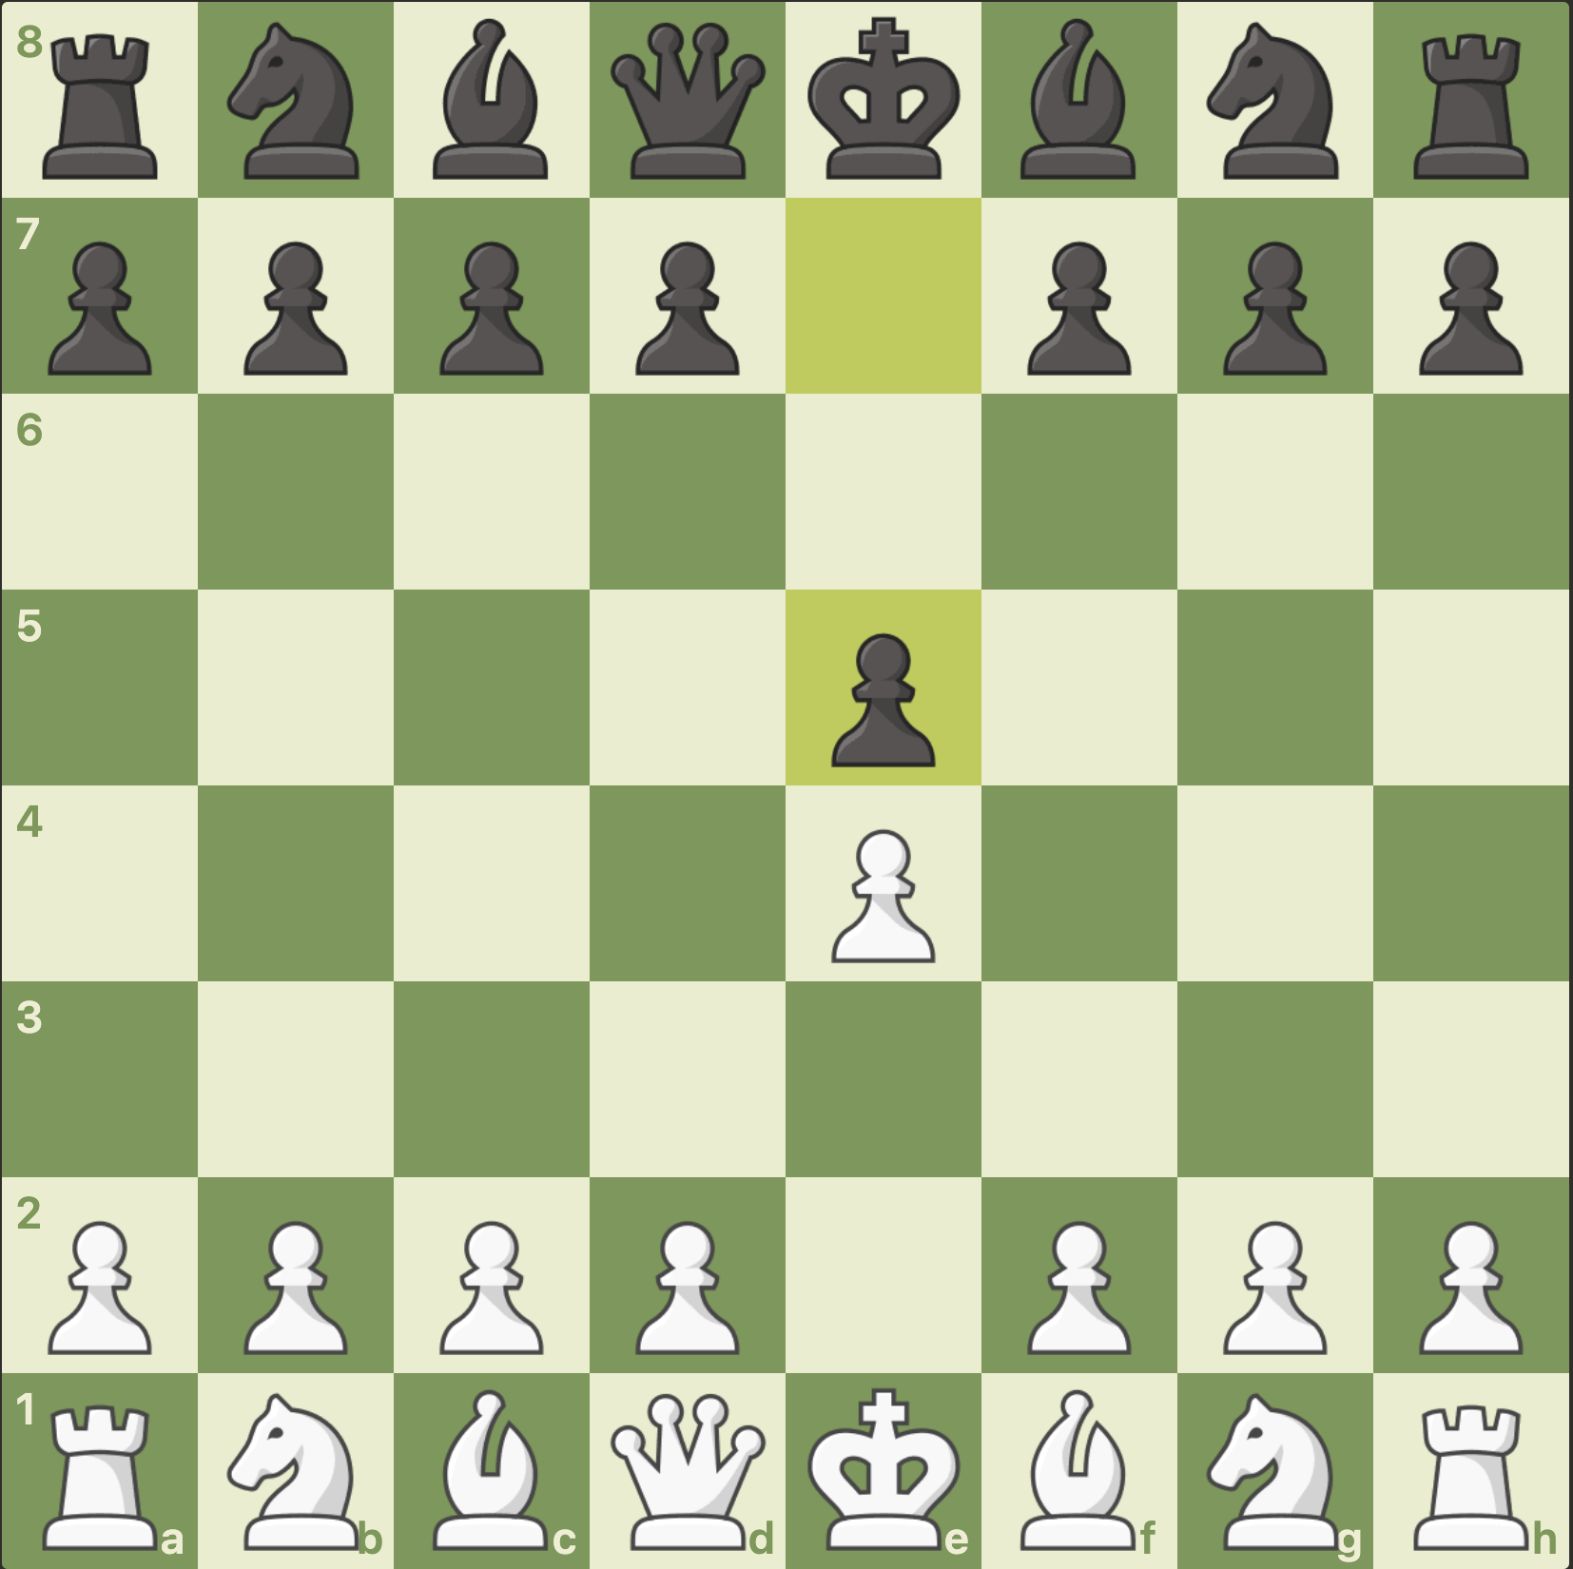
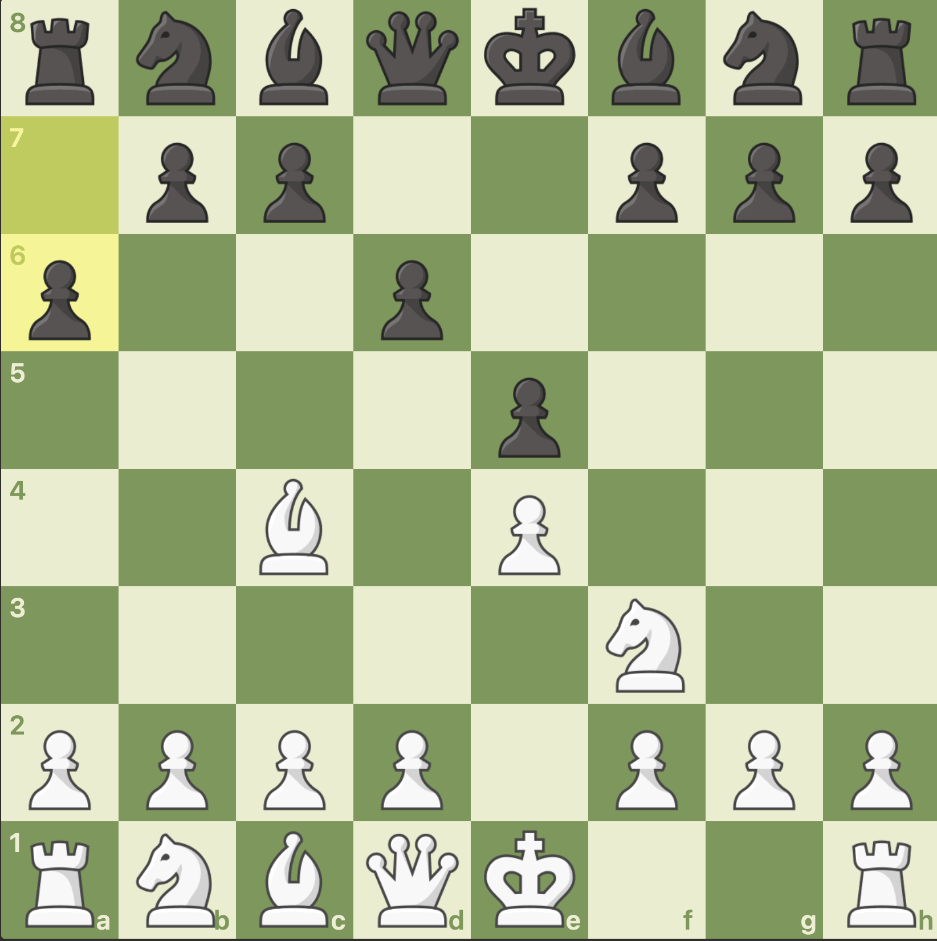
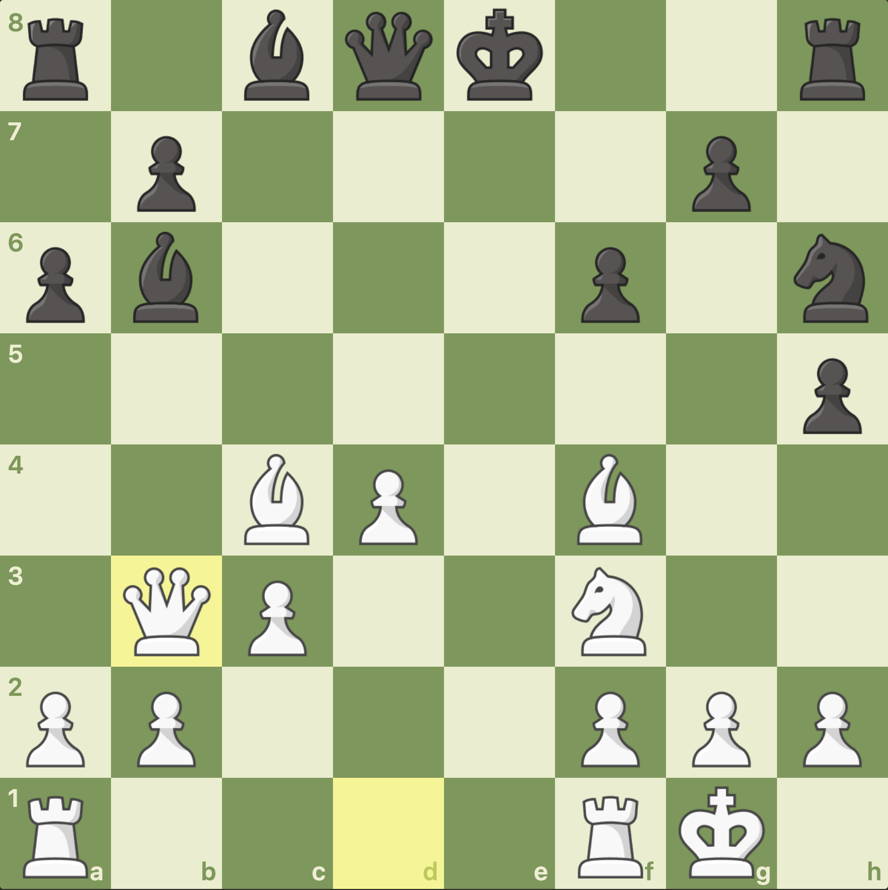
Opening game
Move 1 or 2 Central Pawns
Get your Knights and Bishops out
Castle early

Slide 4
Middle game
Look before you m___ your m___
Look - Can you t___ any of your opponent’s pieces ?
Look - Can your opponent t____ any of your pieces ?
T___ y___ t___ !

Slide 5
Middle game
Look before you MAKE your MOVE
Look - Can you TAKE any of your opponent’s pieces ?
Look - Can your opponent TAKE any of your pieces ?
TAKE YOUR TIME !

Slide 6
Middle game
Look before you make your move
Take free pieces .. Don’t give your pieces away
Look - Can you take any of your opponent’s pieces ?
Attack Attack Attack !
Look - Can your opponent take any of your pieces ?
Defend
Take your time !
Think whilst your opponent thinks

Slide 7
Tactics
Use a F___ to attack 2 pieces at the same time
Use a P__ to attack a piece with a bigger piece behind it
A____ A_____ A_____ !
Attack ! But don’t forget to d_____

Slide 8
Tactics
Use a FORK to attack 2 pieces at the same time
Use a PIN to attack a piece with a bigger piece behind it
ATTACK ATTACK ATTACK!
Attack ! But don’t forget to DEFEND

Slide 9
End game
Promote a P___ to a Q____
Use your R____s together in a “LawnMower”
T___ y____ t____ !

Slide 10
End game
Promote a PAWN to a QUEEN
Use your ROOKS together in “LawnMower”
TAKE YOUR TIME !

Slide 11
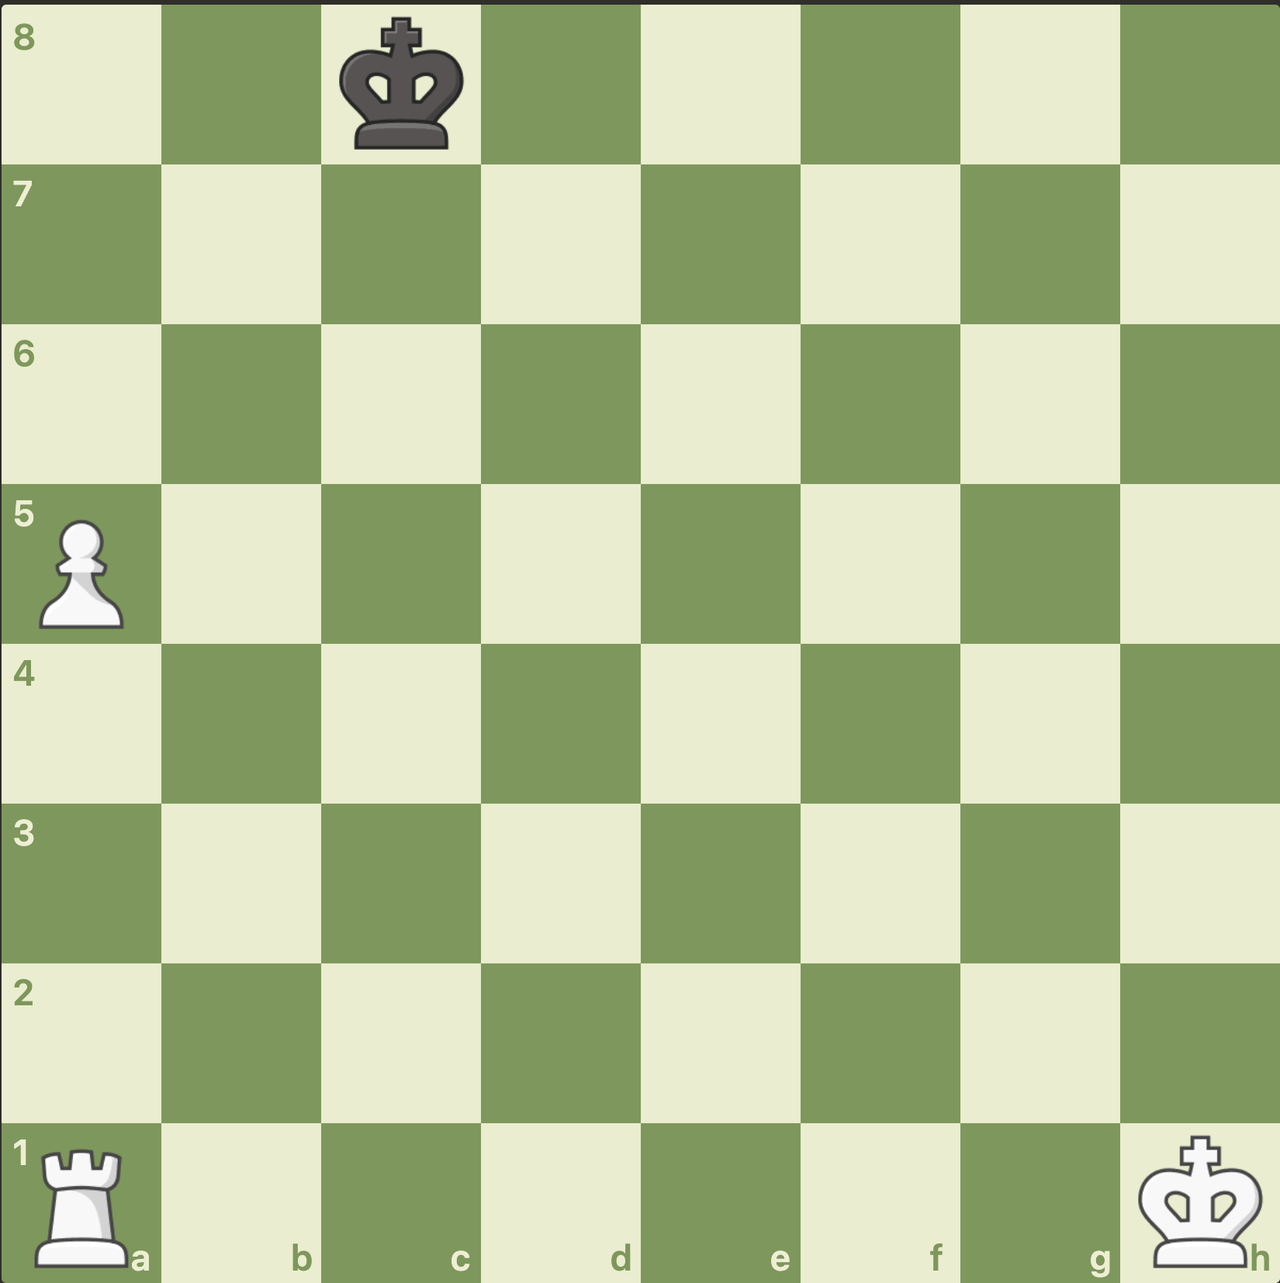
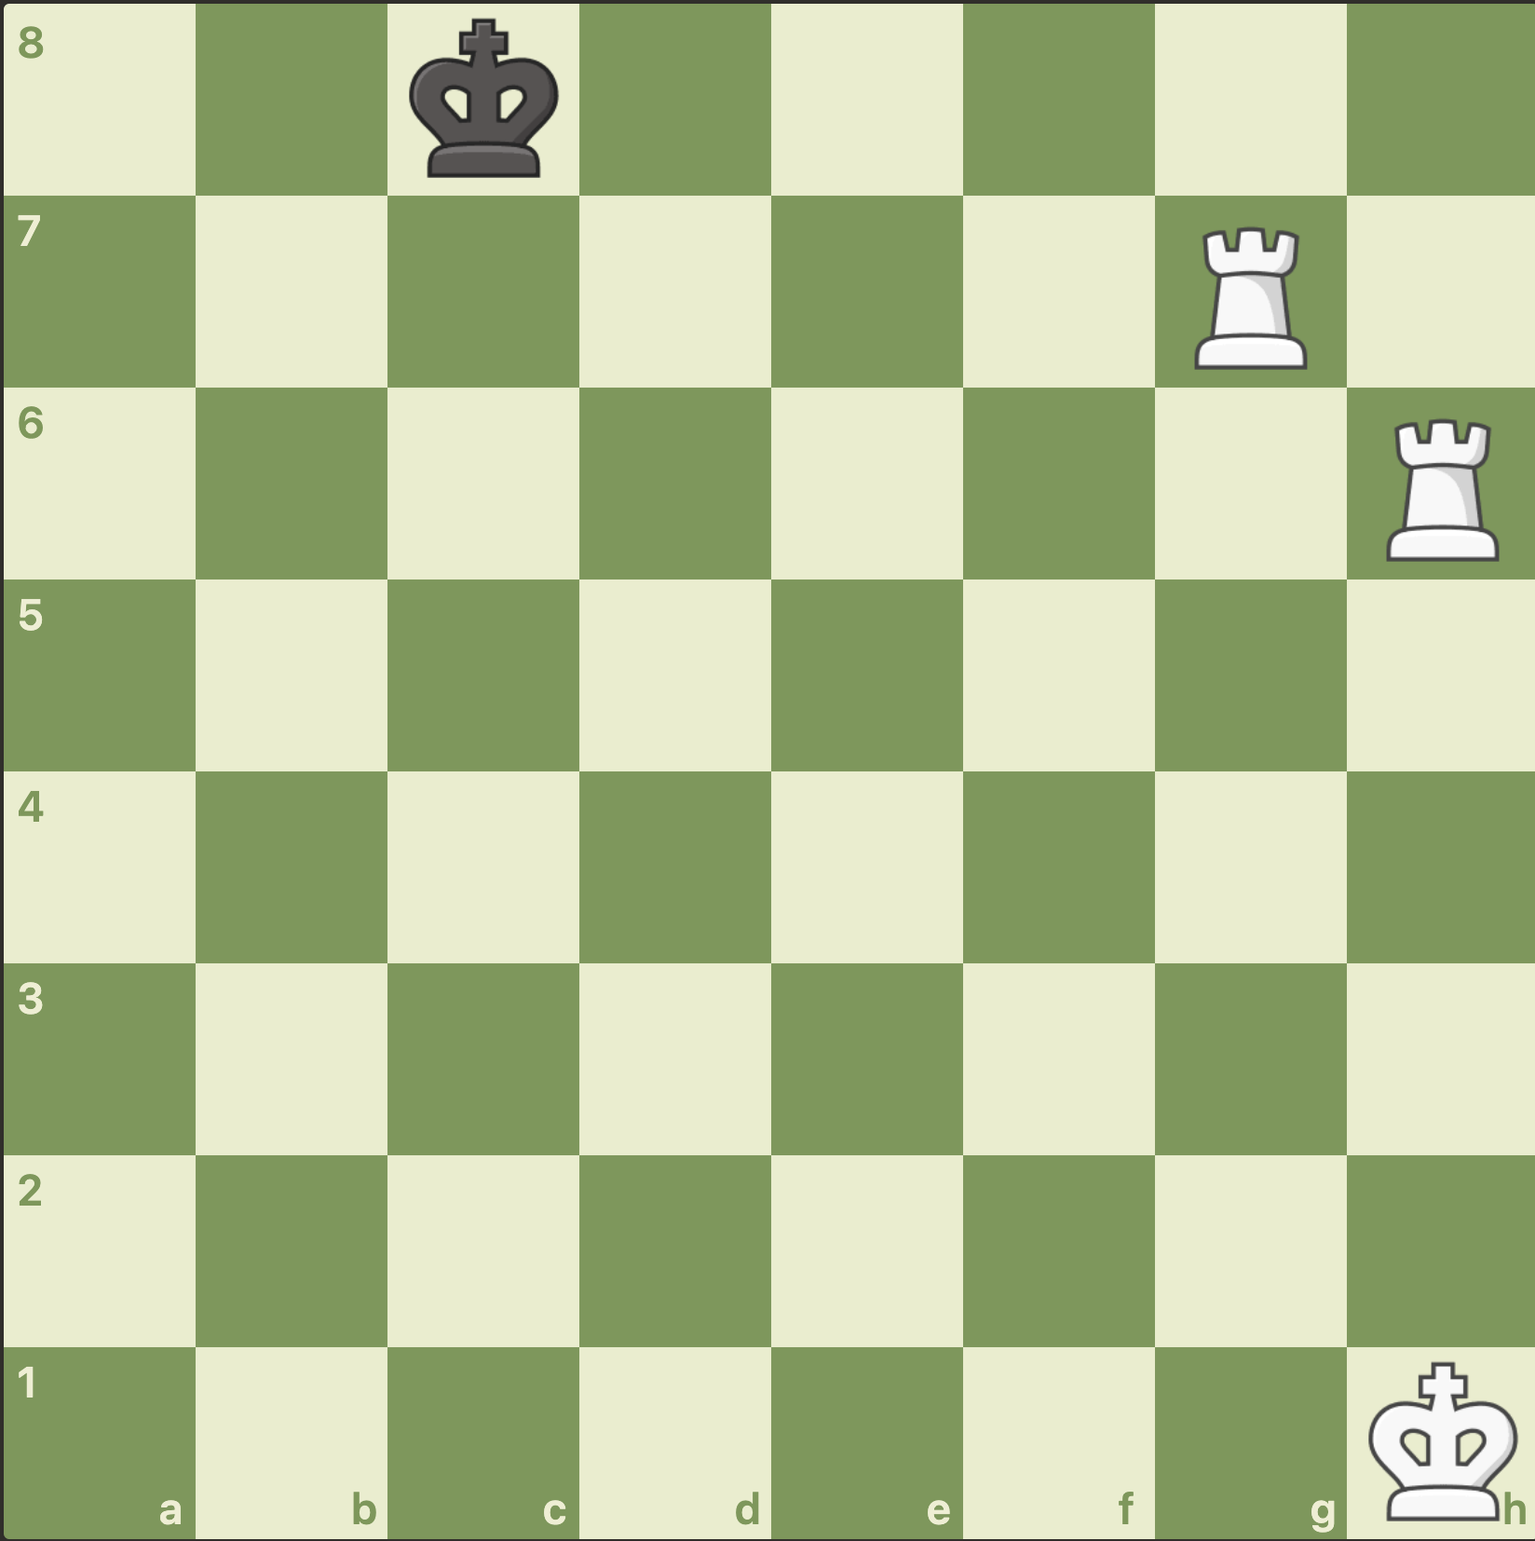
End game
Defend the Pawn !
Promote a Pawn to a Queen
Use your Rooks together in “LawnMower”
Take your time !

