Slide 1
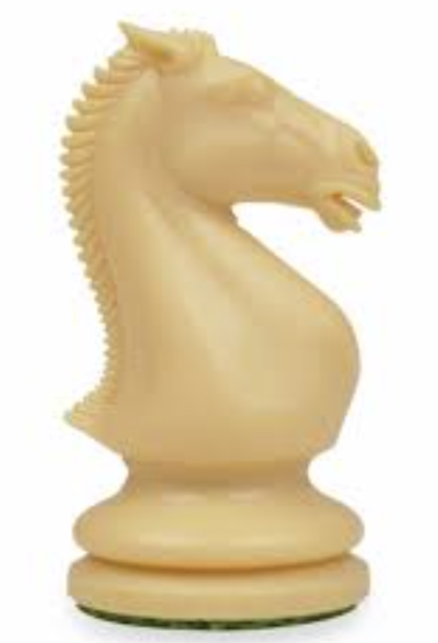
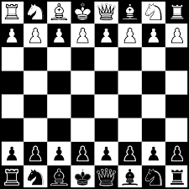
LANCASHIRE CHESS ASSOCIATION
This is to certify that
Represented their school in a chess match between Our Ladies & St Edward’s and Highfield Priory
Colin Greenwood - Lancs Junior Coach

Slide 2
LANCASHIRE CHESS ASSOCIATION
This is to certify that
Represented their school in a chess match between Our Ladies & St Edward’s and Highfield Priory
Colin Greenwood - Lancs Junior Coach

