Slide 1
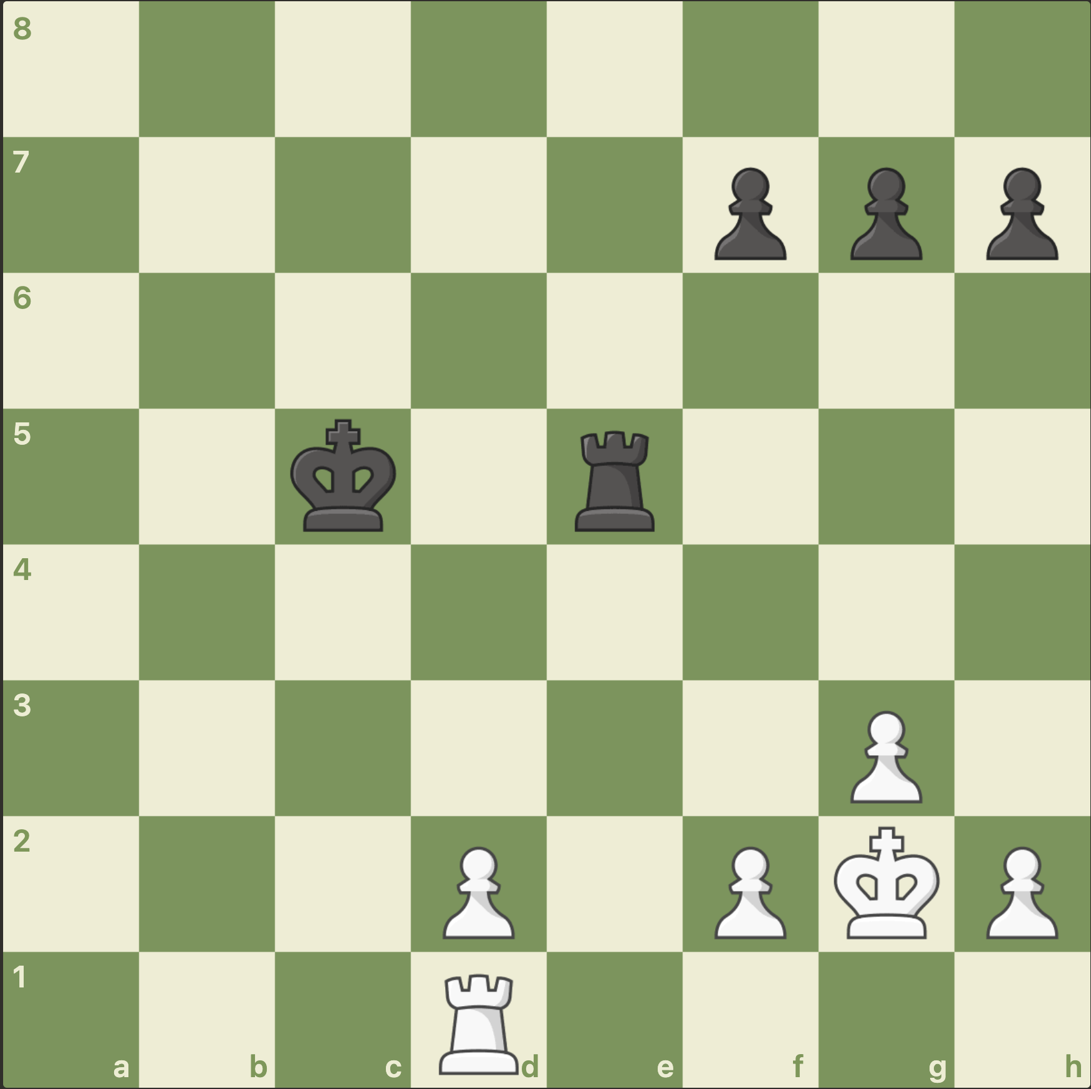
White to move
Whos winning ?
Whats the best move for White ?
What do we call this tactic ?
Who has the best King position ?

Slide 2
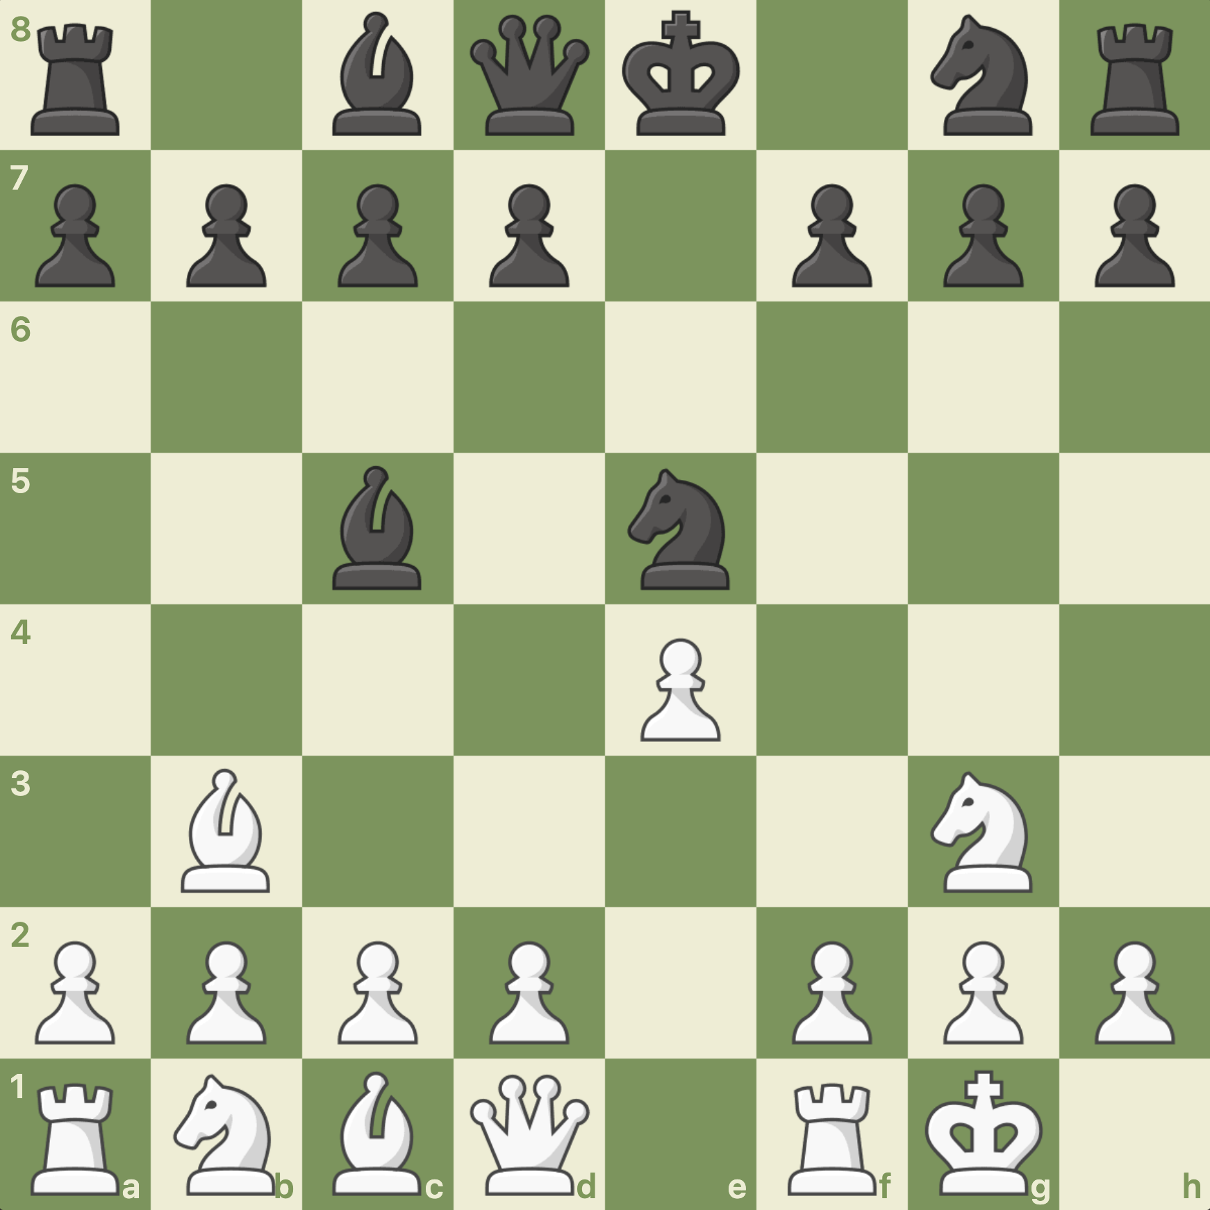
White to move
Whos winning ?
Whats the best move for White ?
What do we call this tactic ?

Slide 3
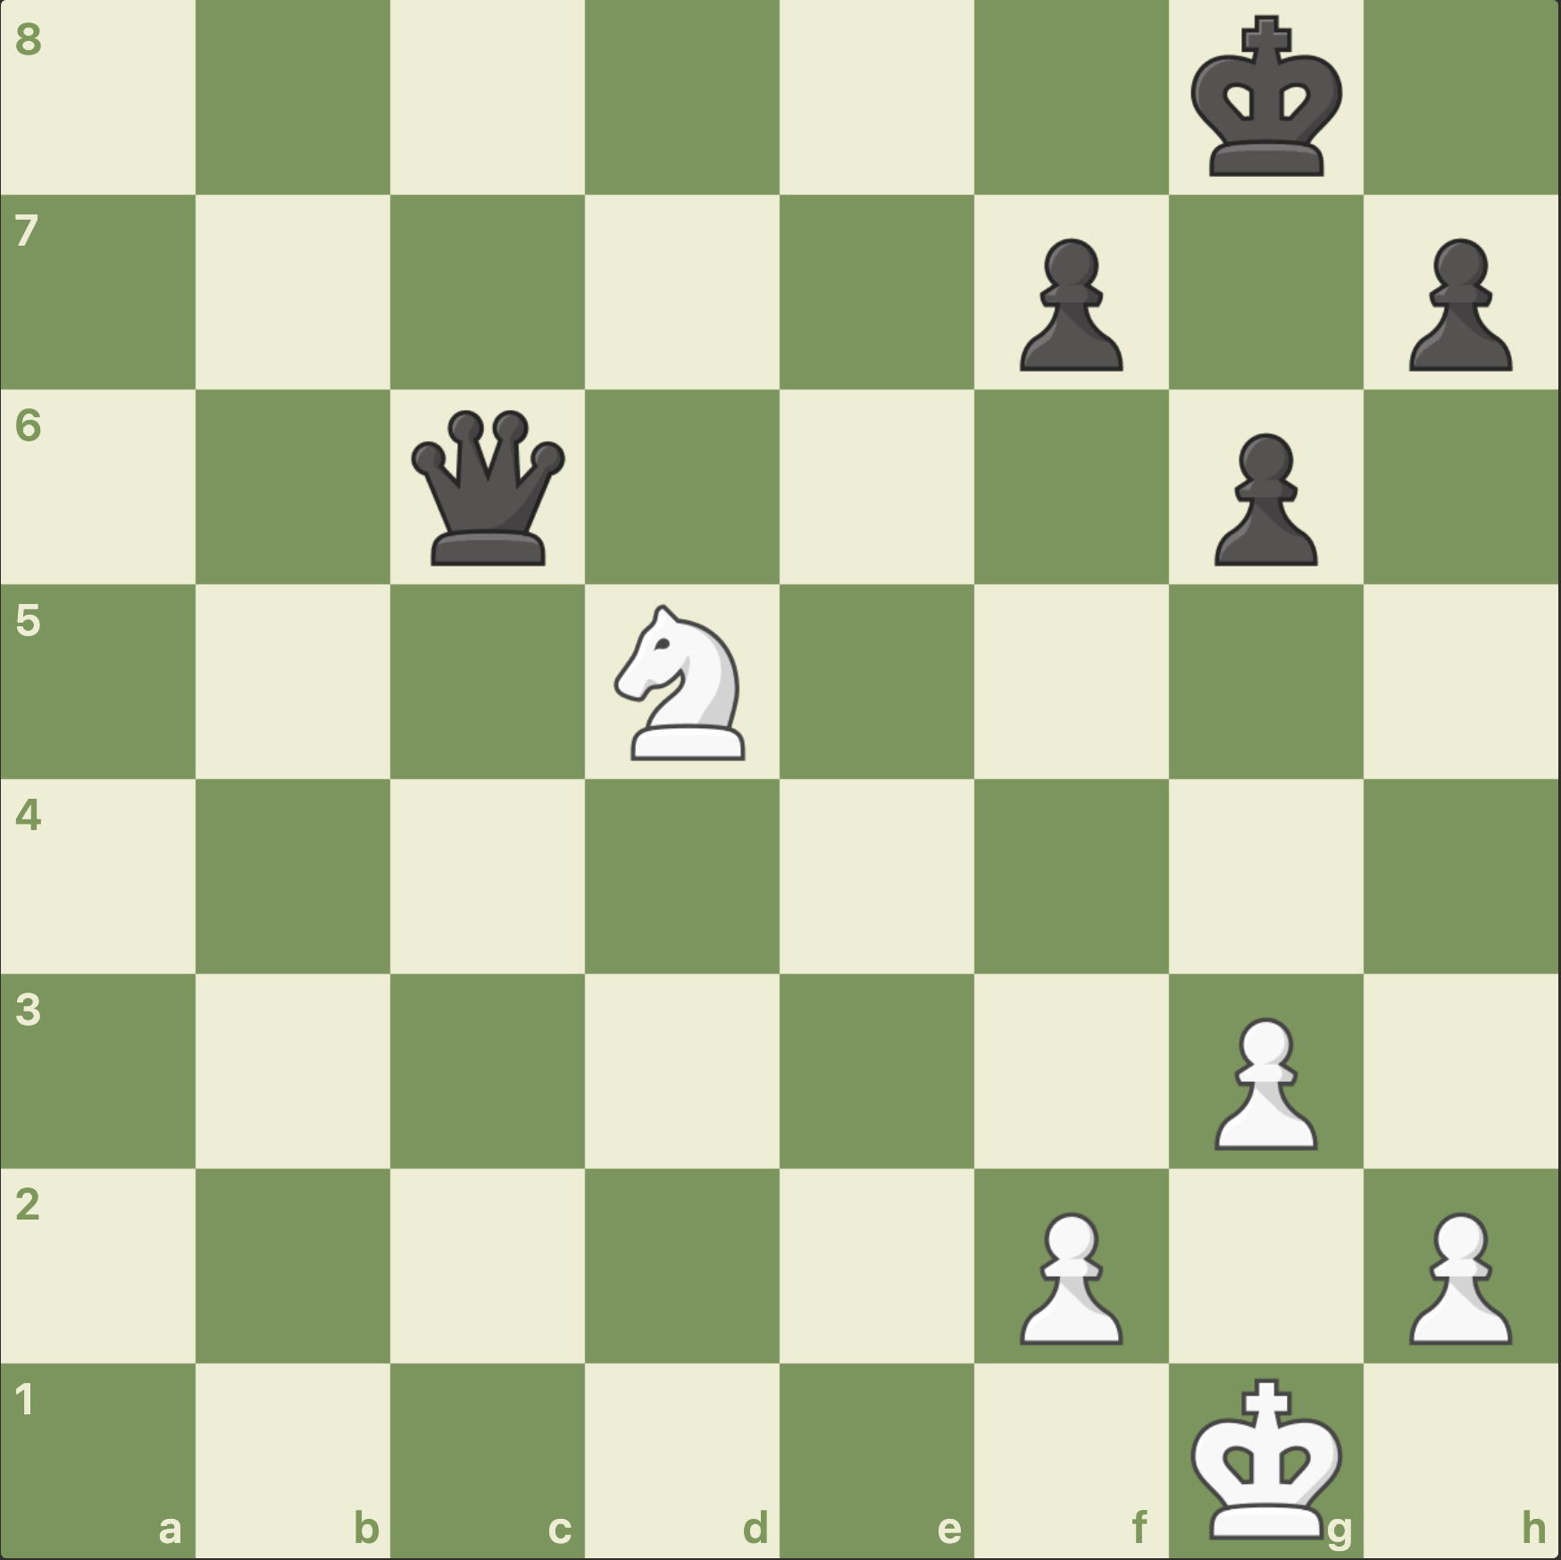
White to move
Whos winning ?
Whats the best move for White ?
What do we call this tactic ?

Slide 4
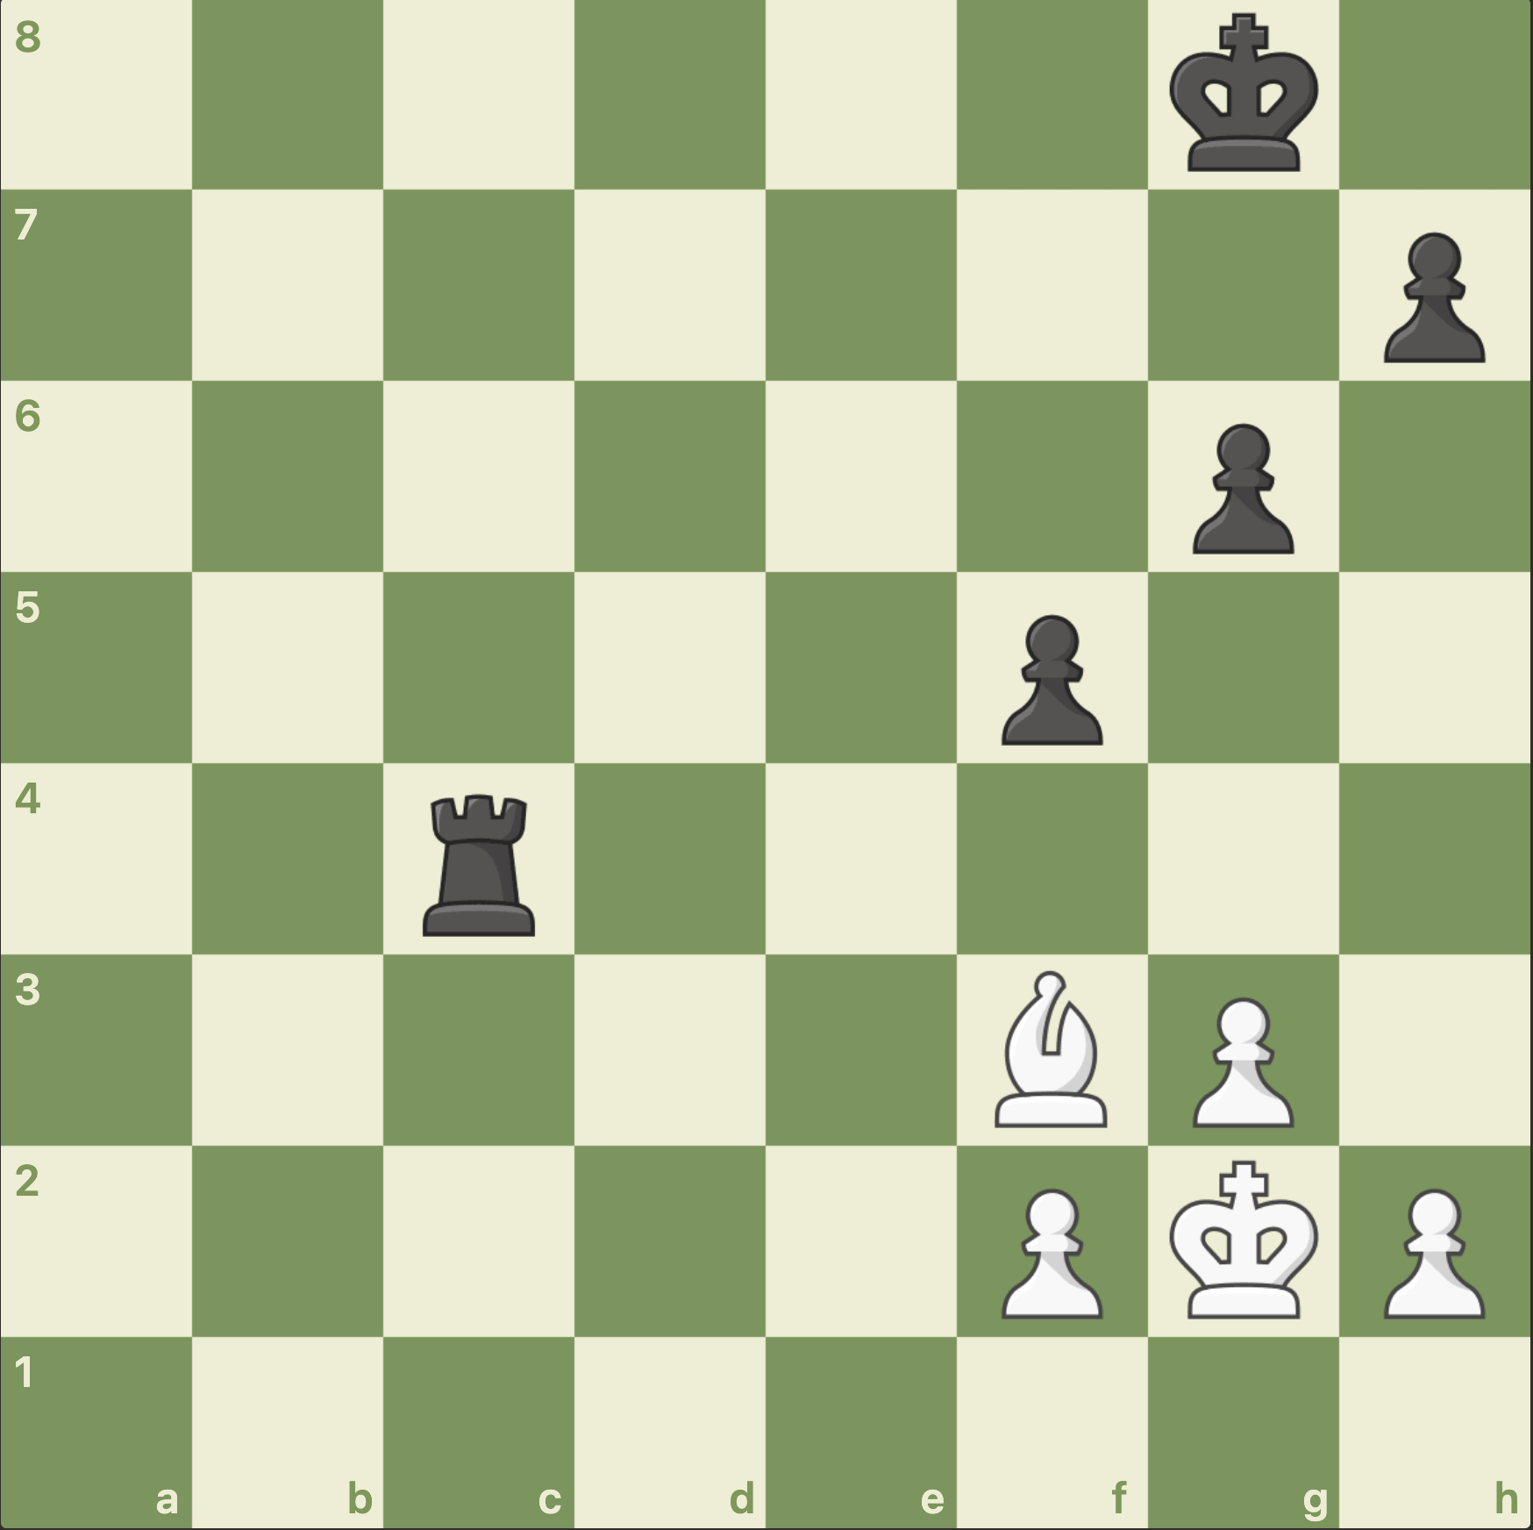
White to move
Whos winning ?
Whats the best move for White ?
What do we call this tactic ?

Slide 5
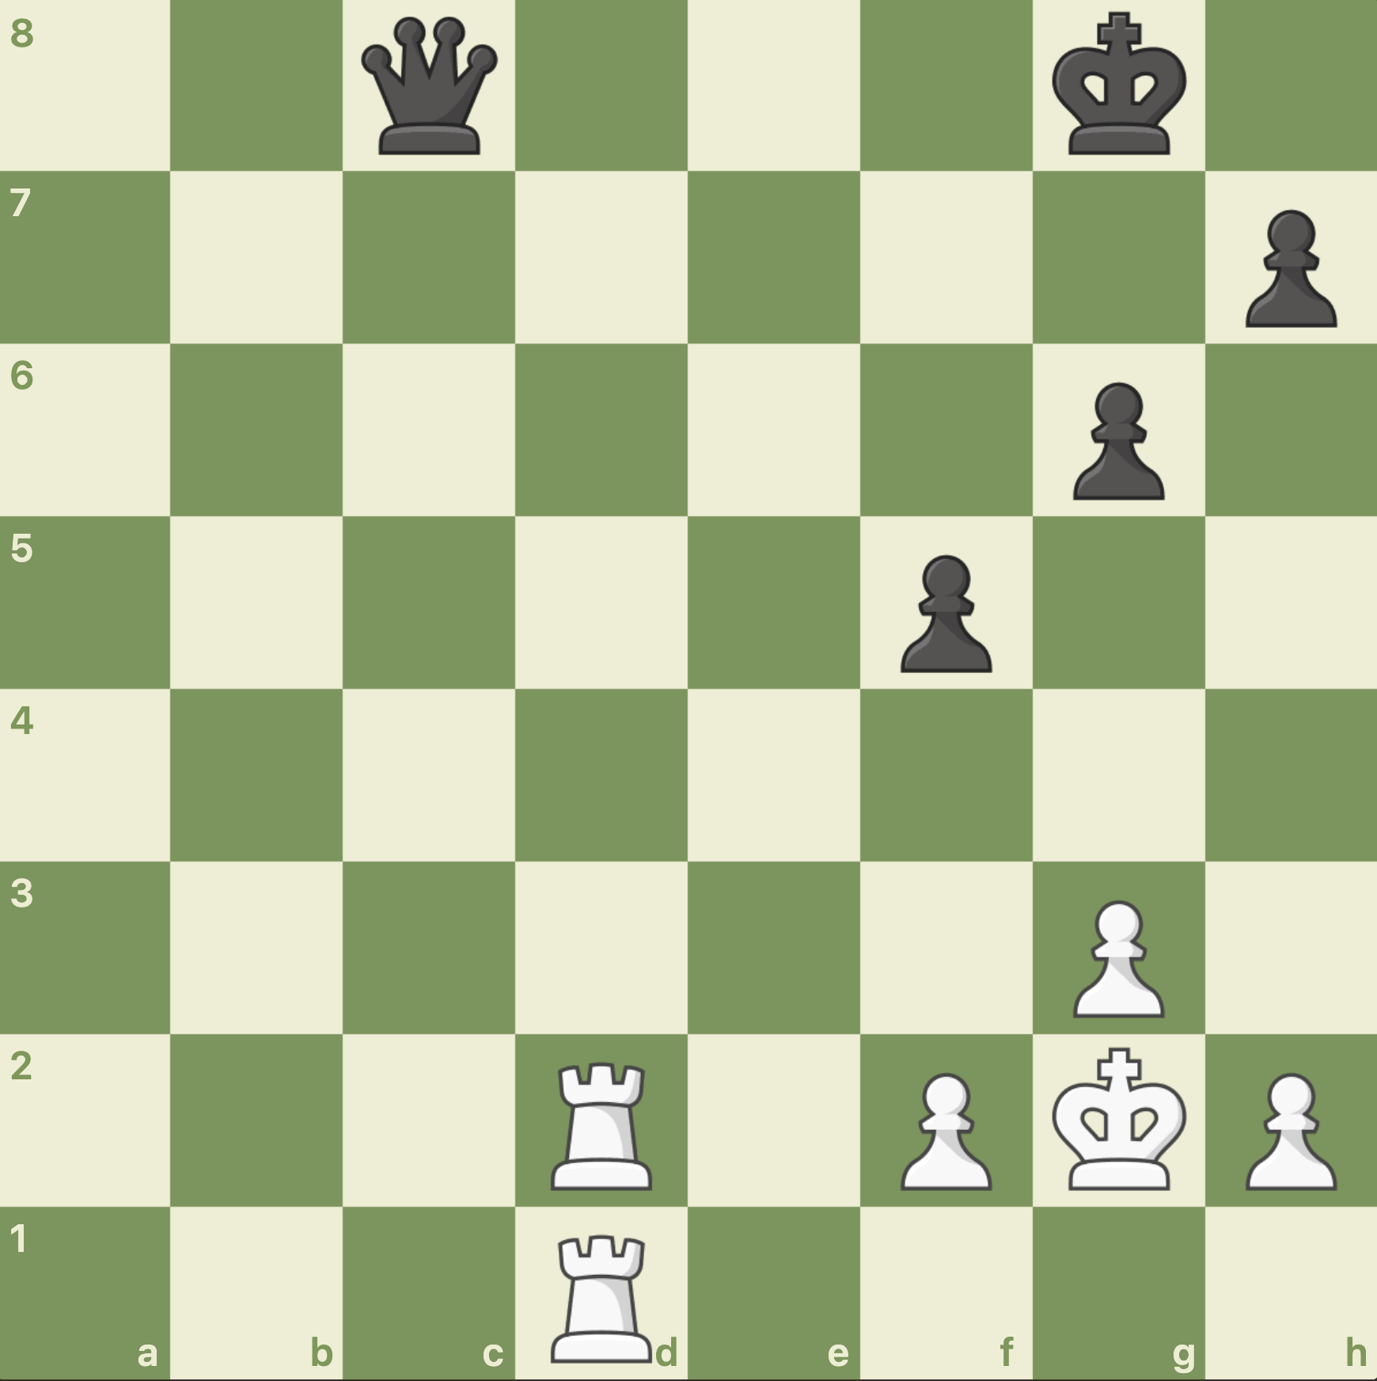
White to move
Whos winning ?
Whats the best move for White ?
What do we call this tactic ?

Slide 6
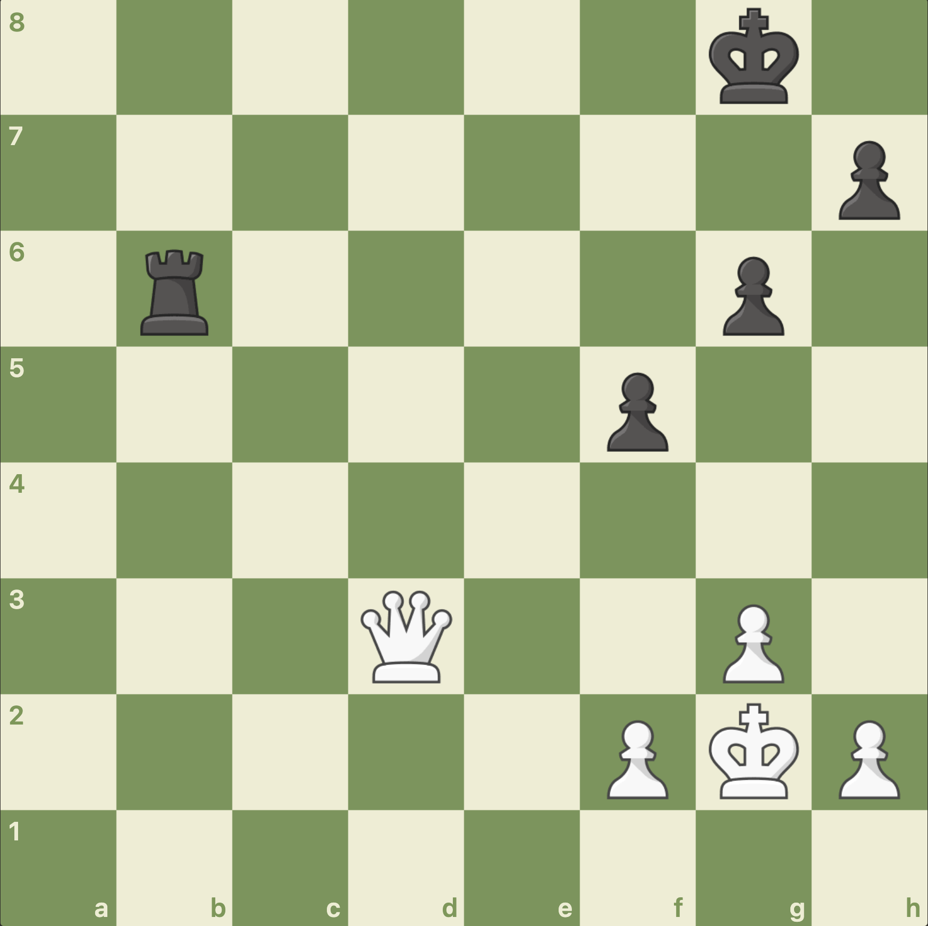
White to move
Whos winning ?
Whats the best move for White ?
What do we call this tactic ?

