Slide 1
Skewer
In a “Skewer” a valuable piece sits in front of a less valuable piece
When the valuable piece is attacked, it must move out of the way, meaning we may win the piece behind
Its like a pin, but the pieces are reversed
https://www.chess.com/terms/skewer-chess

Slide 2
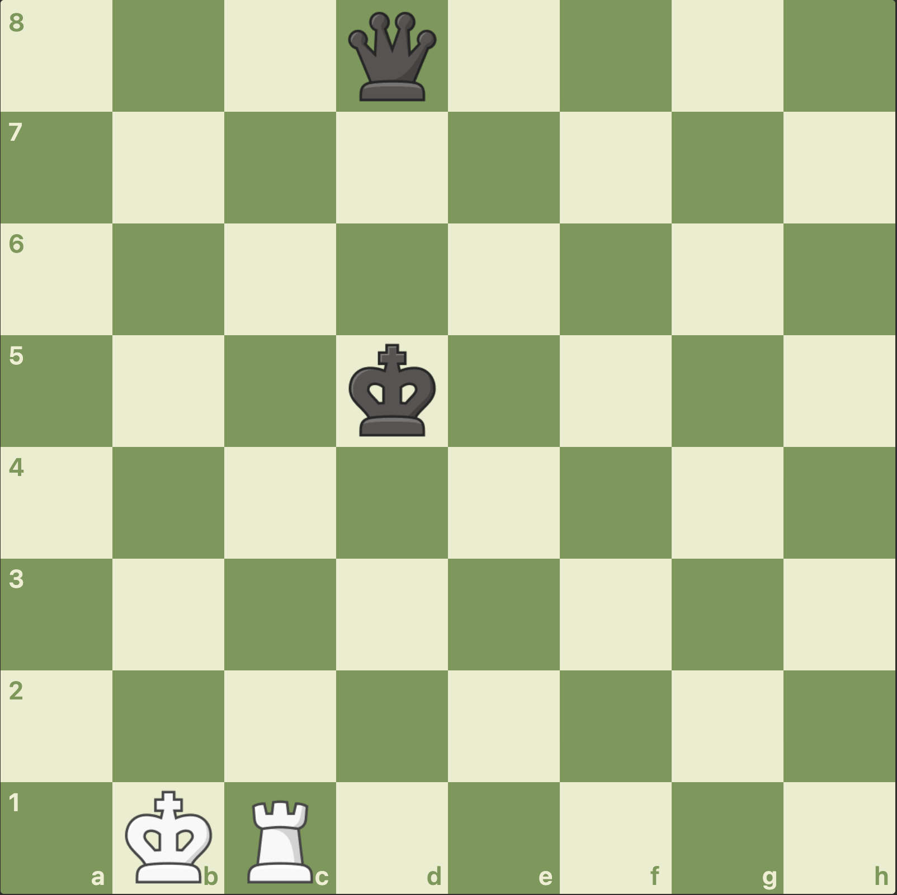

Slide 3
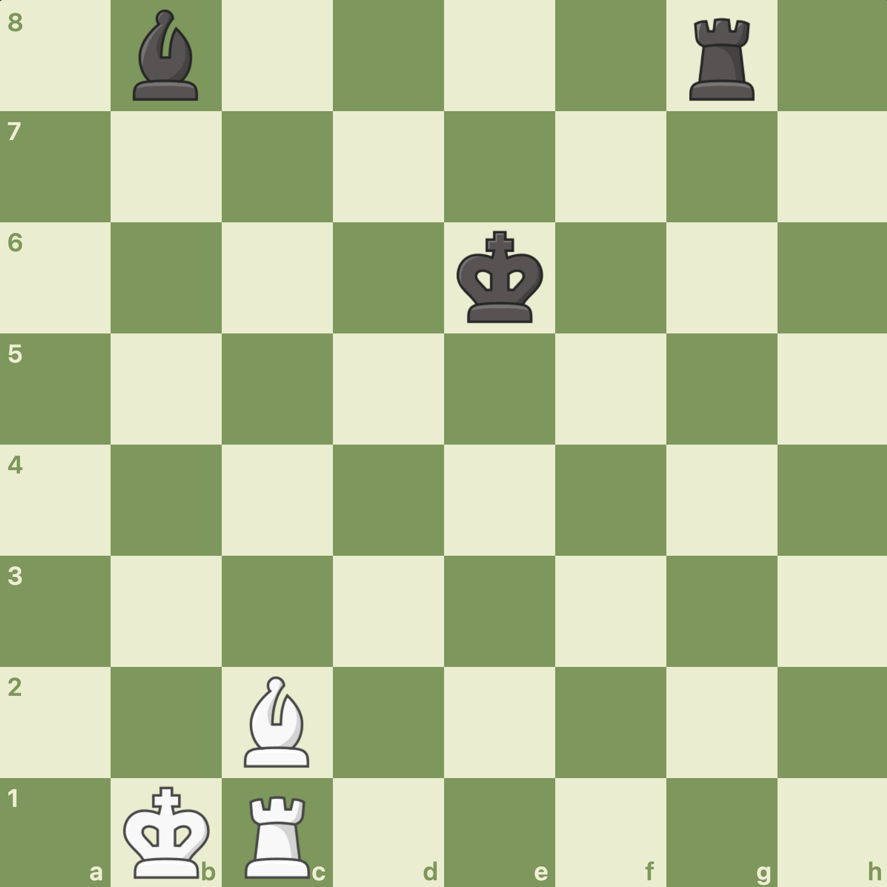

Slide 4
