Slide 1
Twitter Hate Speech Analysis
Milestone two
Colin Green & Sean Zhang

Slide 2
Feature creation and extraction
We created the following features:
num_tokens, num_mentions, num_urls, num_hashtags
We tested out the following word embeddings:
Bag of words, ngrams (n=2, & n=3), TF-IDF
Word2Vec - CBOW, concat(Word2Vec, BOW), and Custom - CBOW
We ran logistic regression and decision on each embedding as a benchmark

Slide 3
Feature extraction
We ran the following models
Logistic Regression, Decision Tree

Slide 4
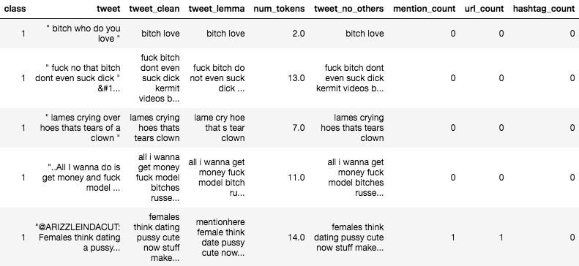
Data before embedding

Slide 5
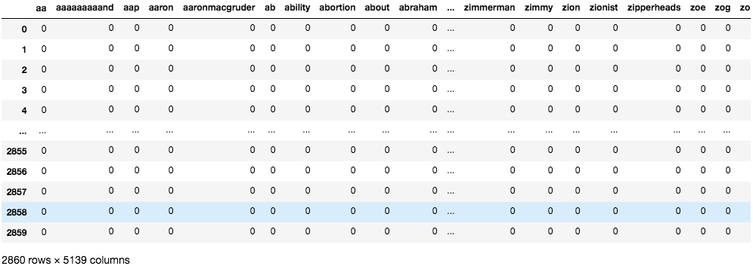
Bag of Words

Slide 6
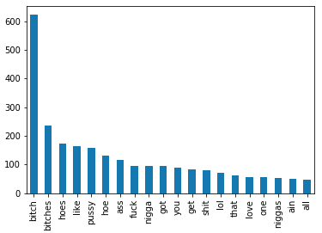
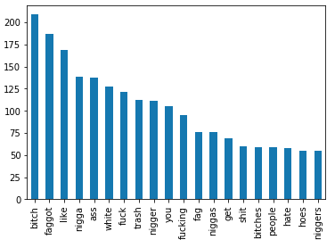
Bag of Words – Feature counts
Offensive Tweets
Hate Tweets

Slide 7
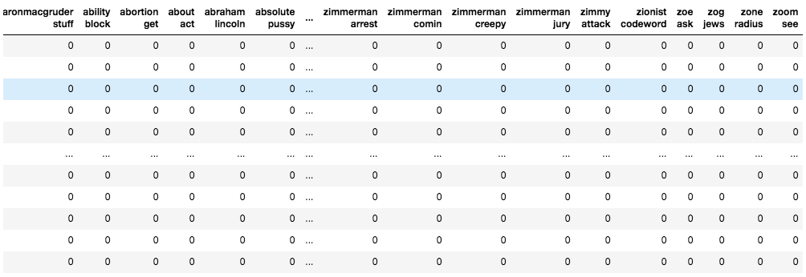
Ngrams (N=2)

Slide 8
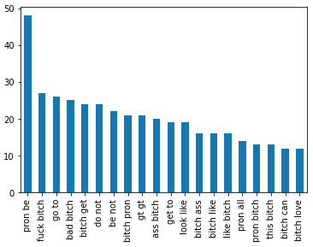
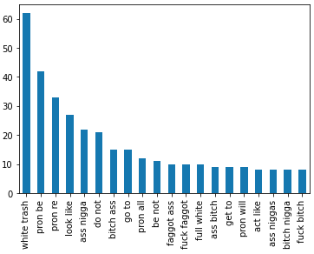
Ngrams (n=2) – feature count
Offensive Tweets
Hate Tweets

Slide 9
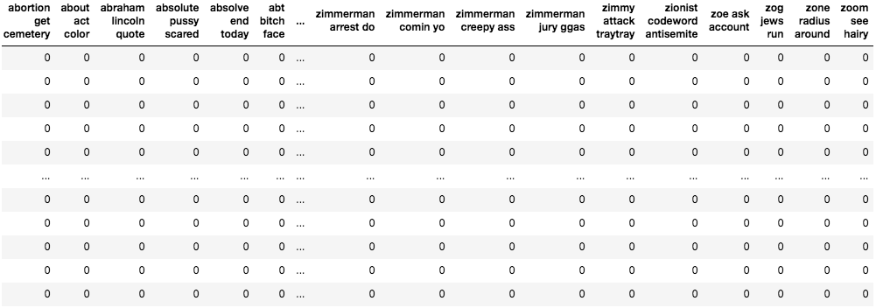
Ngrams (n=3)

Slide 10
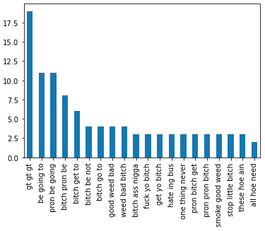
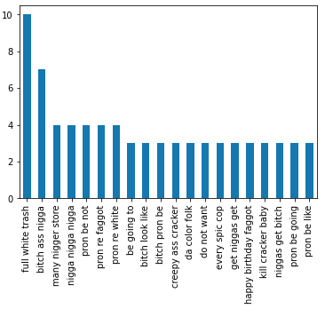
Ngrams (n=3) – feature count
Offensive Tweets
Hate Tweets

Slide 11
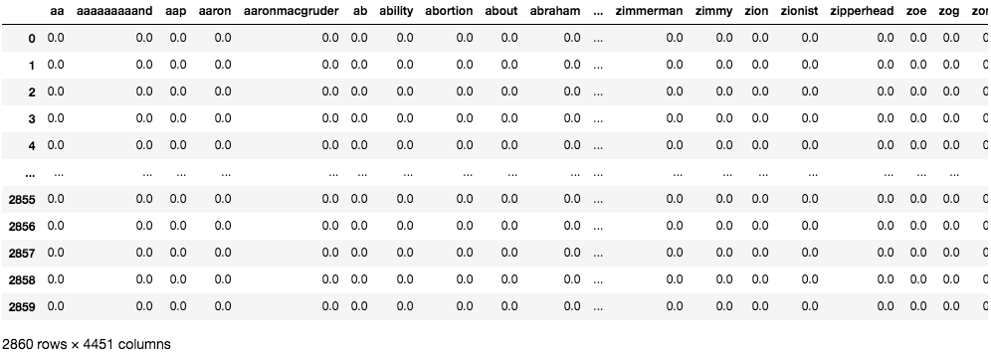
tf-idf

Slide 12
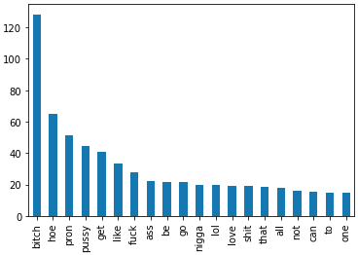
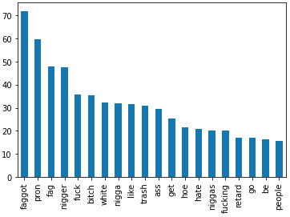
TF-IDF – Feature Count
Offensive Tweets
Hate Tweets

Slide 13
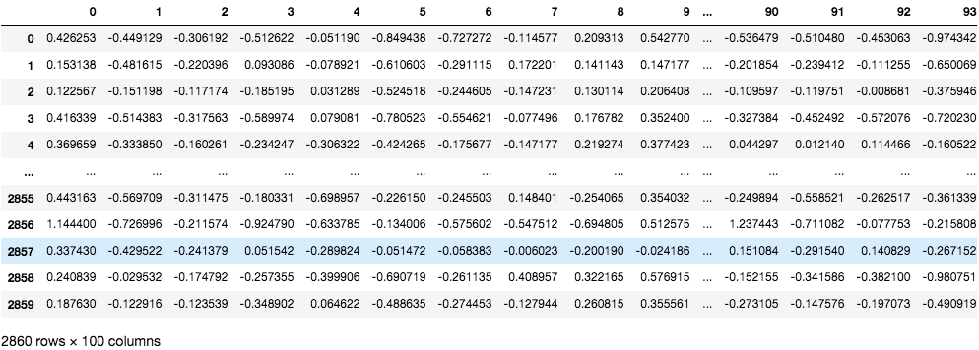
Word2Vec - CBOW

Slide 14
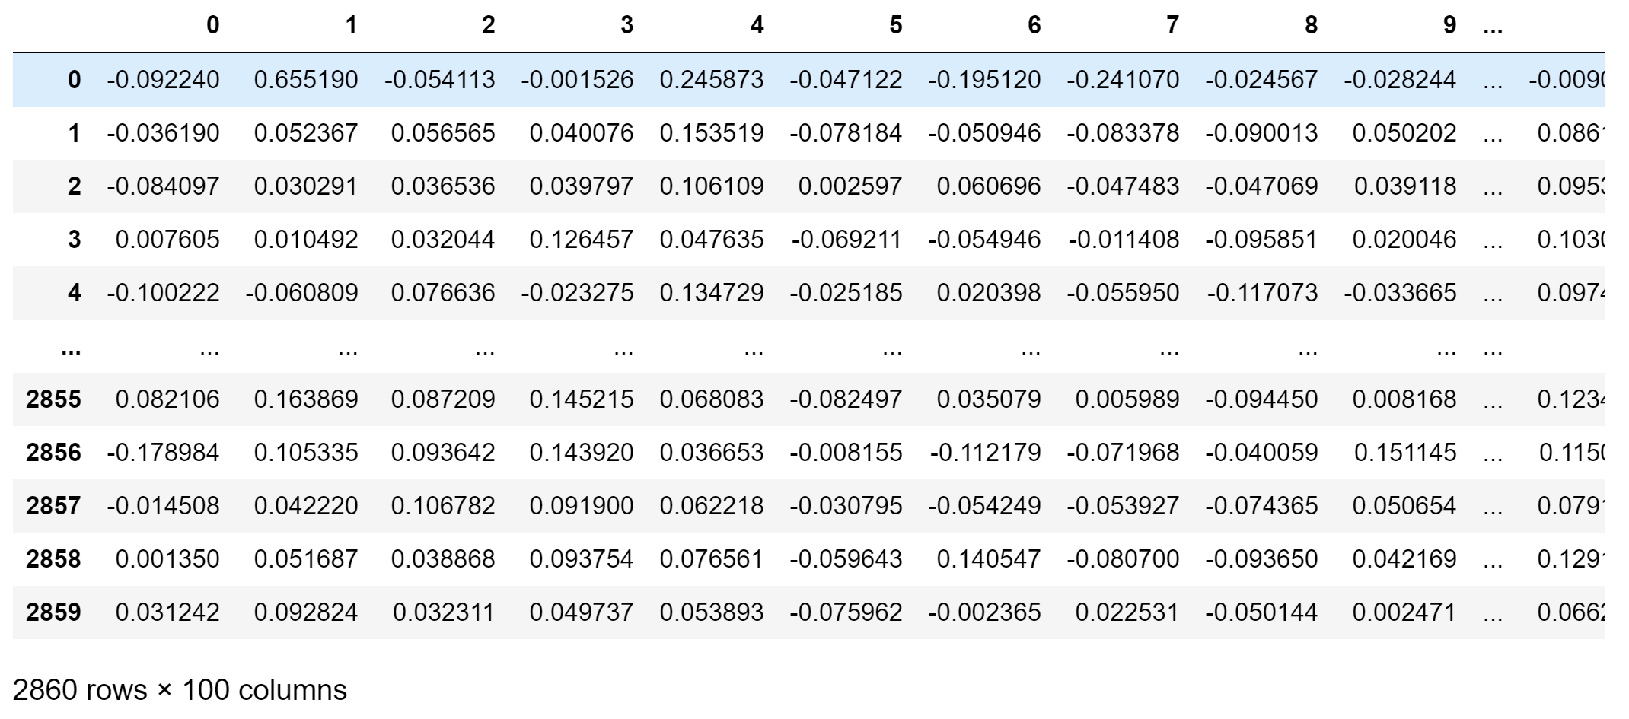
Custom - CBOW

Slide 15
Model and embedding accuracy
Model results (for graph)
LOGISTIC REGRESSION/DECISION TREE
BOW: 0.79/0.76
W2V: 0.79/0.66
Concat(BOW, W2V): 0.78/.69
Custom W2V: 0.72/0.66

Slide 17
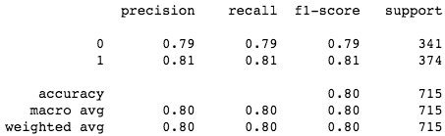
Best model – logistic regression on tf-idf

Slide 18
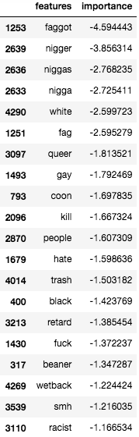
Feature importance tf-idf – Logistic regression

Slide 19
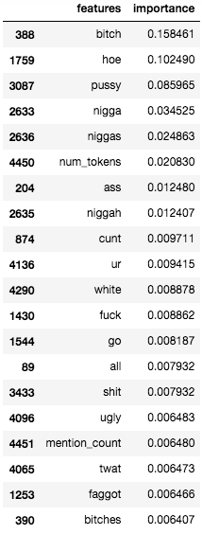
Feature importance tf-idf – Decision tree

Slide 20
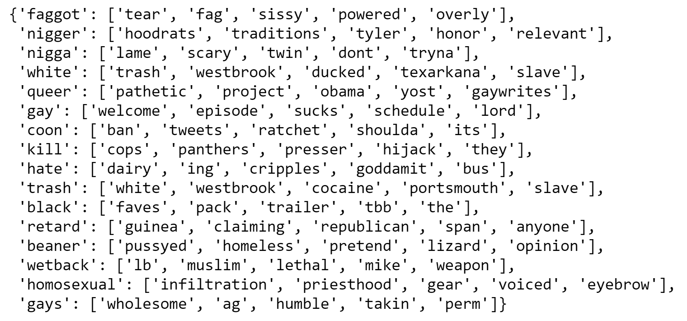
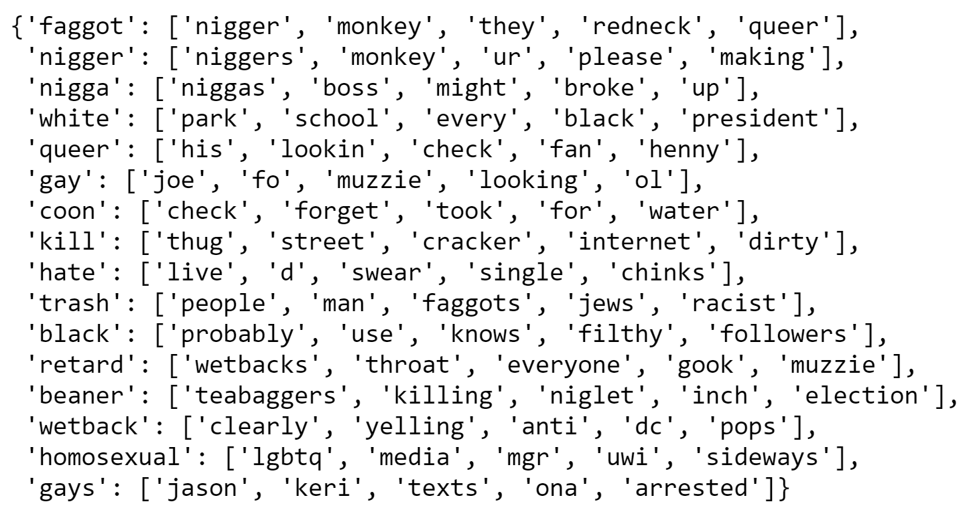
SIMILAR WORDS (from feature importance)
WORD2VEC
CUSTOM-TRAINED

Slide 21
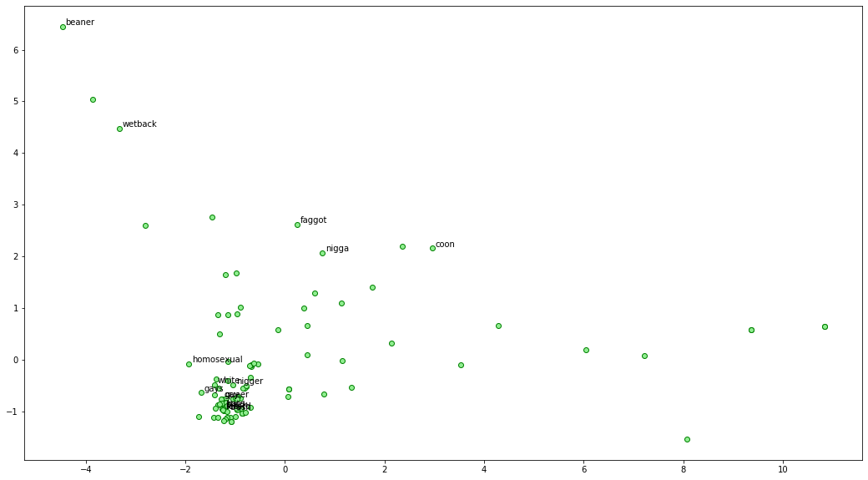
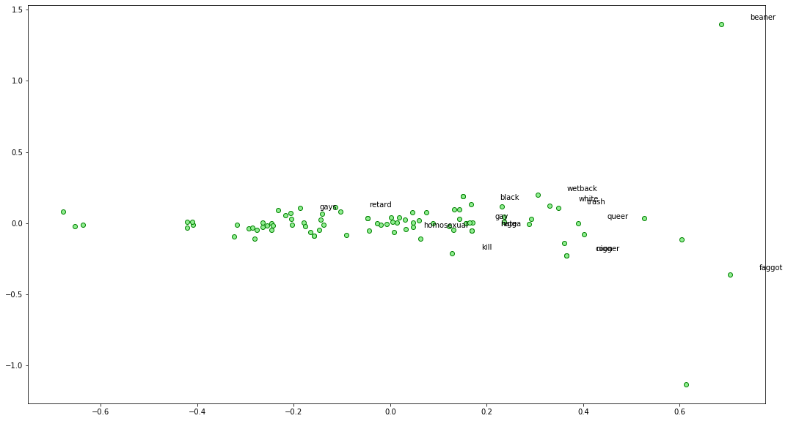
PCA
Word2vec
Word2vec
CUSTOM

Slide 22
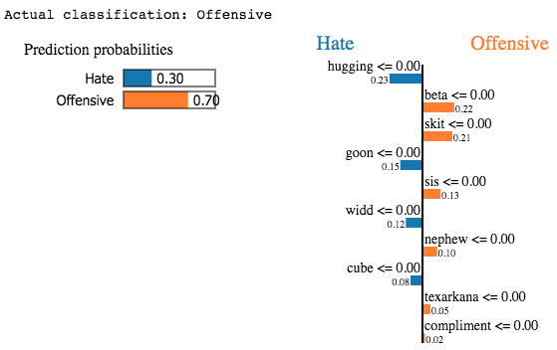
LIME – Specific Example (Offensive)

Slide 23
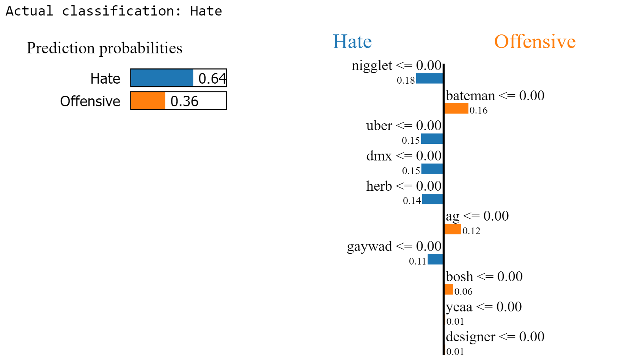
LIME – Specific Example (Hate)

Slide 24
summary
TF-IDF + extracted features appears to be best for prediction and interpretability
Hateful words were captured by feature importance
Differences in W2V and Custom CBOW – some semantic meaning is still captured
Model performance already exceeds that of original authors’ (80% vs 60%)
Will use TF-IDF + extracted features moving on

