Slide 1
Twitter Hate Speech Analysis
Milestone two
Colin Green & Sean Zhang

Slide 2
Feature creation and extraction
We created the following features:
num_tokens, num_mentions, num_urls, num_hashtags
We tested out the following features:
Bag of words, ngrams (n=2, & n=3), TF-IDF
Word2Vec - CBOW, concat(Word2Vec - CBOW, BOW), and Custom - CBOW
We ran logistic regression and decision tree on each embedding as a benchmark

Slide 3
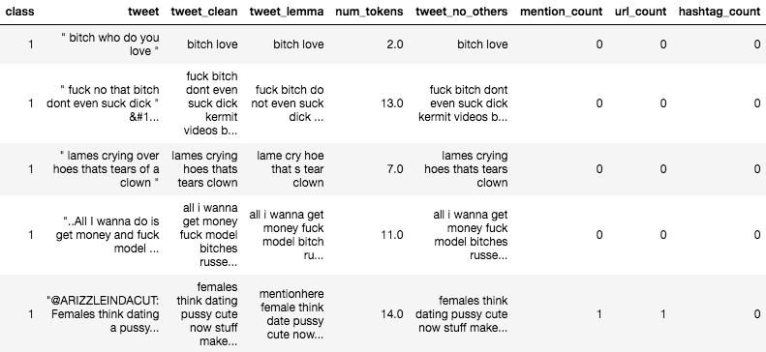
Data before embedding

Slide 4
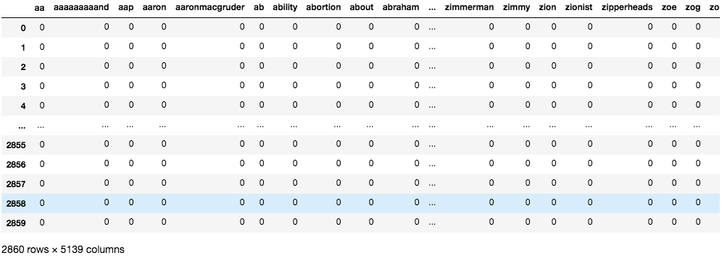
Bag of Words

Slide 5
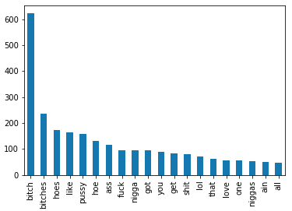
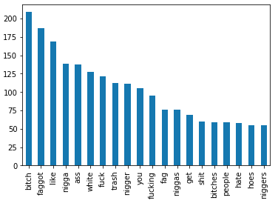
Bag of Words – Feature counts
Offensive Tweets
Hate Tweets

Slide 6
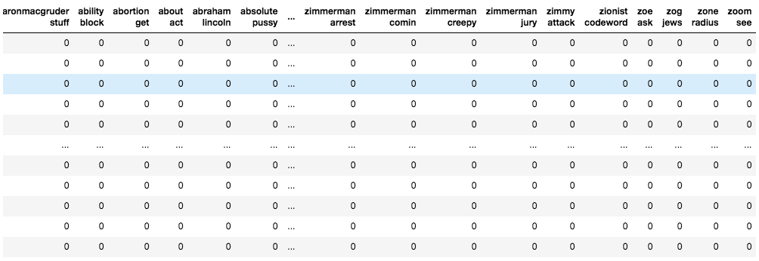
Ngrams (N=2)

Slide 7
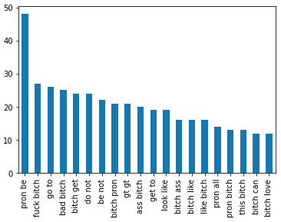
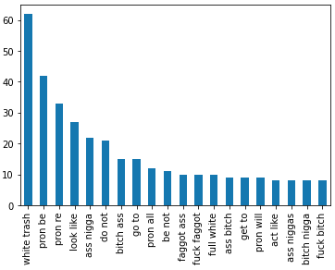
Ngrams (n=2) – feature count
Offensive Tweets
Hate Tweets

Slide 8
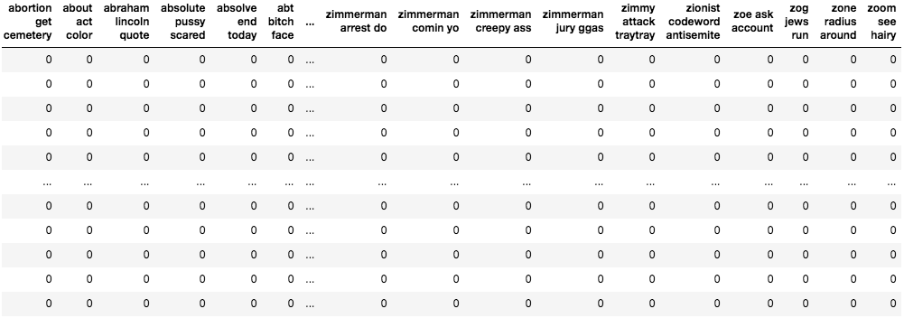
Ngrams (n=3)

Slide 9
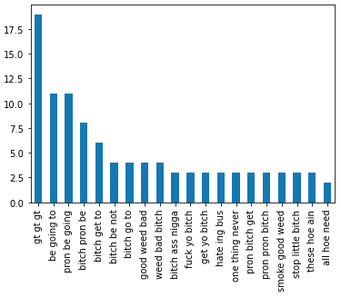
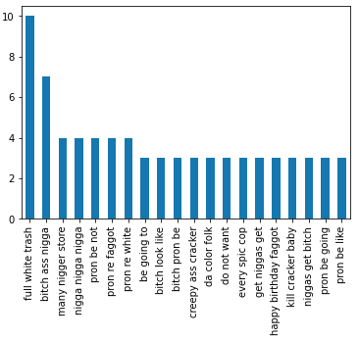
Ngrams (n=3) – feature count
Offensive Tweets
Hate Tweets

Slide 10
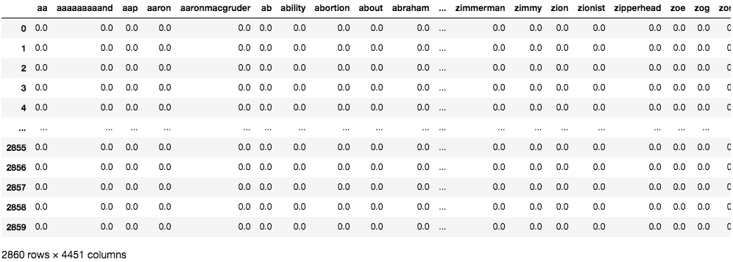
tf-idf

Slide 11
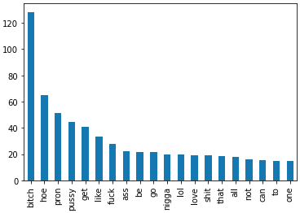
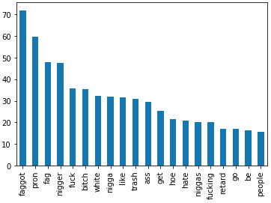
TF-IDF – Feature Count
Offensive Tweets
Hate Tweets

Slide 12
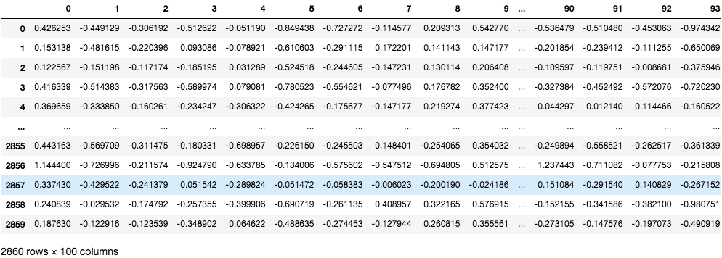
Word2Vec - CBOW

Slide 13
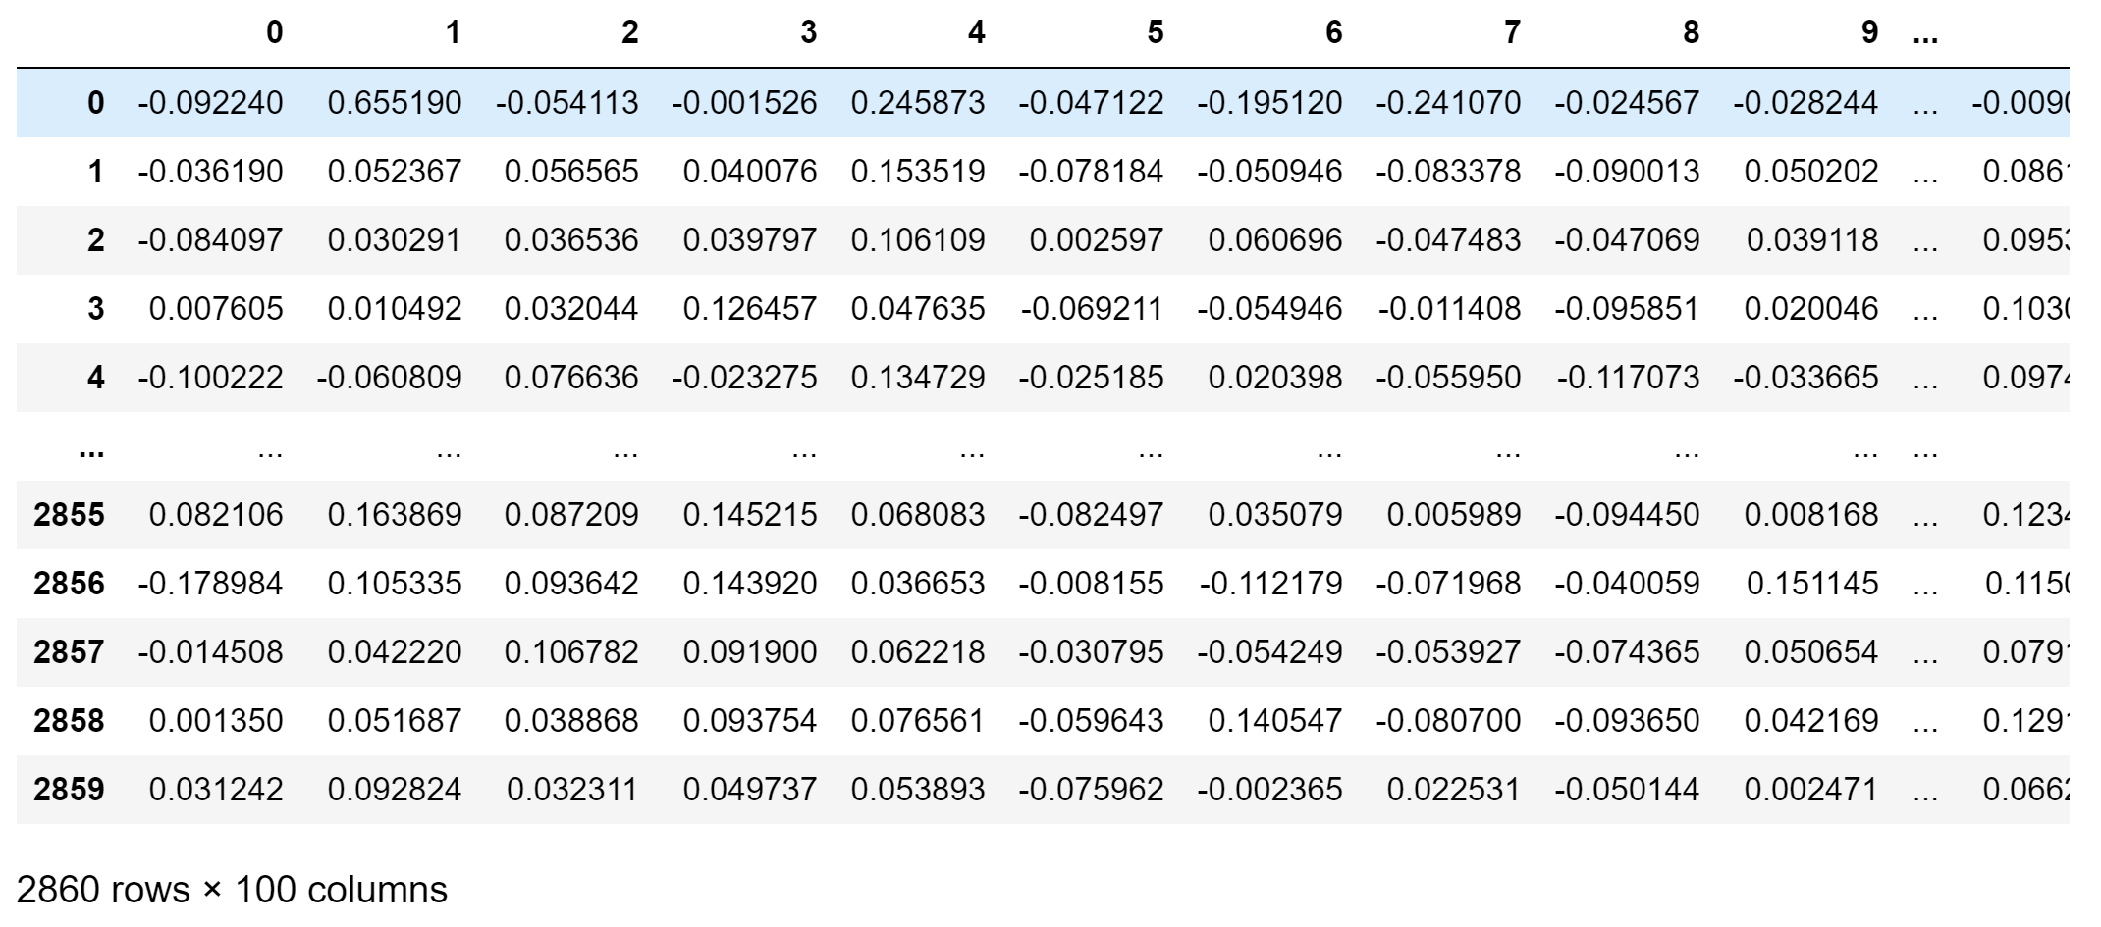
Custom - CBOW

Slide 14
Feature selection – True Positive Rate

Slide 15
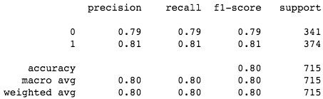
Best model – logistic regression on tf-idf

Slide 16
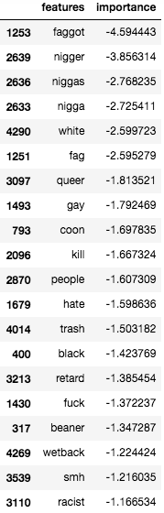
Feature importance tf-idf – Logistic regression

Slide 17
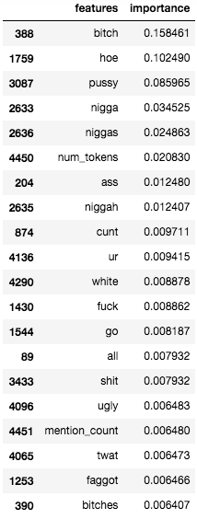
Feature importance tf-idf – Decision tree

Slide 18
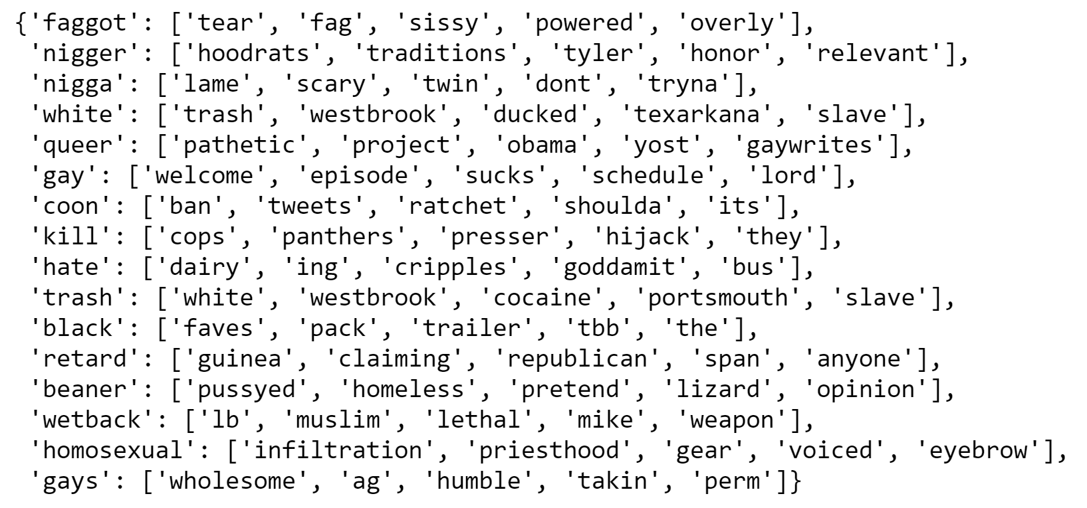
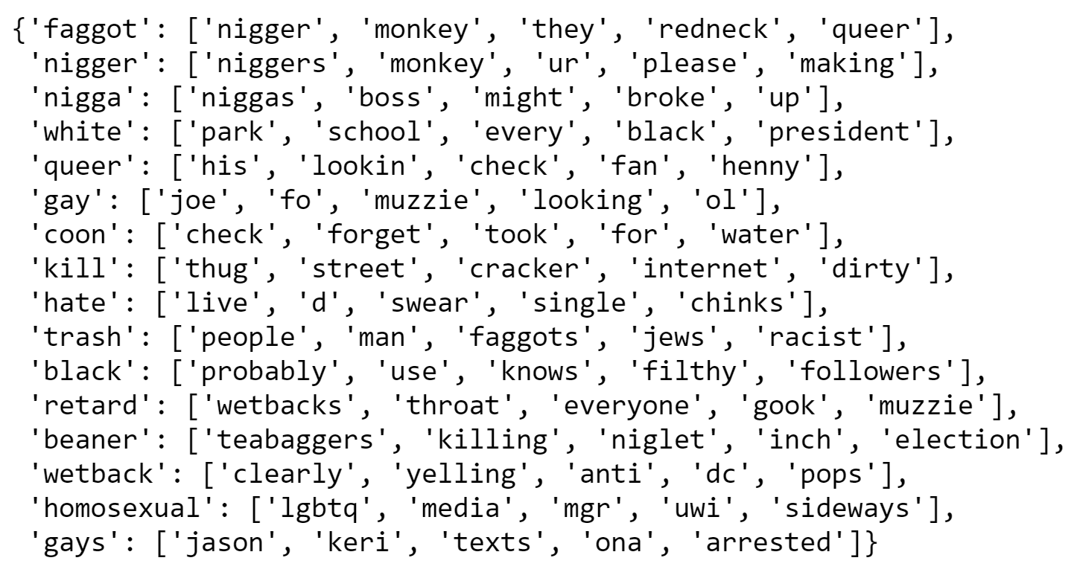
SIMILAR WORDS (from feature importance)
WORD2VEC
CUSTOM-TRAINED

Slide 19
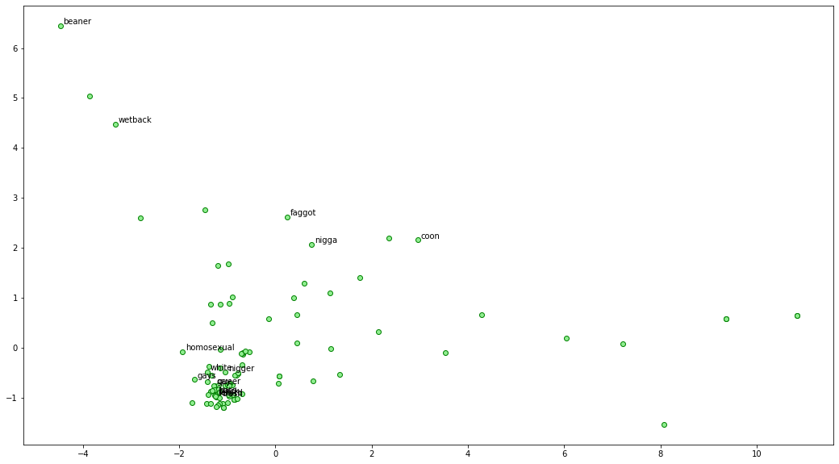
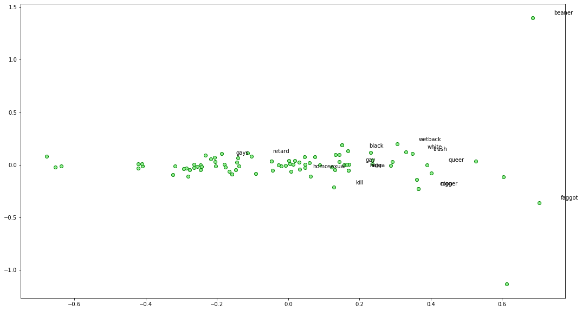
PCA
Word2vec
Word2vec
CUSTOM

Slide 20
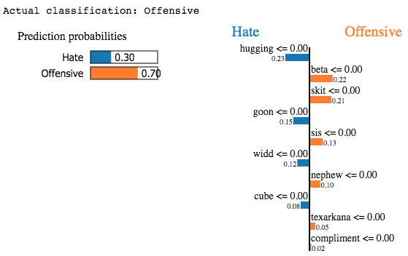
LIME – Specific Example (Offensive)

Slide 21
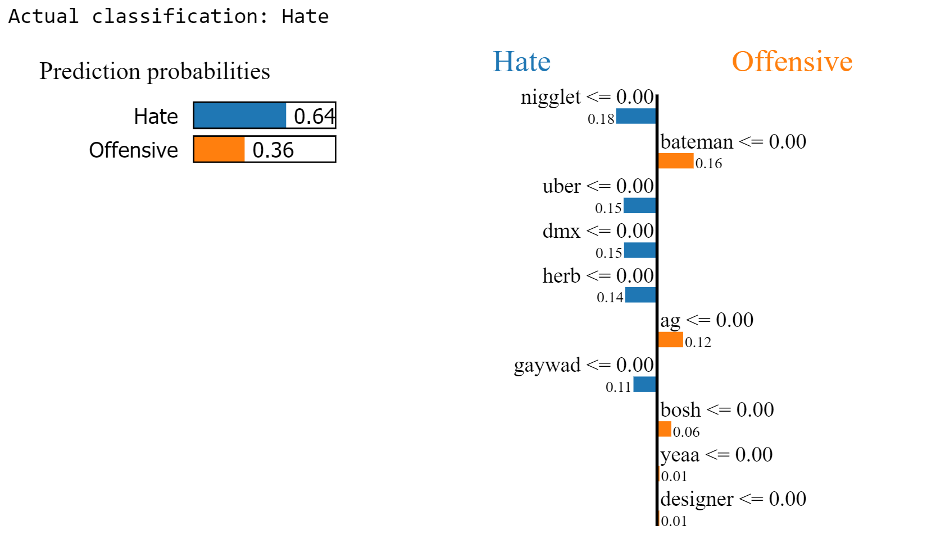
LIME – Specific Example (Hate)

Slide 22
summary
TF-IDF + extracted features appears to be best for prediction and interpretability
Hateful words were captured by feature importance
Differences in W2V and Custom CBOW – some semantic meaning is still captured
Model performance already exceeds that of original authors’ (80% vs 60%)
Will use TF-IDF + extracted features moving on

