Slide 1
Twitter Hate Speech Analysis
Milestone one
Colin Green & Sean Zhang

Slide 2
Problem Statement
Hate speech can have harmful consequences
Hate speech targets an individual or group and is derogatory
Rule-based approach would have difficulty differentiating between offensive language and hate speech
Increase the accuracy in successfully identifying instances of hate speech from offensive language

Slide 3
Disclaimer
This contains uncensored offensive language for the purposes of data exploration and visualization.

Slide 4
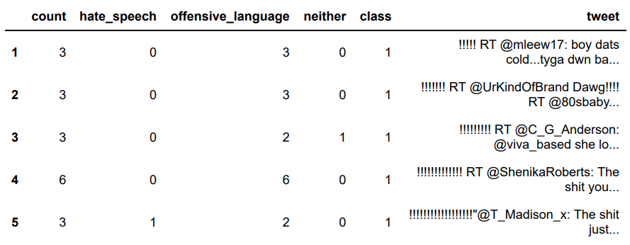
Initial Data

Slide 5
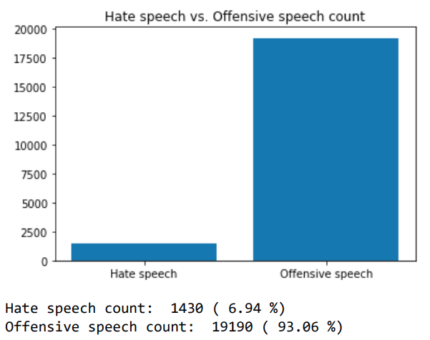
Unbalanced Data

Slide 6
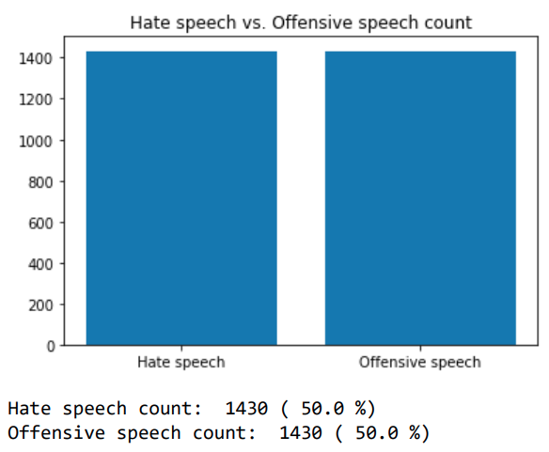
After balancing

Slide 7
Data Cleaning
Replaced mentions with “MENTIONHERE”
Replaced URLS with “URLHERE”
Replaced white space with a single space
Identified symbols, nouns, and verbs using NLP

Slide 8
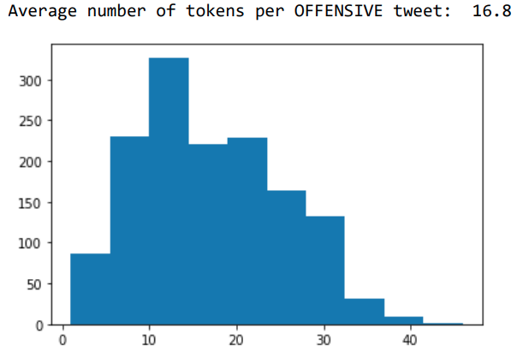
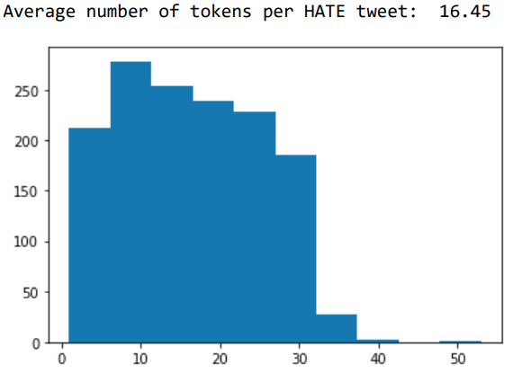
Data exploration

Slide 9
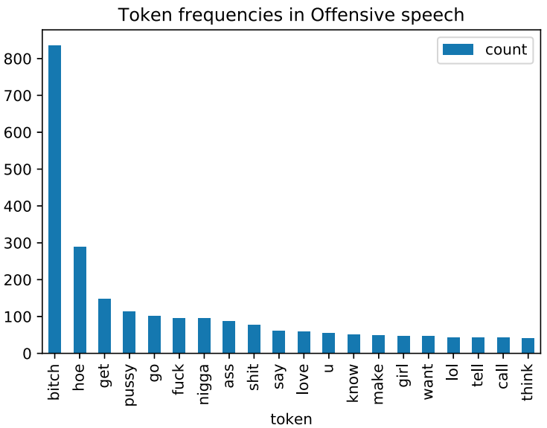
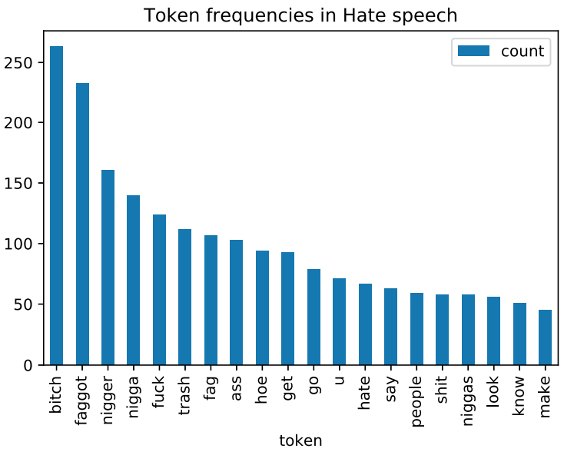
Data exploration

