Slide 1
Twitter Hate Speech Analysis
Milestone three
Colin Green & Sean Zhang

Slide 2
Balanced Dataset
Ran Random Forest and Logistic Regression as a benchmark
Compared with tuned versions of Random Forest and Logistic Regression
Used the bagging method for those 4 models as well as untuned:
Extra Trees, KNN, SVC, Ridge Classifiers
Also used Ada Boost, Grad Boost, XG Boost and an Ensemble

Slide 3

Logistic Regression vs Random Forest

Slide 4
False Negatives

Slide 5
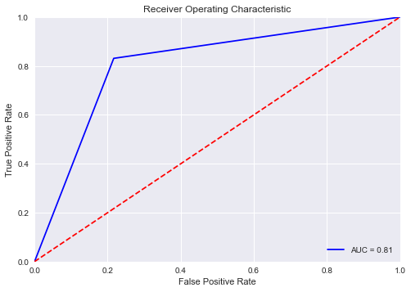
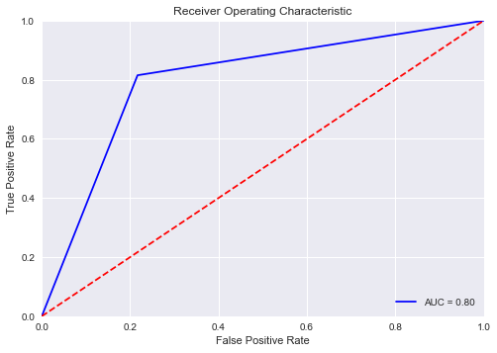
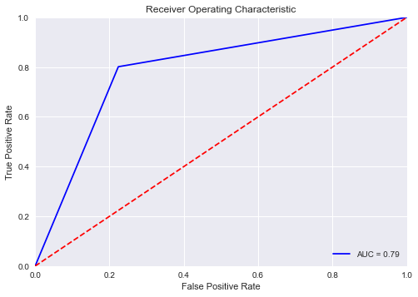
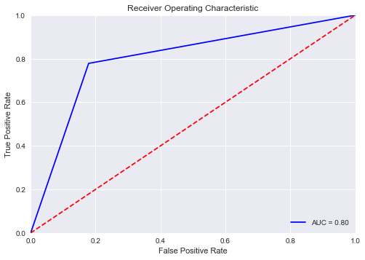
ROC Curves
Base Random Forest
Tuned Random Forest
Based Logistic Regression
Tuned Logistic Regression

Slide 6
Area Under the Curve

Slide 7
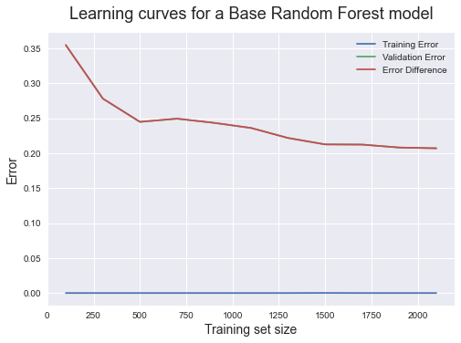
Learning Curves – Base Random Forest

Slide 8
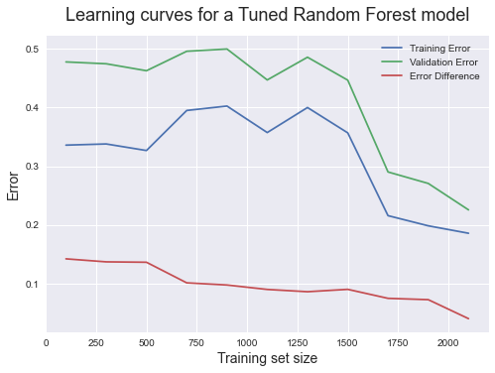
Learning Curves – Tuned Random Forest

Slide 9
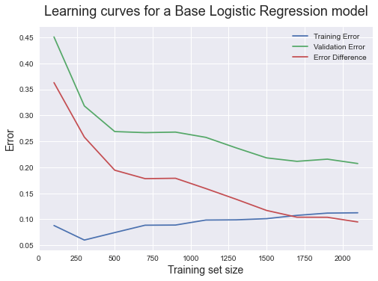
Learning Curves – Base Logistic Regression

Slide 10
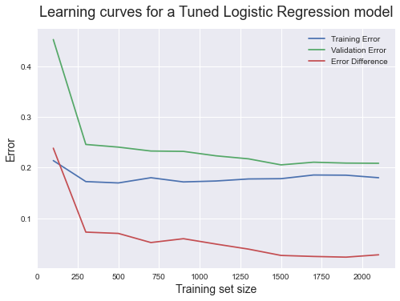
Learning Curves – Tuned Logistic Regression

Slide 11

Bagging

Slide 12
Bagging to reduce variance

Slide 13
boosting

Slide 14
FULL DATASET
Used Logistic Regression as Benchmark
Ran to see whether learning curves would converge
Comparison of: Base, under/oversampling, hyperparameter tuning, bagging, ensemble (voting)
Decision boundary visualization

Slide 15
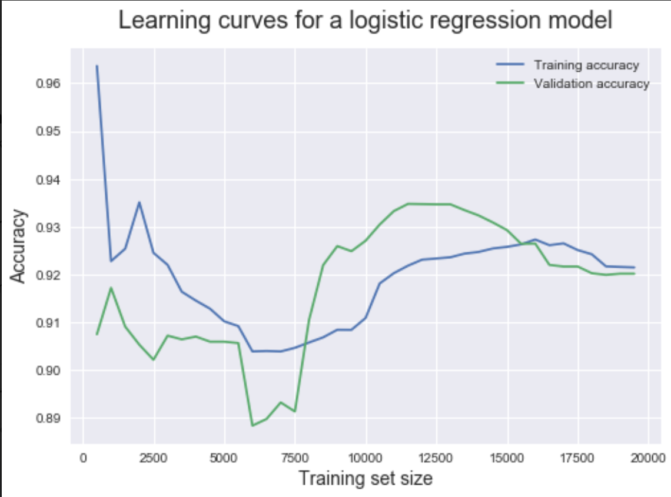
Learning Curves – Tuned Logistic Regression (FULL DATA)

Slide 16
Accuracy metrics (FULL DATA)
Imbalanced sampling done with imblearn package
Voting ensemble: Random Forest, Extra Trees, KNN, Support Vector Machine, Logistic Regression

Slide 17
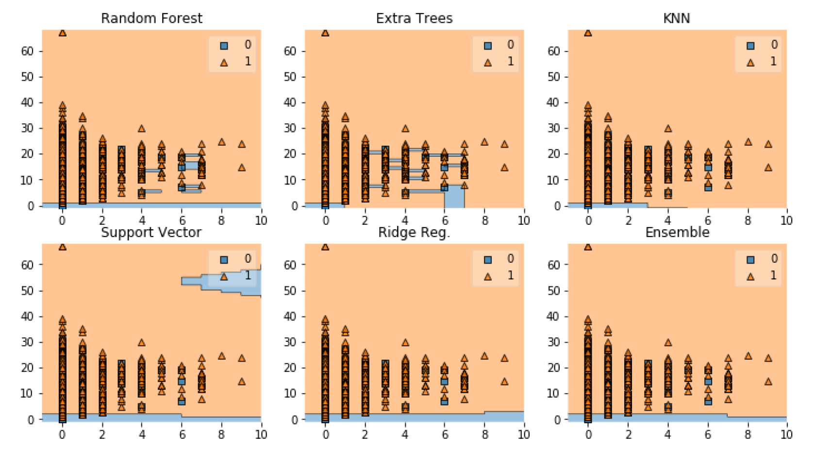
DECISION boundaries
X: hashtag count 0: Hate speech
Y: number of tokens 1: Non-hate speech
Chose numerical variables based on importance and the fact that word features are too sparse
Observations with lower number of tokens tends to be classified as hate speech (this was something noticed in previous EDA, feature importance, and past research)

Slide 18
CONCLUSIONS
Algorithm converged in full dataset compared to balanced subset
Tuning slightly increased accuracy
Bagging slightly increased accuracy and decreased variance in most cases
Imbalanced sampling significantly decreased accuracy with no improvement in sensitivity or precision
Ensemble learning slightly improved accuracy

