Slide 1

Implementing Material Design
When, Why, and How

Slide 2

Overview
Released in 2014 under the MIT License
The official design framework for Google applications
Based on interactions with real-world objects, specifically layers of paper at various distances
Defines common UX paradigms, such as animation, visual focus, layout, and user flow

Slide 3
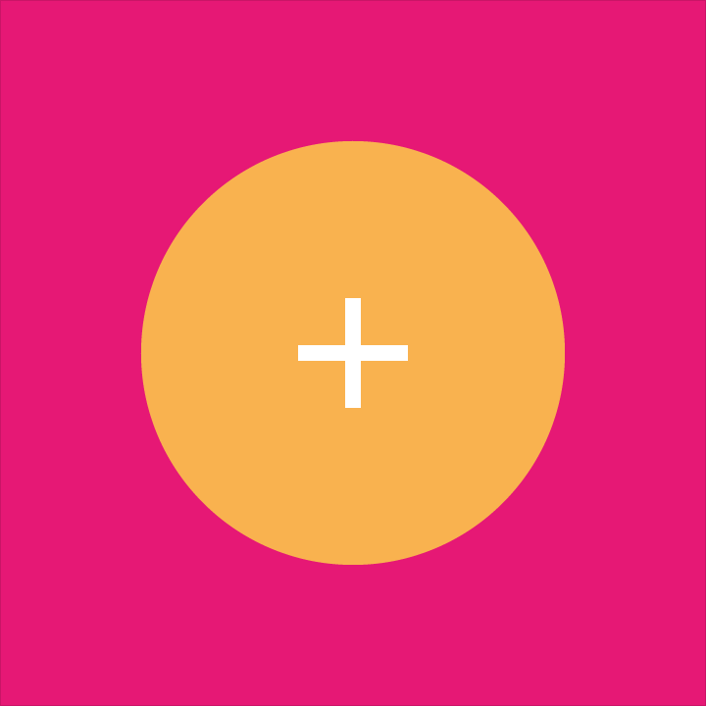
Why?
A foundation upon which to build your UX
Battle-hardened set of practices for guiding users through various workflows
UX paradigms that users are unquestionably familiar with
Approaches all platforms, from a mobile-first mentality
Extremely well documented

Slide 4

When?
You don’t have a dedicated UX
Your UX isn’t give a lot of time for design
You’re building a multi-app or enterprise design system
Development deadlines (budgets) are tight
You want to follow common UX practices
You just don’t wanna hafta think about it

Slide 5
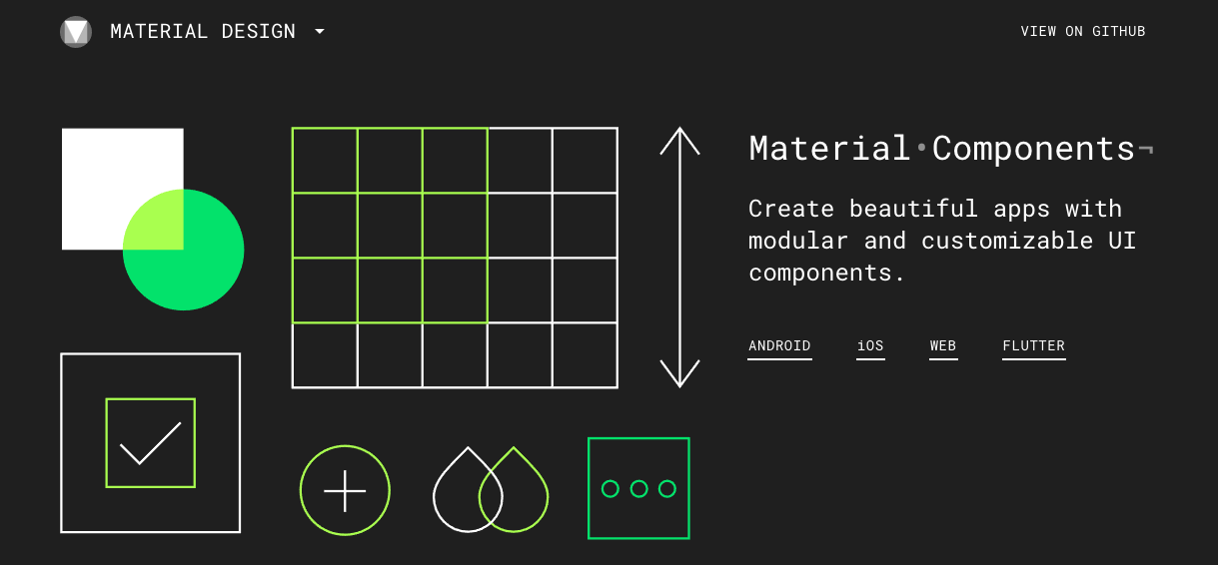
How?
Google published a list of core components that they use to implement Material Design

Slide 6
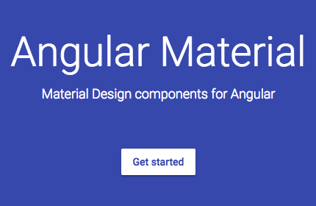
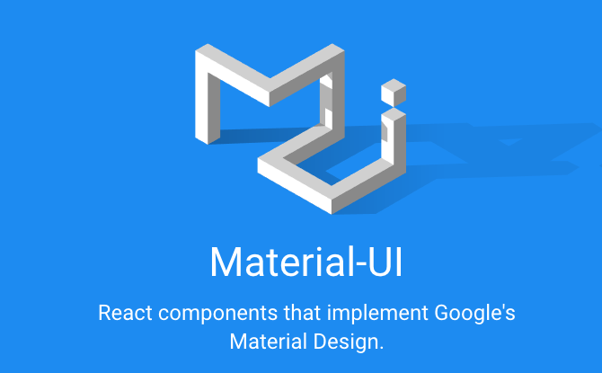
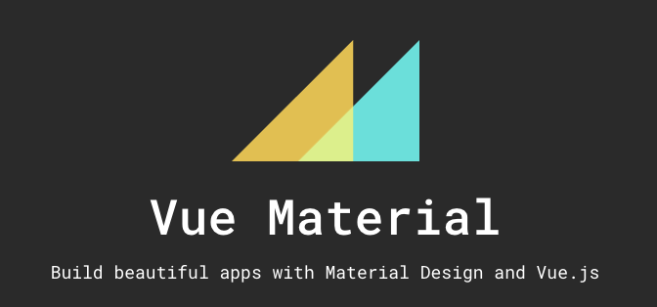
How in my Framework?
By way of awesome, open-source community projects have implemented Material Design components in the major UI frameworks.
Beta*
Beta*

Slide 7
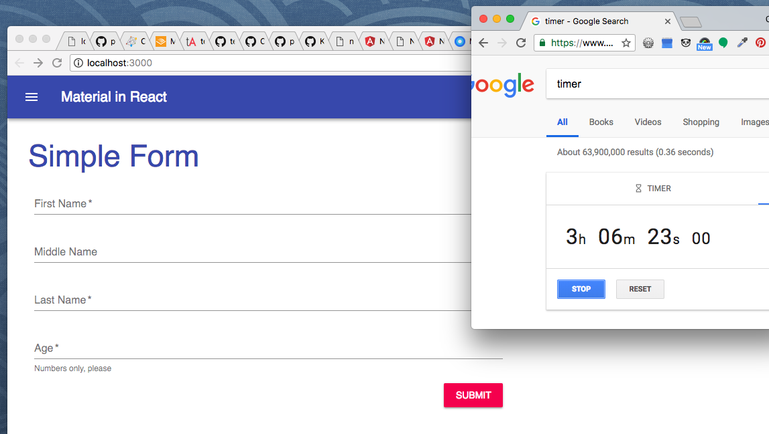
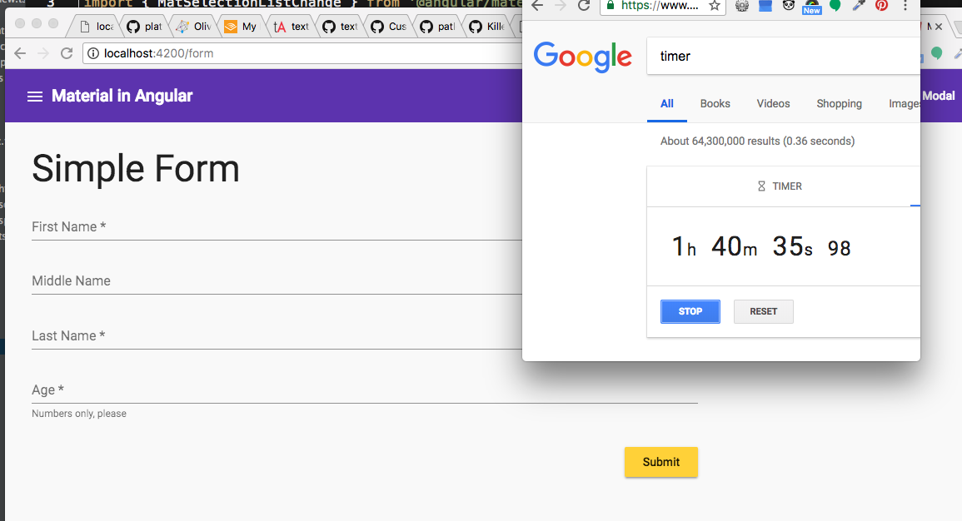
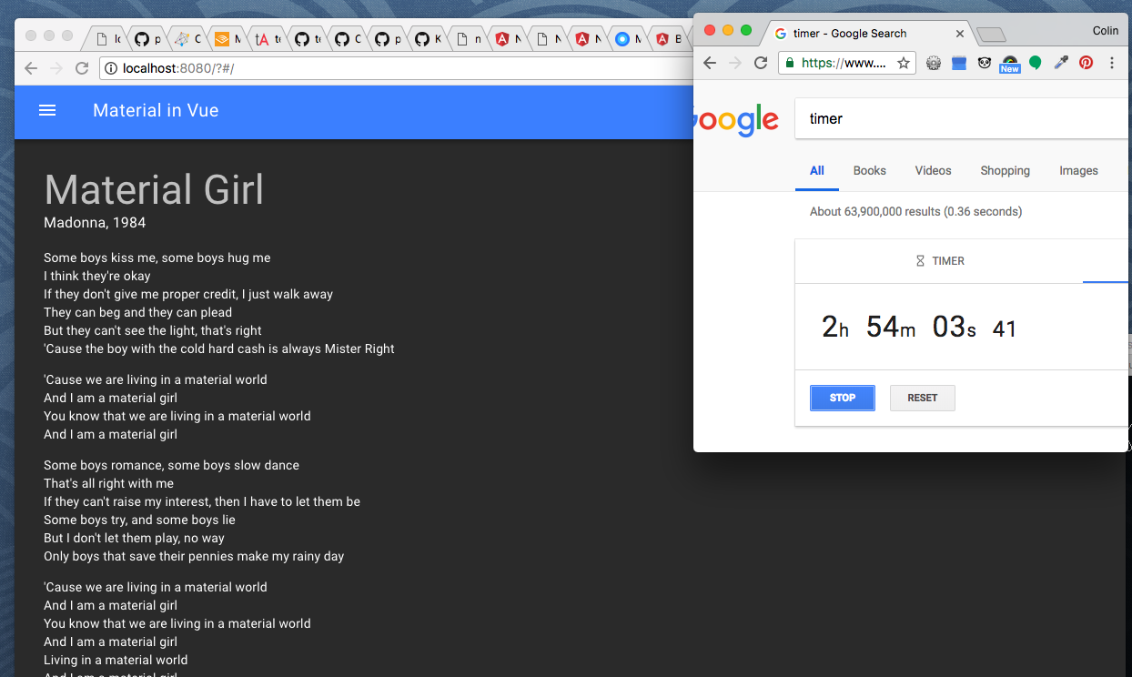
How hard is it?

Slide 8

How do I theme it?
Select colors to start with: https://www.materialpalette.com/
Test and tweak in various layouts:
https://material.io/color/
Generate theme variables for your framework:
http://mcg.mbitson.com/

Slide 9

How do I learn more?
The demo repo: https://github.com/colinjlacy/material-in-action
Material Design design docs:
https://material.io/guidelines/
Knowledge base:
https://design.google/library/

