Slide 1
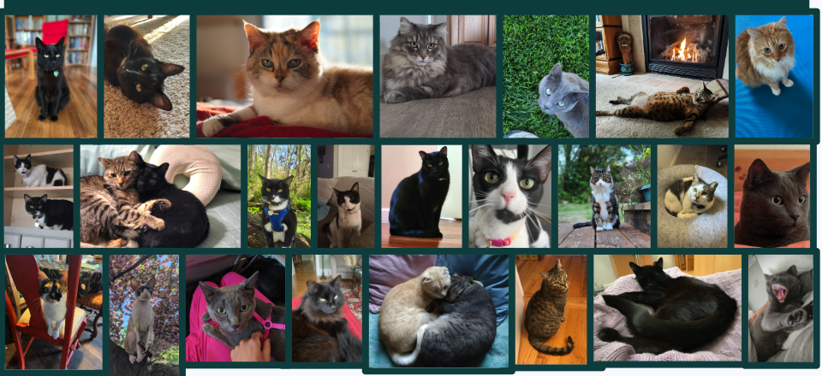
Cat Coat Phenotypes and Survey Concordance
Colin Klick
Colin Klick

Slide 2
Data used for this presentation
Phenotypic survey data and genetic data from ~1500 cats through Darwin’s Ark

Slide 3
Darwin’s Ark - Elinor’s Idea
Everyone wanted to tell Elinor about their dog
The idea was to capture all this information to a format usable for science

Slide 4
A powerful model. For instance . . .
Compulsive behaviors

Slide 5
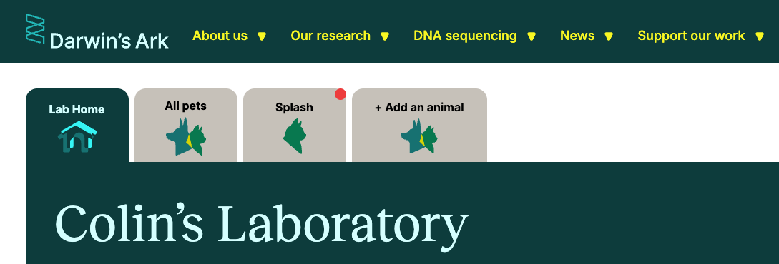
Darwin’s Ark, a community science nonprofit
“Together, we can unlock the mysteries of pet behavior and genetics to help cats, dogs, and humans live healthier, happier lives.”

Slide 6
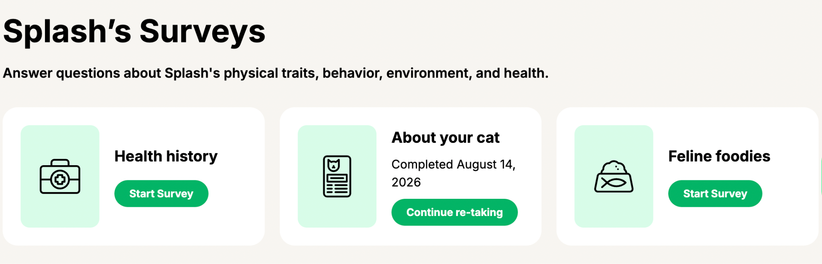
~260 Questions across 21 surveys

Slide 7
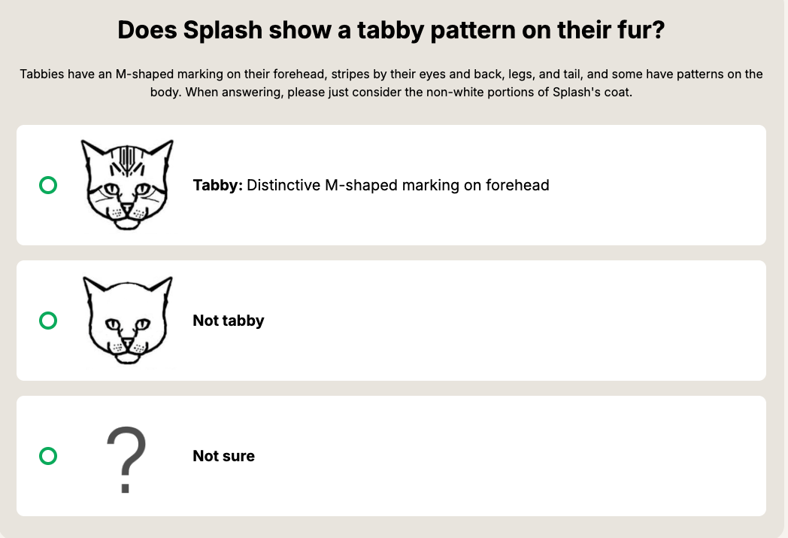
We are going to examine the coat and fur survey

Slide 8
Why the coat and fur survey?
Start by examining simpler traits caused by one or a few variants
It’s the toughest survey in terms of owner accuracy, so it’s perfect for concordance/discordance analysis

Slide 9
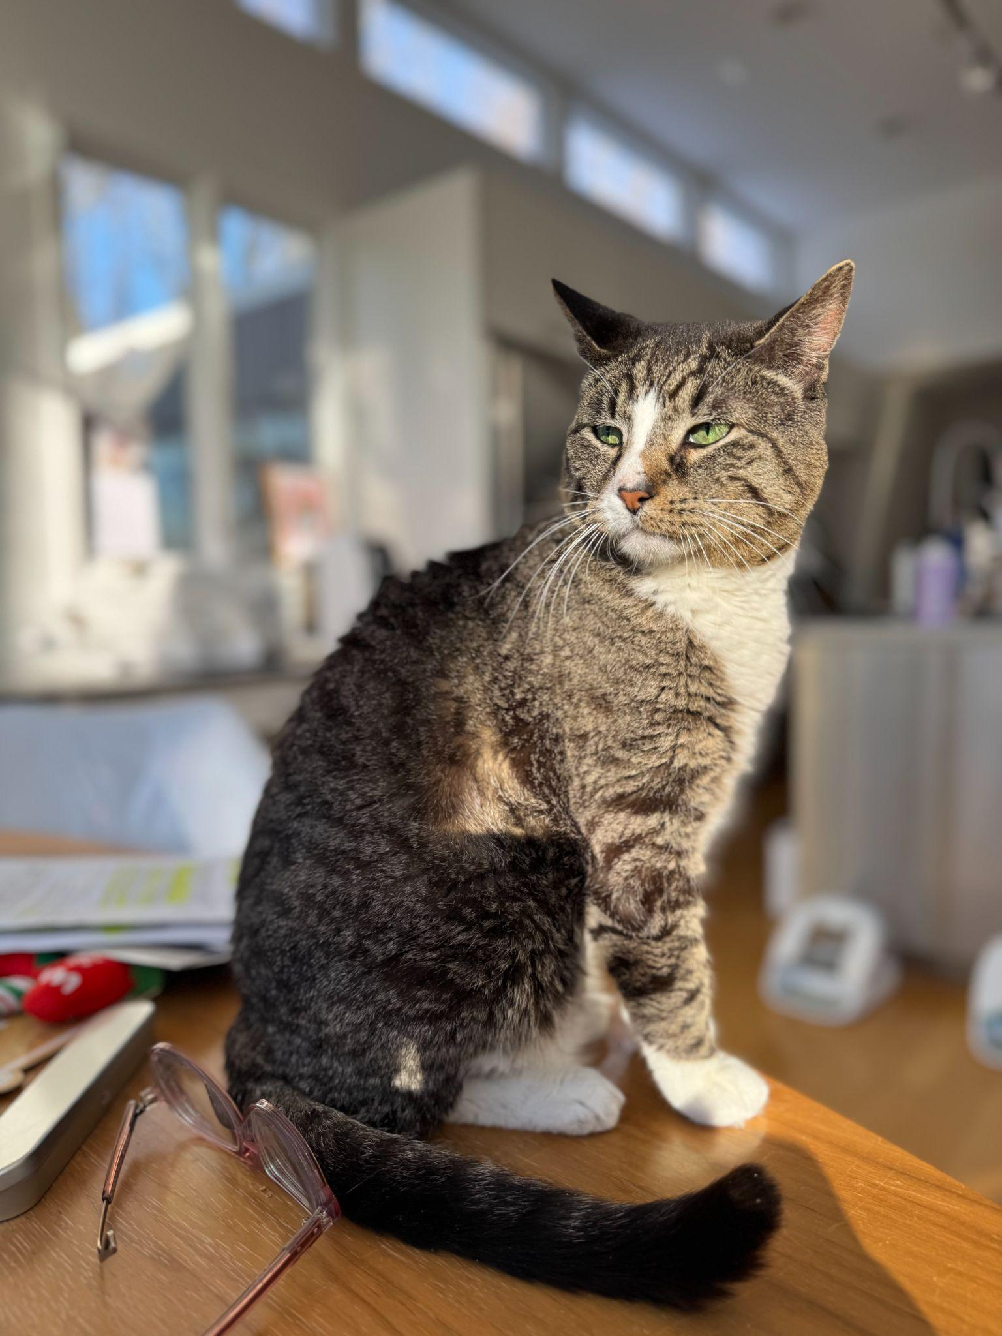
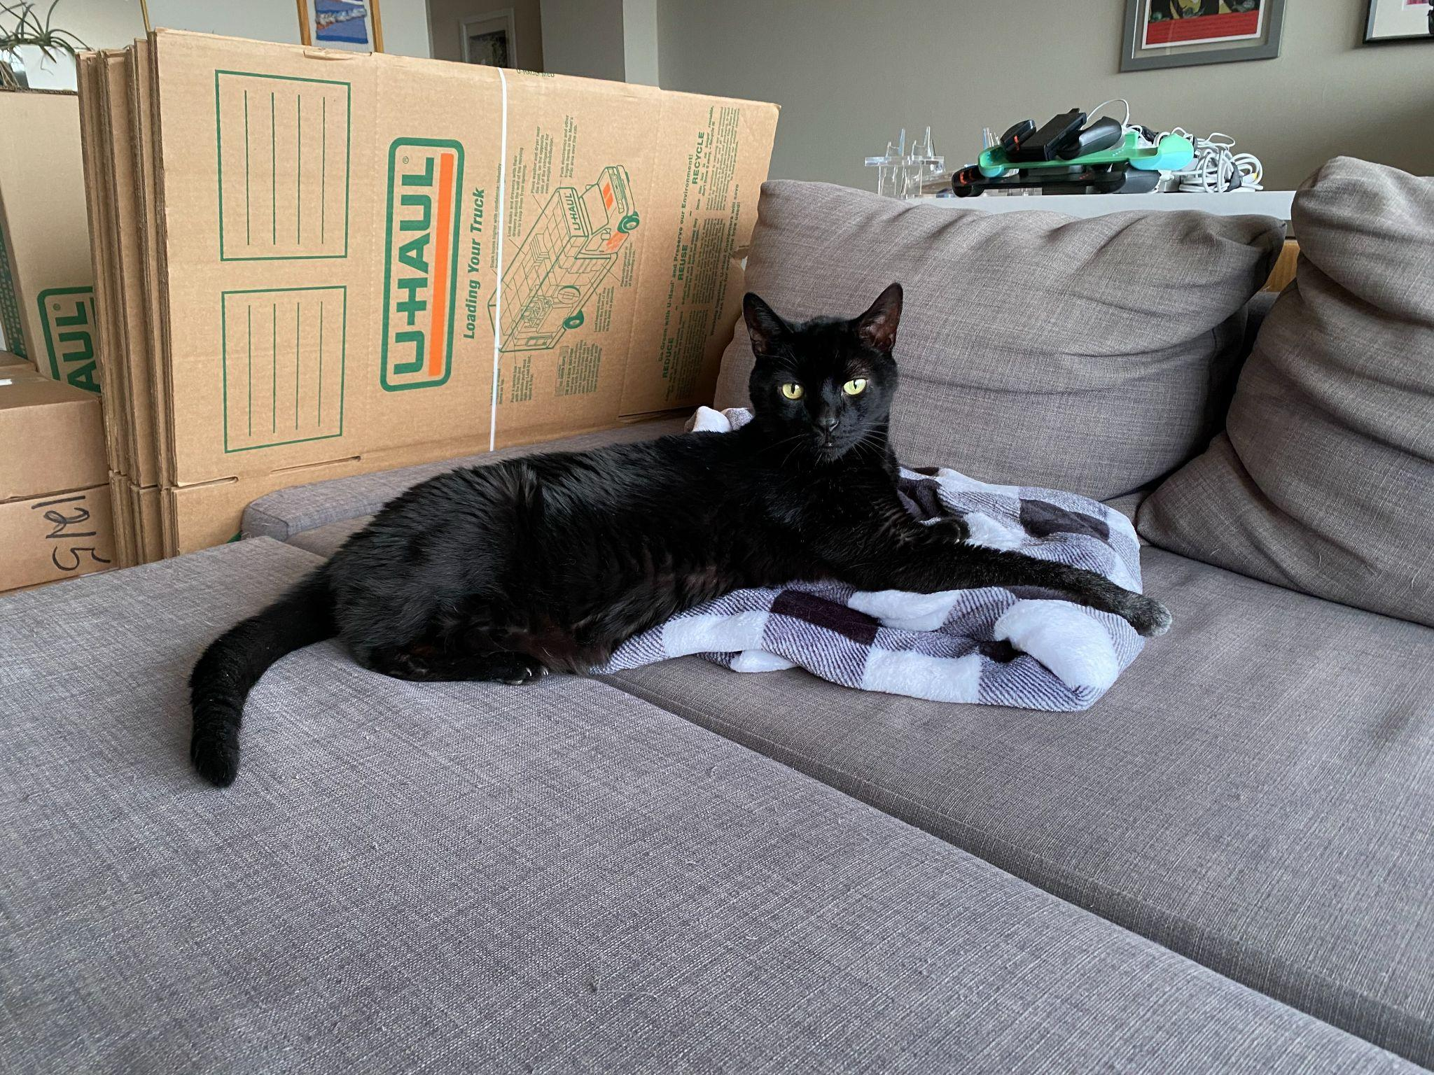
Let’s dive in to a trait

Slide 10

Normal agouti hairs
Eumelanin bands
Phaeomelanin bands

Slide 11
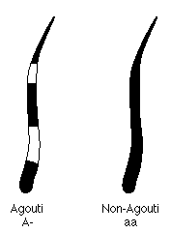
Non-agouti hair (right)

Slide 12
ASIP turns the MC1R protein on and off
ASIP MC1R
inhibits

Slide 13
Eizirik et al. 2003 - Finding ASIP
ASIP was a candidate gene from the literature (e.g., from mice)
Used markers next to ASIP in an 89-cat pedigree
Sequenced ASIP and found a 2 bp deletion, frameshifting the protein and truncating its critical C-terminal domain
Confirmed with association with ~140 cats (small by today's standards)

Slide 14
Other variants affecting cat coat phenotypes
Similarly to the non agouti variant, cat coat phenotypes are caused by one or a small number of variants

Slide 15
Previous studies used a combination of:
Pedigree analysis
Small-scale association analysis
Development biology

Slide 16
Darwin’s Ark takes a different approach
Population-scale, not pedigree-based
Unbiased genome-wide scan, not candidate genes
Owner-reported phenotypes, not clinical/expert scoring

Slide 17
A look into other traits and their variants

Slide 18
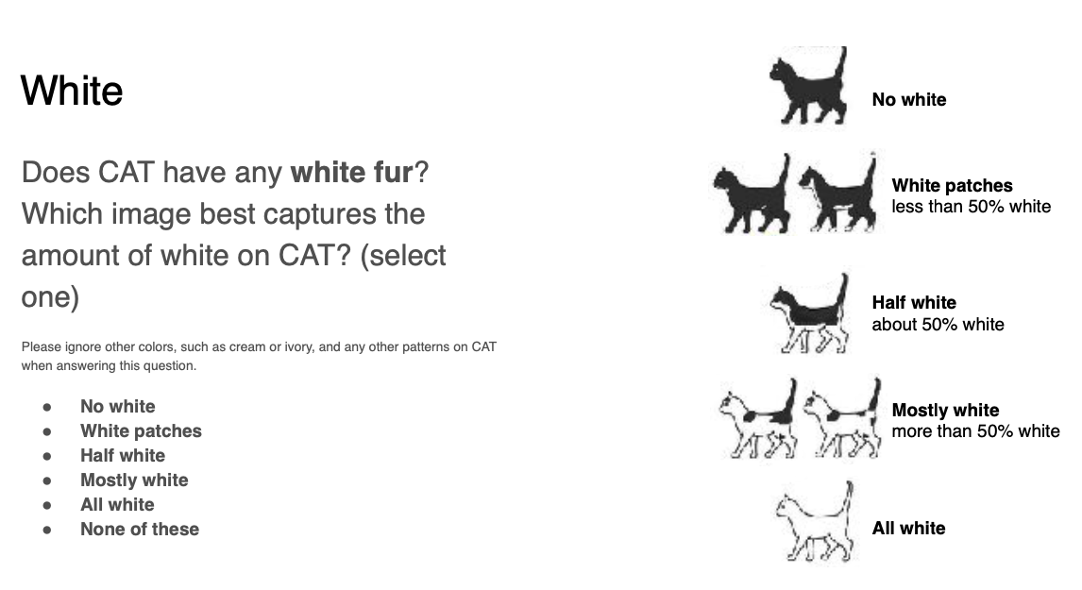
KIT - White spotting
Epistatic to other coat phenotypes

Slide 19
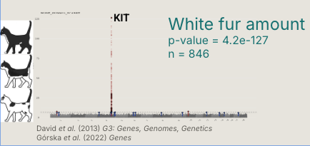
Darwin’s Ark GWAS replicates the association

Slide 20
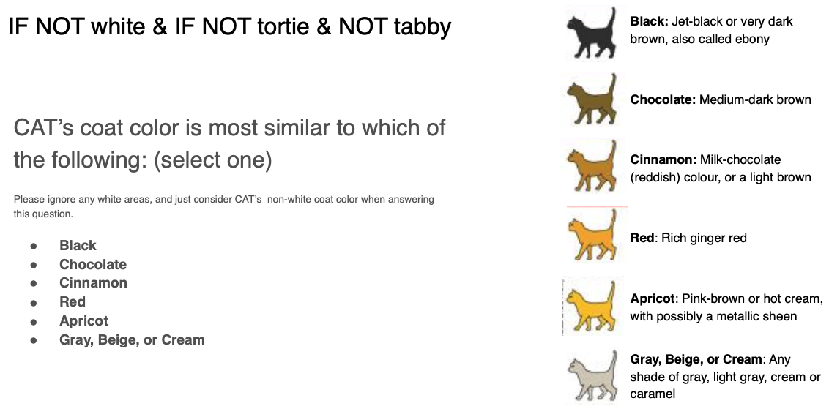
Orange Locus
For areas on coat that are not white, orange is epistatic to black

Slide 21
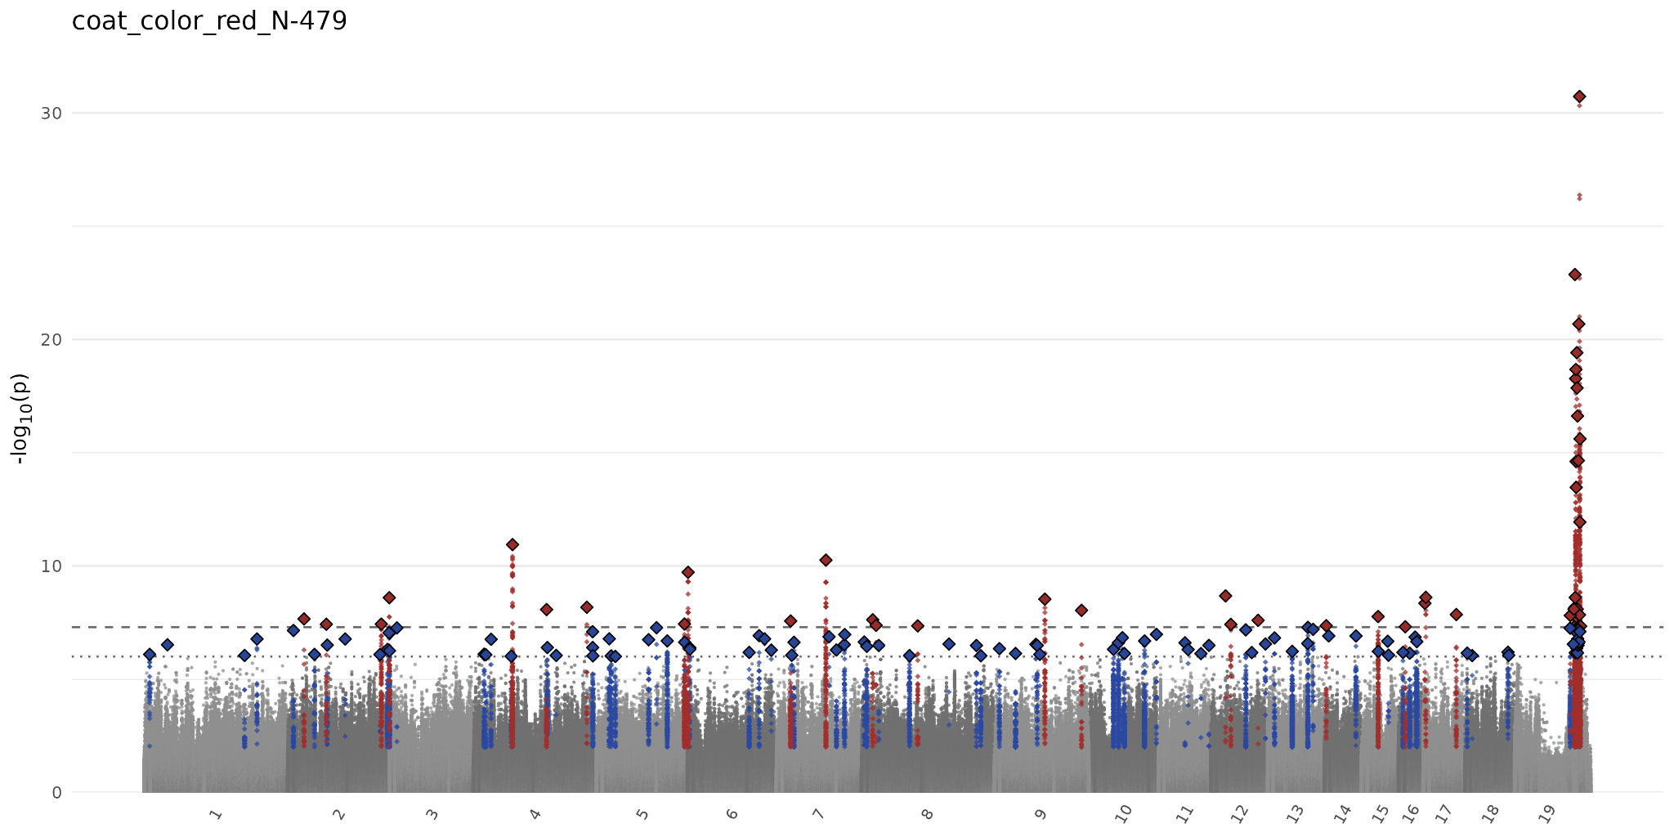
Darwin’s Ark GWAS replicates the orange locus

Slide 22
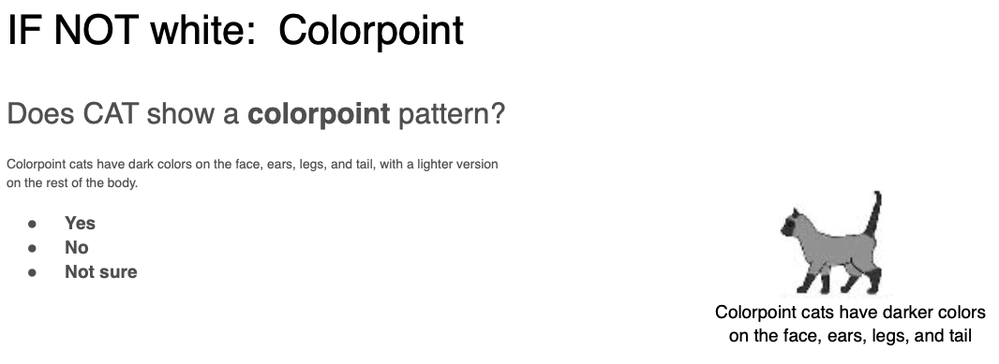
Colorpoint
Colorpoint variant acts independently of other traits

Slide 23
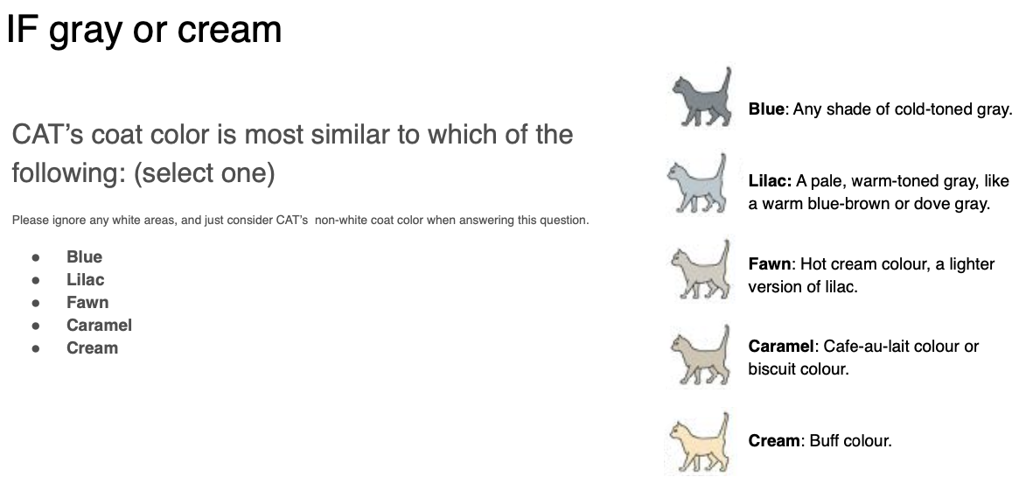
Dilute
Dilute variant acts independently of other traits

Slide 24
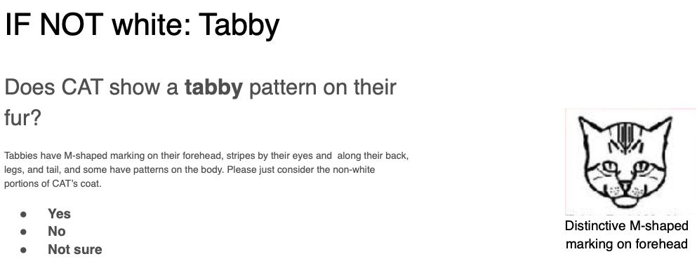
Agouti/nonagouti (Tabby status)
Describes the individual hairs on a cat

Slide 25
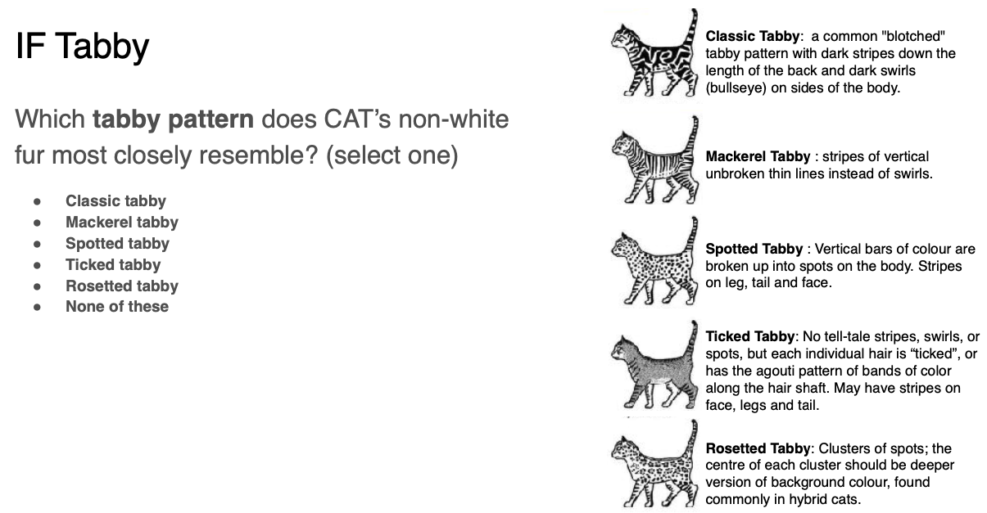
If tabby, what is tabby type

Slide 26
Describing a coat phenotype
Colorpoint / Not colorpoint (TYR)
Dilute / Not dilute (MLPH)
Agouti / Not agouti
  If Agouti: Mackerel / Blotched / Ticked / Other

Slide 27
Pictures - Rule-based organizing into categories

Slide 28
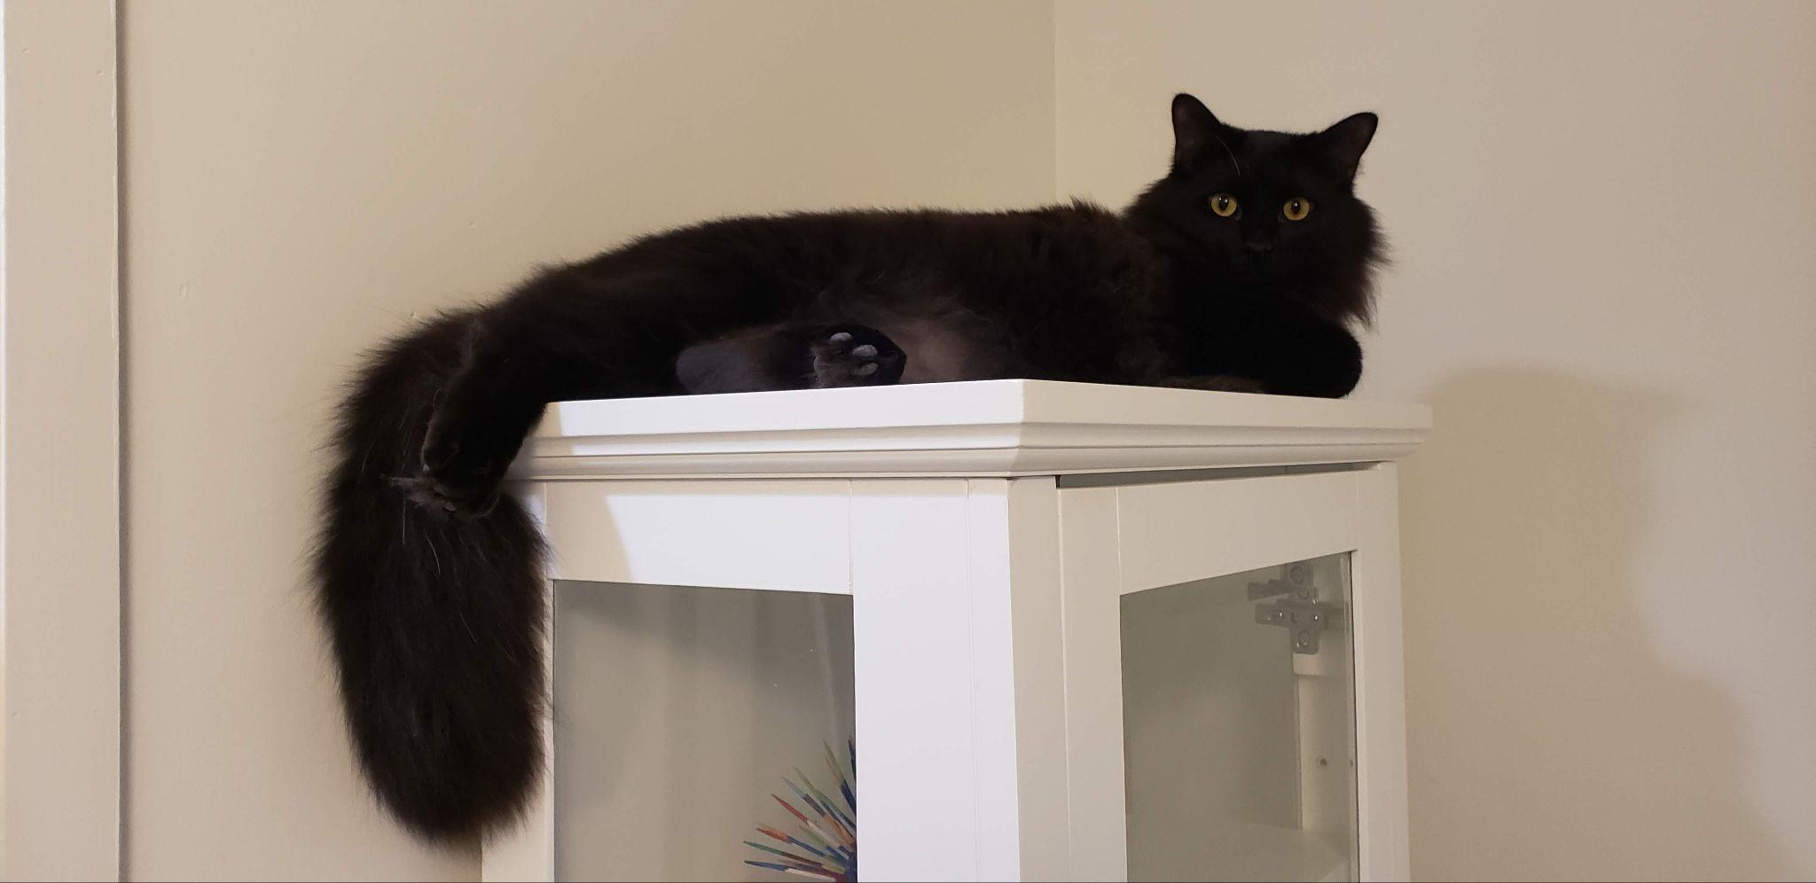
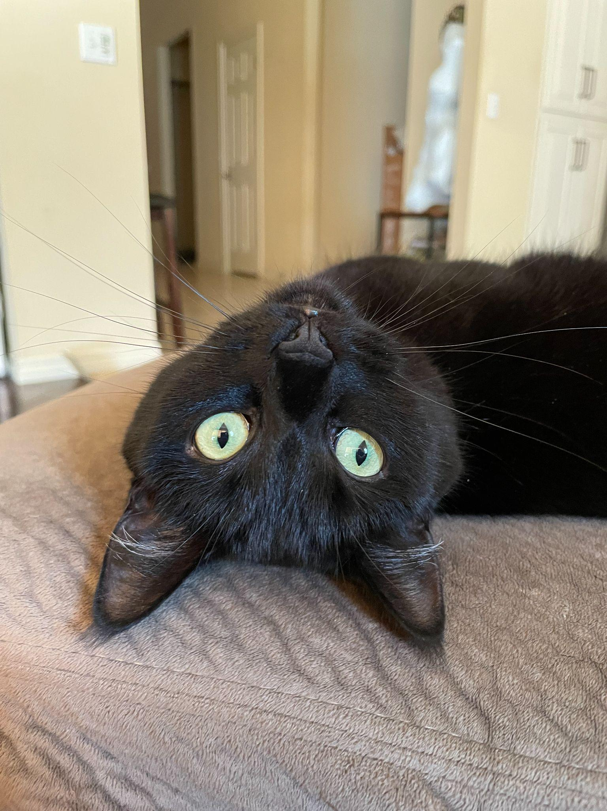
Not dilute, not colorpoint, non agouti (536)

Slide 29
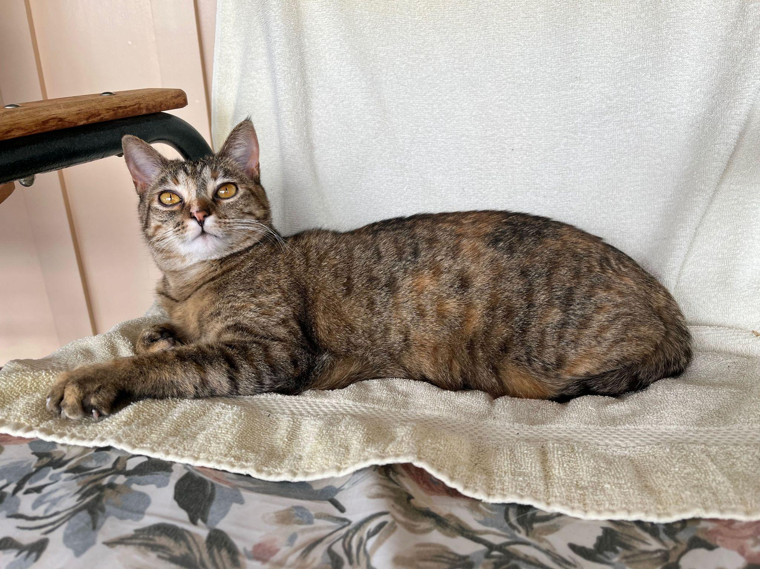
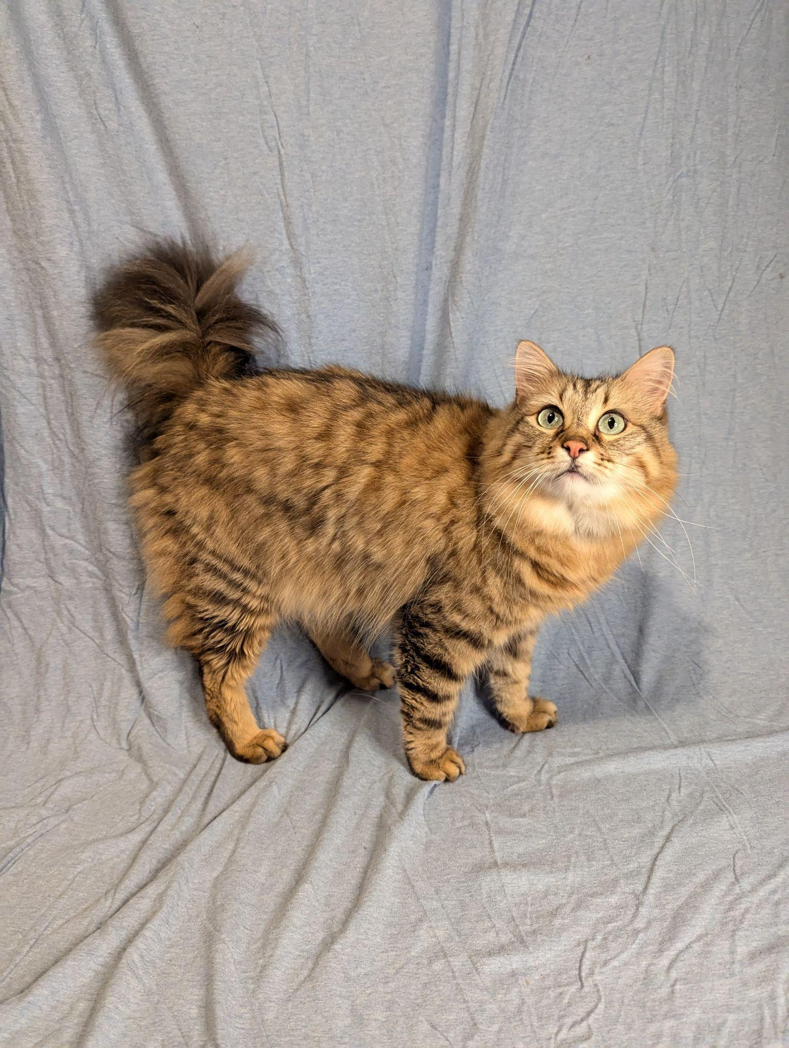
Not dilute, not colorpoint, mackerel (322)

Slide 30
Variants from the literature (OMIA)
site_names = {
('chrD1', 44013031): 'siamese',
('chrD1', 44022819): 'burmese',
('chrA3', 24831082): 'agouti',
('chrA1', 94477275): 's59x',
('chrA1', 94536796): 'w841x',
('chrC1', 218197447): 'dilute',
('chrB1', 40428846): 'a18v',
('chrB1', 40429492): 'c63y',
('chrD4', 38142265): 'chocolate',
('chrD4', 38130163): 'cinnamon'
}

Slide 31
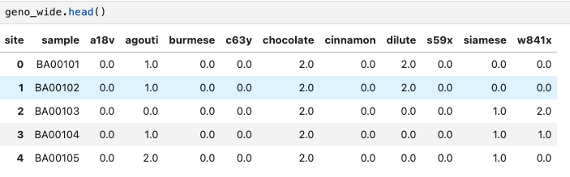
Building phenotype table from genotype
Bcftools used to return genotype per site per cat
Map genotype to allele count
Pivot so each cat has its own row with allele counts for all sites

Slide 32
Using rules from the literature, assign phenotype
Example: To classify the tabby pattern
  If homozygous at one variant or heterozygous at two variants, then classify as ‘Blotched’
  This designation can be overridden by ‘Ticked’ alleles

Slide 33
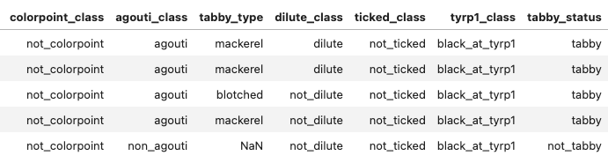
Classify cats according to their genotype

Slide 34
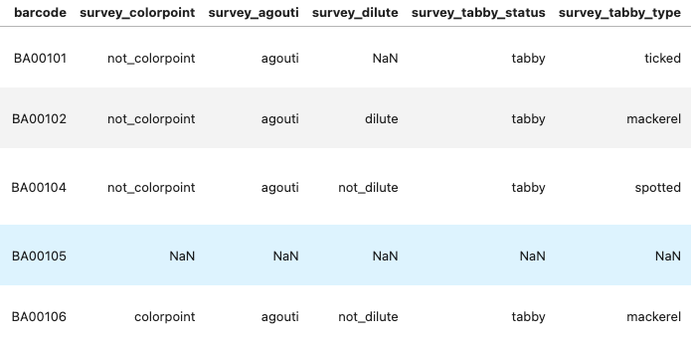
Classify cats according to their owner’s survey

Slide 35
Colorpoint
Colorpoint variant acts independently of other traits

Slide 36
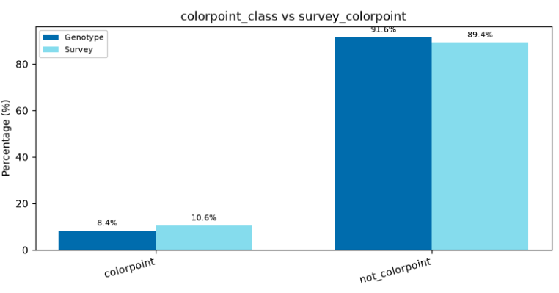
Colorpoint
Overall discordance: 3.8%

Slide 37
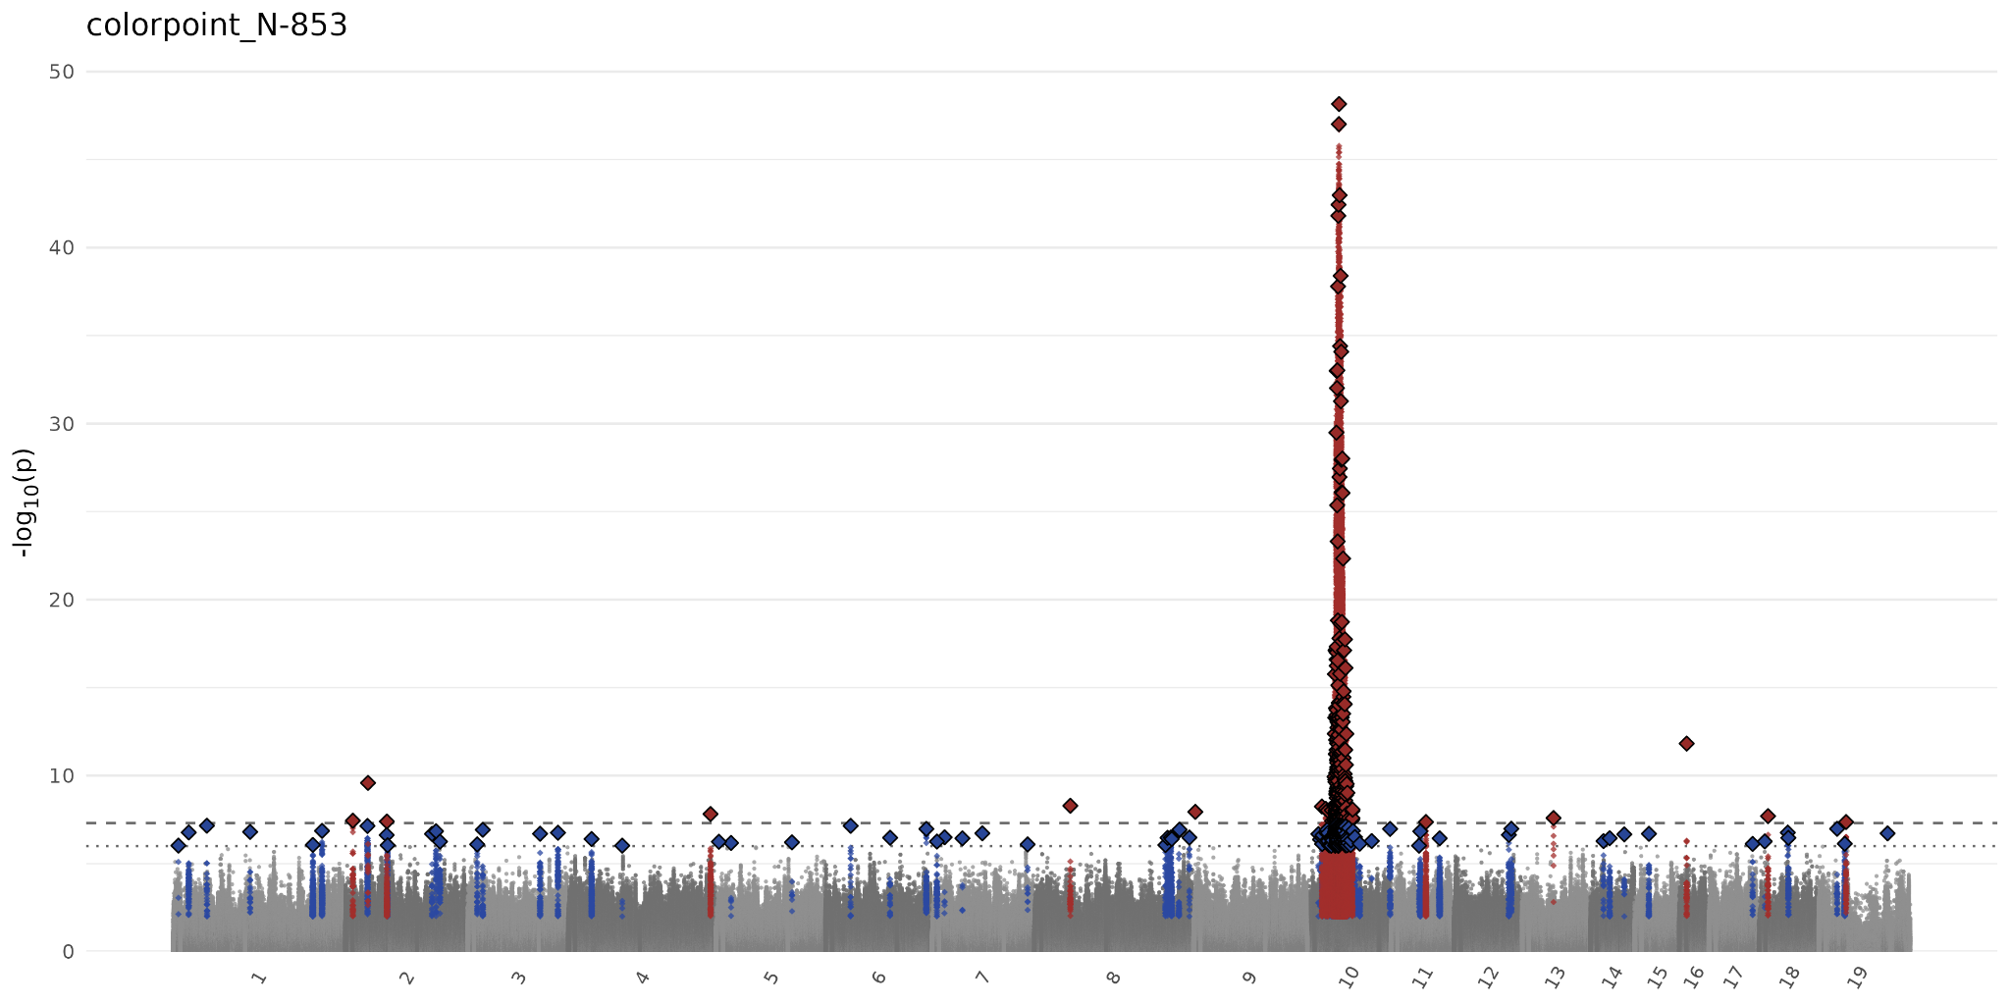
Darwin’s Ark colorpoint GWAS

Slide 38
Dilute
Dilute variant acts independently of other traits

Slide 39
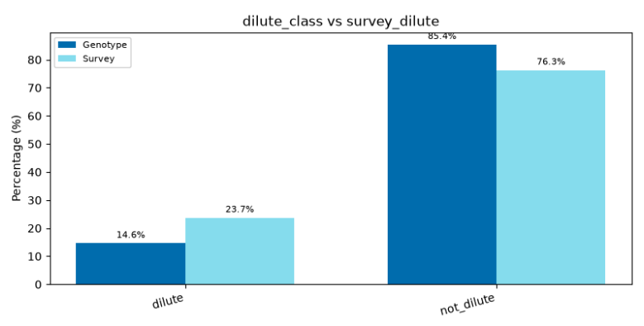
Dilute Concordance
Overall discordance: 14.0%

Slide 40
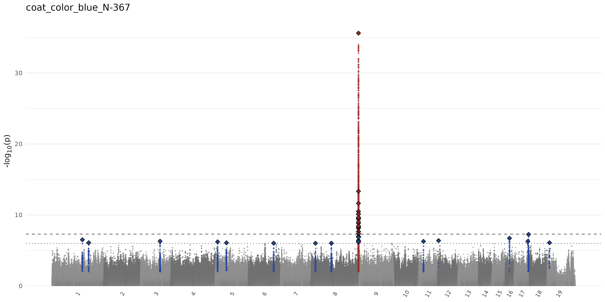
Darwin’s Ark dilute GWAS (blue)

Slide 41
Agouti/nonagouti (Tabby status)
Describes the individual hairs on a cat

Slide 42
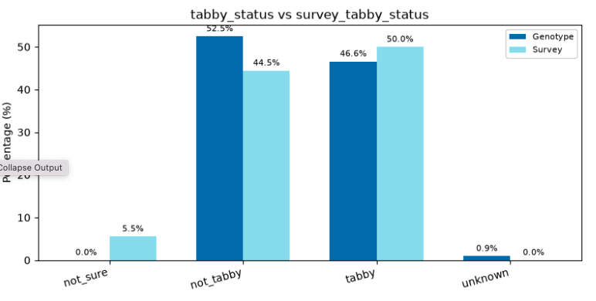
Tabby status
Overall discordance: 17.8%

Slide 43
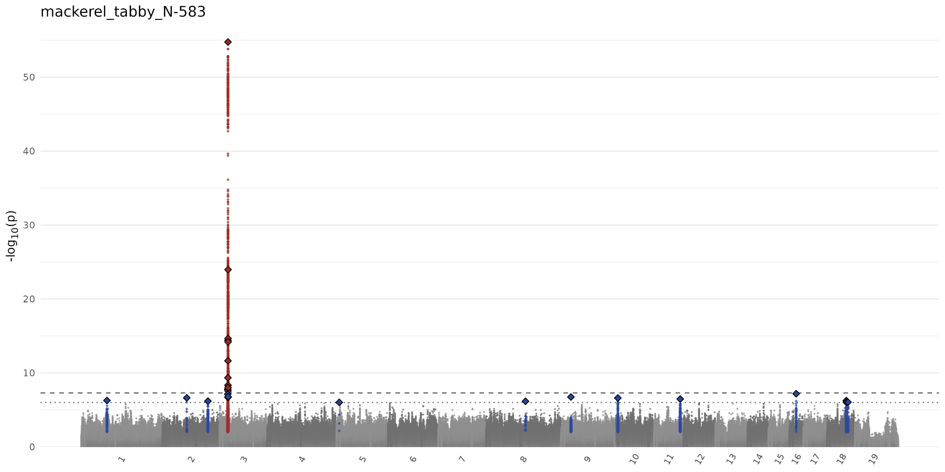
Darwin’s Ark tabby GWAS

Slide 44
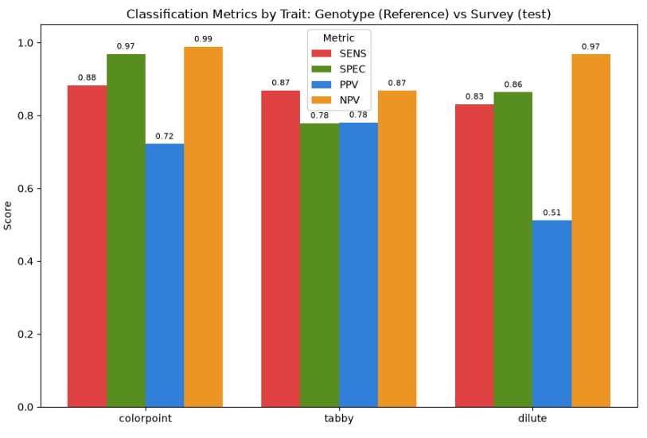
Metrics for colorpoint, agouti, dilute

Slide 45
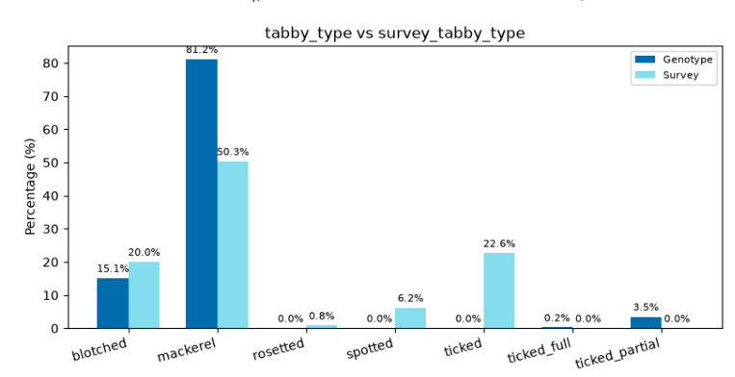
Tabby type discordance
Overall discordance: 17.8%
Overall discordance: 29.8%

Slide 46
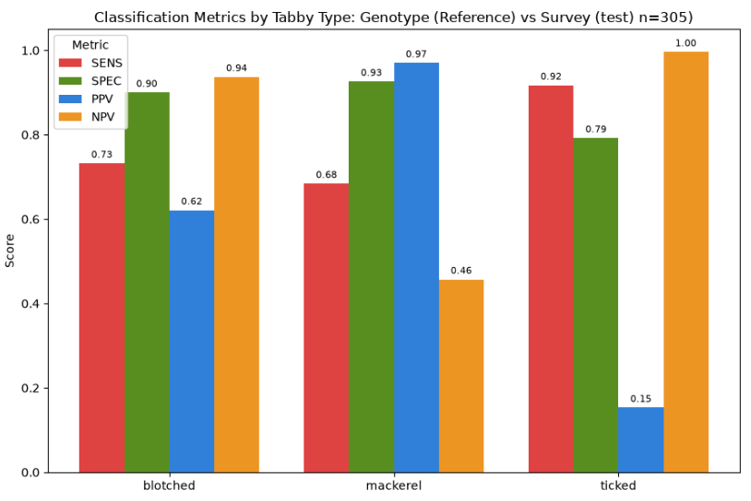
Metrics for tabby type

Slide 47
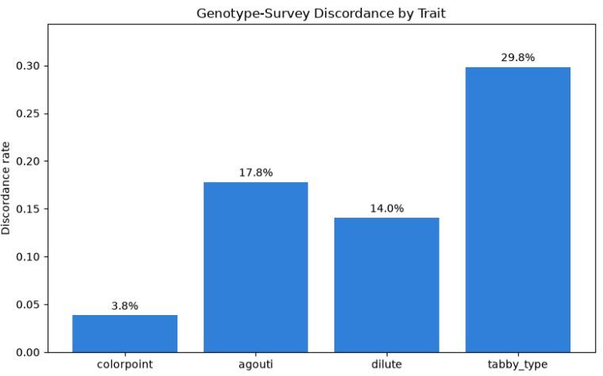
Genotype-Survey Discordance

Slide 48
What does the Darwin’s GWAS have to say . . .?

Slide 49
Coming soon

Slide 50
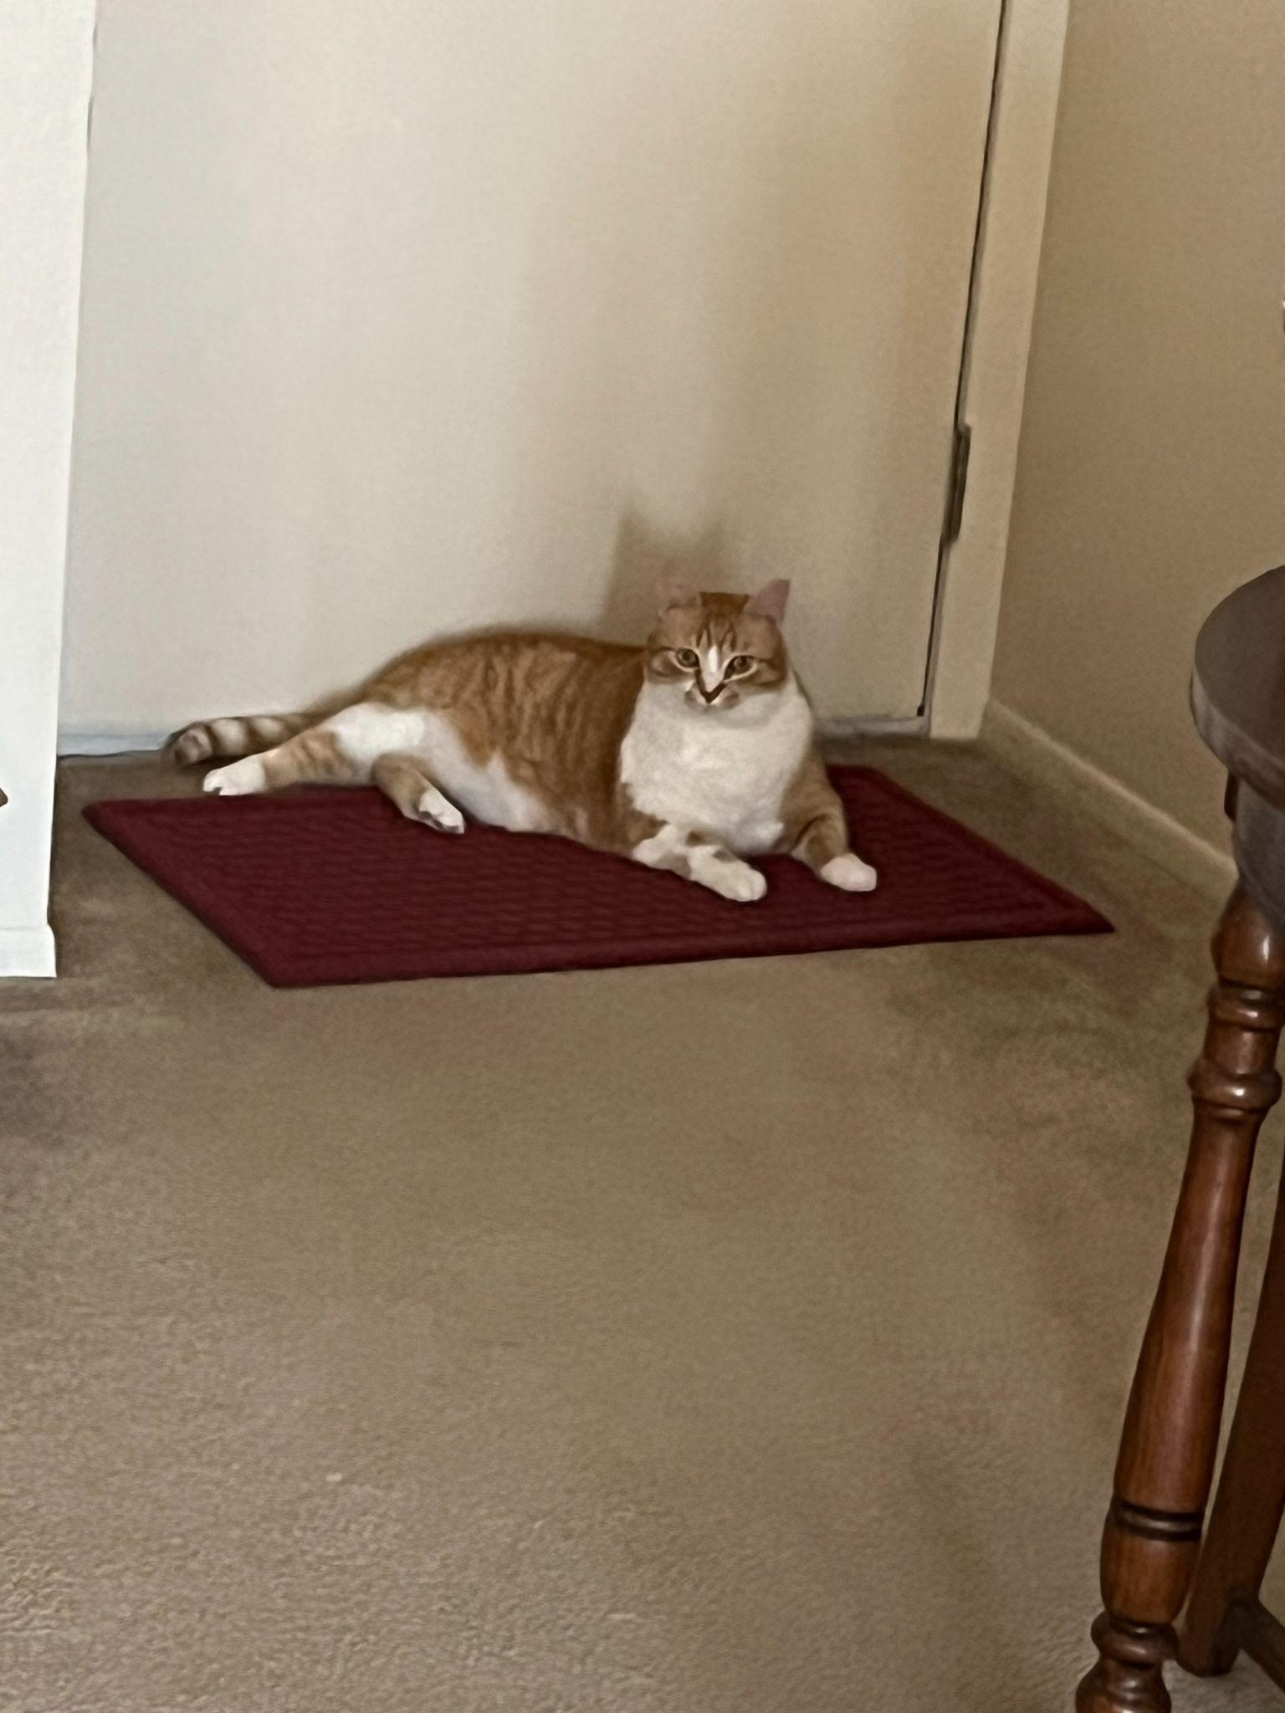
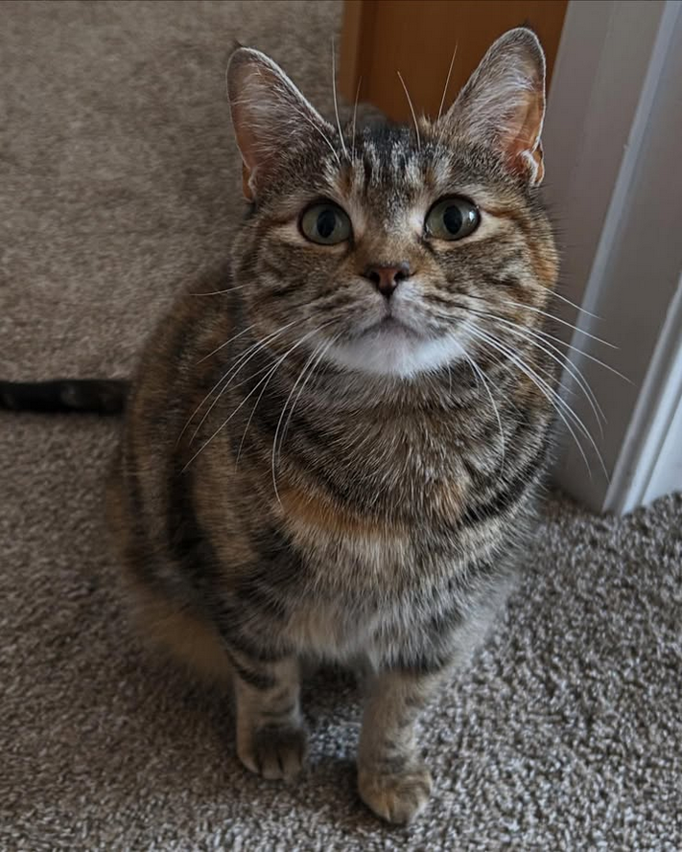
Diving in to the Ticked discrepancy
61 owners called their cat ‘Ticked’ when the genotype said ‘Mackerel’ or ‘Blotched’
Owner misclassification ⇒
Mackerel
Classic (“Blotched”)

Slide 51
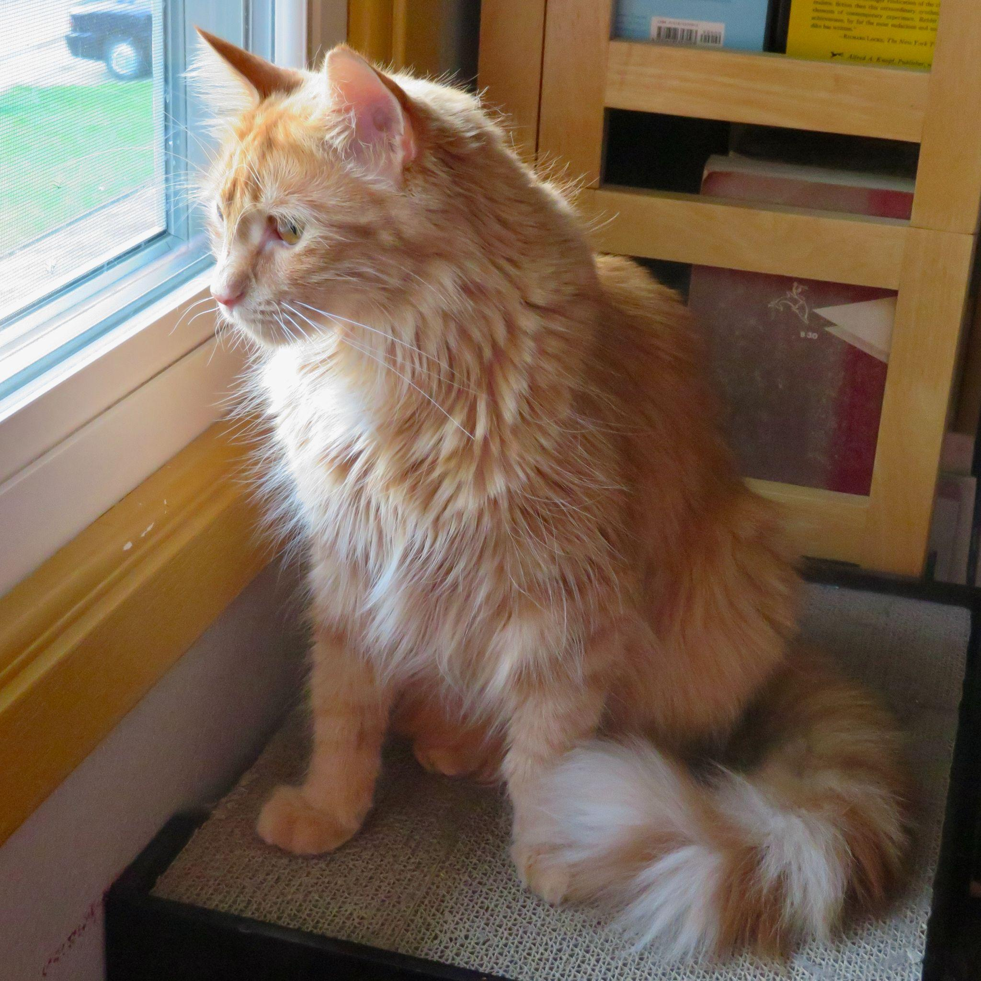
Diving in to the Ticked discrepancy
Orange cats

Slide 52
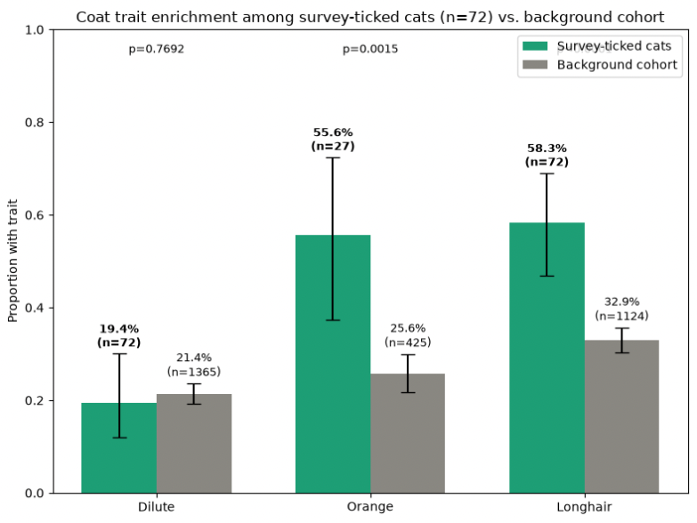
Ticked cats are enriched with risk factors

Slide 53
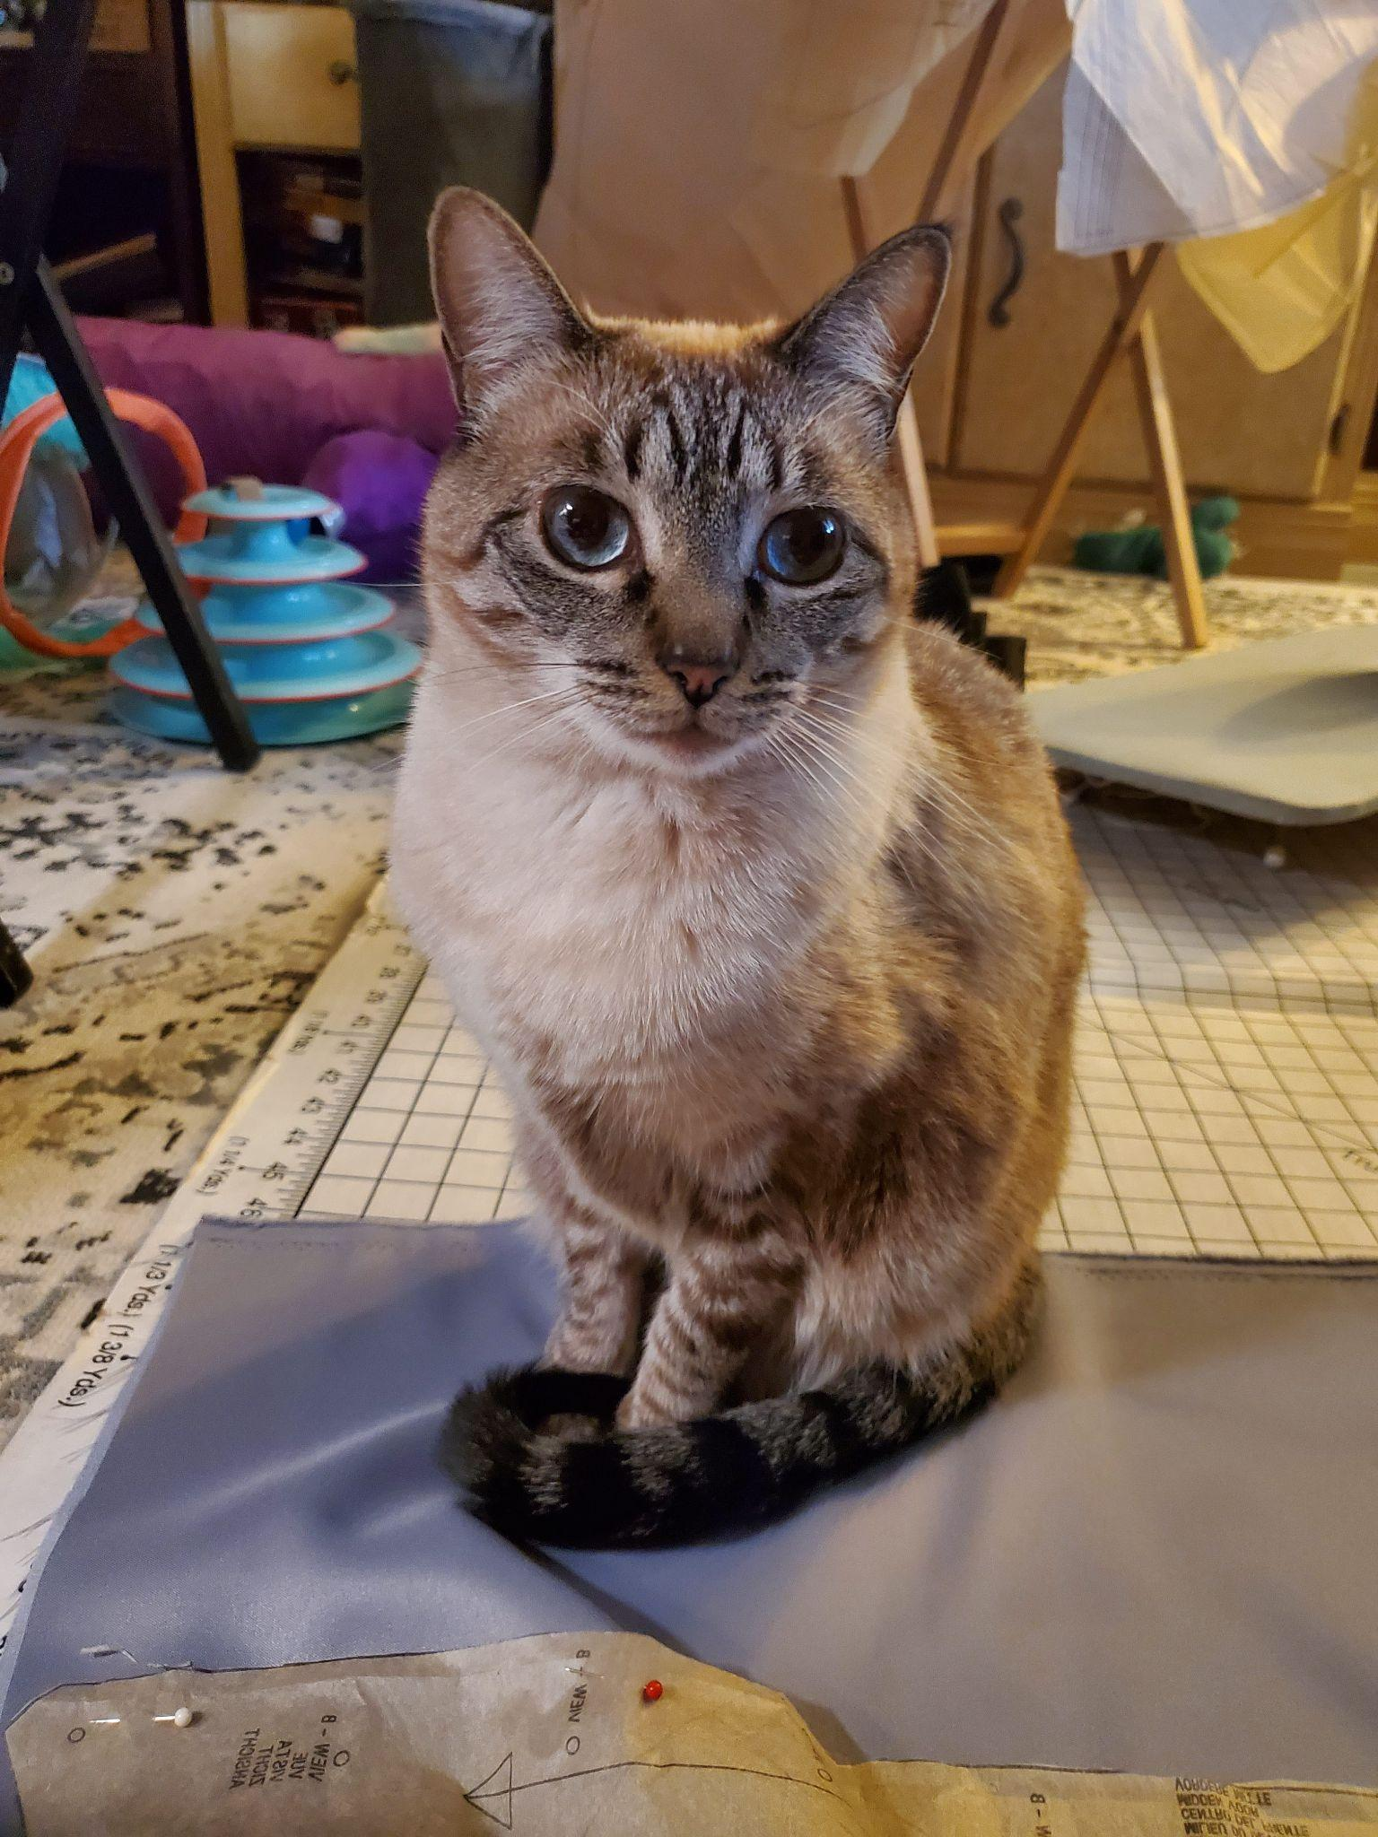
Diving into the Ticked discrepancy
Some tougher calls
Colorpoint mackerel

Slide 54
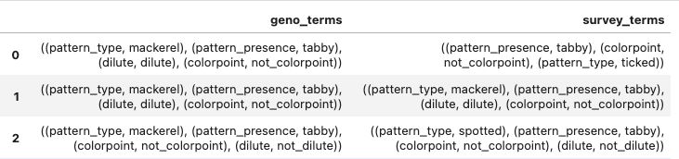
Discordance in general
Another way to compare: Sets of traits from genotype and from survey

Slide 55
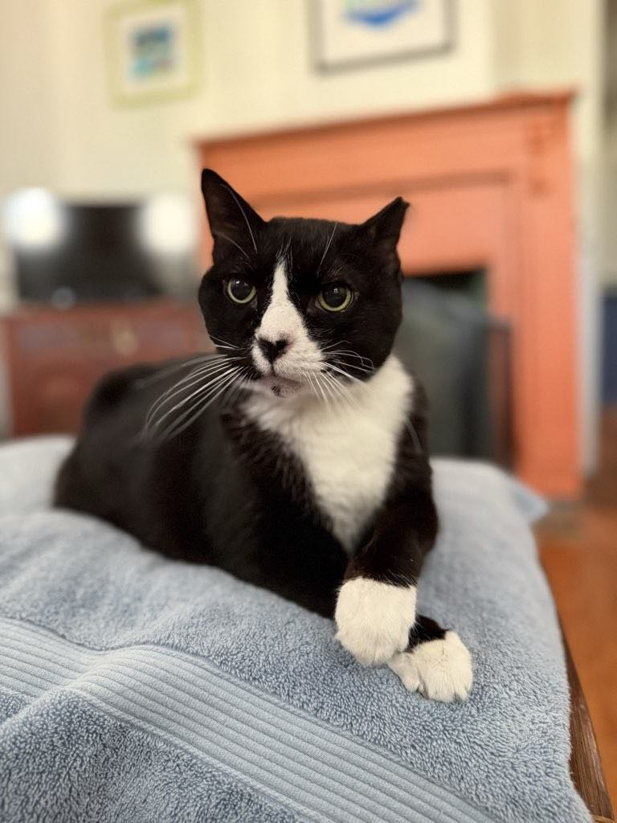
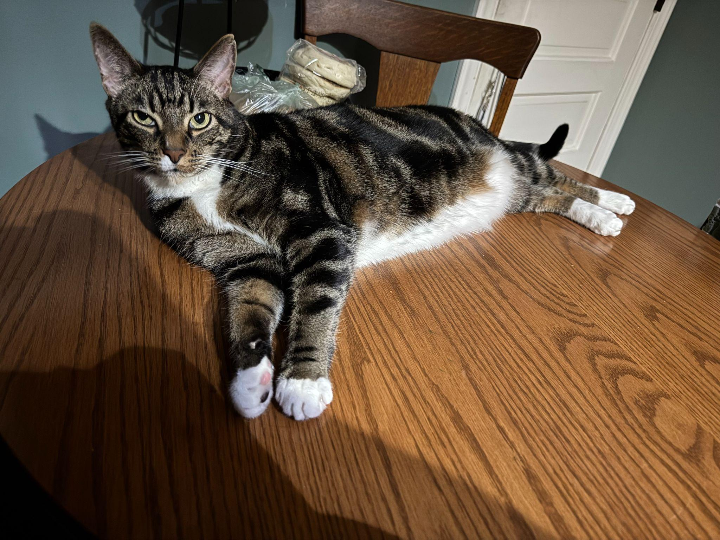
Total agreement (Easy cats)

Slide 56
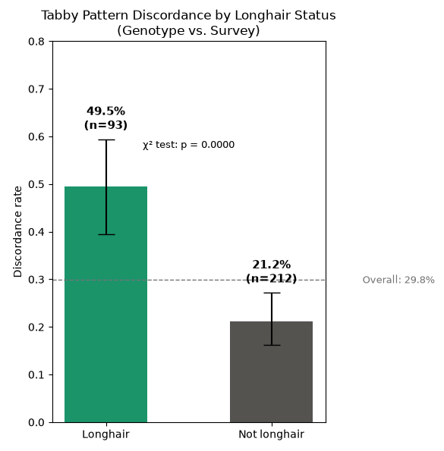
Longhair coat length predicts genotype-survey discordance
(in 305 cats with tabby type and survey tabby type not missing)

Slide 57
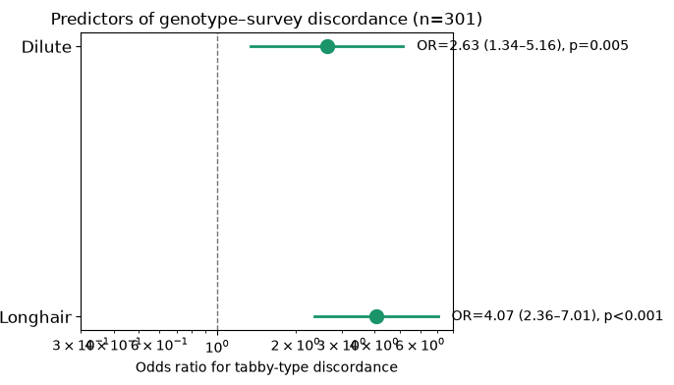
Longhair cats have 4.1× the odds of genotype-survey discordance
(in 305 cats with tabby type and survey tabby type not missing)

Slide 58
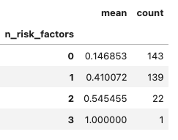
Risk factors: “Longhair”, “Dilute”, “Orange”
Discordance increases with additional risk factors.

Slide 59
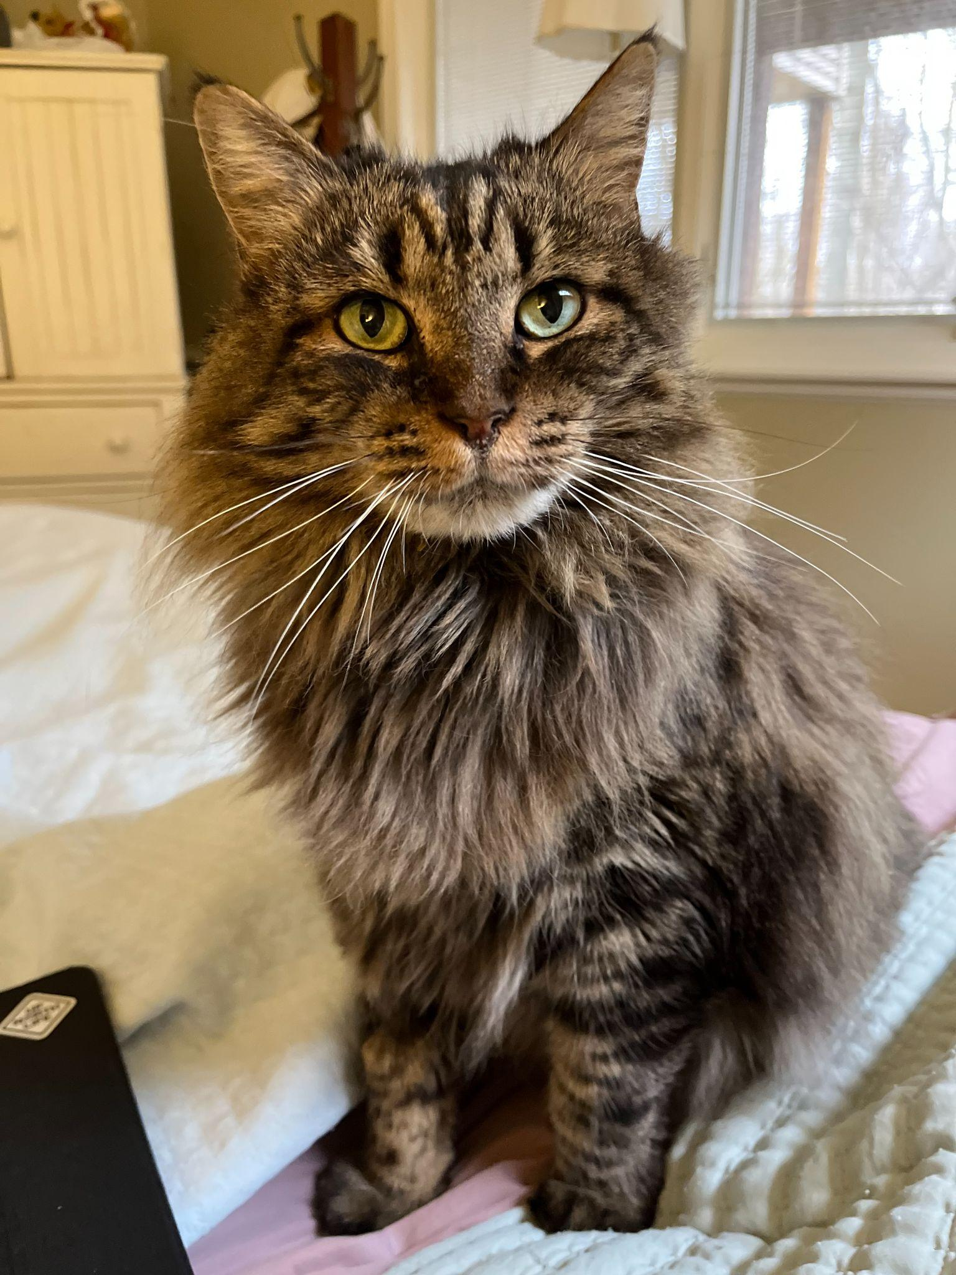
Two mismatches (Difficult cats)
GENOTYPE: Not dilute, not colorpoint, mackerel tabby
SURVEY: Dilute, not colorpoint, ticked tabby

Slide 60
Key Takeaways
Survey takers may need more help answering some of the toughest questions on cat coat description (e.g., example photos)
Darwin’s Ark has replicated and validated much of the literature on cat coat phenotypes
Darwin’s Ark will be crucial to validate tabby patterns as well as to explore them further
The Darwin’s Ark model works!

