Slide 1
Adopting Agile
Colin Knebl, Agile Consultant
Notes:
Hello, my name is Colin Knebl, and I am your agile consultant here to help your company implement the agile development methodology!

Slide 2
What we are going to cover
What is waterfall?
What is agile?
The problem with waterfall
Implementing agile
How to build successful agile teams
How agile will benefit ACME Corp.

Slide 3
What is Waterfall?
Linear, sequential approach to the software development
Steps do not overlap
Clearly defined milestones and
Easy management
Notes:
Waterfall is a linear and sequential approach to software development
Steps do not overlap, and there is typically a signoff at the end of each step prior to beginning the next step of the waterfall
There are clear milestones and deadlines
Because of the clearly defined schedule and deadlines, this makes for simple management over the project lifecycle

Slide 4
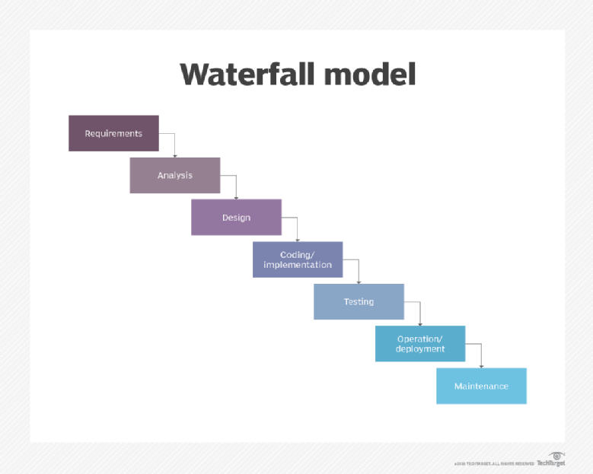
Notes:
Waterfall is a sequential process with each successive step beginning once the current step is completed.
Going back to previous steps is very costly if not impossible.
Non-overlapping steps
Requirements
Analysis (not pictured)
Design
Coding/Implementation
Testing
Operation/Deployment (not pictured)
Maintenance

Slide 5
What is Agile?
Definition
Agile Manifesto
4 Core values
12 Principles
Notes:
Definition: adjective - able to move quickly and easily
- Within software development, it is an umbrella term for a set of frameworks and practices based on the values and principles expressed in the Agile Manifesto and the 12 Principles behind it.
Agile Manifesto
Core values
Individuals and interactions over processes and tools
Working software over comprehensive documentation
Customer collaboration over contract negotiation
Responding to change over following a plan
Principles:
Our highest priority is to satisfy the customer through early and continuous delivery of valuable software.
Welcome changing requirements, even late in development. Agile processes harness change for the customer's competitive advantage.
Deliver working software frequently, from a couple of weeks to a couple of months, with a preference to the shorter timescale.
Business people and developers must work together daily throughout the project.
Build projects around motivated individuals. Give them the environment and support they need, and trust them to get the job done.
The most efficient and effective method of conveying information to and within a development team is face-to-face conversation.
Working software is the primary measure of progress.
Agile processes promote sustainable development. The sponsors, developers, and users should be able to maintain a constant pace indefinitely.
Continuous attention to technical excellence and good design enhances agility.
Simplicity--the art of maximizing the amount of work not done--is essential.
The best architectures, requirements, and designs emerge from self-organizing teams.
At regular intervals, the team reflects on how to become more effective, then tunes and adjusts its behavior accordingly.

Slide 6
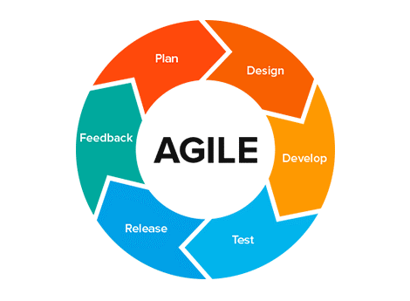
Notes:
Agile has similar steps to the waterfall method, but the separator is how those steps are implemented.
As you can see in the diagram, agile is a cyclical and iterative process.

Slide 7
The Problem with Waterfall
It is not an ideal model for a large size project
Trouble with unclear guidelines
Difficult moving backward
Testing after development
No feedback during development from users and other stakeholders
Little to no flexibility built into the process
Notes:
How waterfall tactics sometimes lead to failure
- It is not an ideal model for a large size project with changing requirements
- If the requirements are not clear at the beginning, it is a less effective method.
- Very difficult to move back to makes changes in previous phases. It can be thought of as a one way street, you can’t go backward to previous phases once they are completed. Or a waterfall, water only flows one direction.
The testing process starts once development is over. As a result, chances are high for bugs to be found once development is finished where they are expensive to fix. Additionally, a bug found at this point may shed light on a problem with the architecture of the application which can be very time consuming and costly to fix.
Software is not shipped to the customer until the end of the product life cycle. This could result in software that does not meet the customer’s requirements.
- Inflexible – there is very little wiggle room to adjust to changes in requirements

Slide 8
Implementing Agile
Types of agile
Scrum
KanBan
Extreme Programming (XP)
Terms
Product Owner
Scrum Master
User Stories
Backlog
Sprint planning
Sprints
Retrospective
Notes:
Different types of agile - differing ways of implementing the principles in the manifesto
Product Owner: sets the vision for the product
Scrum Master: facilitator for an agile development team
User Stores: A way of expressing work that needs to be done, Typical format: a <type of user>, I want <some goal> so that <some reason>.
Sprint planning: a meeting conducted at the beginning of each sprint where user stories from the backlog are added to the sprint backlog. Each story moved from the product backlog to the sprint backlog is a commitment by the team to complete that user story
Backlog: What needs to be done to build the product, a collection of user stories
Sprints: time boxed durations of work, typically 1-4 weeks
Retrospective: A meeting conducted at the end of each sprint for the purposes of identifying ways in which the team can improve and be more productive in future sprints.

Slide 9
Steps to implement Agile
Step 1: Set your vision with a strategy meeting
Step 2: Build out your product roadmap
Step 3: Create a release plan
Step 4: Plan the sprints
Step 5: Conduct daily standups
Step 6: It’s time for a review
Step 7: What’s next? Decide what to focus on in your sprint retrospective
Step 8: Repeat steps 4 - 7
Notes:
Step 1: Set your vision with a strategy meeting
Step 2: Build out your product roadmap – this is the product backlog, should be prioritized from most important to least
Step 3: Create a release plan – set a tentative launch date
Step 4: Plan the sprints
Step 5: Conduct daily standups
Step 6: It’s time for a review
Step 7: What’s next? Decide what to focus on in your sprint retrospective
Step 8: Repeat steps 4 - 7

Slide 10
Building Agile Teams
Stages
Forming
Storming
Norming
Performing
Remember, building an agile team takes time
Notes:
There are different stages of building agile teams
Stages
Forming: assemble team members and focus on defining and assigning tasks, establishing a schedule, and organizing the team’s work. May include ice breaker activities if the team members do not know each other
Storming: after a team has spent some time together, issues are sure to arise. This stage is all about brainstorming ideas to find solutions to the issues they have
Norming: focus on developing shared values and determining ways to best work together
Performing: this is the goal of each scrum team. team members understand each other’s strengths and weaknesses, and communicate effectively among each other
This is not a quick process, so be patient!

Slide 11
Agile and ACME Corp.
Stakeholder Engagement
Transparency
Early and Predictable Delivery
Flexibility
Focuses on Business Value
Improves Quality
Focuses on Users
Faster time to market
Notes:
Why would agile be beneficial to his company and How agile works to drive those benefits
Stakeholder Engagement
Agile provides multiple opportunities for stakeholder and team engagement – before, during, and after each Sprint. One of the goals of agile is to deliver working software early and frequently. This gives stakeholders the ability to shape the product as it matures.
Transparency
Similar to the previous point, agile allows clients to be involved from the very beginning of the project.
Early and Predictable Delivery
Agile operates in time-boxed iterations called sprints, typically lasting between 1-4 weeks (2 being the most common length). This can also allow for early releases of the software if it creates business value before originally projected.
Flexibility
Because of the sprints, the team only commits to a couple of weeks at a time. At the end of each sprint the team pulls in new stories to work on. These stories can be reprioritized at any time allowing for flexibility in the development process
Focuses on Business Value
Clients and other stakeholders determine how features are prioritized. This gives the team insight into what stakeholders want to see in the product.
Improves Quality
In agile, there is high priority placed on testing and quality assurance. The frequency of builds/releases allows for finding and fixing defects quickly and identifying features that don’t meet expectations.
Focuses on Users
As demonstrated by many of the benefits, agile focuses on the user. Using user stories is one way the team keeps the user at the forefront.
Faster time to market
Agile will allow ACME Corp to release their products and features in less time which will increase both revenue and customer satisfaction.

Slide 12
Questions?
Notes:
Why would agile be beneficial to his company and How agile works to drive those benefits
Stakeholder Engagement
Agile provides multiple opportunities for stakeholder and team engagement – before, during, and after each Sprint. One of the goals of agile is to deliver working software early and frequently. This gives stakeholders the ability to shape the product as it matures.
Transparency
Similar to the previous point, agile allows clients to be involved from the very beginning of the project.
Early and Predictable Delivery
Agile operates in time-boxed iterations called sprints, typically lasting between 1-4 weeks (2 being the most common length). This can also allow for early releases of the software if it creates business value before originally projected.
Flexibility
Because of the sprints, the team only commits to a couple of weeks at a time. At the end of each sprint the team pulls in new stories to work on. These stories can be reprioritized at any time allowing for flexibility in the development process
Focuses on Business Value
Clients and other stakeholders determine how features are prioritized. This gives the team insight into what stakeholders want to see in the product.
Improves Quality
In agile, there is high priority placed on testing and quality assurance. The frequency of builds/releases allows for finding and fixing defects quickly and identifying features that don’t meet expectations.
Focuses on Users
As demonstrated by many of the benefits, agile focuses on the user. Using user stories is one way the team keeps the user at the forefront.
Faster time to market
Agile will allow ACME Corp to release their products and features in less time which will increase both revenue and customer satisfaction.

