Slide 1
4/29 meeting
AR 眼鏡

Slide 2
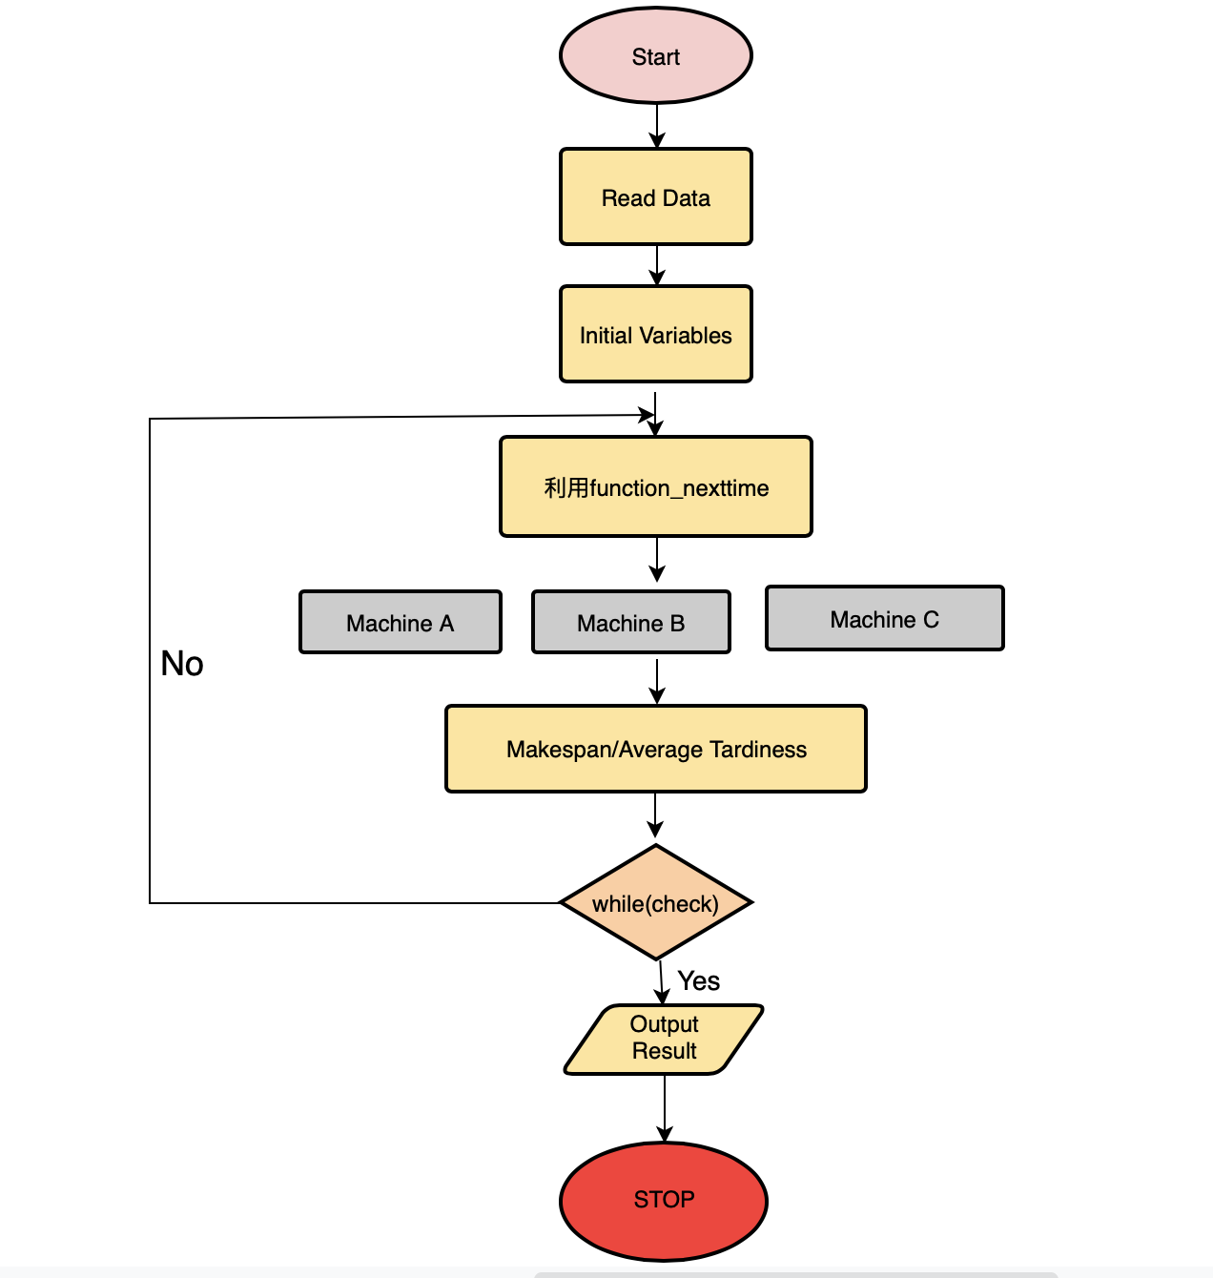
Flow Chart
Notes:
Check 裡面有Wholelist job 1-7 若空結束 非空未結束

Slide 3
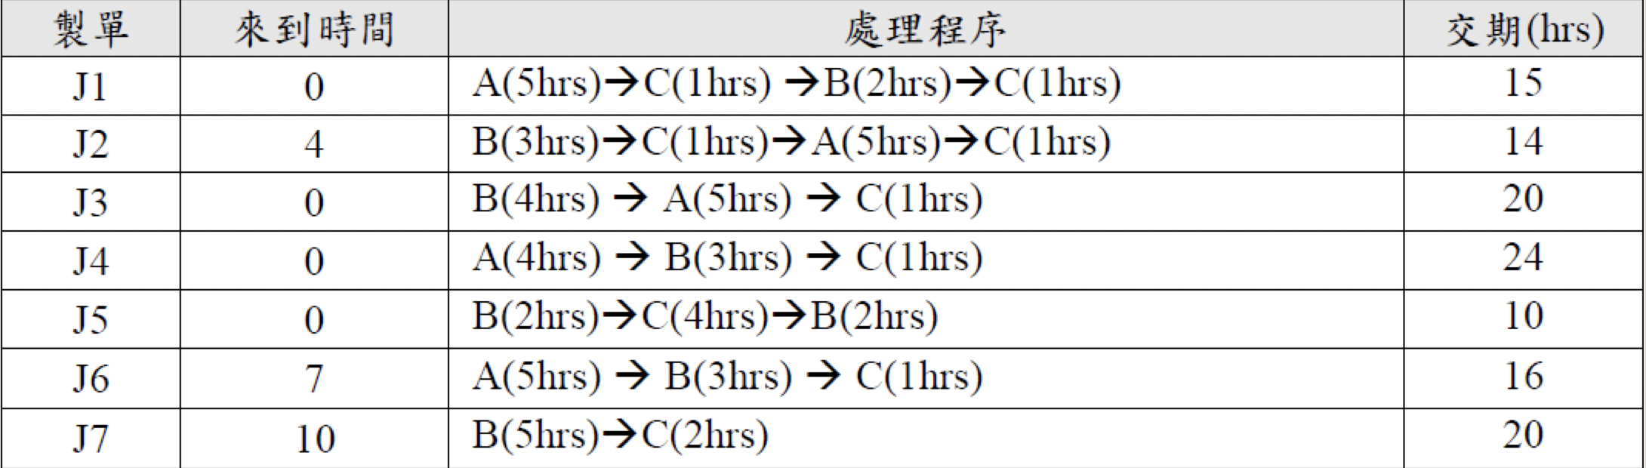
Ｅ
Arrival Event
Time
Event Type
A_Buffer
B_Buffer
C_Buffer
J3
J5
J1
J4
Machine A
Machine B
Machine C
0 hour
Future Event List
Event type | Time
Arrival | 4
A_Complete | 4
B_Complete | 2
C_Complete | 0

Slide 4
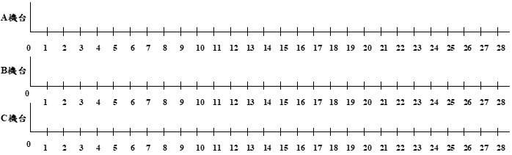
J4
J5
TNOW

Slide 5
Ｅ
Arrival Event
Time
Event Type
A_Buffer
B_Buffer
C_Buffer
J1
J4
J3
J5
J5
Machine A
Machine B
Machine C
2 hour
0
A_Complete | 4
B_Complete | 6
C_Complete | 6
Arrival
4

Slide 6
J4
J5
J3
J5
TNOW

