Slide 1
Hopscotch Hashing
Kenneth Xu and Colin Man

Slide 2
Brief Introduction
Hash Tables want to support insert(), remove(), and lookup()
Two general strategies:
Chained Hashing
Strict buckets
Multiple elements per bucket
Examples: Chaining, Second-Chance
Open Addressing
Looser constraints on where an element can be
At most one element per bucket
Examples: Linear Probing, Cuckoo, Robin Hood

Slide 3
What is Hopscotch Hashing?
Alternative Open-Addressing solution
Uses a circular array
2008 – Maurice Herlihy, Nir Shavit, and Moran Tzafrir
Targeted towards today’s cache-sensitive machines
Attempts to minimize the number of cache misses
Borrows techniques from chaining, linear probing, and cuckoo hashing
Yet also has important similarities with Robin Hood Hashing!
Works well even with high load factors (>90%)

Slide 4
Distinguishing Idea
Virtual overlapping buckets called neighborhoods
Fixed constant size H
Every bucket i has its own neighborhood
Extends over the inclusive range [i, i + H – 1]
This means that each bucket:
Can belong to H different neighborhoods
Starts its own own neighborhood range
Neighborhoods are a relaxation of strict buckets
Every element belongs to a single unique neighborhood starting at h(x)
Strict constant bound H on search time!
Elements belonging to the same neighborhood MUST have hashed to the same original index

Slide 5
Important Nuance
Because they are overlapping, neighborhoods will “pollute” each other
Every inserted element takes up a space in H different neighborhoods
A neighborhood range can be completely full, but not the neighborhood itself
How do we fix this?
We can freely shift elements within their neighborhoods!
This preserves our neighborhood invariant
“Hop” empty slots backwards…

Slide 6
Insertion
If x is inserted and there exists an empty slot within H-1 buckets downstream from h(x):
We can safely insert x because it is still in the correct neighborhood
Otherwise the nearest empty slot is too far downstream from h(x):
We must bring that empty slot back to the correct neighborhood!

Slide 7
Bringing Empty Slot Home
Find some intermediate neighborhood that:
Encompasses the empty slot
Contains an element located upstream of the empty slot
Swap the empty slot and that upstream element!
The upstream element stays in the same neighborhood
The empty slot moves upstream, closer to the target neighborhood
Repeat until the empty slot reaches the target neighborhood
If the intermediate neighborhood does not exist, resize and rehash
Happens when a neighborhood is full (has H elements already)

Slide 8
Contains and Remove
Simply have to search the neighborhood starting at h(x) for the element
How does a neighborhood keep track of its elements?
Two approaches – for each bucket, store:
A bitmap of length H -> 0011
A small offset to next element in the neighborhood
Slightly more efficient memory-wise with bigger H’s

Slide 9
DEMO!

Slide 10
Efficiency
Easily parallelizable design
Every neighborhood carries a lock
Because elements hashed to the same bucket are guaranteed to be within H of each other
Higher chance of a neighborhood being on the same cache line
Fewer cache misses

Slide 11
Runtime Analysis
Contains and Remove run in expected constant time
Need to search up to H elements, a constant
Want to keep probability of rehash low, so how large should H be?

Slide 12
Analogy To Chaining
E[# elements in a neighborhood] =
E[# elements in a chaining bucket]
Hopscotch Hashing:
Elements in the same neighborhood have hashed to the same index
Chaining:
Elements chained in the same bucket have hashed to the same index
Can use chaining proofs:
So expected number of elements per neighborhood is constant
Probability of a neighborhood filling up is 1/H! [Knuth, 1998]
Incredibly small: 1/32! < 10^-30

Slide 13


Runtime Analysis (CONT.)
Insertion bounded by the linear probing time
Because and the 1/H! probability
Expected number of entries to probe:
Which is a constant!

Slide 14
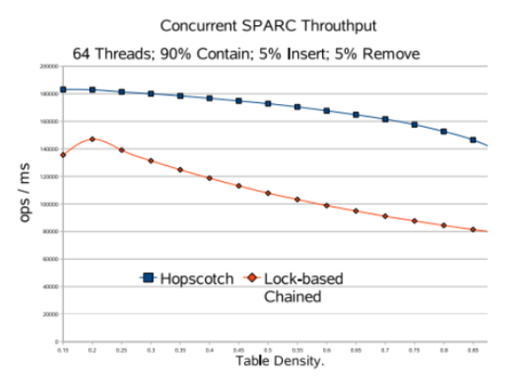
Original Results
Concurrent Comparison
Against Lock-based Chaining – the fastest concurrent solution at the time

Slide 15
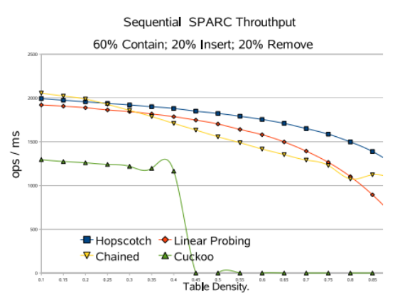
Original Results
Sequential Results

Slide 16

Our Experiment
Concurrent Implementation
Higher number of threads exploded the runtime
Synchronization cost high

Slide 17
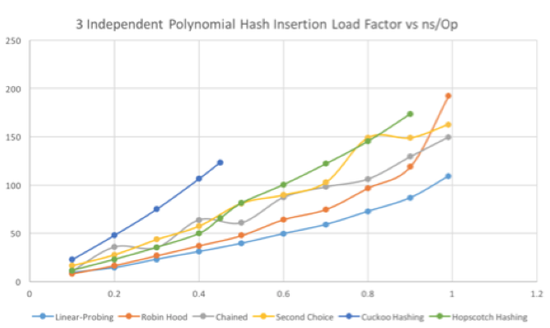
Our Experiment
Sequential Comparison: Insertion

Slide 18
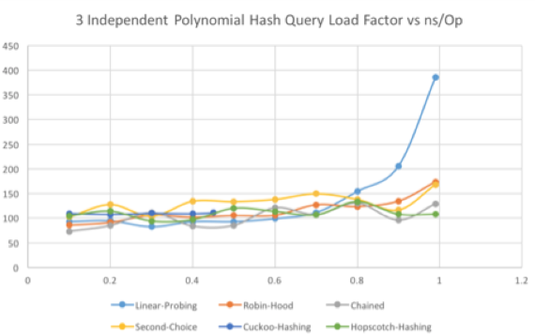
Our Experiment
Sequential Comparison: Query

Slide 19
Conclusion
Unable to observe a “cache-boost”
Implementation may be more nuanced than described, especially with concurrence.
Query times appear to be unaffected by load factor

