Slide 1
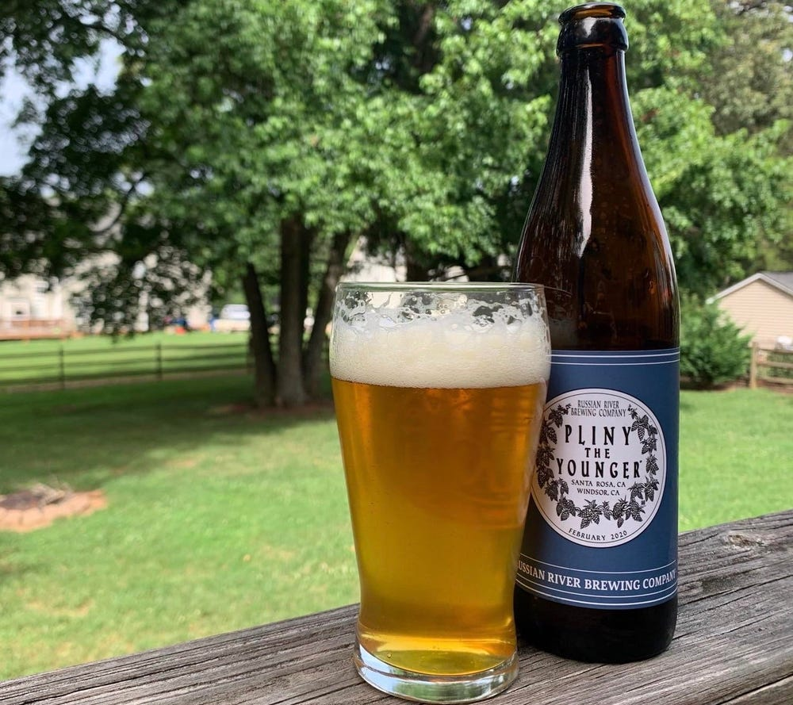
Beer Review Analysis & Recommendation System
Colin McMorrow

Slide 2
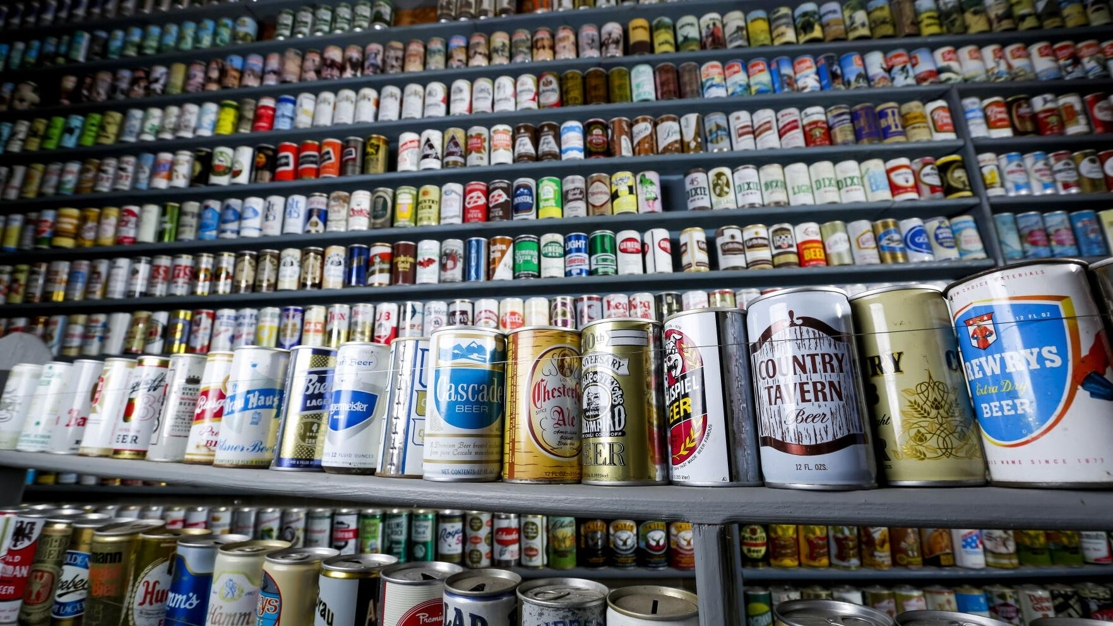
Objective / Motivation
Enormous variety of beers, brewers and styles available worldwide
Some brewers have hundreds
Many new alcoholic beverage services emerging
Delivery, beer clubs, etc.
With so many to choose from, having a successful recommendation engine can be the difference in retaining customers

Slide 3
Project Design
Data Souce:
RateBeer.com (credit Julian McAuley, UCSD)
Clean and vectorize text data from each review
Reduce vectorized text into digestible themes using topic modeling
Tune parameters to maximize completeness of topics
Pair numerical topic information with details and ratings of each beer
Construct a content-based recommendation system for beers with similar qualities

Slide 4

The Data
10000 reviews
User
Beer
Brewer IDs
Styles
ABV
Review
Ratings:
Overall
Aroma
Taste
Appearance
Palate

Slide 5
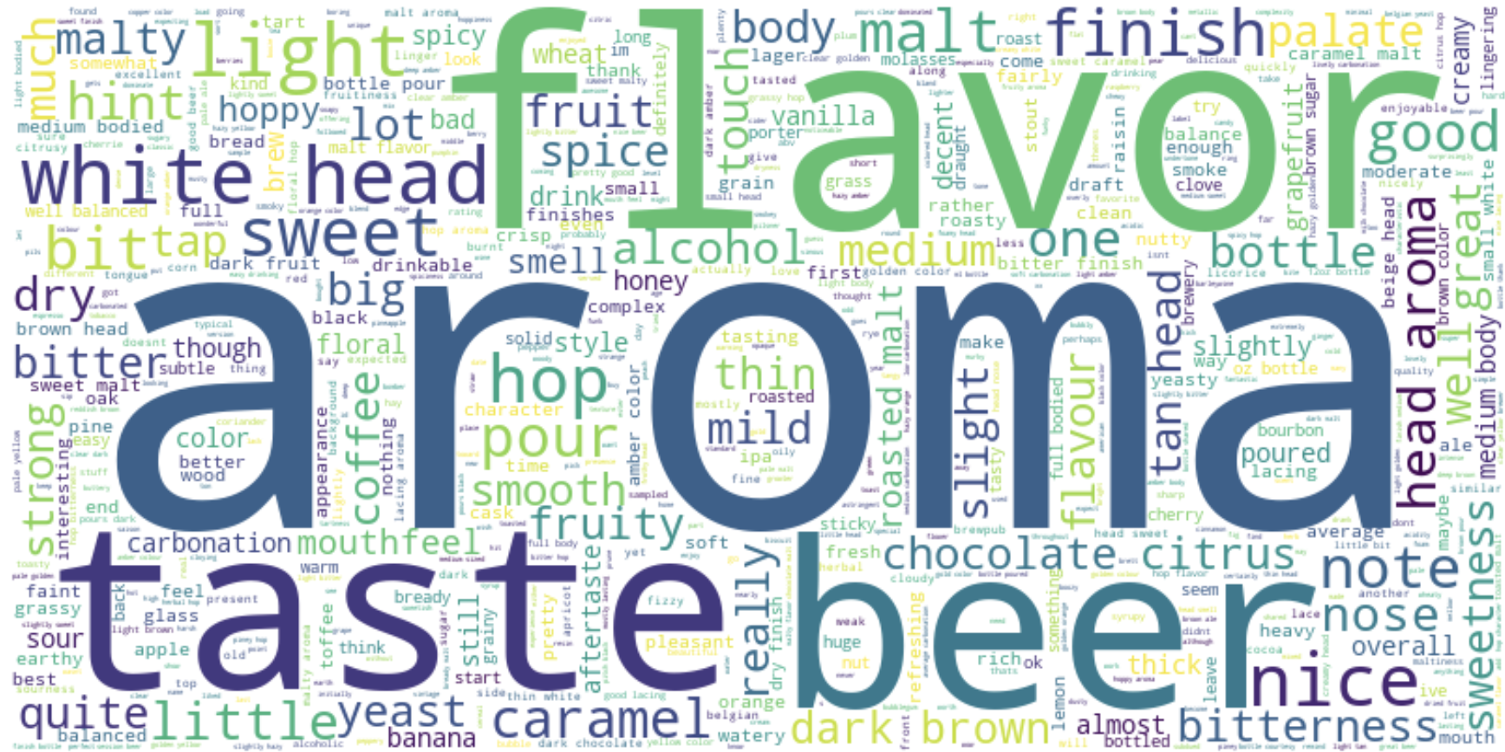
Reviews Analysis
Cleaned, stemmed, and removed non-semantic words
Parts of speech:
Noun, Verb, Adjective, Adverb
Removed low frequency words to limit misspelled terms

Slide 6


Topic Modeling (LDA)
Trained topic model using Latent Dirichlet Allocation (LDA)
Tuned model until topics began to make sense
Started with 20 topics
Added common bigrams
Set limits on min and max frequency

Slide 7
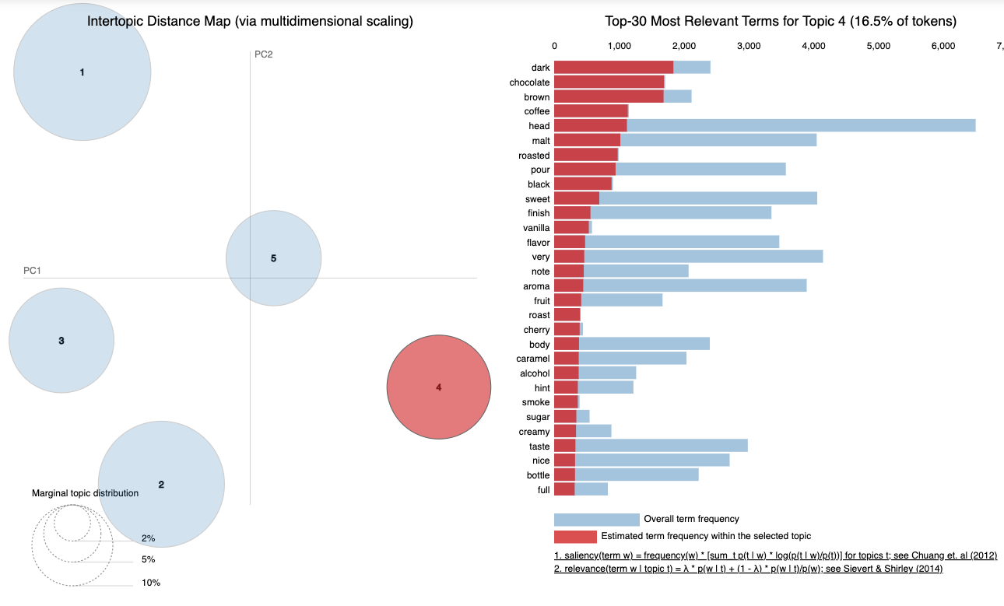
Topic designated as “dark”
Most distinguished topic
Low overlap with others

Slide 8
Final Topics & Base Words
Darkness
‘dark’, ‘chocolate’, ‘brown’, ‘coffee’, ‘roasted’, ‘sweet’
Body
‘light’, ‘medium’, ‘head’, ‘white’, ‘finish’, ‘pour’
Hoppiness
‘hop’, ‘nice’, ‘head’, ‘malt’, ‘bitter’, ‘hoppy’, ‘amber’
Sweetness
‘head’, ‘hop’, ‘fruit’, ‘sweet’, ‘caramel’,
Quality
‘beer’, ‘taste’, ‘flavor’, ‘good’, ‘bad’

Slide 9
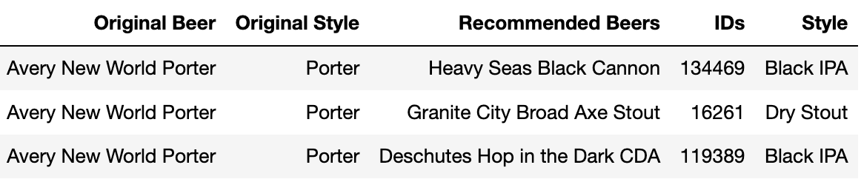
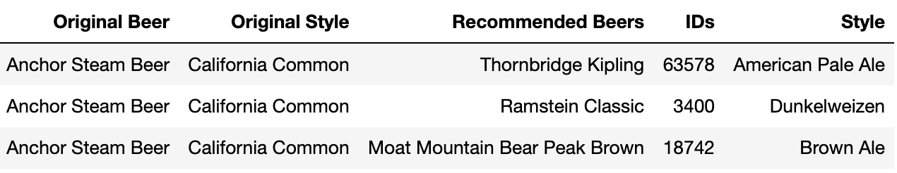
Content-Based Recommendations
Merged numerical representation of reviews with beer attributes
Averaged review data for each beer ID
Determined similarity with cosine similarity
Generated top 3 matches with beer names and styles

Slide 10
Key Takeaways
LDA topic model did create some strong distinguished categories, however some were also quite vague led to poor recommendations
The “Darkness” topic was a clear indicator and unique collection of words, which helped generate strong recommendations
Many of the other topics had overlapping terms
Content-based engine looks promising, but needs better topic analysis and more item data

Slide 11
Future Ambitions
Continue cleaning text and tuning topic model
With more time and resources, expand to include entire dataset
200+ million total reviews
Build a collaborative recommendation engine
This dataset also contains enticing user data
Will be interesting to explore possibilities

