Slide 1
MLB Pitching Analysis and Regression
Colin McMorrow

Slide 2
Objective
Analyze historical MLB data to determine the impact of pitching on team win percentage to aid in roster personnel decisions.
Goals:
Acquire pitching data via web scraping
Identify features of interest and map trends
Use regression to construct an explanatory model

Slide 3
Project Scope
Data
Data Source: baseball-reference.com
1970 – 2021 single season team pitching
Target value: Team Win Percentage
Design
Clean data and build initial regression models
Explore relationships between data to drive feature selection/engineering
Evaluate model assumptions and efficacy
Determine validity of selected model

Slide 4
Study Limitations and Assumptions
Isolated study of pitching
Batting and fielding excluded
Evolution of rules and technological advancements lead to higher variance during selected time period (1970-2021)

Slide 5
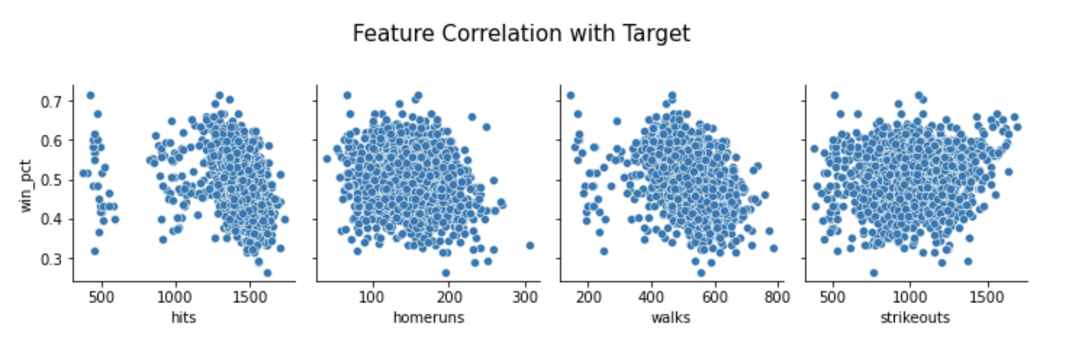
Feature Selection
Initial Variables Selected:
Hits
Home runs
Walks
Strikeouts
Linear Regression Results:
Adjusted R² = 0.229
Root Mean Squared Error = ± 0.063 win %

Slide 6
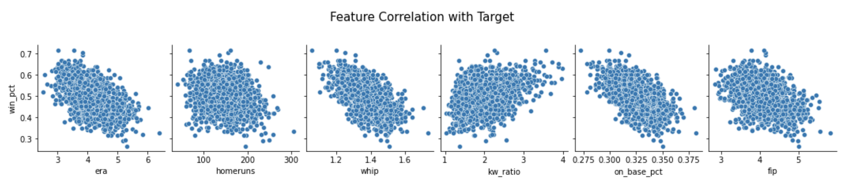
Feature Selection
Feature Engineering
Removed insignificant variables and incorporated into combined statistics
ERA (Earned Runs Average)
WHIP = Walks + Hits / Innings Pitching
KW Ratio = Strikeouts / Walks
FIP (Field Independent Pitching)

Slide 7
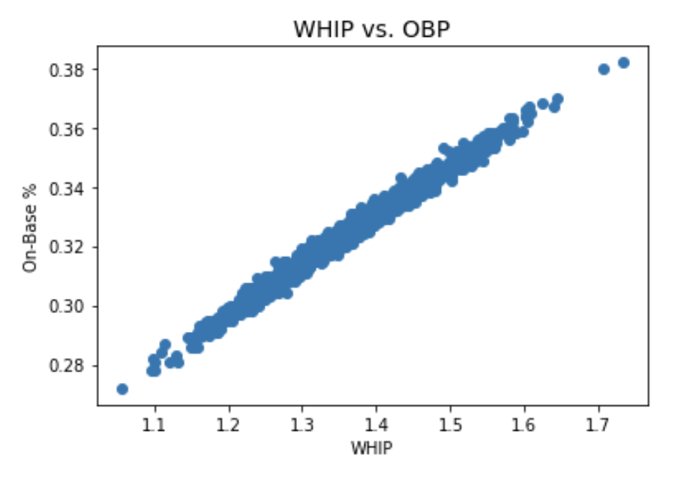
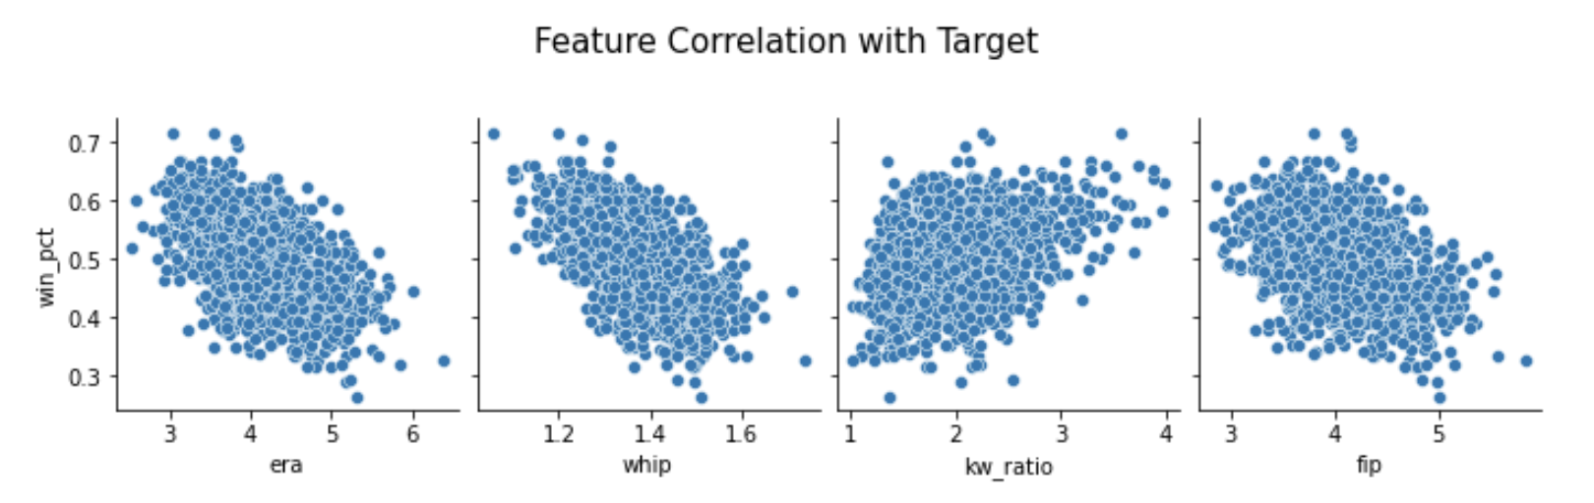
Model Building
Final exclusions
Home runs: weak correlation
On-Base Percentage: strong collinearity
Selected Features
ERA
WHIP
K/W Ratio
FIP

Slide 8
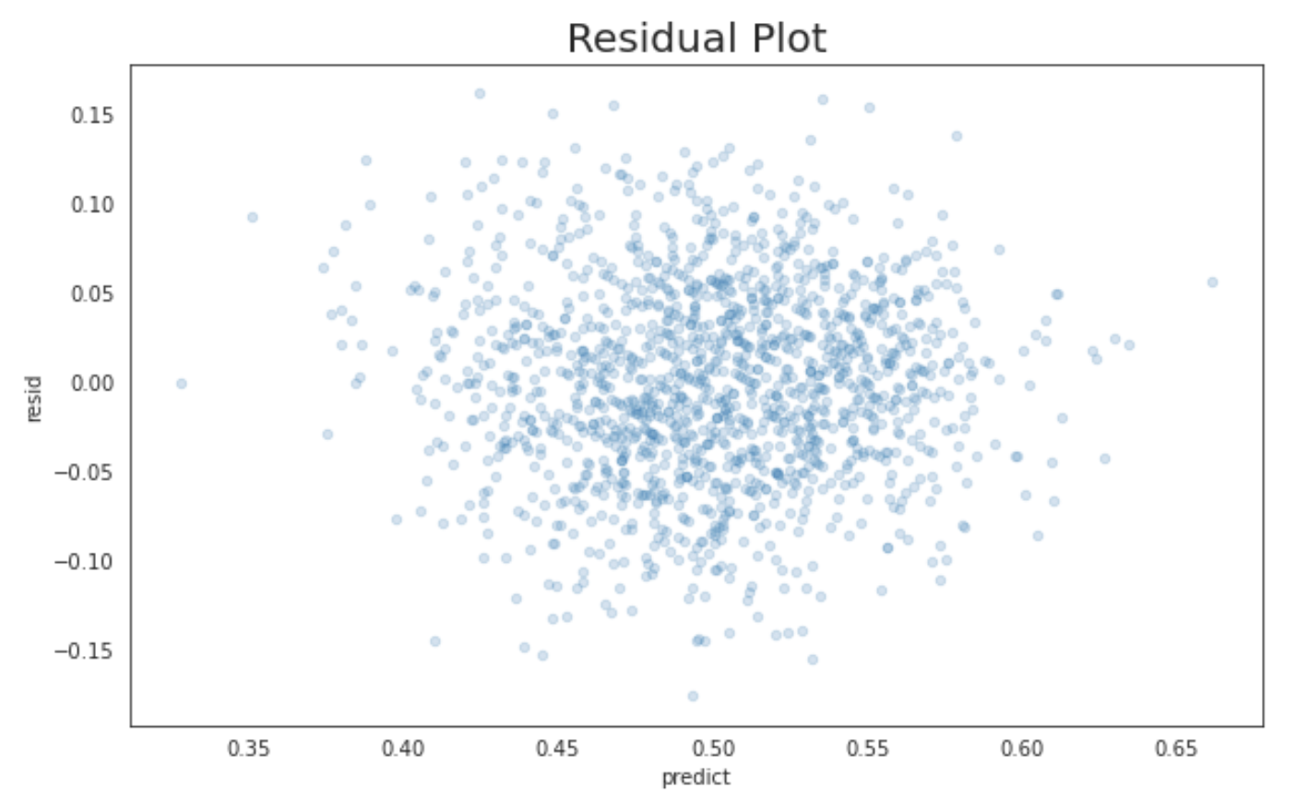
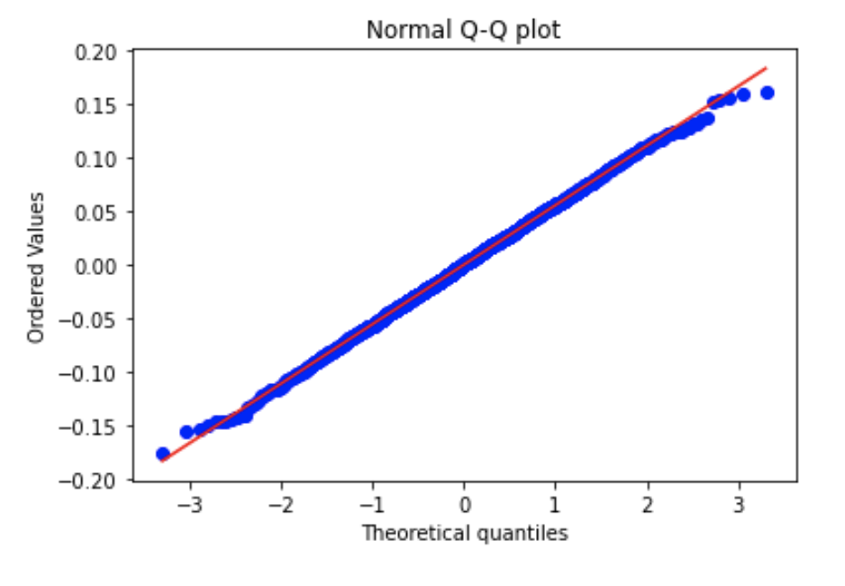
Model Building
Assessing Normality

Slide 9
Model Validation
Cross-validation
Train/Validation: 80%
Test: 20%
5-fold cross-validation scheme
Train Adjusted R² = 0.400
Train RMSE = ± 0.055 Win %
Results
Test Adjusted R² = 0.378
Test RMSE = ± 0.057 Win %
Overfitting Evaluation
5.5% reduction in R²
3.6% reduction in RMSE
Not Overfit

Slide 10
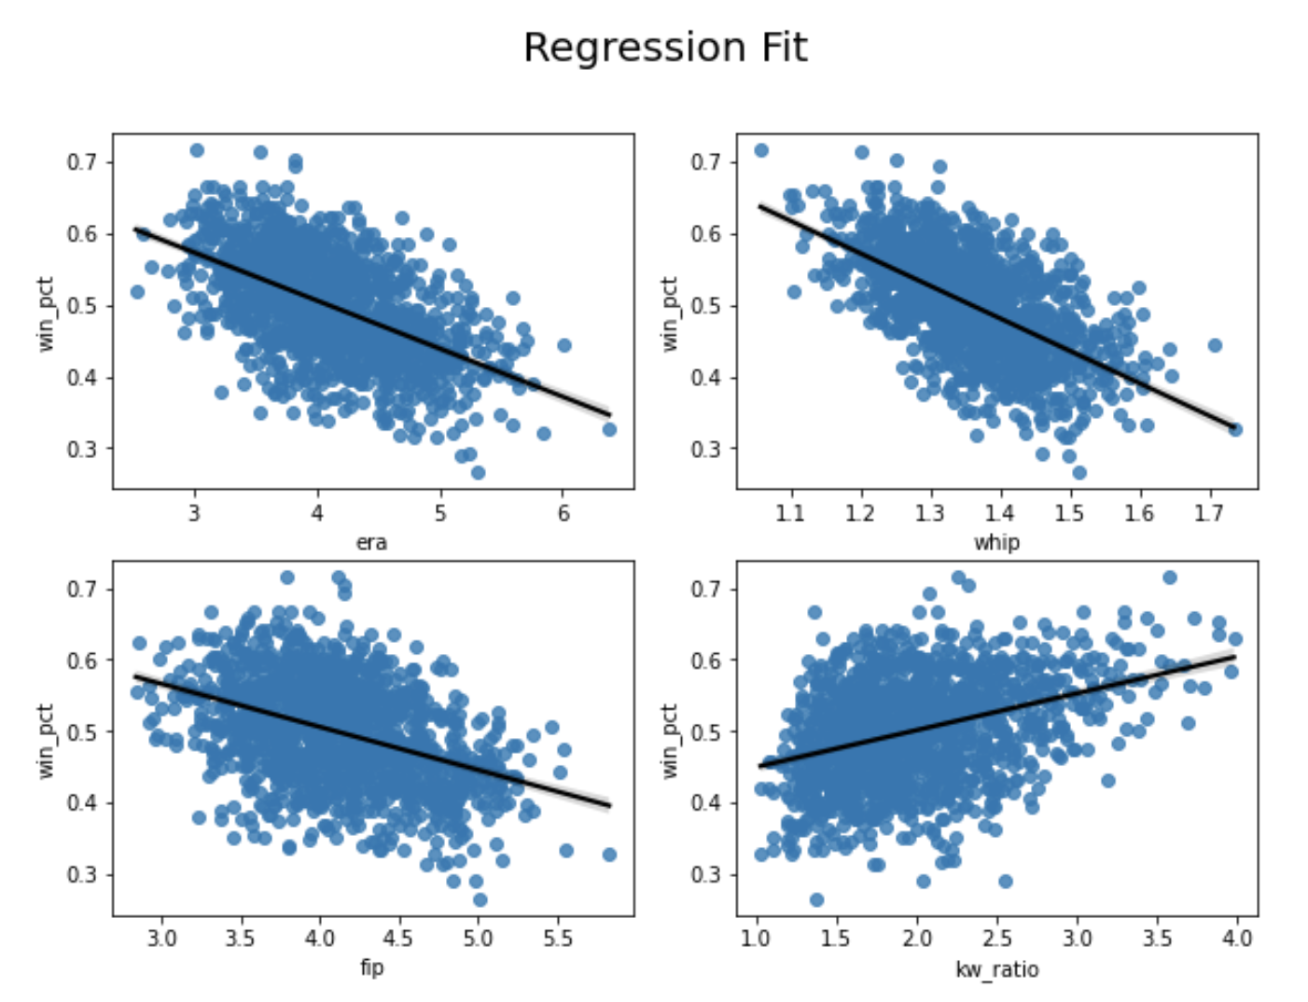
Model Evaluation
Metrics
Adjusted R² = 0.400
RMSE = ± 0.055 Win %
Coefficients
ERA: -0.0856
WHIP: -0.1408
K/W Ratio: 0.0285
FIP: -0.0576

Slide 11
Conclusions
Clear linear relationship between these features and win percentage
Front office decision makers should focus on ERA, WHIP, K/W Ratio and FIP statistics when evaluating pitchers
Prioritizing minimum ERA and WHIP would provide the greatest boost in win percentage

Slide 12
Future Model Considerations
Incorporate more advanced metrics
Model differences across different historical periods
Evaluate individual players and project their future performance

