Slide 1
MTA Analysis
Colin McMorrow

Slide 2
Objective
An emerging player in the sunglass market is looking to explore advertising options to expand their exposure and boost sales in New York City.
Goals:
Gain understanding of peoples’ movements around the city
Identify points of interest
Develop best marketing strategies

Slide 3
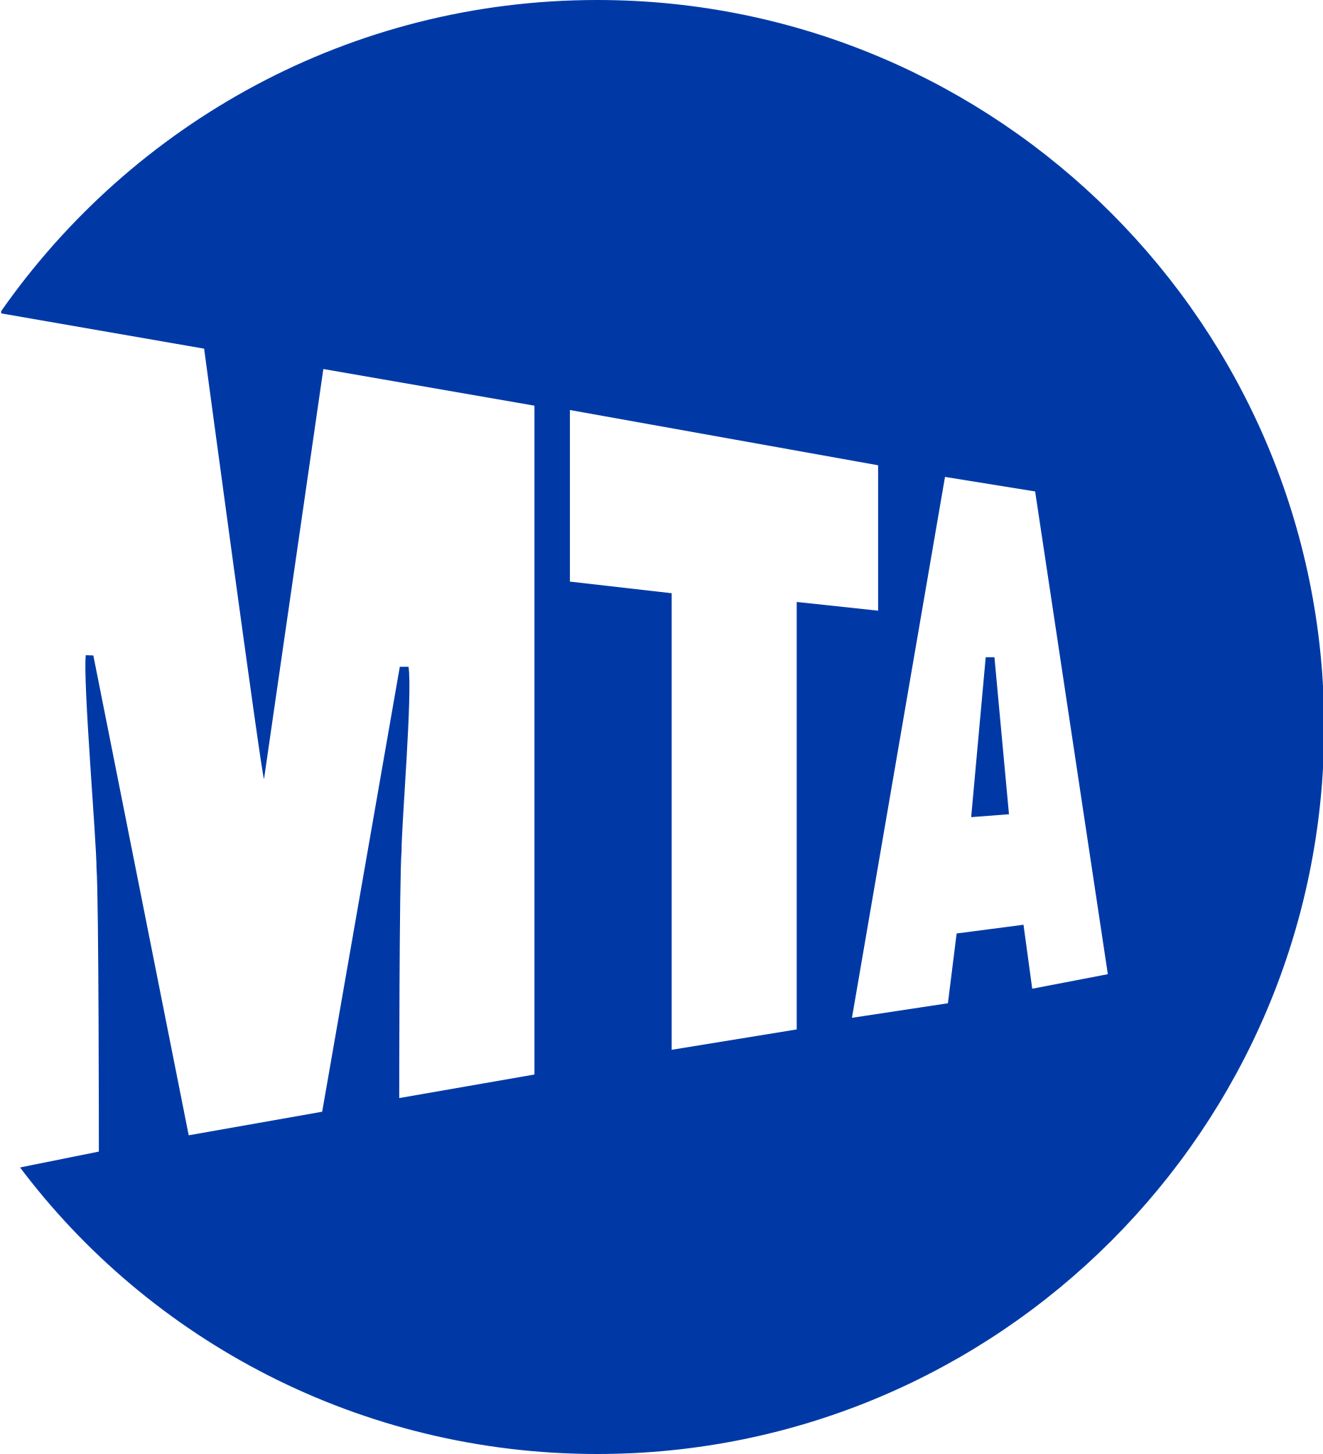
Project Scope
Design
Data source: subway turnstile entry/exit data from the New York MTA
Locate highest traffic areas during the summer months (June-August)
Summer 2019
Compute precise traffic info based on weekday and time of day
Clearly visualize points of interest

Slide 4
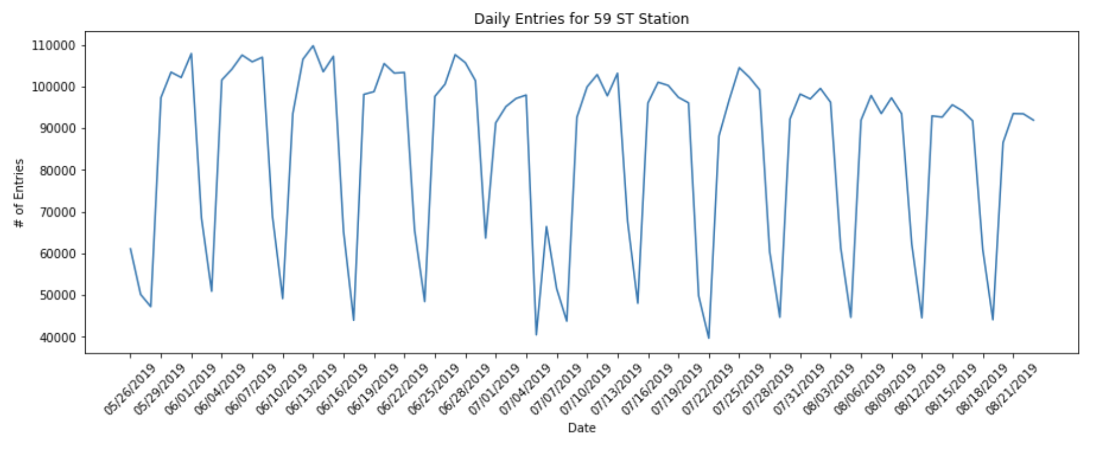
Time Series for Single Station (May 25 – Aug 23, 2019)

Slide 5
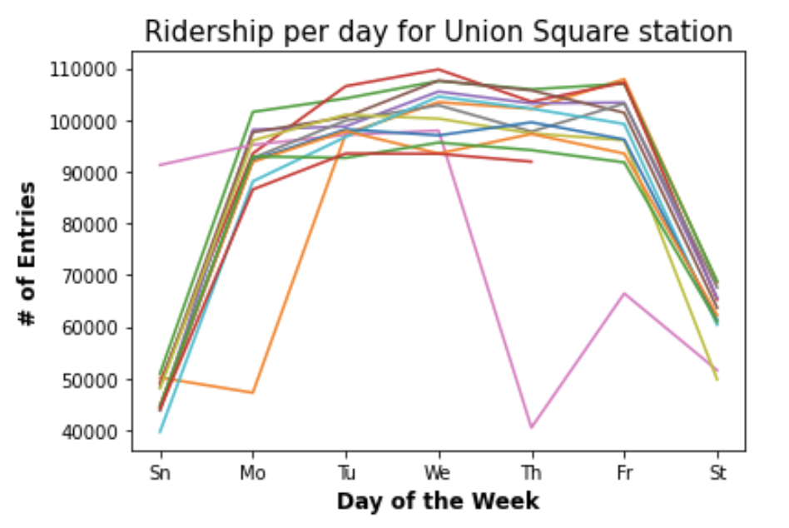
Weekly Ridership Overlay

Slide 6
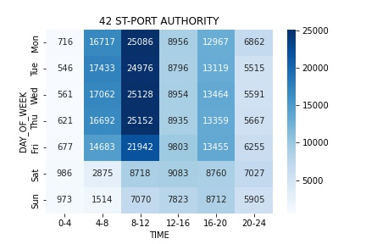
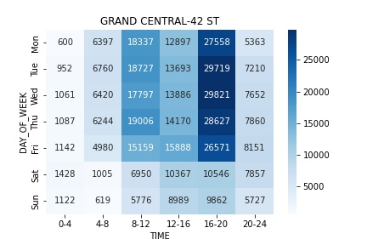
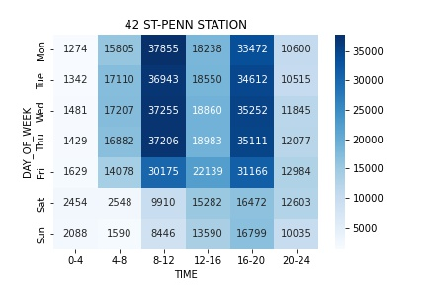
Median Entries per Day of Week, 4-Hour Intervals Major Commuting Hubs

Slide 7
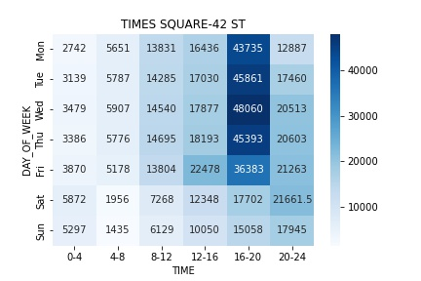
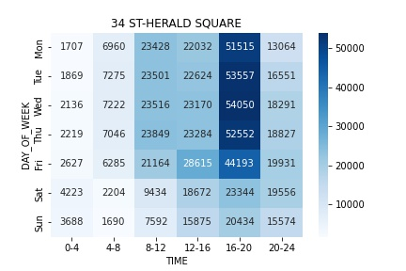
Median Entries per Day of Week, 4-Hour Intervals Tourist/Shopping Hubs

Slide 8
Conclusions
Large commuting sites in and out of the city would reach the largest viewership
Ideal locations for static content, billboard ads
Highest traffic volume between 8-12am and 4-8pm on weekdays
Times Square / 34th St. locations ideal for more targeted advertising
Tourist/shopping centers
Still very high traffic numbers in evening
May get more attention from non-commuters

Slide 9
Future Investigations
Analyze and leverage turnstile exit data as well
Explore median income residential data to identify locals that would fit sunglass price range
Explore tourism data to find peak dates in the year

