Slide 1
Drug overdose prevention
Colin McMorrow

Slide 2
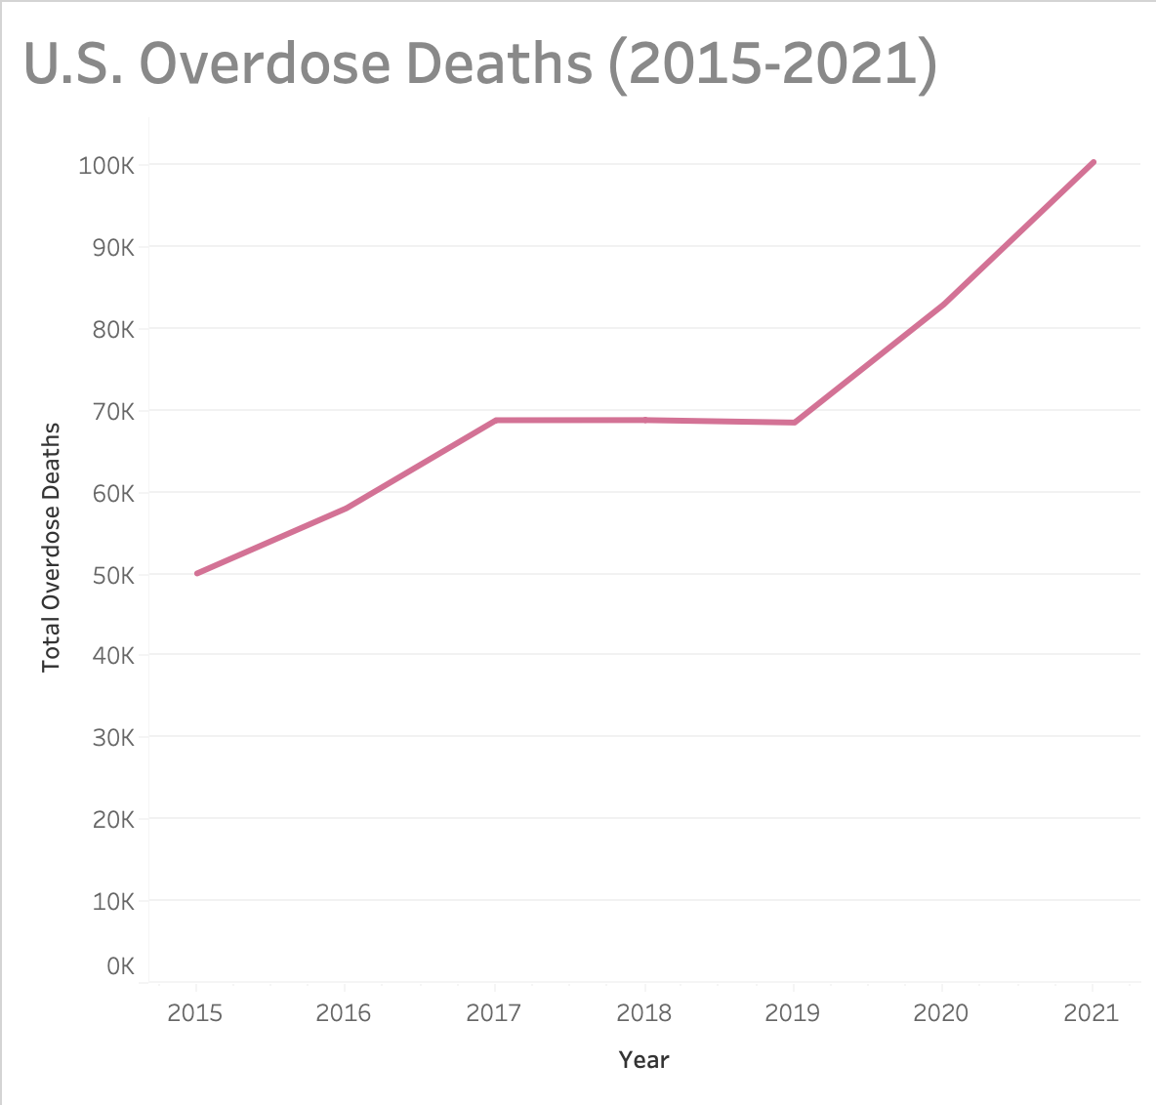
Motivation
Clients: DEA & Sunrise Recovery
With the enormous rise in opiate-related overdoses over the past decade, the DEA is seeking a data-driven solution for allocating prevention and recovery resources throughout the country
Hoping to lower annual overdose deaths back under 75k

Slide 3
Key Questions
Which states are experiencing the greatest number of drug overdose deaths?
Consider population adjustments
Which states are currently seeing the greatest increase in deaths year-to-year?
Which drugs are appearing the most?
Help focus education tactics and awareness

Slide 4
Design
Data sources:
CDC National Vital Statistics System (NVSS)
National Forensics Laboratory Information System (NFLIS)
Aggregate overdose counts for each state over time
Identify most common drugs being reported
Goal:
Create targeted education and recovery plan based on key points
Reduce annual U.S. drug overdose deaths under 75k

Slide 5
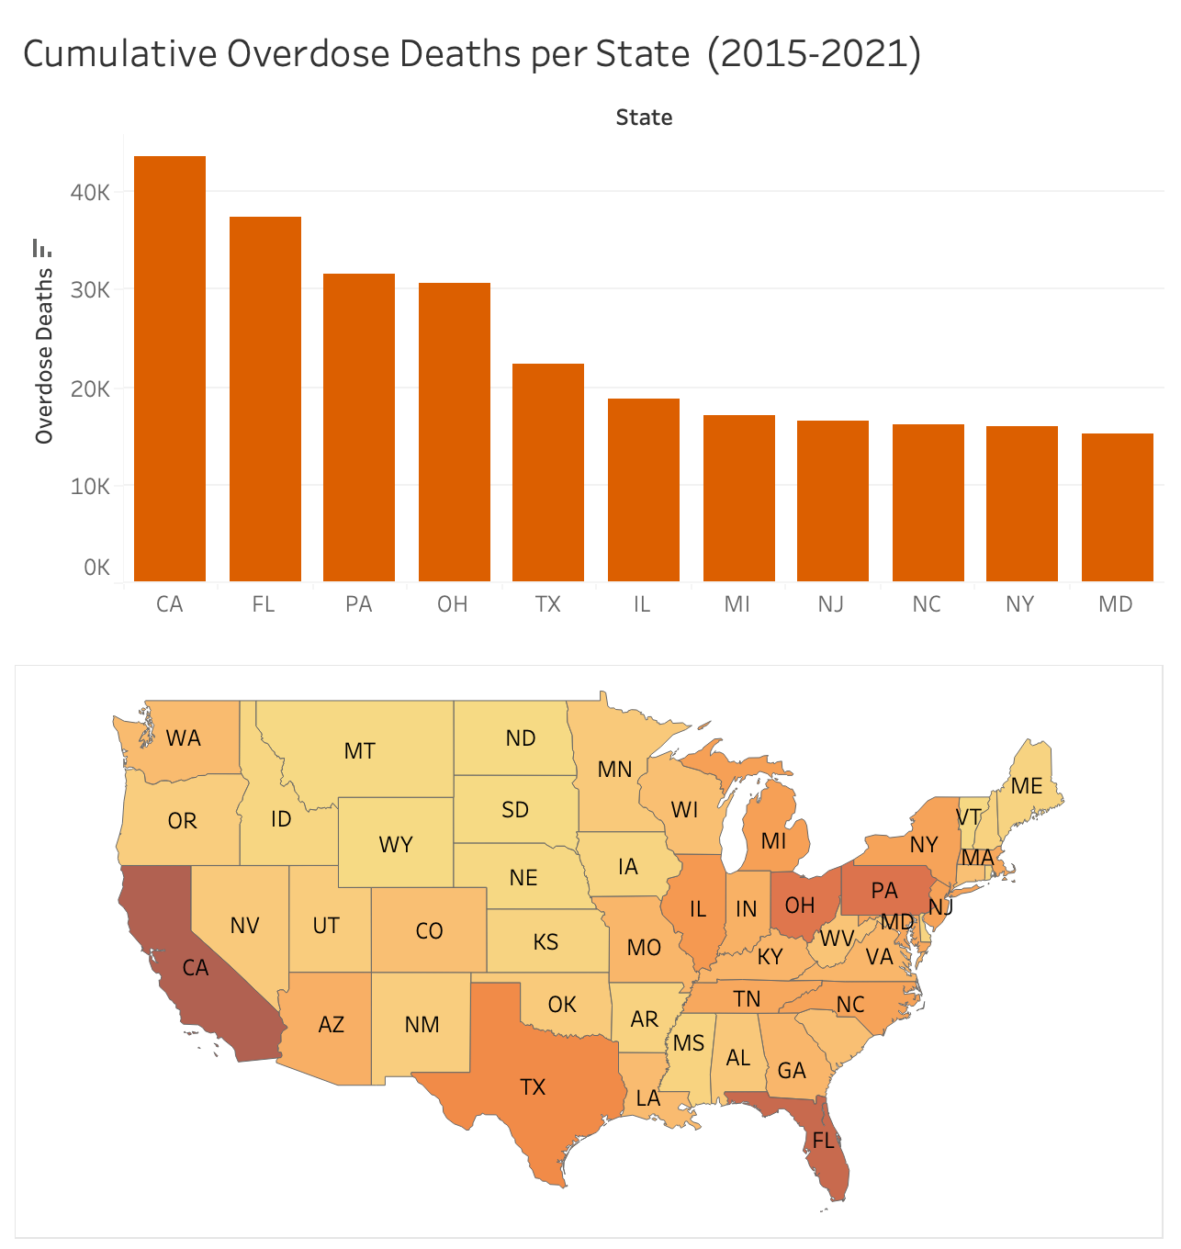
Distribution of overdose deaths
Cumulative overdose deaths in each state over period from 2015-2021
California, Florida, Pennsylvania, and Ohio stand out as highly impacted areas with over 30k deaths during the span

Slide 6
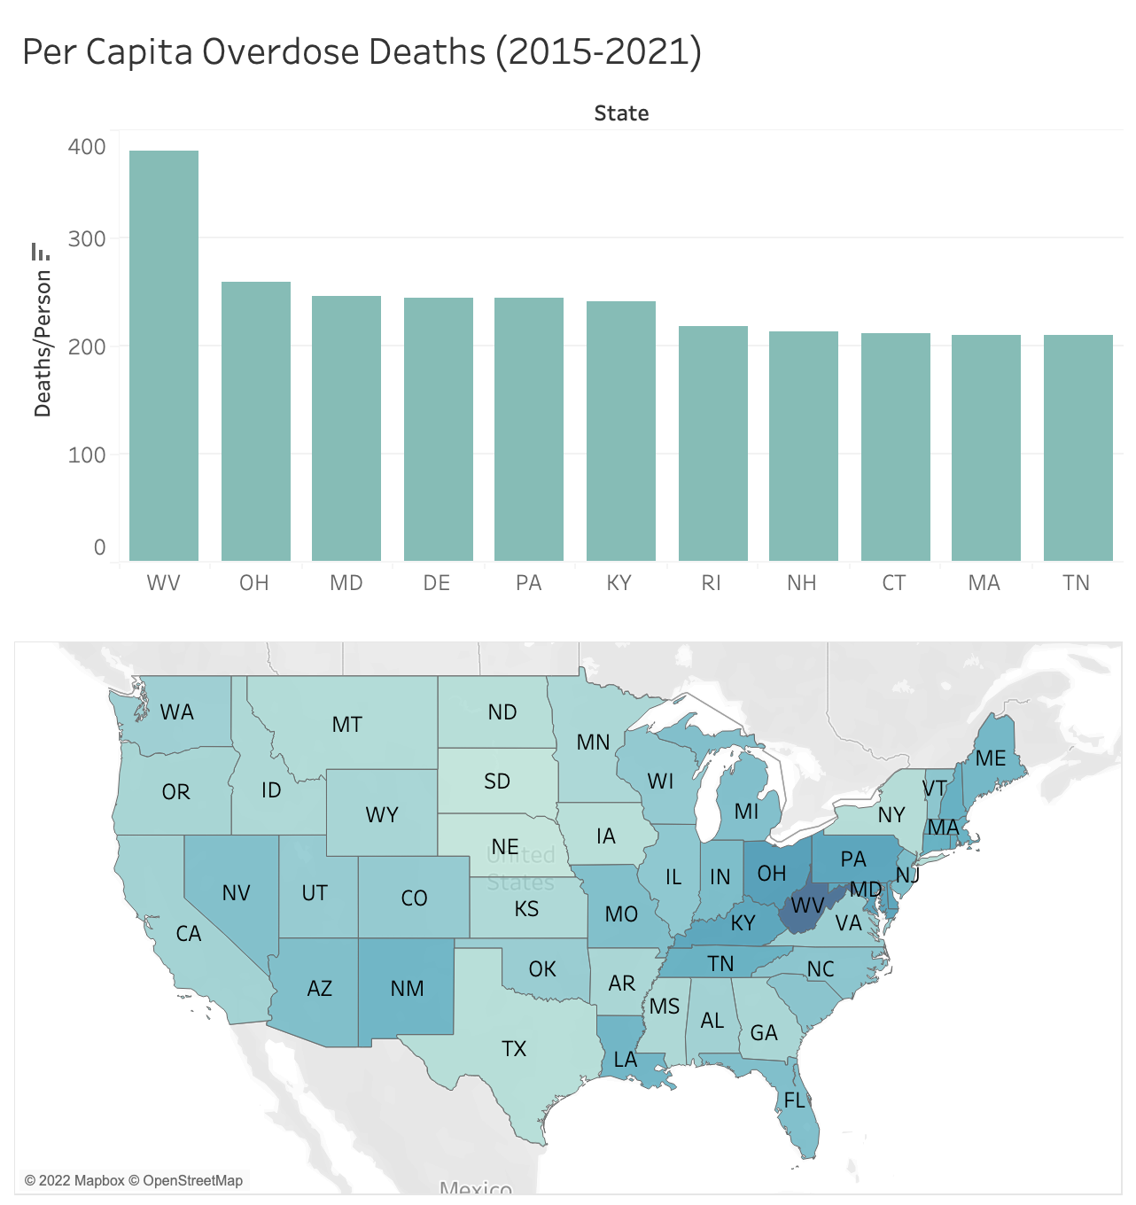
Distribution of overdose deaths (Population-adjusted)
Per capita adjustment for density of overdose deaths
West Virginia, Ohio, and Maryland are most alarming
In this analysis, the larger states such as California, Florida, and Texas are less of hot spots

Slide 7
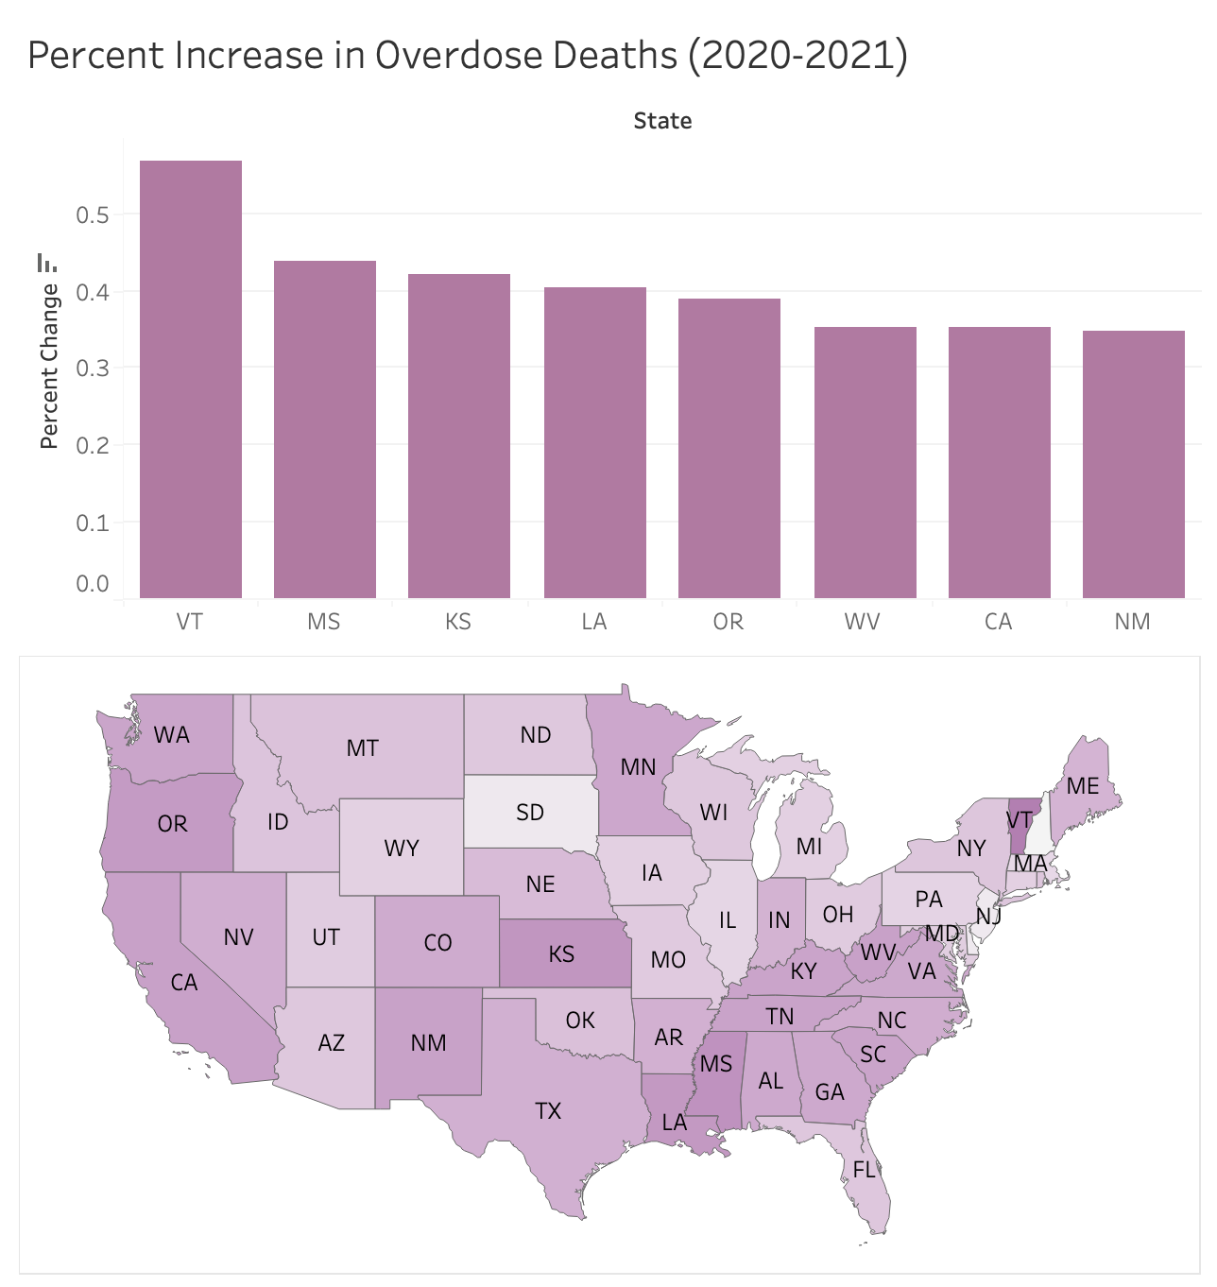
Rising Problem States
In the most recent year-on-year change, we see that there are entirely new states experiencing an uptick in drug overdoses
Important targets for preventive actions

Slide 8
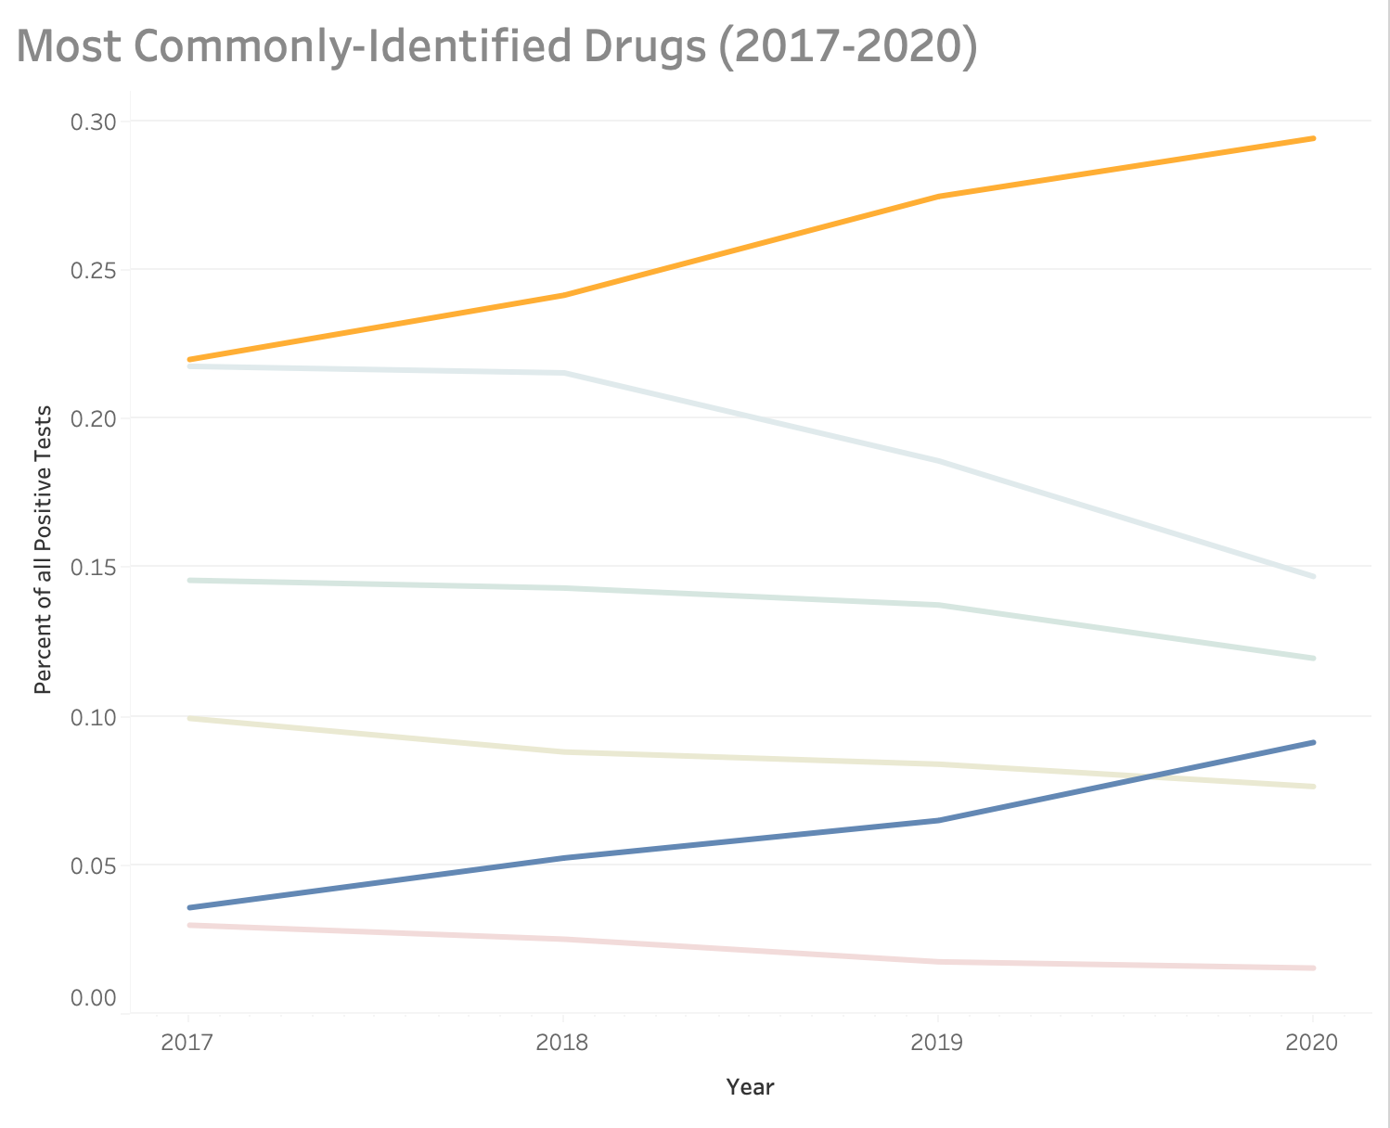
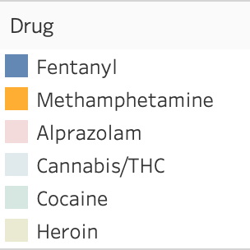
Drug Classes to focus on
Proportion of drugs identified by law enforcement and hospitalizations
Surge in cases involving fentanyl and methamphetamine

Slide 9
Takeaways
The larger states like California, Florida and Texas are good candidate states to fund targeted recovery centers and drug education
In terms of reducing deaths to goal of 75k or less, state-level policy decisions made here would have the greatest impact
However, states with larger density of overdose deaths like West Virginia, Maryland, Ohio and Pennsylvania should be more immediate targets for recovery centers; these states have the highest proportion of their populations afflicted and likely are feeling the affects most
Recovery specialists and law enforcement should be trained and equipped appropriately to combat the rise in fentanyl and methamphetamine use
If the right actions are taken, this information should lead to a flattening of the rising curve in drug overdoses

Slide 10
Future Additions
Another potential goal for this project going forward would be to construct a predictive model for next year’s overdose deaths
With enough data we could possibly build a machine learning model to predict which states are most likely to be hit with this overdose epidemic

