Slide 1
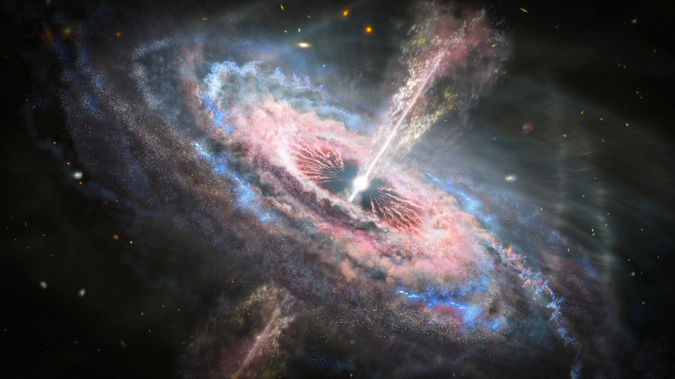
Stellar Object Classification
Colin McMorrow

Slide 2
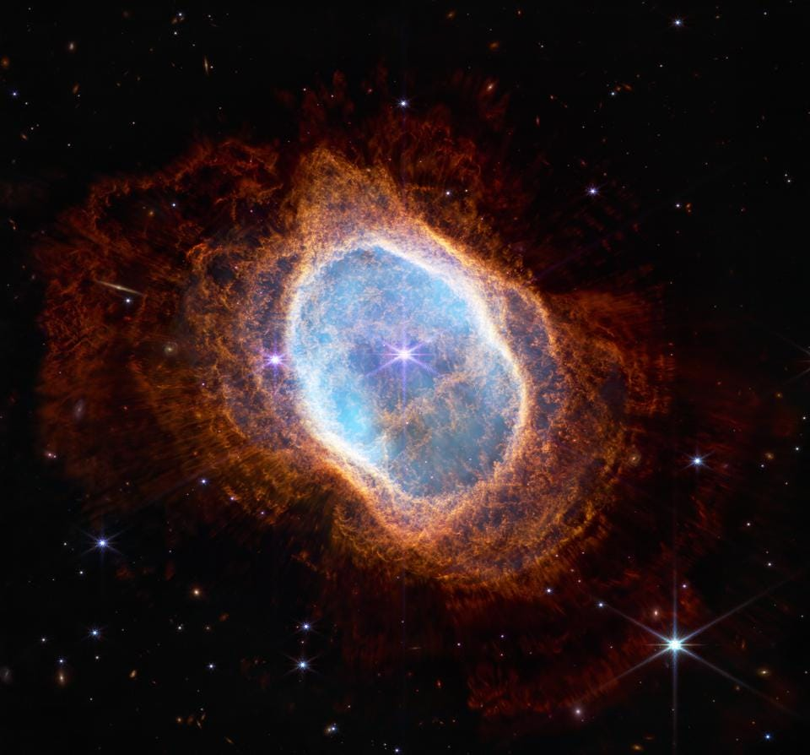
Objective / Motivation
There are billions of billions of documented objects in deep space, and billions more are discovered each year with more sensitive instruments
Astronomers would be able to save energy and resources by leveraging data science to quickly classify these new objects

Slide 3
Project Design
Data Source:
Sloan Digital Sky Survey (SDSS)
Data Release 17
Clean data and search for features with strong separation between classes
Build baseline model to assess predictive ability
Expand and tune model to maximize accuracy

Slide 4
The Data
100 thousand entered objects
Spectral Data:
U, G, R, I, Z: different wavelength filters ranging from ultraviolet to infrared
Redshift: generally measures distance
Scan Data:
Object Identifiers
Telescope angles
Dates
Equipment IDs
Classes:
Star: individual stars
Galaxy: very large cluster of stars
Quasar: Extremely bright light released from a supermassive black hole

Slide 5
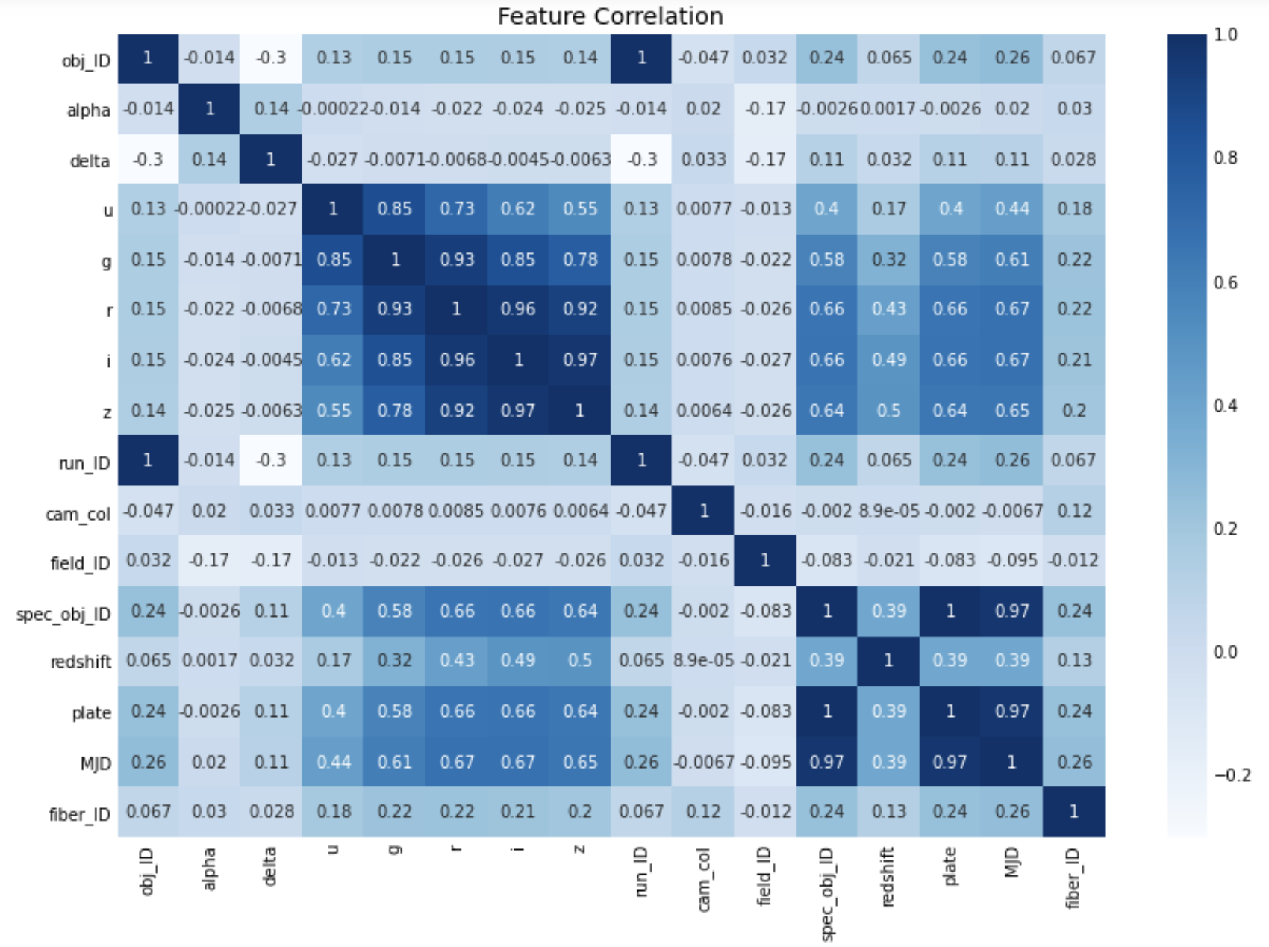
Feature Selection
Perfect or near-perfect collinearity
Plate, MJD(Date), Run ID
Many of the spectral features appear to provide similar information
Targets for exploration

Slide 6
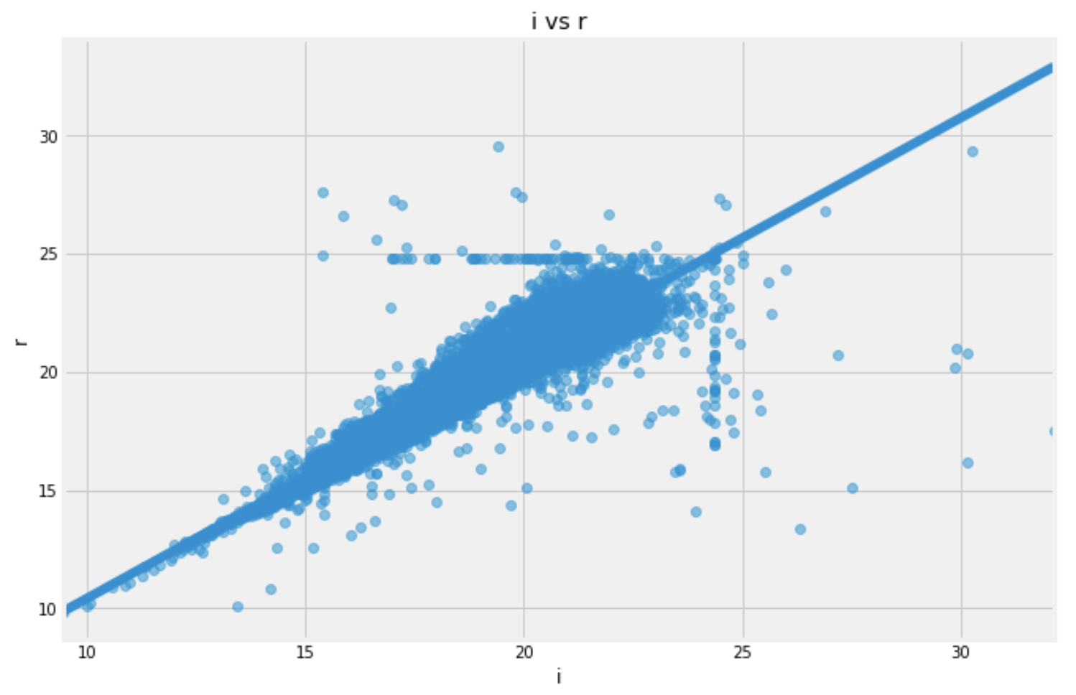
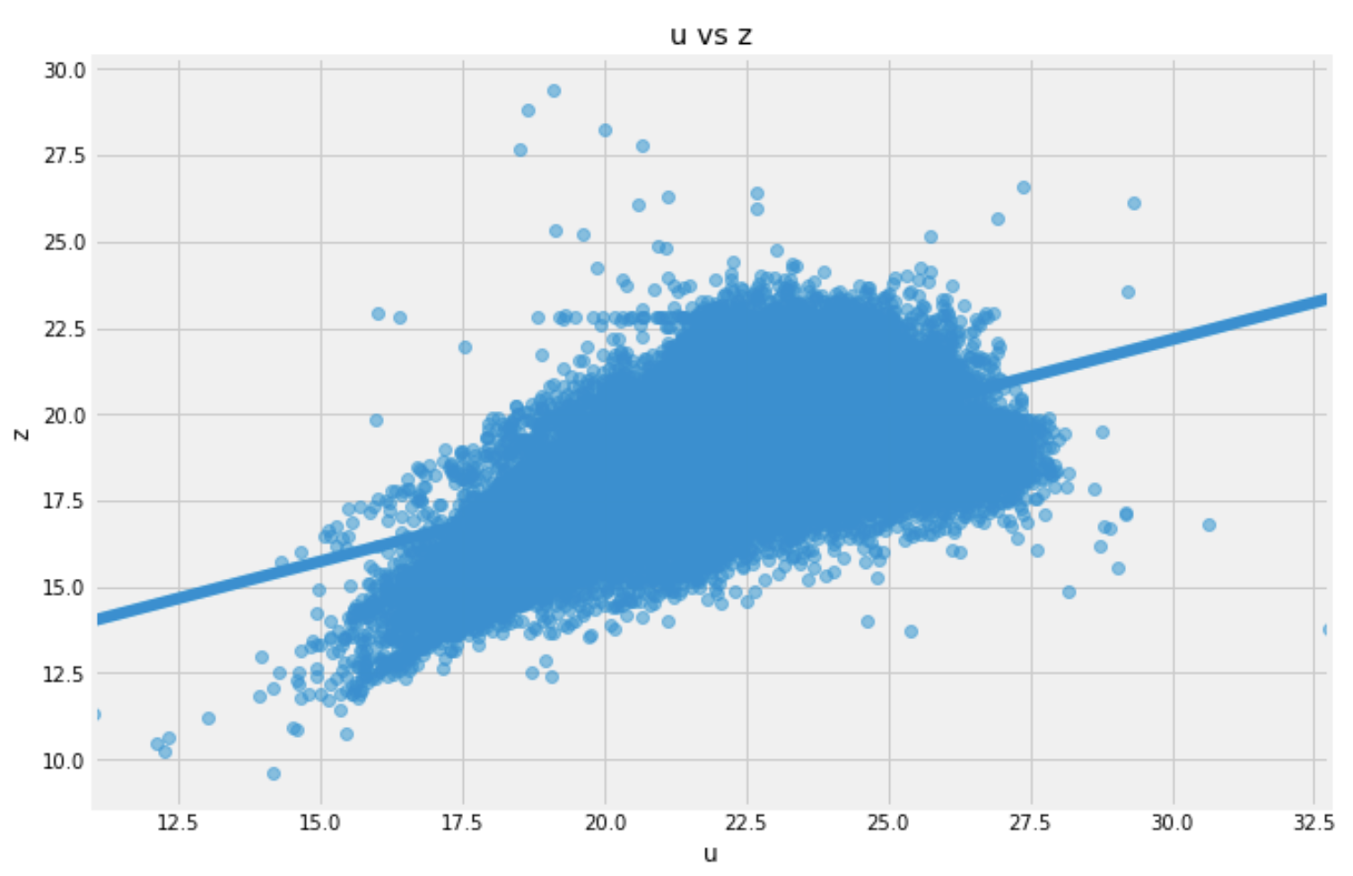
Feature Selection
Spectral features that are adjacent (top) have very high collinearity
U and Z (bottom) likely capture all predictive information that is needed and have much lower correlation of 0.55
Removed G, R and I from feature list

Slide 7
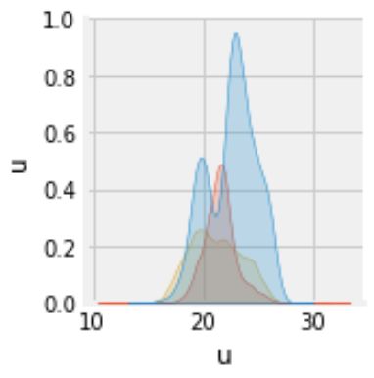
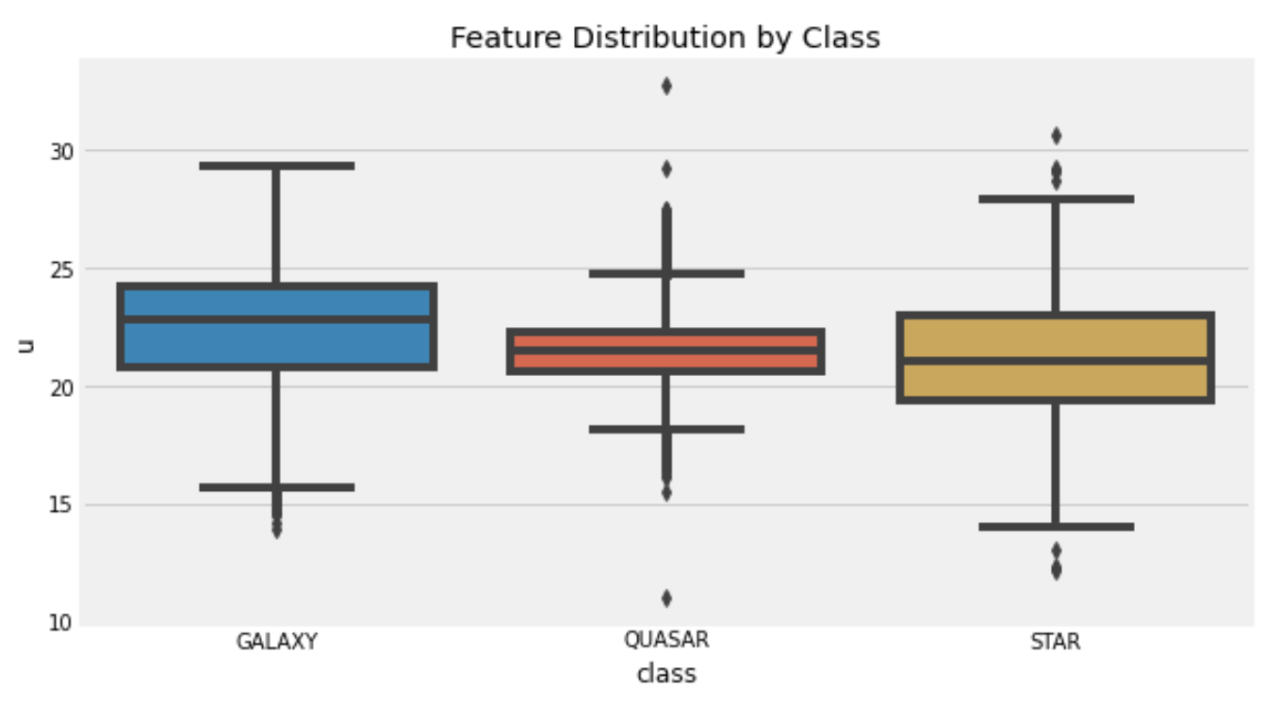
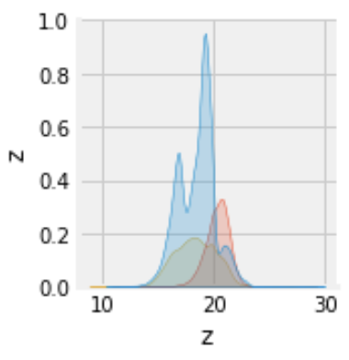
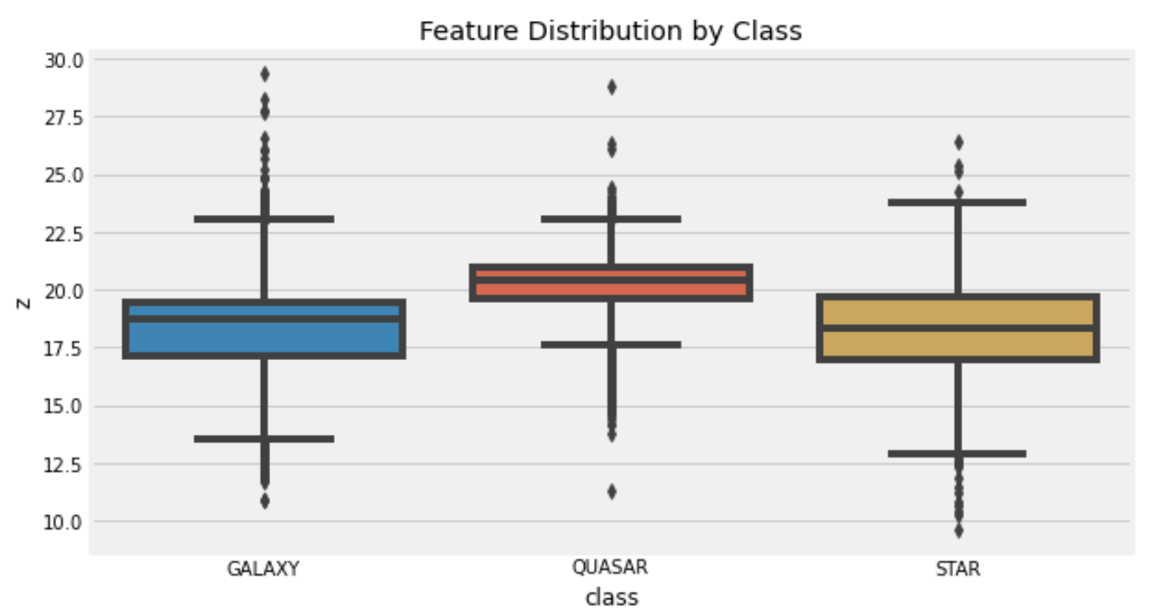
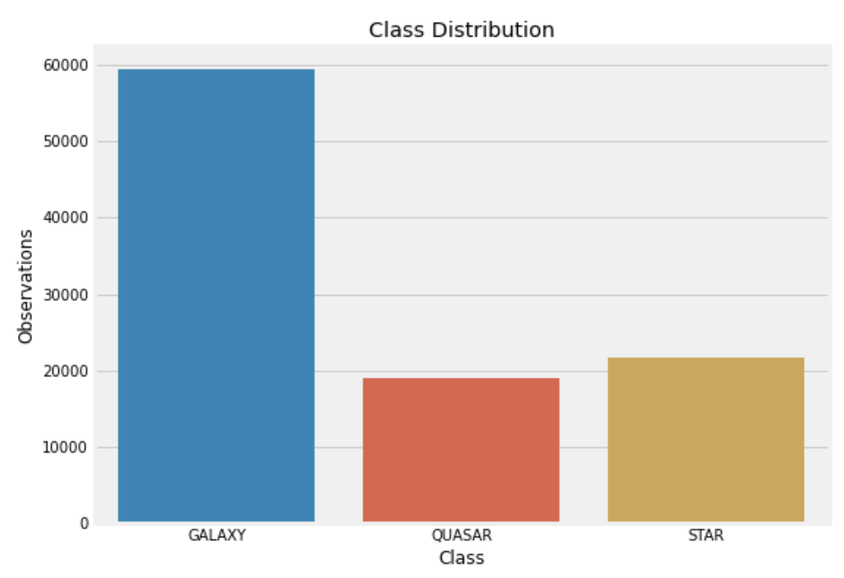
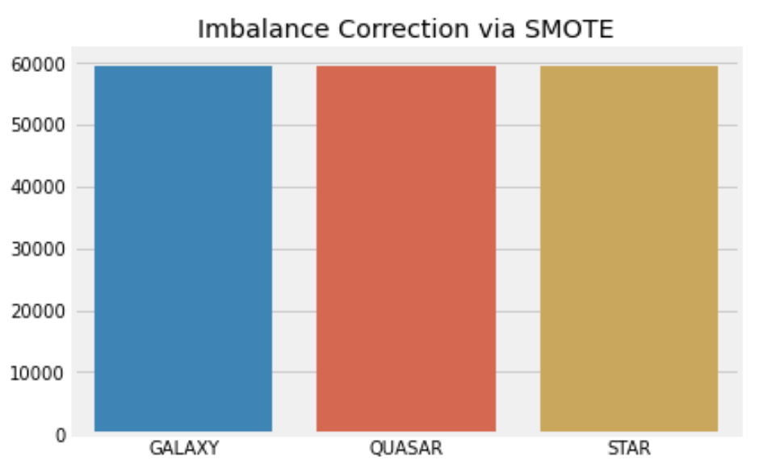
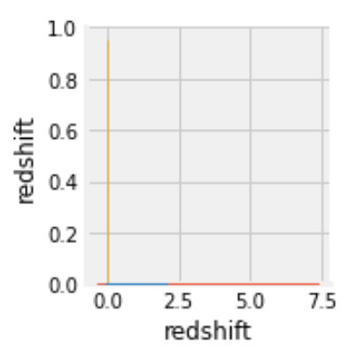
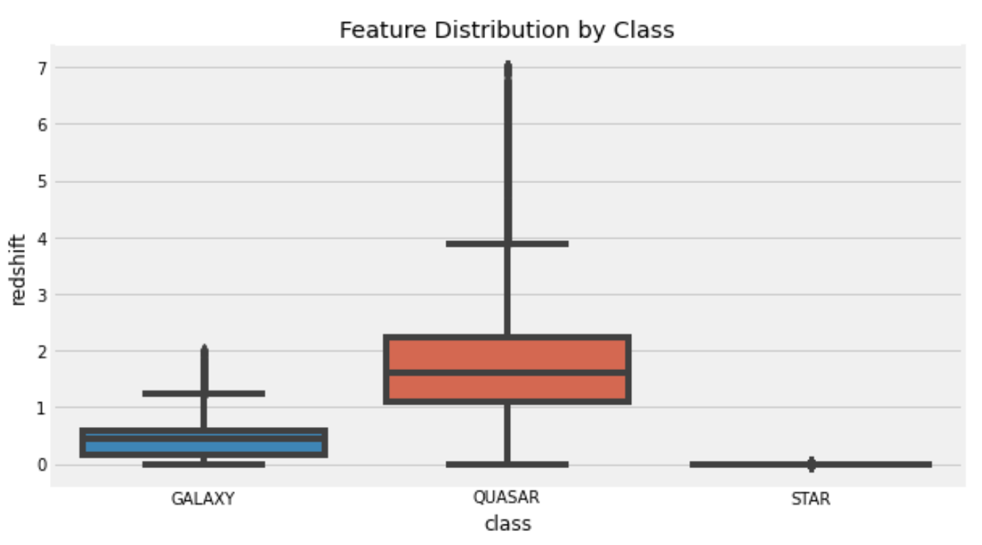
Class Breakdown
Identified Potentially strong predictors in redshift, z, and u
3:1:1 Class imbalance
Corrected using SMOTE

Slide 8
Validation Scheme / Metrics
5-fold cross validation
kNN
60-20-20 train-val-test split
Logistic Regression
Random Forest
Metrics:
Accuracy
F1 Score

Slide 9
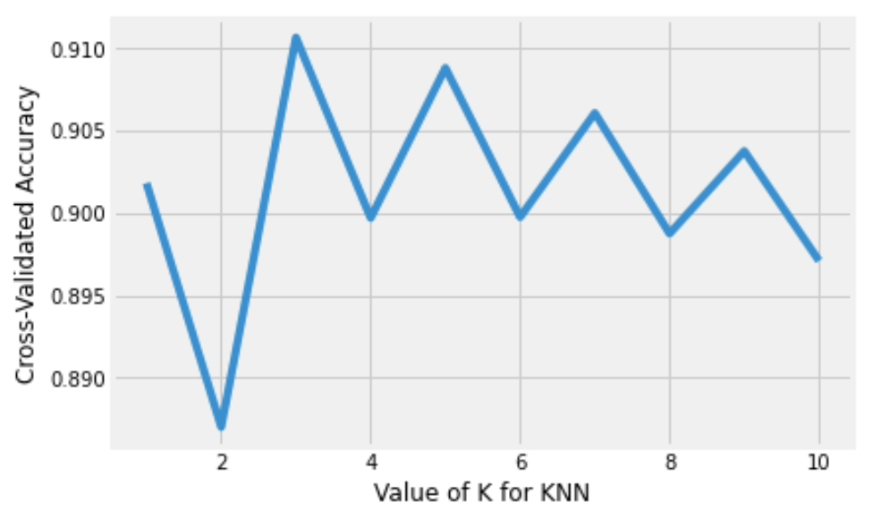
Baselining
K-Nearest Neighbors
5-fold cross-validation
K=3
Accuracy: 0.91
F1 Scores:
GALAXY: 0.94
QUASAR: 0.91
STAR: 0.87

Slide 10
Baselining
Logistic regression
Multiclass one-vs-rest
Accuracy: 0.94
F1 Scores:
GALAXY: 0.95
QUASAR: 0.90
STAR: 0.96
Notable Coefficients:
GALAXY:
1.5 (u), -1.25 (z)
QUASAR:
-2.36 (u), 4.66 (redshift)
STAR:
-51.3 (redshift)

Slide 11
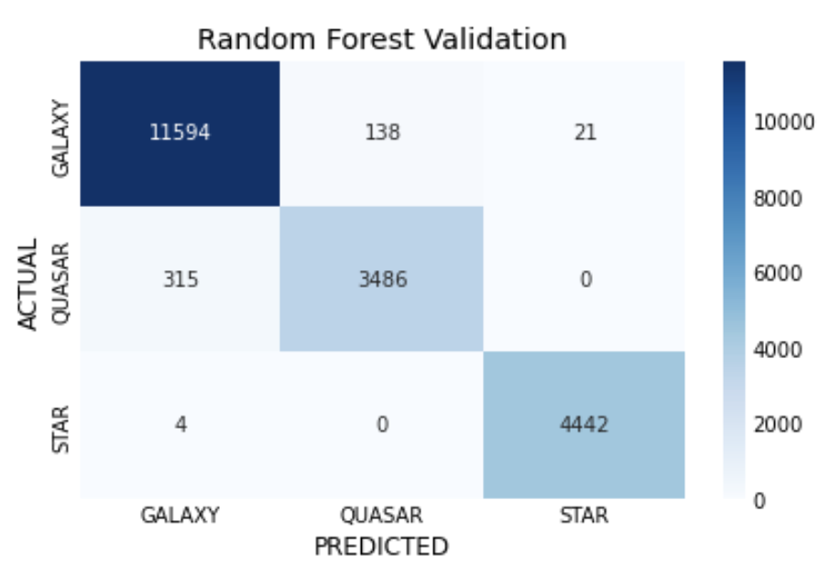
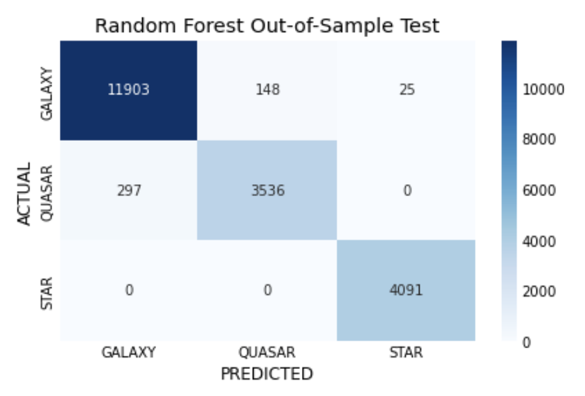
Random Forest
Validation:
Accuracy: 0.98
F1 Score:
GALAXY: 0.98
QUASAR: 0.94
STAR: 1.00
Test:
Accuracy 0.98
F1 Score:
GALAXY: 0.98
QUASAR: 0.94
STAR: 1.00

Slide 12
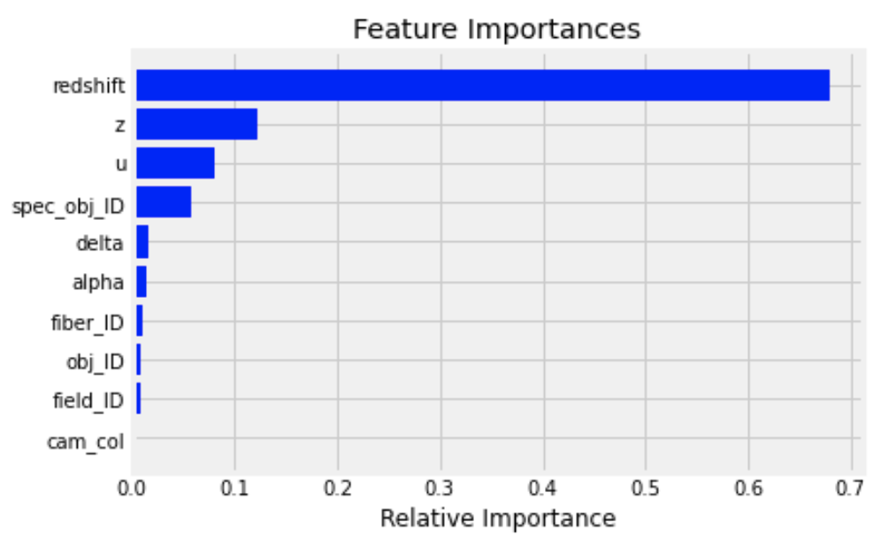
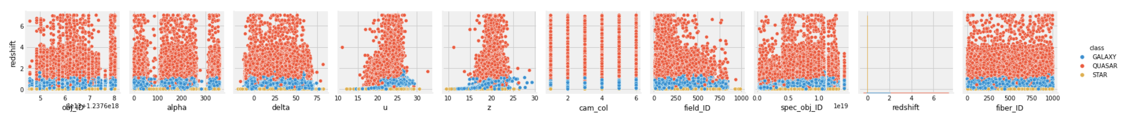
Feature Importance
Redshift values appear to be the principal factor in determining class in this model
Redshift represents the speed an object is moving away from Earth, a measurement that roughly translates to distance
Can we build this model without it?

Slide 13
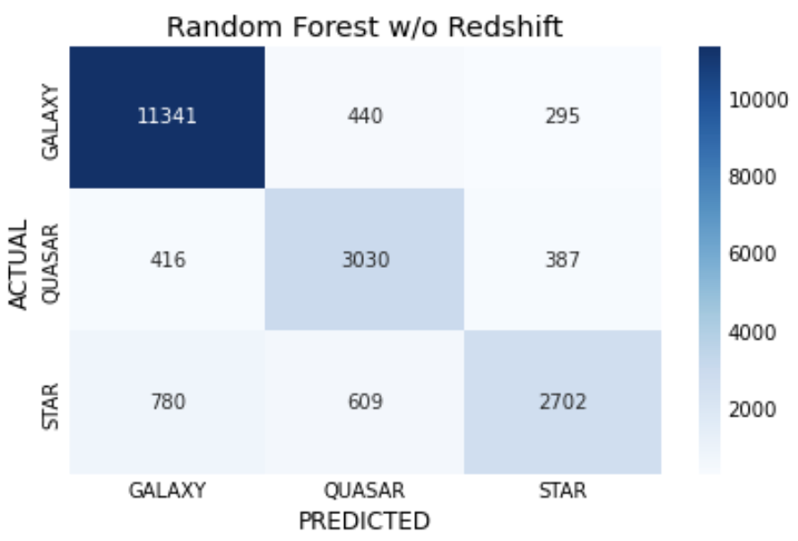
Redshift Removed
Accuracy: 0.85
F1 Scores:
GALAXY: 0.92
QUASAR: 0.77
STAR: 0.72

Slide 14
Key Takeaways
We are able to make highly accurate classifications for stars, galaxies and quasars with relatively few features
Random Forest provided best model
Little to no drop-off in performance when testing out-of-sample data
Not overfit to training data, not too complex
Redshift is a significantly stronger predictors than other features
Removing feature leads to relatively mild performance decrease
Interesting modeling challenge to pursue going forward

