Slide 1

Presented by: Colin Moughton
Date: Dec 24
Rev. 1

Slide 2
Project Definition
Title: FT100 predictive deep learning stock trading model
The project goal was to create a predictive model capable of identifying trading opportunities. The model operates on historical daily stock price data that has the data features ‘open’, ‘high’, ‘low’, ‘close’ and ‘volume’ (OHLCV) for stocks within the FT-100 index. This financial index is made up of the largest 100 public companies trading on the London Stock Exchange.
The machine learning (ML) software developed to achieve this goal is called ‘Ginger’. It runs as a FastAPI web application. These slides aim to provide an overview of what Ginger is and how it works. The software is available on GitHub and can easily be run using Docker.
Ginger software available at: https://github.com/colinmoughton/Ginger

Slide 3
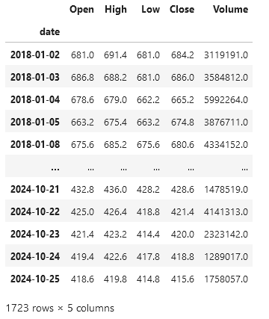
Daily OHLCV data
‘OHLCV’ stands for ‘open’, ‘high’, ‘low’, ‘close’ & ‘volume’.
The opening price is the price the stock starts trading when the market opens.
The high price is the highest price the stock reaches over the day.
The low price is the lowest price the stock reaches over the day.
The close price is the price the stock finally trades at the end of that day.
Volume is the amount of shares traded in the day.
It looks like this

Slide 4
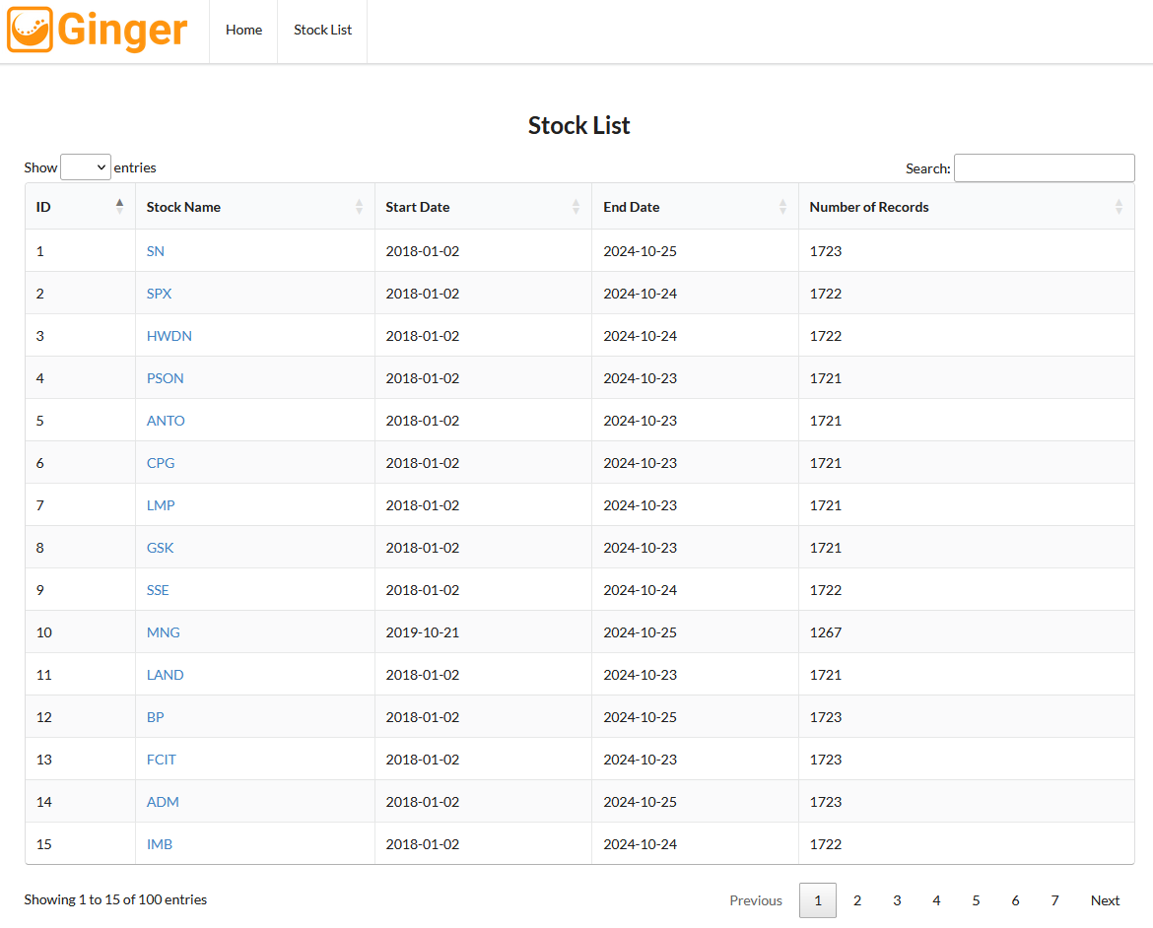
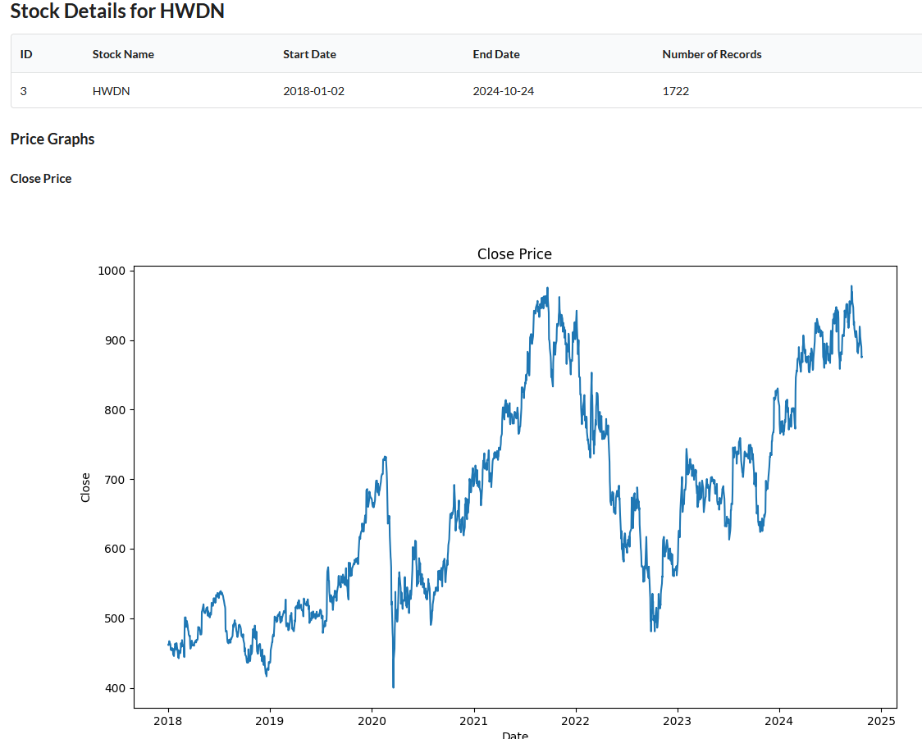
A time series database
Time series history data was downloaded for the 100 stocks in the FT 100 index.
They were stored in an sqlite database
The stock data for each can be explored by clicking the hyperlinks to show the graphed time history.

Slide 5
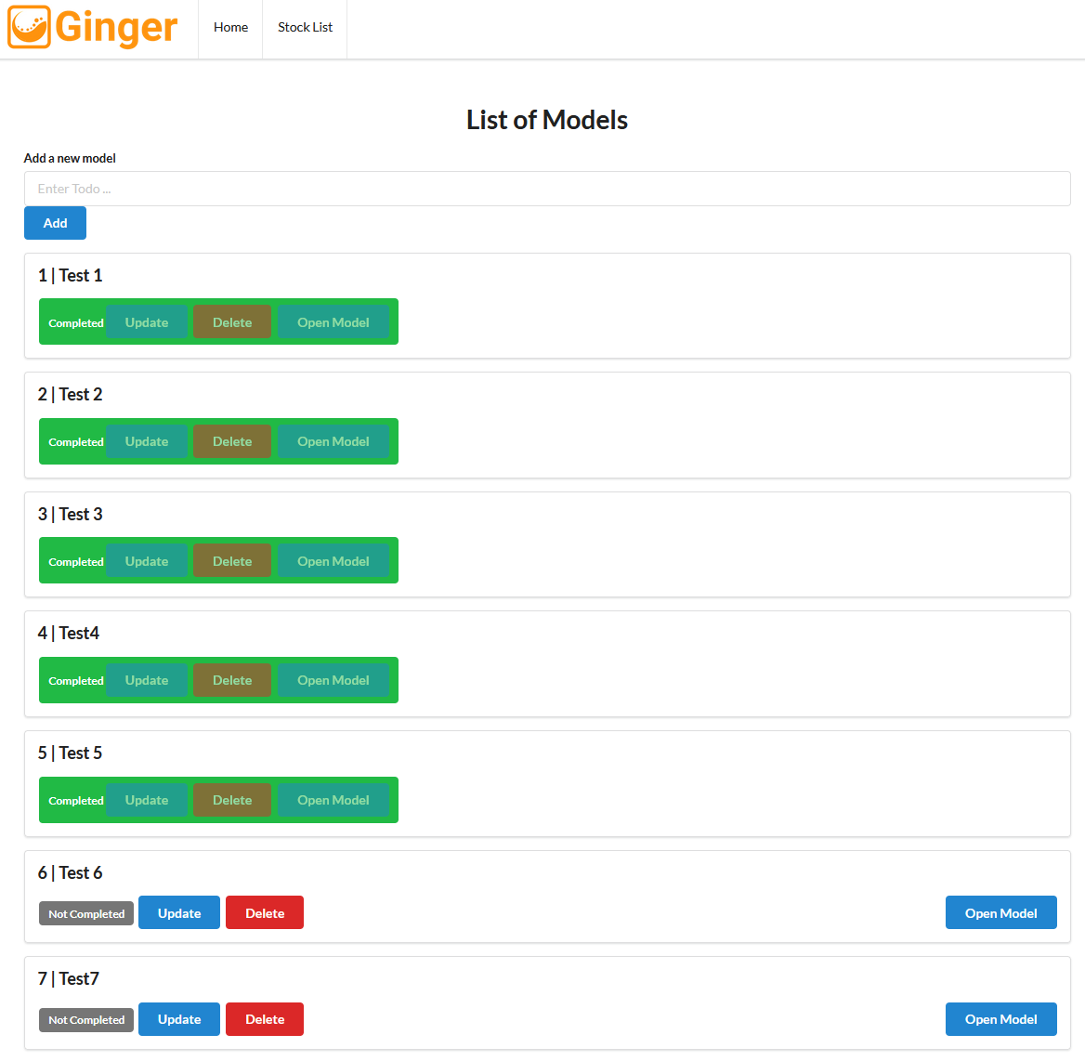
The Ginger Workflow
Model creation and inputs
Stock screening
Stock data exploration & selection
ML Model selection and training
Back testing and results evaluation

Slide 6
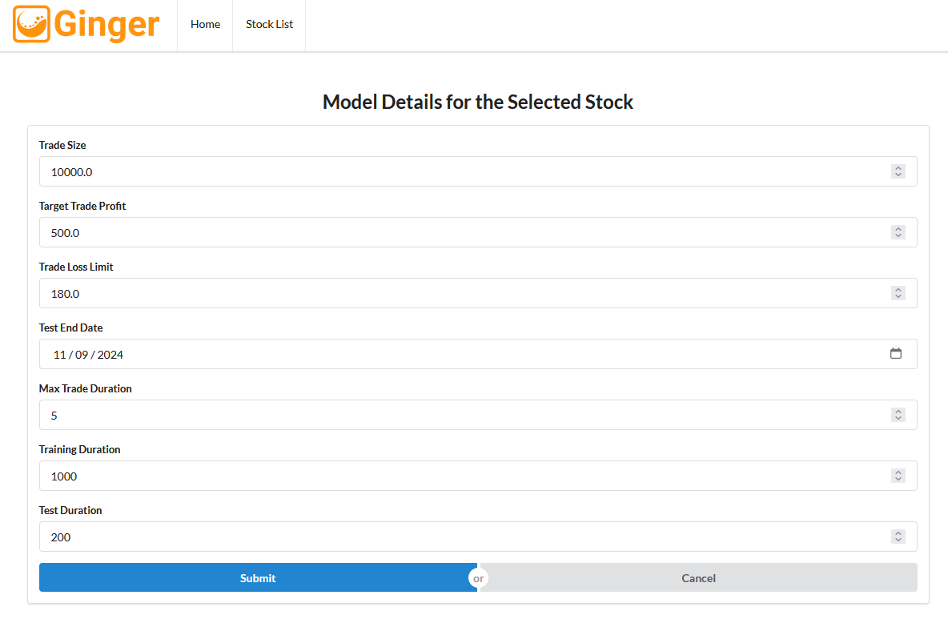
Model creation and inputs
To start working with Ginger the user opens a new model and is presented with a form.
The user enters a number of parameters into the model details form.
These parameters define what a successful trading event looks like
They include the maximum time span of that event.
Also defined are the number of days that will be used by Ginger for training and testing a machine learning model.

Slide 7
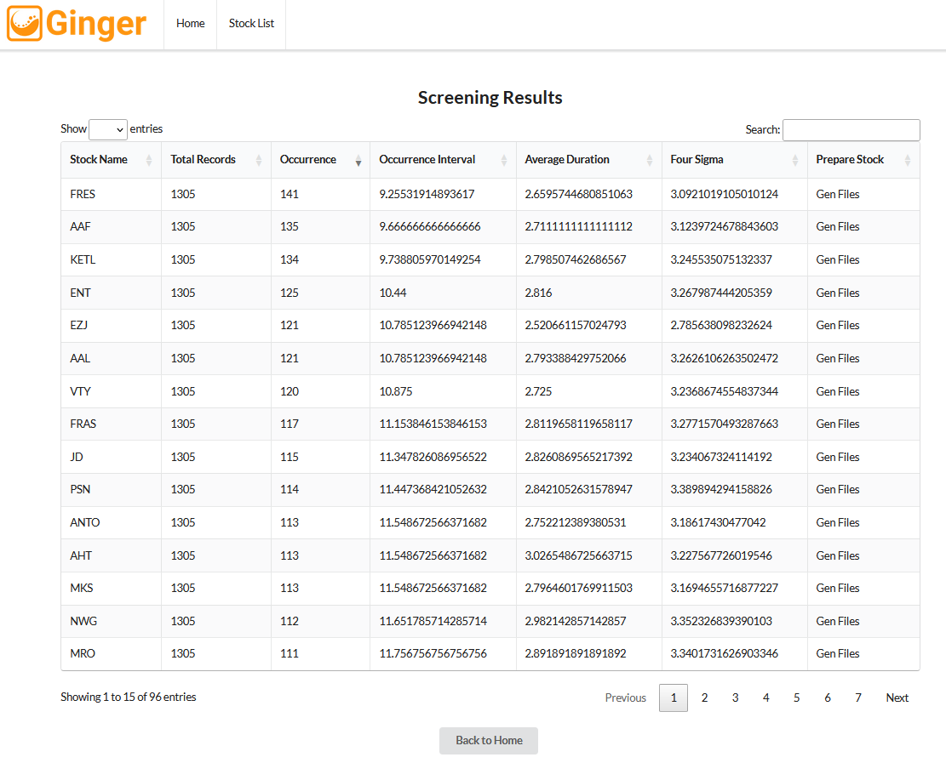
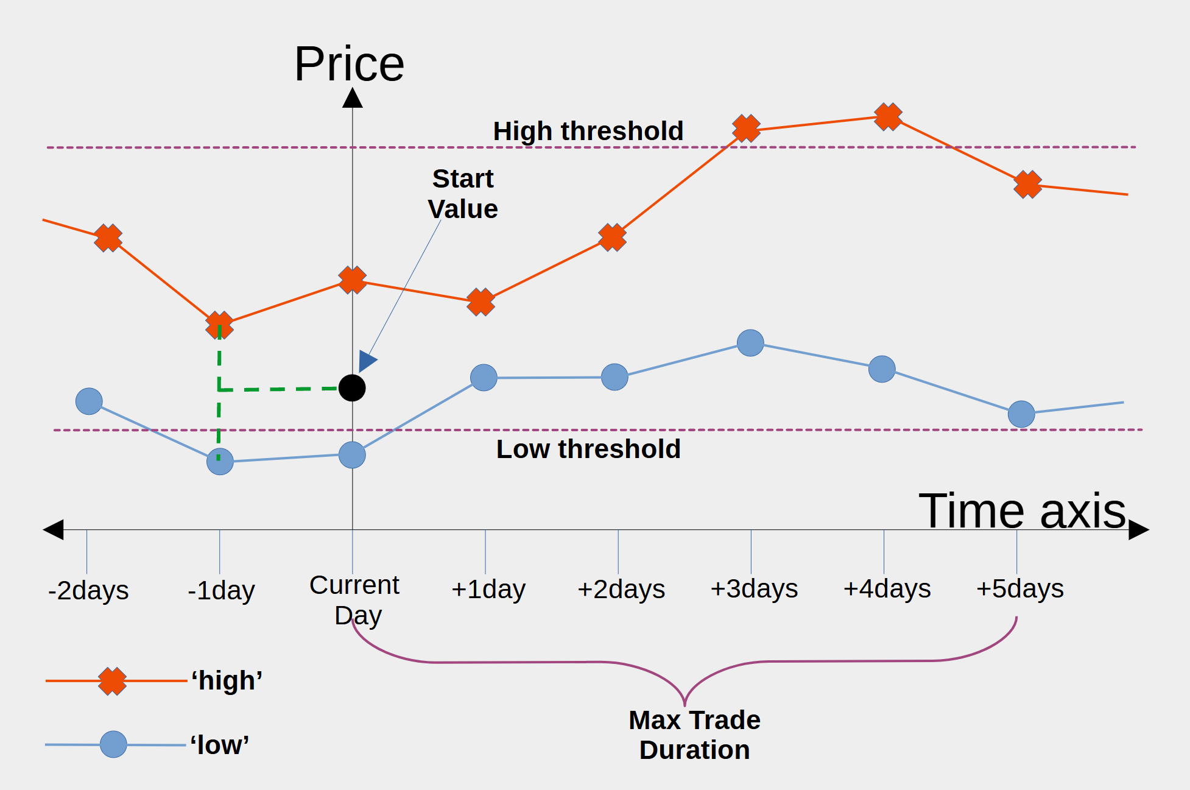
Stock screening
High & Low thresholds are calculated using the Start Value, Trade Size, Target Trade Profit and Trade Loss Limit.
These parameters are used to screen the stocks and rank them by Occurrence opportunity.

Slide 8
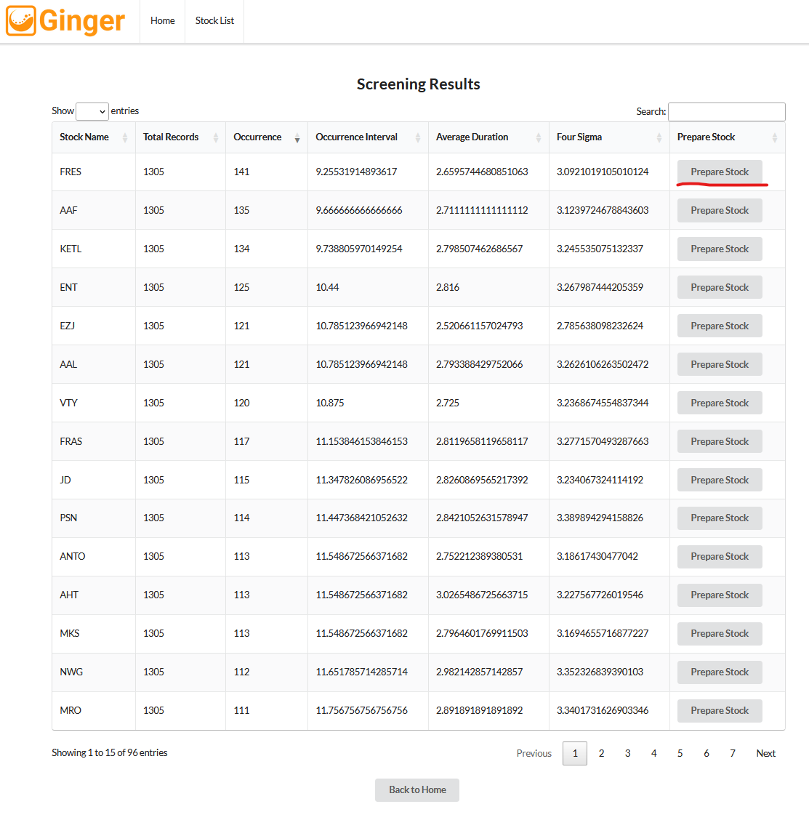
Stock data exploration & selection
The user can look at the curves for the preferred stocks in the database.
Then choose which one to go for.

Slide 9
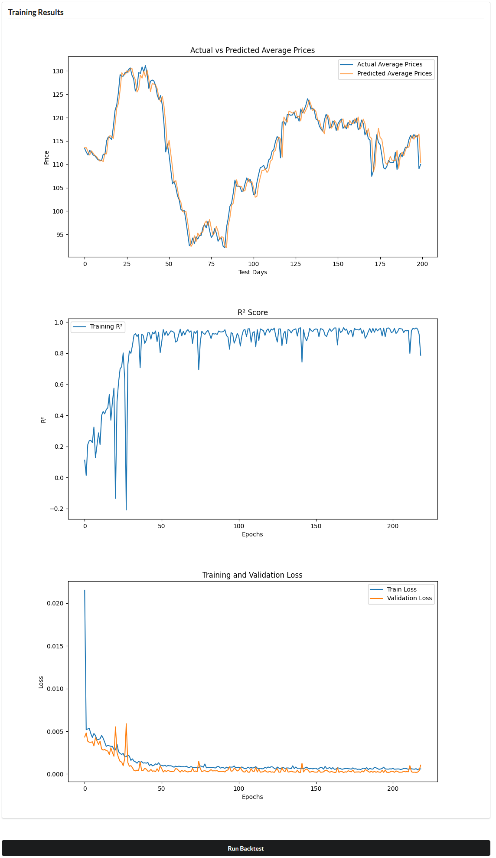
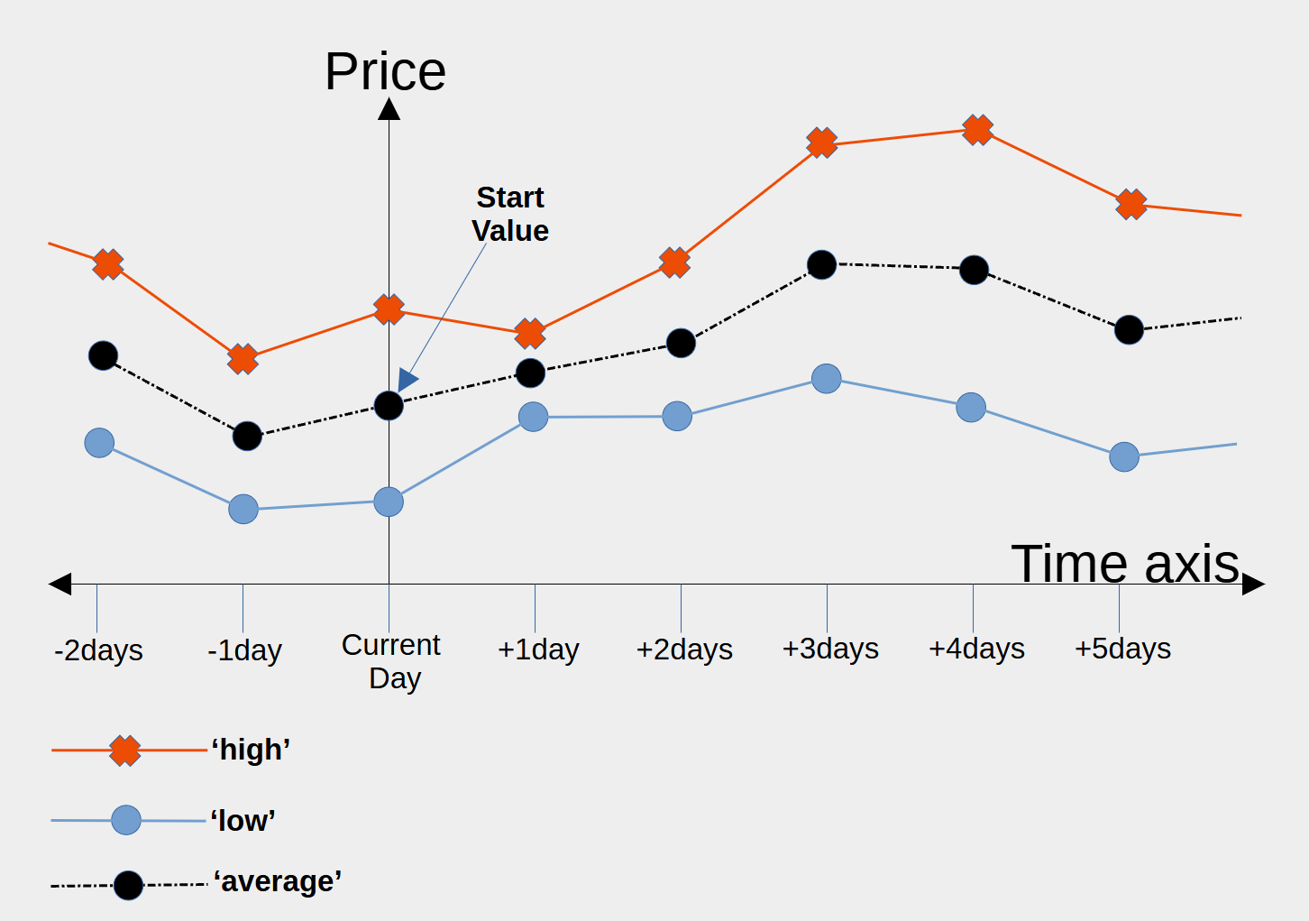
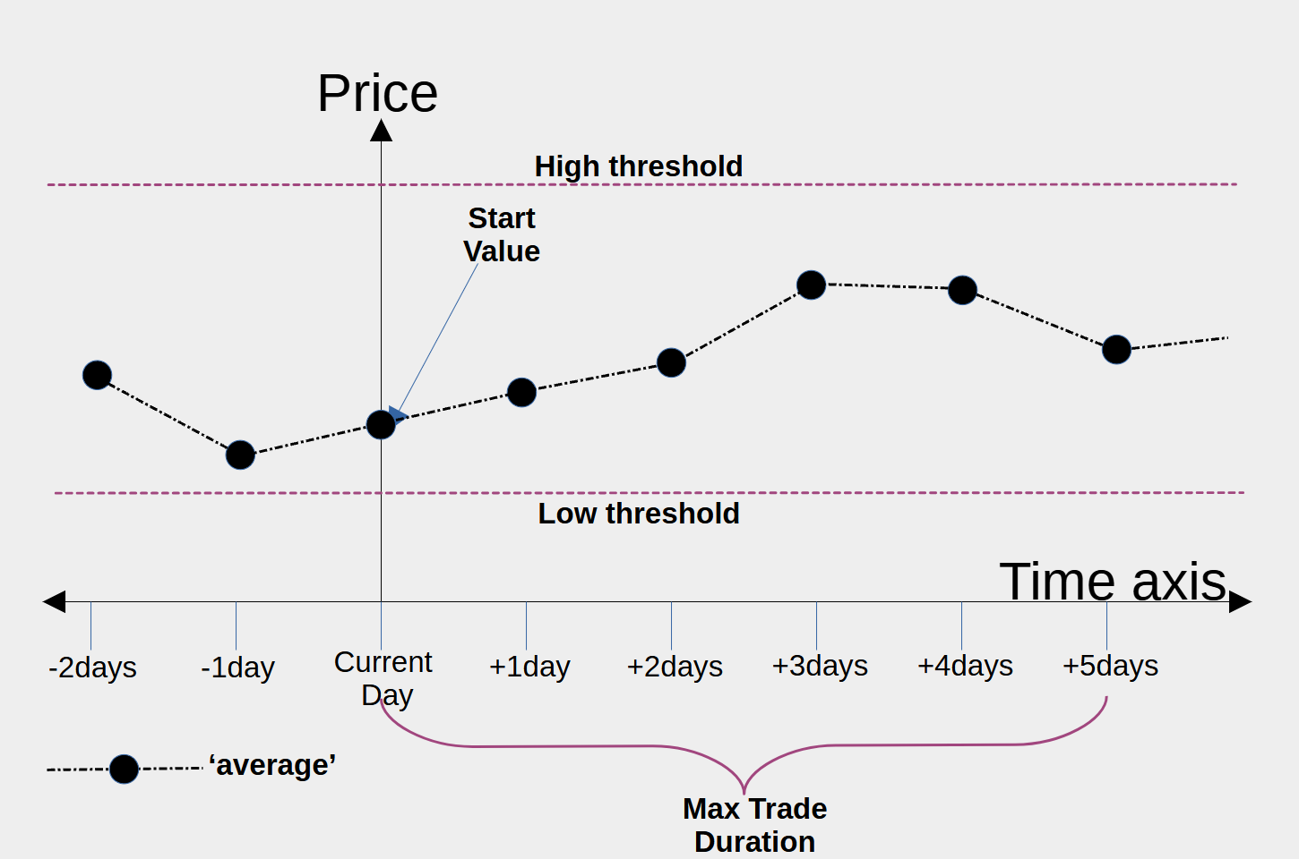
ML Model selection and training
Option of a ‘High Low Mean’ ML model or a ‘High Low’ ML model. Only former implemented at present.
Once the user hits the Train Model button the selected machine learning model is trained. When it finishes the training results are presented.
High Low Mean model uses a simplified way of classifying good trade events.

Slide 10
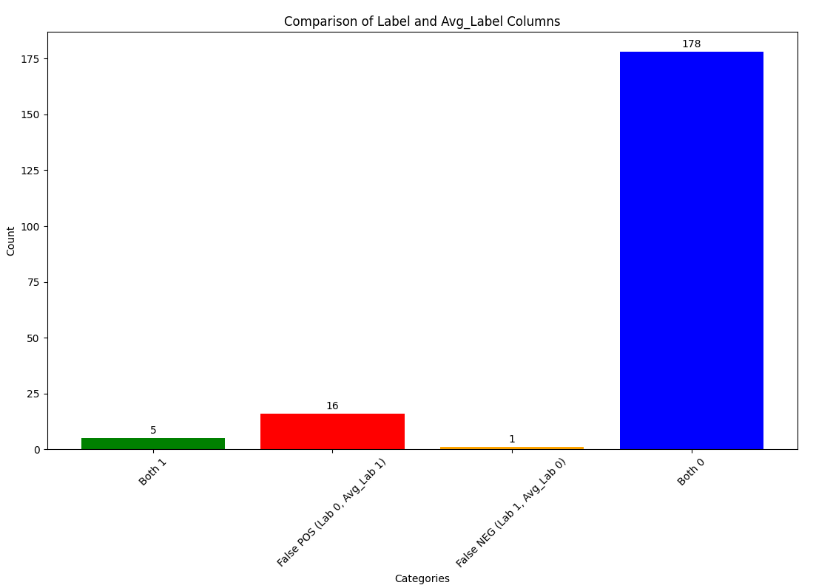
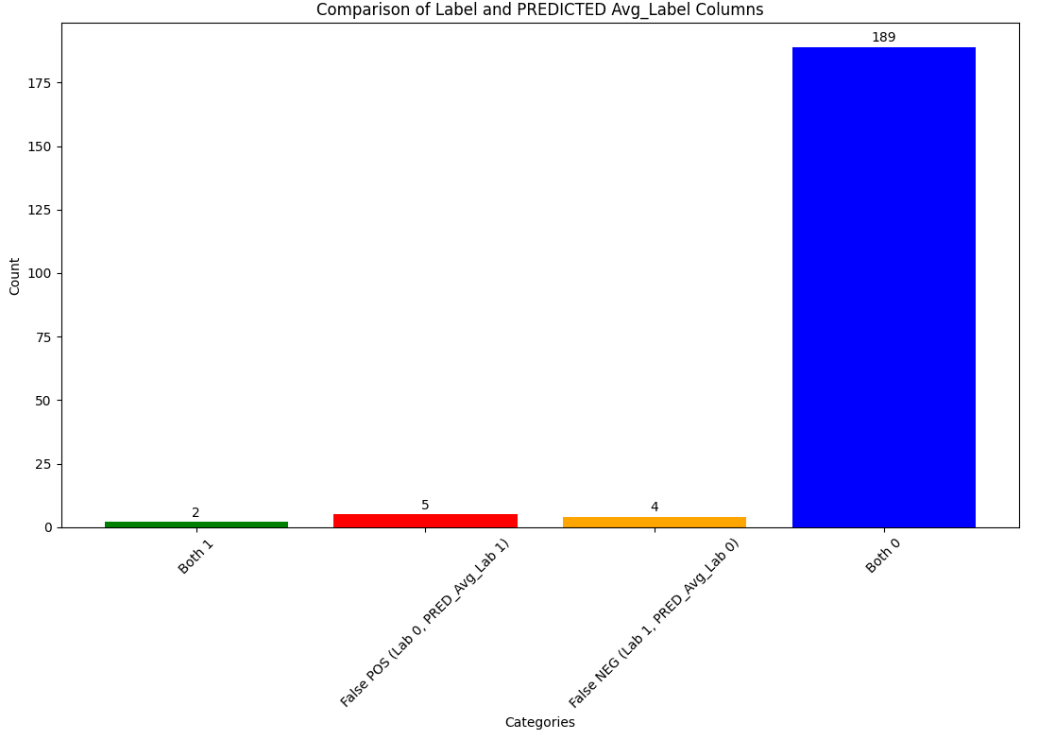
Back testing and results evaluation
This graph shows how well the ML model predicted using the simplified classification High-Low-Mean (averaged curves)
Not too bad but can improve!
This graph shows how well the simplified classification works (not to great!)

Slide 11
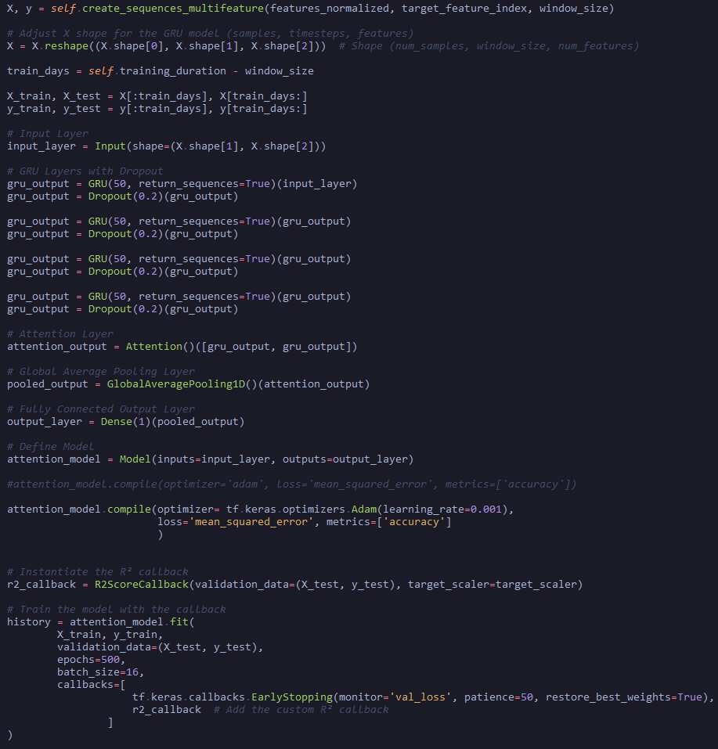
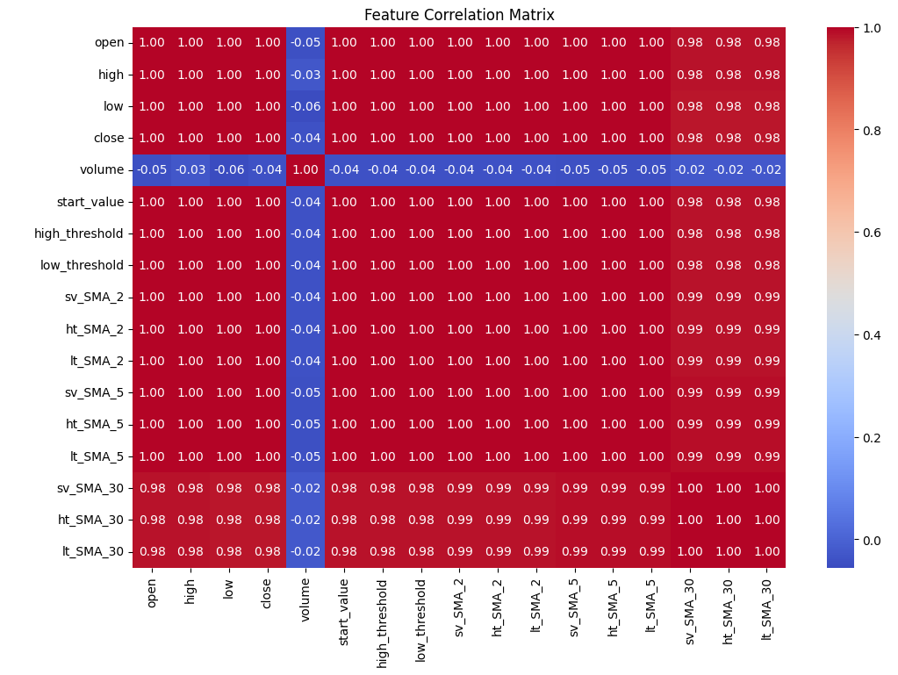
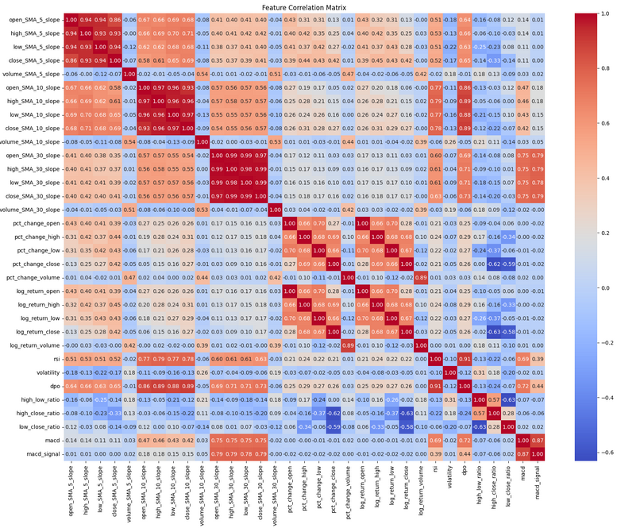
The Attention-GRU model
This is the RNN model that was developed.
Also tried LSTM, Dense Neural Network and a Random Forrest classifier.
Hyper parameter tuning.
Feature engineering.

