Slide 1
Introduction to Kivy
Colin Sauze
<cos@aber.ac.uk> or <csauze@aberlab.uk>

Slide 2
Contents
About me and background
What is Kivy?
Kivy Hello World
Buttons and events
Images
KV language
Kivy quirks

Slide 3
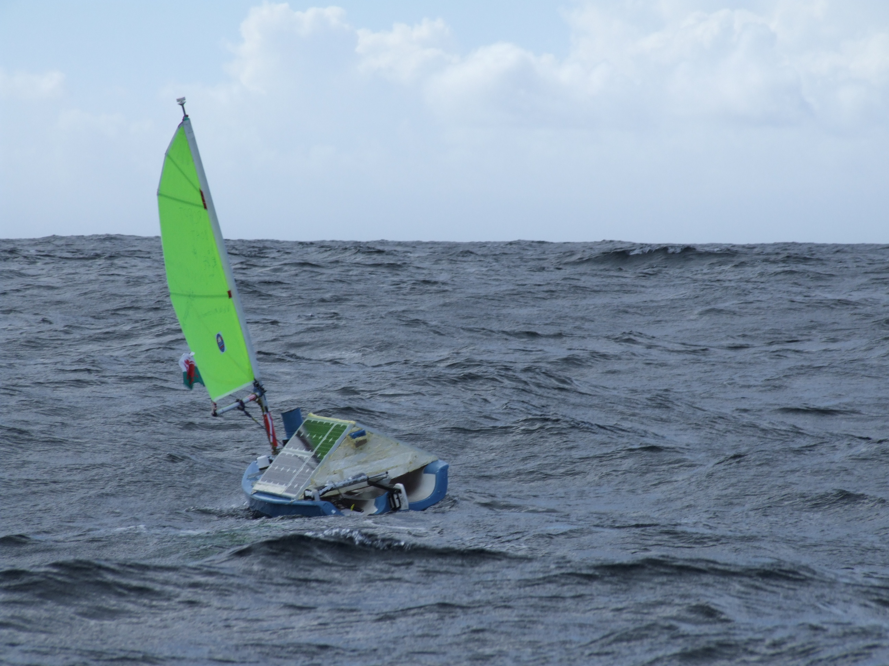
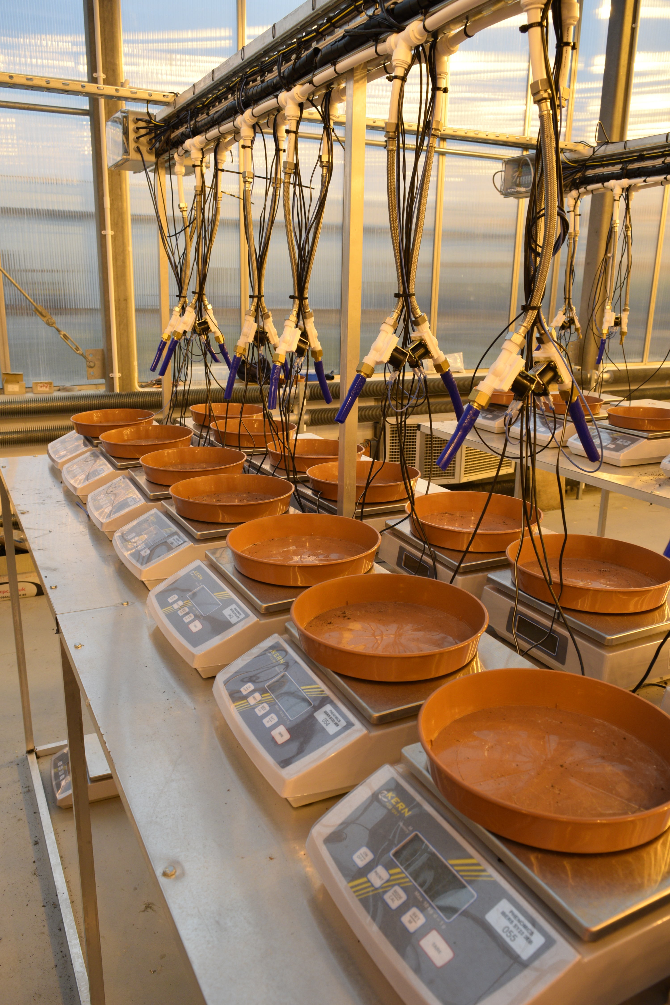
About Me
Data Manager at National Plant Phenomics Centre, IBERS, Aberystwyth University
Formerly in Department of Computer Science, Robotics PhD + Postdoc
Lots of Raspberry Pi's at work
  Camera triggering
  Temperature monitoring
  Watering systems
Raspberry Pi's at home
  Amateur Radio
  Weather Station (WIP)
  Media Players

Slide 4
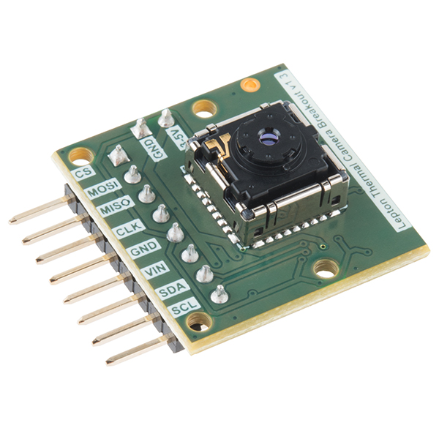
How I came to use Kivy
Interface FLIR Lepton Thermal imager
  Low cost (~£150)
  80x60 pixels
  Demo for showing kids about stress in plants
  Raspberry Pi + Touchscreen display

Slide 5
My requirements
Simple UI needed
  Only a shutdown button and image
  Fast startup time
X based examples for the Lepton
  Buttons too small for touchscreen
  Adds to startup time
Options considered:
  QT5
  Kivy
  Write direct to framebuffer in C
  Something X based, GTK perhaps
  Kivy appeared to offer path of least resistance

Slide 6
What is Kivy?
Cross platform python GUI platform
  Works in Windows, Mac, Linux, Android and iOS
  Touchscreen optimised
    Multitouch support
  Linux version runs in a framebuffer or X Windows
  OpenGL accelerated

Slide 7
Installing Kivy on the Pi
sudo apt-get install kivy-python - CHECKME
  Old version
  Missing some useful features
Sudo pip install kivy
  Newer version

Slide 8
Kivy Skeleton App
from kivy.app import App
from kivy.uix.widget import Widget
class TestWidget(Widget):
pass
class TestApp(App):
def build(self):
return TestWidget()
if __name__ == '__main__':
TestApp().run()
Empty widget causing blank screen
App class instantiates widget
Returning it, causes it to be displayed
Main runs App class
A widget is the building block of Kivy
Lets us draw things on the screen, receive input events etc.

Slide 9
Hello World
from kivy.app import App
from kivy.uix.label import Label
class TestApp(App):
def build(self):
l = Label(text="Hello world")
return l
if __name__ == '__main__':
TestApp().run()
Create a label
Returning it causes it to be displayed
Run's the TestApp class
We actually got away without creating a widget here.
Will need one for more complex things.

Slide 10
Buttons
from kivy.app import App
from kivy.uix.button import Button
class TestApp(App):
def build(self):
button = Button(text='Hello world')
button.bind(on_press=self.callback)
return button
def callback(self,event):
print "Pressed Button"
if __name__ == '__main__':
TestApp().run()
Create a button
With text “hello world”
Choose what function
Will be called when button is pressed
Called when button is pressed
Will print “Pressed Button” in terminal
This will make the button take over whole screen
Will talk about layouts later

Slide 11
Images
from kivy.app import App
from kivy.uix.image import Image
class TestApp(App):
def build(self):
image = Image(source='picymru.png')
return image
if __name__ == '__main__':
TestApp().run()
Create an image from the file “picymru.png”

Slide 12
Layouts
Need to be able to manage how/where things appear on screen.
Add multiple “widgets” such as buttons or images to the layout
Each will appear in a different location
from kivy.app import App
from kivy.uix.gridlayout import GridLayout
from kivy.uix.button import Button
from kivy.uix.image import Image
class TestApp(App):
def build(self):
layout = GridLayout(cols=2,rows=2)
layout.add_widget(Button(text="1"))
layout.add_widget(Button(text="2"))
layout.add_widget(Button(text="3"))
layout.add_widget(Image(source='picymru.png'))
return layout
if __name__ == '__main__':
TestApp().run()
Arrange layout as 2x2 grid
Other layout options are
available
Create a button with a “1” in the first cell
Create a button with a “2” in the second cell
Create an image in the fourth cell.

Slide 13
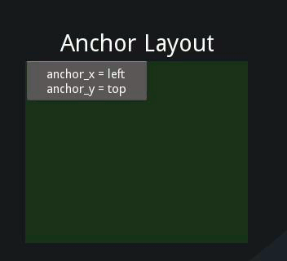
Anchor Layout
Aligns items to a border:
  top, bottom, left, right or center
  layout = AnchorLayout(anchor_x='right', anchor_y='bottom')

Slide 14
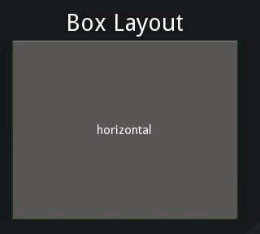
Box Layout
Horizontal or Vertical Boxes
layout = BoxLayout(orientation='vertical')

Slide 15
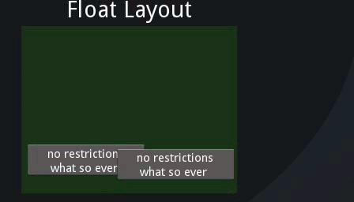
Float, Relative and Scatter Layout
Float Layout
  No restrictions
  Need to give explicit locations
  Pos argument to widgets
    e.g. button = Button(text='Hello',pos=(2, 2))
Relative Layout
  Like float layout
  But locations are relative
  Not absolute
Scatter Layout
  Like relative layout
  Widgets can be rotated or scaled

Slide 16
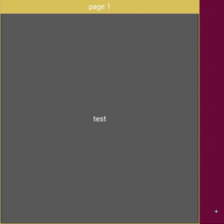
Page Layout
Sliding/Flipping Pages
Think mobile app

Slide 17
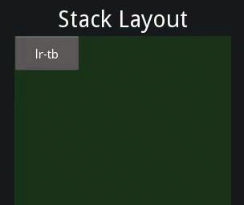
Stack Layout
Widgets added in horizontal or vertical stack
Don't all have to be same size

Slide 18
KV Language
As interfaces get complicated we need a lot of code
Mixing of code between layout and program logic
KV language alternate language to design interface
Leave Python code to do the logic
KV is to Kivy what CSS is to HTML/Javascript

Slide 19
KV Example
6.py:
test.kv
Set GridLayout
Force width
Without this, it displays wrong
from kivy.app import App
from kivy.uix.widget import Widget
class TestWidget(Widget):
pass
class TestApp(App):
def build(self):
return TestWidget()
if __name__ == '__main__':
TestApp().run()
<TestWidget>:
GridLayout:
width: 800
height: 600
cols: 2
rows: 2
Button:
text: "1"
Button:
text: "2"
Button:
text: "3"
Image:
source: "picymru.png"
Make Buttons
Creates a widget called TestWidget
Display image

Slide 20
KV and button events
from kivy.app import App
from kivy.uix.widget import Widget
class TestWidget(Widget):
def button_handler(self):
print "button pressed"
class TestApp(App):
def build(self):
return TestWidget()
if __name__ == '__main__':
TestApp().run()
Handler for button presses
Name of function to do call backs when pressing button.
#:kivy 1.2.0
<TestWidget>:
Button:
text: "1"
on_press: root.button_handler()

Slide 21
Kivy Quirks and Gotchas
Multiple ways to do things
Widgets vs Apps
Naming of KV files and class names
  Kv file should be all lower case
  Named after the class which runs first in the .py file
  If class name ends “App” (e.g. TestApp”) then just include first bit. Kv file for class caled TestApp is test.kv

Slide 22
Controls Gallery
Run showcase example

Slide 23
Thermal Imager Demo

Slide 24
Find out More
Kivy Tutorials - https://kivy.org/docs/tutorials-index.html
  Pong game
  Simple Drawing
Gallery of Examples - https://kivy.org/docs/examples/index.html
Kivy Crash Course (with Youtube videos) - http://inclem.net/pages/kivy-crash-course/

