Slide 1

Stock Data ETL
Group 1

Slide 2
Idea: Consolidate Data Available for New York Stock Exchange
Extract: Financial Analysis Data
Transform: Consolidate data
Load: Financial Analysis Database

Slide 3
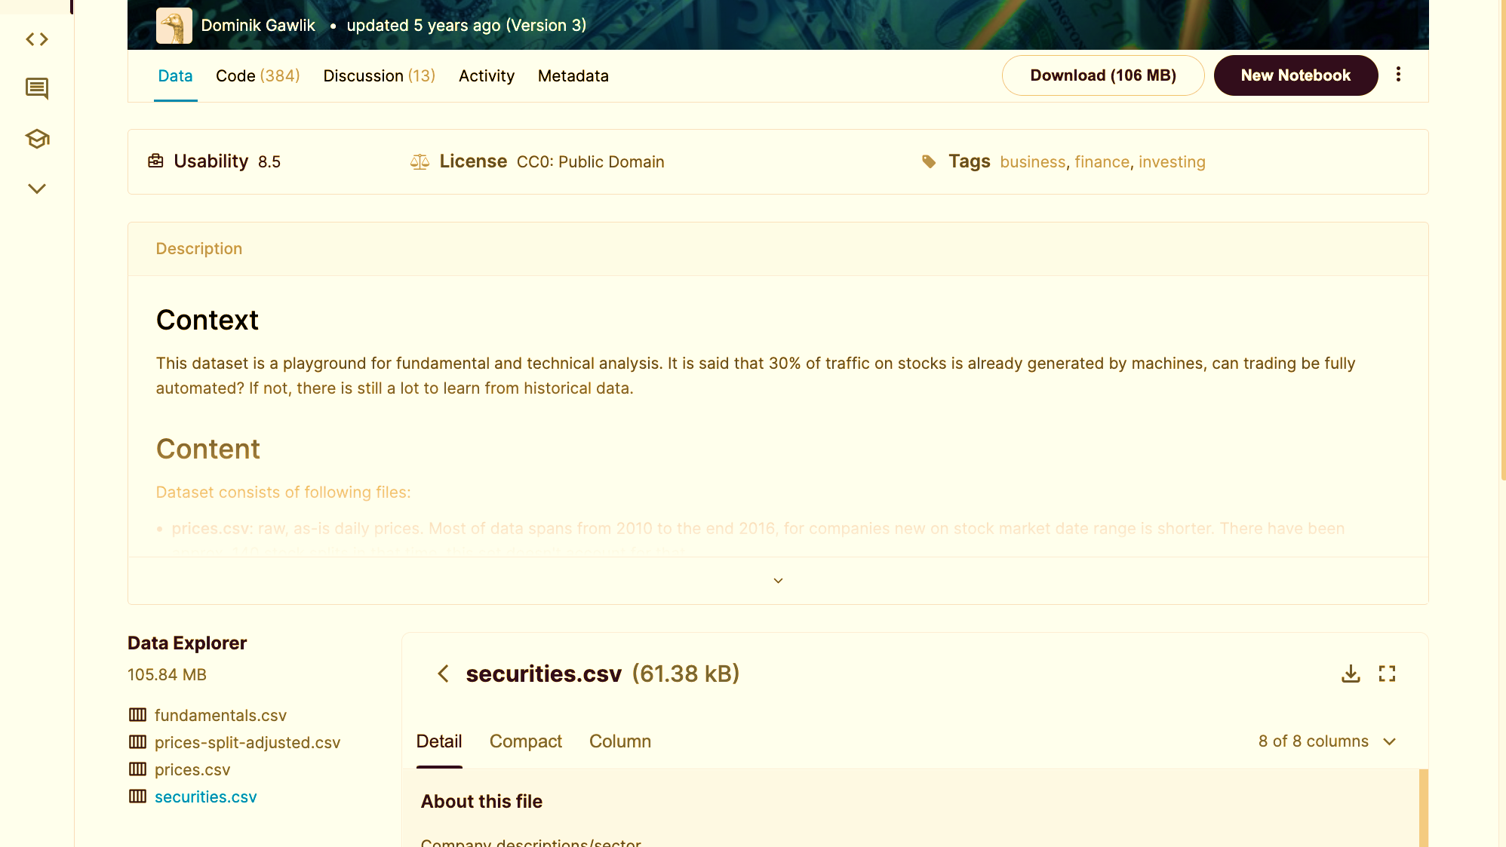
Content : Kaggle - NYSE
Dataset consists of following files:
prices.csv : raw, as-is daily prices. Most of data spans from 2010 to the end 2016, for companies new on stock market date range is shorter. There have been approx. 140 stock splits in that time, this set doesn't account for that.
securities.csv : general description of each company with division on sectors
fundamentals.csv : metrics extracted from annual SEC 10K fillings (2012-2016), should be enough to derive most of popular fundamental indicators.

Slide 4
Extract

Slide 5
Transform

Slide 6
Load

Slide 7
Database

Slide 8
Works Cited
://www.kaggle.com/dgawlik/nyse?select=securities.csv
Prices were fetched from Yahoo Finance, fundamentals are from Nasdaq Financials, extended by some fields from EDGAR SEC databases.

