Slide 1
Programmable Logic (PL)
Processing System (PS)
HLS Accelerated Block
AXI/DMA Interconnect
Zynq-7000
S_AXI4
32
M_AXI4
S_AXI3
32
M_AXI3_GPO
DDR Memory
M_AXIS_OUTPUT
64
S_AXIS4
S_AXIS_INPUT0
64
M_AXIS4_0
M_AXI3_0
64
S_AXI3_HP0
32
S_AXIS_INPUT1
64
M_AXIS4_1
M_AXI3_1
64
S_AXI3_HP1
S_AXIS_INPUT2
64
M_AXIS4_2
M_AXI3_2
64
S_AXI3_HP2
S_AXIS_INPUT3
64
M_AXIS4_3
M_AXI3_3
64
S_AXI3_HP3
FCLK
FCLK
FCLK
* Reset and interrupt signals are not displayed for readability purposes

Slide 2
Programmable Logic (PL)
Processing System (PS)
HLS Accelerated Block
AXI/DMA Interconnect
Zynq-7000
S_AXI4
32
M_AXI4
S_AXI3
32
M_AXI3_GPO
M_AXIS_OUTPUT
64
S_AXIS4
DDR Memory
S_AXIS_INPUT0
64
M_AXIS4_0
M_AXI3_0
64
S_AXI3_HP0
32
S_AXIS_INPUT1
64
M_AXIS4_1
M_AXI3_1
64
S_AXI3_HP1
S_AXIS_INPUT2
64
M_AXIS4_2
M_AXI3_2
64
S_AXI3_HP2
S_AXIS_INPUT3
64
M_AXIS4_3
M_AXI3_3
64
S_AXI3_HP3
FCLK
FCLK
FCLK

Slide 3
Input/Output
Zynq-700
32
S_AXI_LITE
HLS Block
M_AXIS_OUTPUT
M_AXIS_TX
M_AXI_TX
64
AXI0
AXI4
AXI3
S
AXI
64
S_AXI
M_AXI
S_AXI3_HP0
S_AXIS_INPUT1
M_AXIS_RX
M_AXI_RX
64
AXI1
S
M
S_AXI
32
AXI Crossbar
AXI Protocol Converter
AXI Direct Memory Access
M
AXI0
32
S_AXI_LITE
AXI4
AXI3
M
AXI1
S_AXIS_INPUT1
M_AXIS_RX
M_AXI_RX
64
S_AXI
M_AXI
S_AXI3_HP1
AXI
S
M
AXI2
AXI Direct Memory Access
AXI Protocol Converter
M
AXI3
M
AXI4
32
S_AXI_LITE
AXI4
AXI3
AXI Crossbar
S_AXIS_INPUT2
M_AXIS_RX
M_AXI_RX
64
S_AXI
M_AXI
S_AXI3_HP2
32
AXI Direct Memory Access
AXI Protocol Converter
32
S_AXI_LITE
AXI4
AXI3
AXI4-L
AXI3
S_AXIS_INPUT3
M_AXIS_RX
M_AXI_RX
64
S_AXI
M_AXI
S_AXI3_HP3
S_AXI
S_AXI
M_AXI
AXI Direct Memory Access
AXI Protocol Converter
32
AXI Protocol Converter
* Reset, clock and interrupt signals are not displayed for readability purposes

Slide 4
Firings Inputs
Synapse Weights
Neuron Types
Synapse Potential
Update Synapses per neuron
Synapse Potential
Neuron Potential
Get total conductance per synapses
Izhikevich’ s equations per neuron
Accumulated Conductance
Neuron Potential
Number of Neurons
Neurons per Layer
Processing Block
External Inputs
Number of Neurons
Internal Variables
Loop

Slide 5
Firings Inputs
Synapse Weights
Neuron Types
Synapse Potential
Update Synapses per neuron
Synapse Potential
Neuron Potential
Get total conductance per synapses
Accumulated Conductance
Izhikevich’ s equations per neuron
Neuron Potential
Number of Neurons
Neurons per Layer
Processing Block
External Inputs
Number of Neurons
Internal Variables
Loop

Slide 6
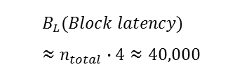
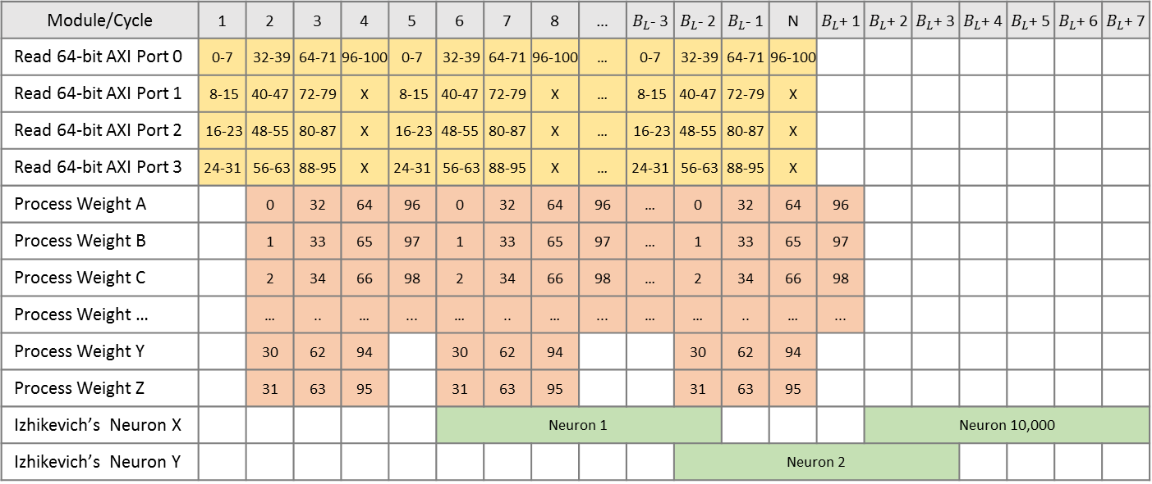
Neuron 1
Neuron 2
Neuron 10,000
$$B_{L}(Block latency) \\ ≈n_{total}∙4≈40,000$$
Module/Cycle | 1 | 2 | 3 | 4 | 5 | 6 | 7 | 8 | … | $B_{L}$- 3 | $B_{L}$- 2 | $B_{L}$- 1 | N | $B_{L}$+ 1 | $B_{L}$+ 2 | $B_{L}$+ 3 | $B_{L}$+ 4 | $B_{L}$+ 5 | $B_{L}$+ 6 | $B_{L}$+ 7
Read 64-bit AXI Port 0 | 0-7 | 32-39 | 64-71 | 96-100 | 0-7 | 32-39 | 64-71 | 96-100 | … | 0-7 | 32-39 | 64-71 | 96-100
Read 64-bit AXI Port 1 | 8-15 | 40-47 | 72-79 | X | 8-15 | 40-47 | 72-79 | X | … | 8-15 | 40-47 | 72-79 | X
Read 64-bit AXI Port 2 | 16-23 | 48-55 | 80-87 | X | 16-23 | 48-55 | 80-87 | X | … | 16-23 | 48-55 | 80-87 | X
Read 64-bit AXI Port 3 | 24-31 | 56-63 | 88-95 | X | 24-31 | 56-63 | 88-95 | X | … | 24-31 | 56-63 | 88-95 | X
Process Weight A |  | 0 | 32 | 64 | 96 | 0 | 32 | 64 | 96 | … | 0 | 32 | 64 | 96
Process Weight B |  | 1 | 33 | 65 | 97 | 1 | 33 | 65 | 97 | … | 1 | 33 | 65 | 97
Process Weight C |  | 2 | 34 | 66 | 98 | 2 | 34 | 66 | 98 | … | 2 | 34 | 66 | 98
Process Weight … |  | … | .. | … | ... | … | .. | … | ... | … | … | .. | … | ...
Process Weight Y |  | 30 | 62 | 94 |  | 30 | 62 | 94 |  |  | 30 | 62 | 94
Process Weight Z |  | 31 | 63 | 95 |  | 31 | 63 | 95 |  |  | 31 | 63 | 95
Izhikevich’s Neuron X |  |  |  |  |  | Neuron 1 |  |  |  |  |  |  |  |  | Neuron 10,000
Izhikevich’s Neuron Y |  |  |  |  |  |  |  |  |  |  | Neuron 2
256 bits per cycle
Iteration Latency
Weights Read
Accumulated conductance
Izhikevich’s model processing

Slide 7
Logical Representation
HLS Block
0
1
2
3
4
5
6
…
-7
-6
-5
-4
-3
-2
-1
AXI Stream Reader/Converter
0
1
2
3
4
5
6
…
25
26
27
28
29
30
31
32
33
34
35
36
37
38
…
57
58
59
60
61
62
63
4 x 64-bit FIFO streams
Neuron 1
Array 0
96-100 | 64-71 | 32-39 | 0-7 | … | 96-100 | 64-71
HP0
Array 1
X | 72-79 | 40-47 | 8-15 | … | X | 72-79
HP1
3
X | 80-87 | 48-55 | 16-23 | … | X | 80-87
100
Array 2
HP2
3
Neuron 10,000
100
3
100
Array 3
X | 88-95 | 56-63 | 24-31 | … | X | 88-95
HP3
3
100
3
100
3
Neuron 1
100
Neuron 10,000
3
100
256 bit sent per cycle
Neuron 1
64-bit data
X
Doesn’t care
8-bit data
32 weights processed in parallel per cycle

Slide 8
Memory operations
Arithmetic operations and expressions
Module/Cycle | 1 | 2 | 3 | 4 | 5 | 6 | 7 | … | 9999 | N | N+1 | N+2 | N+3 | N+4 | N+5 | N+6
Read potential V (Port A) | 1 |  | 4 |  | 5 |  | ... |  | N-1
Read potential V (Port B) |  | 2 |  | 4 |  | 6 |  | … |  | N
Read input firing (Port A) |  | 1 | 2 | 3 | 4 | 5 | 6 | … | … | N-1 | N
Read synapse potential (Port A) |  |  | 1 | 2 | 3 | 4 | 5 | 6 | … | … | N-1 | N
Expressions/Multiplexers |  |  |  | 1 | 2 | 3 | 4 | 5 | 6 | … | … | N-1 | N
Mult (Synapse x Decay Factor) |  |  |  |  | 1 | 2 | 3 | 4 | 5 | 6 | … | … | N-1 | N
Add (Synapse + 1.0) |  |  |  |  |  | 1 | 2 | 3 | 4 | 5 | 6 | … | … | N-1 | N
Write synapse potential (Port B) |  |  |  |  |  |  | 1 | 2 | 3 | 4 | 5 | 6 | … | … | N-1 | N
1 neuron per cycle
Iteration Latency

Slide 9
Iteration/Cycle | 1 | 2 | 3 | 4 | 5 | 6 | … | N | N+1 | N+2 | N+3
Iteration 1 | A | B | C | D
Iteration 2 |  | A | B | C | D
Iteration 3 |  |  | A | B | C | D
…
Iteration N |  |  |  |  |  |  |  | A | B | C | D
Iteration/Cycle | 1 | 2 | 3 | 4 | 5 | 6 | … | N/2 | N/2+1 | N/2+2 | N/2+3
Iteration 1 | A1 | B1 | C1 | D1
Iteration 1 | A2 | B2 | C2 | D2
Iteration 3 |  | A1 | B1 | C1 | D1
Iteration 4 |  | A2 | B2 | C2 | D2
…
Iteration N-1 |  |  |  |  |  |  |  | A1 | B1 | C1 | D1
Iteration N |  |  |  |  |  |  |  | A2 | B2 | C2 | D2

Slide 10


HLS Block Updates
HLS Block Synthesis & Analysis
Simulation of HLS Block
Export RTL of HLS Block
5-10
1-2
Bit stream Generation
System Implementation
System Synthesis
System Blocks Design
5-10
10-20
20-60
C/C++ Algorithm, HW Drivers Updates
Vivado High-Level Synthesis
Zynq-7000 Simulation
Vivado IP Integrator
Xilinx Software Development Kit
Automatic process time (minutes)
< 1
Manual process (Workings required)

Slide 11
HLS Block Updates
HLS Block Synthesis & Analysis
Simulation of HLS Block
Export RTL of HLS Block
5-10
1-2
Bit stream Generation
System Implementation
System Synthesis
System Blocks Design
5-10
10-20
20-60
C/C++ Algorithm, HW Drivers Updates
Vivado High-Level Synthesis
Zynq-7000 Simulation
Vivado IP Integrator
Xilinx Software Development Kit
Automatic process time (minutes)
< 1
Manual process (Workings required)

Slide 12
Input Layer
Hidden Layer
Output Layer
Data flow

Slide 13
Input Layer
Hidden Layer
Output Layer
Input-Output flow
Loop feedback

Slide 14
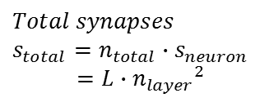




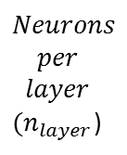
Input Layer
Hidden Layers
Output Layer
$Number$ of neurons
$$n_{total}=L∙n_{layer}$$
$$Neurons \\ per \\ layer$$ $(n_{layer}$)
$$Synapses per neuron$$
$$s_{neuron}=n_{layer}$$
.
.
.
.
.
.
.
.
.
.
.
.
$$Total synapses$$
$$s_{total}=n_{total}∙s_{neuron} \\ =L∙{n_{layer}}^{2}$$
$$Layers (L)$$
$Synapses per neuron$ ($s_{neuron}$)
Input Layer
Hidden Layers
Output Layer
.
.
.
.
.
.
.
.
.
.
.
.
Zero weight
Inactive neuron

Slide 15
Input Layer
Hidden Layers
Output Layer
Neurons per layer
.
.
.
.
.
.
.
.
.
.
.
.
.
.
.
Number of layers
Synapses per neuron
Target Firing Rate
In
H1
H2
H3
H4
Current Firing Rate
Out

Slide 16












$$E_{1}$$
$$w_{k1}$$
$$E_{2}$$
$$w_{k2}$$
.
$$v_{k}$$
.
$$Σ$$
.
$$s_{k}$$
$$I_{syn}$$
$$E_{N−2}$$
$$w_{k_{N−2}}$$
$$E_{N−1}$$
$$w_{k_{N−1}}$$

Slide 17
Resource/Cycle | 0 | 10 | 20 | 30 | 40 | 50 | 60 | 70 | 80
Resource A
Resource B
Resource C
Resource D
Case A
10
10
10
5 ns
4
4
4
7
7
7
3
3
3
Resource/Cycle | 0 | 5 | 10 | 15 | 20 | 25 | 30 | 35 | 40 | 45 | 50 | 55 | 60 | 65 | 70 | 75 | 80 | 85
Resource A
Resource B
Resource C
Resource D
Case B
13
13
13
13
10 ns
4
4
4
4
9
9
9
9
3
3
3
3
Dependency

Slide 18
OR
AND
1
0
1
1
0
0
1
0
XOR
1
0
0
1

