Slide 1
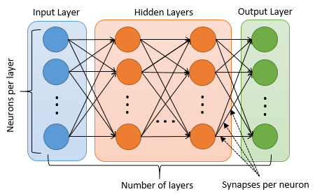
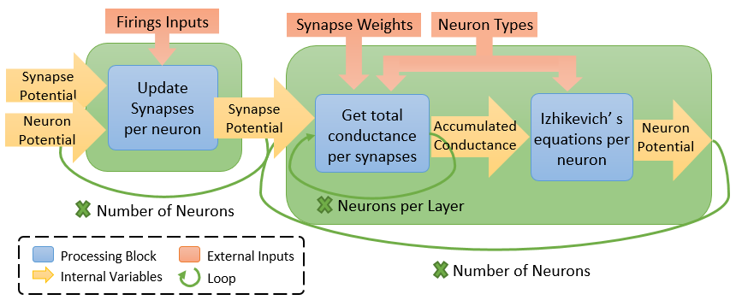
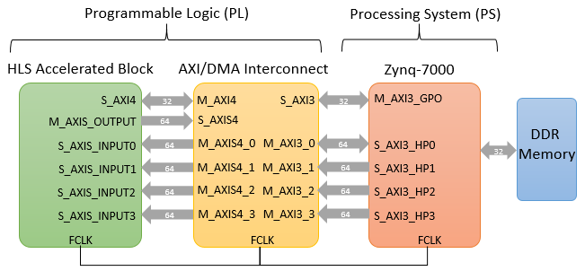






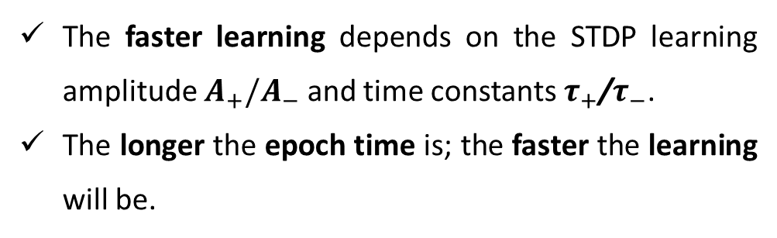
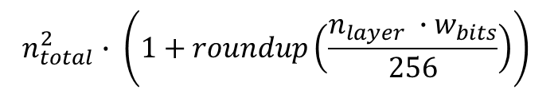
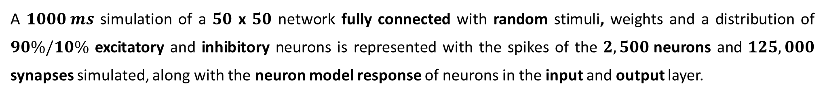
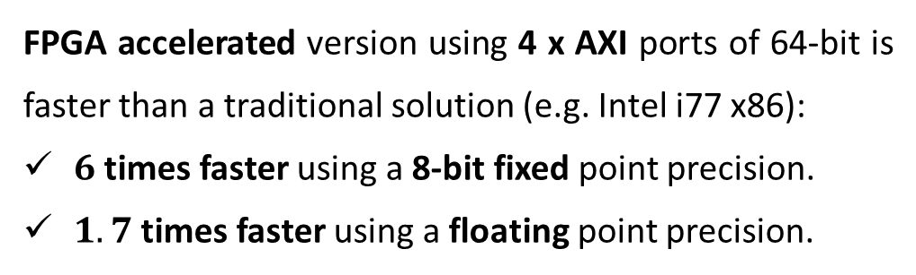

Building Brains with ARM Processors and FPGAs
By Felipe Galindo Sanchez Supervisor: Dr. J L Nunez-Yanez
Introduction
Implementation
High-performance simulations are required for understanding biological systems with neural networks of billions of neurons such as the human cerebral cortex.
FPGA and GPU-based implementations of spiking neural networks (SNN) have become attractive [1] for addressing high-performance and low-power requirements.
Deep learning techniques [2] have become appealing for applications with large amounts of data processing such as speech recognition, computer vision, drug discovery, among others.
Feed-forward network based on neuron model described by Izhikevich [3].
For a $N$ x $N$ network, $N^{2}$ neurons and $N^{3}$ synapses are being simulated.
Models are simulated with a step time of $0.5 ms$, while the overall block is 1$ms$.
Critical latency is defined by the input throughput of the${ N}^{3}$ synapses.
256 synapse-bits are processed parallel per cycle.
The hardware block latency is defined as:
Objectives
Research neuron models and network topologies: computational complexity, power consumption and biological plausibility.
Apply high-level synthesis (HLS) optimizations to the proposed spiking neural network (SNN) using Vivado tools.
Analyze the overall performance and power consumption of the solutions after implementing the different simulation architectures.
Evaluate deep learning algorithms for the resolution of specific tasks.
$$n_{total}^{2}∙ \left(1+roundup\left(\frac{n_{layer} ∙w_{bits}}{256}\right)\right)$$
Data flows though 4 x AXI ports of 64-bits and 1 x AXI lite of 32-bit for control.
Overall system is evaluated in a Zynq-7000 SoC [4] containing a dual core ARM Cortex-A9 and an Artix-7 FPGA.
Results & Analysis
Performance Latency
Energy Consumption
Spike timing cross-correlation of floating and fixed precision
Based on the energy required by a traditional solution (e.g. Intel i7 mobile processor), the FPGA/ARM accelerated implementation requires only:
From $0.1\%$ to 2.3$\%$ using a 8-bit fixed point precision.
From $0.2\%$ to 8.4$\%$ using a floating point precision.
$90\%$ of spikes are correlated precision with a zero delay against a 32 and 16-bits fixed implementation.
$87\%$ of spikes are distributed with a delay of $1.5±2 ms$ for a 8-bit fixed precision.
Autocorrelation error of firing rates in the output later of a 30x30 network is less than $0.0437\%$
FPGA accelerated version using 4 x AXI ports of 64-bit is faster than a traditional solution (e.g. Intel i77 x86):
$6$ times faster using a 8-bit fixed point precision.
$1.7$ times faster using a floating point precision.
Simulations
Conclusions
A $1000 ms$ simulation of a $50$ x $50$ network fully connected with random stimuli, weights and a distribution of $90\%/10\%$ excitatory and inhibitory neurons is represented with the spikes of the $2,500$neurons and $125,000$ synapses simulated, along with the neuron model response of neurons in the input and output layer.
The FPGA-based neuron network achieves higher performance with lower power consumption than implementations using high-end Intel processors.
High-level synthesis (HLS) significantly increases productivity for any design complexity compared with using native hardware description language (e.g. VHDL or Verilog)
Numerical precision can increase the performance and reduce energy without a significant impact on the desired results.
A Hebbian-based learning algorithm has been applied to the network implemented in order to perform specific tasks.
Membrane Potential (mV)
Spike Timing Dependent Plasticity (STDP) Learning
XOR Benchmark
Expected behavior
$100 ms$ epoch
$200 ms$ epoch
3-6-1 topology with a first-to-spike encoding learns a XOR with a 98% accuracy in around 1,200 epochs.
Changes in weight decrease through the epochs.
References
The faster learning depends on the STDP learning amplitude $A_{+}/A_{−}$ and time constants $τ_{+}$/$τ_{−}$.
The longer the epoch time is; the faster the learning will be.
[1]. S. Areibi G. Lacey and G.W. Taylor, “Deep Learning on FPGAs: Past, Present, and Future,” CoRR, abs/1602.04283, 2016
[2]. LeCun, Y., Bengio, Y., & Hinton, G. (2015, May). Deep learning [Review]. Nature, 521, 436-444.
[3]. E. Izhikevich, “Simple model of spiking neurons,” IEEE Trans. Neural Netw. IEEE Transactions on Neural Networks, vol. 14, no. 6, pp. 1569–1572, 2003.
[4]. “Zynq-7000 All Programmable SoC Overview (DS190),” Xilinx, November-2015. [Online]. Available: http://www.xilinx.com/support/documentation/data_sheets/ds190-Zynq-7000-Overview.pdf. [Accessed: 2016].

