Slide 1
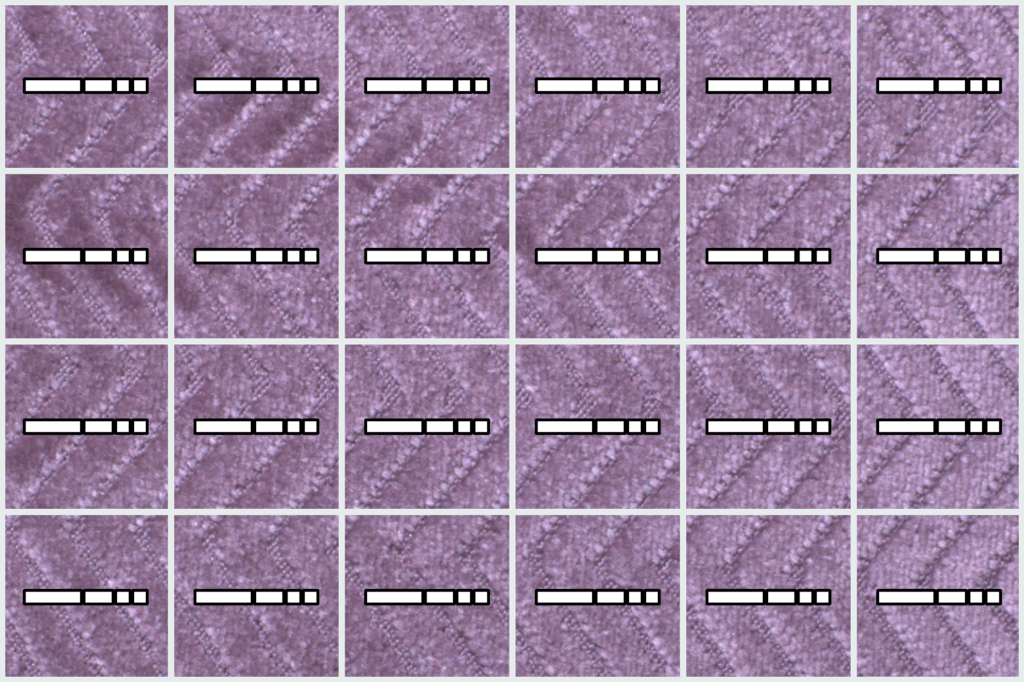
Latent n t
u′
u
g
Δu
ωi
ωo
Geometry decoder

