Slide 1
Productionizing ML model at scale with docker & kubernetes
Satya Narayan
Principal Software Engineer @Walmartlabs
August 2019

Slide 2
Agenda
Machine Learning Deployment Challenges
Machine learning in Kubernetes & docker
Rise of Model Servers
Clipper
Clipper Demo
Seldon core
Seldon Demo

Slide 3
Machine Learning Deployment challenges
Hidden Technical Debt in Machine Learning Systems – Google Paper
Data Verification
Machine Resource Management
Serving Infrastructure
Configuration
Monitoring
Data Collection
ML
Code
Analysis Tools
Feature extraction
Process
Management Tool
Only a small fraction ML systems is composed of the ML code.
The surrounding infrastructure is vast and complex. https://papers.nips.cc/paper/5656-hidden-technical-debt-in-machine-learning-systems.pdf

Slide 4
Challenges in ML deployment
Focus of ML ecosystem has been on model building, not deployment
Model Training
Deployment (MLOPS)
Data Ingestion
Data Prep
EDA
Feature Engg
Model Training
Model Deploy
Serving
Monitoring
Feedback & Re-train
Lack of frameworks for
Deployment
Monitoring
A/B testing , MAB
Feedback
Model interoperability
Multiple frameworks for
Data processing
Feature engineering
Training
Evolution

Slide 5
Challenges in model deployment
Diversity of ML ecosystem
Multiple Languages
Multiple ML Frameworks
Multiple Devices
R
Python
Scala
Java
Cuda(C++)
Sklearn
SparkML
Tensorflow
H2O
Pytorch
CPU
GPU
Edge
Makes it hard to have a single framework for deployment & MLOPS

Slide 6
Challenges in model deployment
Deployment
Auto scaling
Recovery & HA
Low latency, high throughput
Updates–
Rolling, Canary, Blue-green
Management
Monitoring
Auditing
Versioning
CI/CD
Security
Interface
Synchronous - Rest, gRPC
Asynchronous – message queue

Slide 7
Challenges in model deployment
Traditional approach
Rewrite of Model in Java/Scala
Difference in skillset, toolset
Leads to delay for deployment
Docker with flask
Latency & throughput challenge
Model interoperability
Ideal solution
Integrated framework
Recovery & HA
Low latency & high throughput
Support multiple framework
CI/CD,
Auditing Rest & gRPC support
Support for update

Slide 8

Machine Learning in Docker & Kubernetes
Kubernetes for ML
Autoscaling
Multi-tenancy
Fine grain resource control
Multiple ML/Pipeline framework
Tools for monitoring
Tools for service mesh
Itsio, Ambassador
Seldon core
Clipper
H2O
Argo
Kubrflow
Tensorflow
TF-Serving
Spark
Docker for ML
Isolation of environment
Reproducible ML
Ready to use data science env

Slide 9
Rise of Model Servers
Rapid emergence of new class of Model Servers for productionizing ML deployment and serving
Open Source
TensorServe - Google
Clipper - Berkley Rise Lab
Seldon core - Seldon.io
Apache PredictionIO
Deep Learning
TensorRT (Nvidia)
DeepDetect (Jolibrain)
MXNet Model Server (Amazon)
Determined.AI
Cloud
GCP - Cloud AI Platform
Azure - Azure ML
AWS - SageMaker
Clipper & Seldon core are based on docker k8s
We will do deep dive for them

Slide 10
Clipper.ai
Developed in UC Berkeley RISE lab.
Low latency prediction serving system
Supports wide range of ML frameworks
Container orchestration on Docker , K8s
https://rise.cs.berkeley.edu/wp-content/uploads/2017/02/clipper_final.pdf

Slide 11
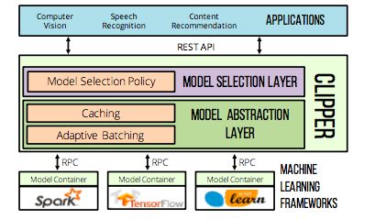
Clipper Architecture

Slide 12
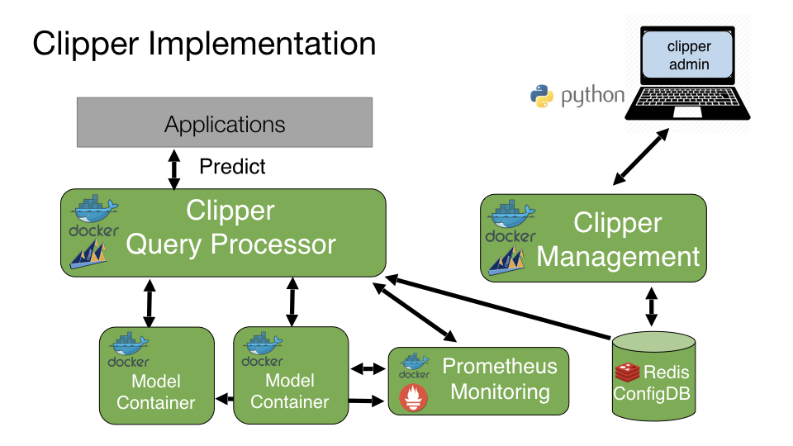
Clipper Container Orchestration
Two Container Manager
Docker Container Manager - Local
Kubernetes Container Manager - Production

Slide 13
Clipper
Key Capabilities
Simplifies model deployment
Model versioning
Improve throughput - millisecond latencies
Adaptive batching, caching, straggler mitigation
Deployer support
R, Python, PySpark, Keras
Model monitoring
key metrics, custom model metrics
Improve prediction accuracy
Support for state-of-the-art bandit & ensemble methods

Slide 14
Clipper Demo

Slide 15
Seldon.io
Seldon: London based AI company with offerings on ML serving,
Seldon core: Open source platform for deploying ML models on k8s
Built on K8s.
Wrapping model with S2I(Source-to-Image)
Supports Istio & Ambassador for Gateway
Support gRPC & Rest
Provides model monitoring - Grafana

Slide 16
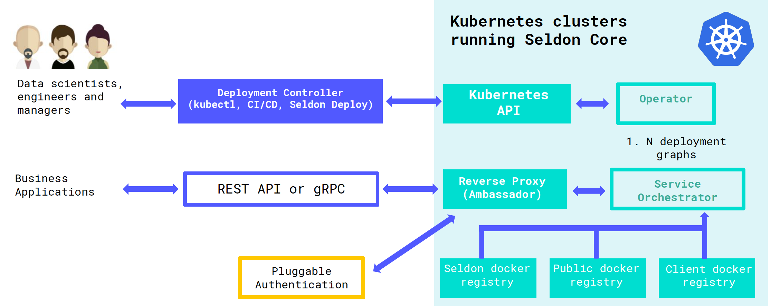
Seldon Core Architecture

Slide 17
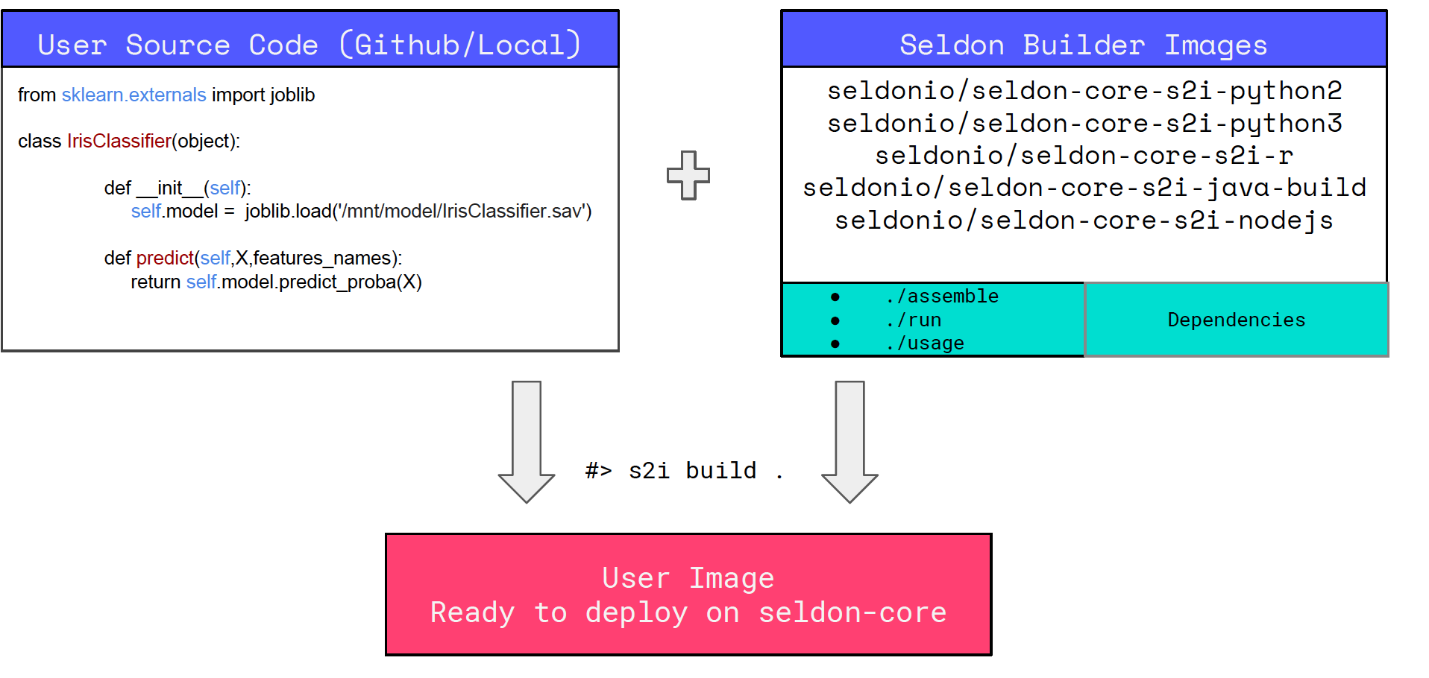
source-to-image(S2I)
S2I is toolkit to build reproducible container image from source code.
S2I produce ready-to-run image by injecting source code to builder image

Slide 18
Seldon
Key features
Seamless K8s Integration
Inference graph support
A/B testing, ensemblers, transformer etc
Support for wide range of ml framework
– R,Python,Spark,H2O,Keras
S2I (source-to-image) support , CI/CD
Update support
Rolling, Canary, Blue-Green etc
Monitoring, metrics, logging support

Slide 19
Seldon Demo

Slide 20
Q & A

Slide 21
References
http://clipper.ai/
https://github.com/SeldonIO/seldon-core
https://www.seldon.io/
https://papers.nips.cc/paper/5656-hidden-technical-debt-in-machine-learning-systems.pdf
https://github.com/openshift/source-to-image

