Slide 1

Multi-Stage Build and
Build Mount With Docker
Apurva Bhandari

Slide 2
Agenda
Working with Dockerfile
Cutting the Size of Image
Multi-Stage Build
Build Mount
Apurva Bhandari

Slide 3
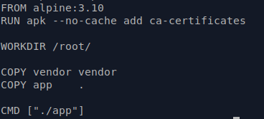
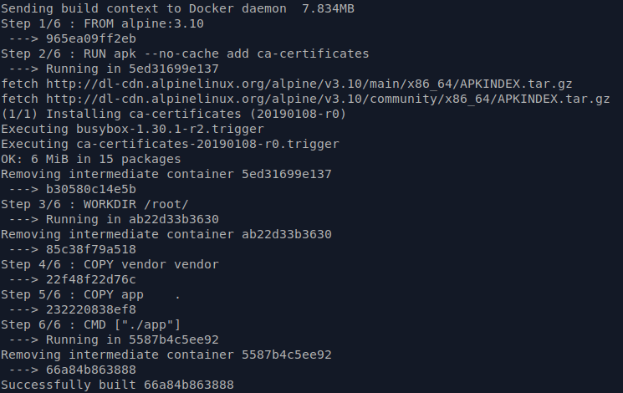
How Dockerfile Works
Dockerfile
Docker build
Apurva Bhandari

Slide 4
Builder pattern – Cut down Image Size
Example steps for Builder pattern;
Derive from a Golang base image with the whole runtime/SDK (Dockerfile.build)
Add source code
Produce a statically-linked binary
Copy the static binary from the image to the host (docker create, docker cp)
Derive from SCRATCH or some other light-weight image such as alpine (Dockerfile)
Add the binary back in
Push a tiny image to the Docker Hub
Apurva Bhandari

Slide 5
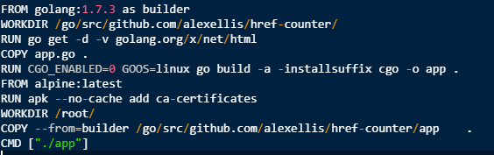
Multi-Stage Build
Dockerfile with Multi-Stage Build Example
Image Size before after
Apurva Bhandari

Slide 6
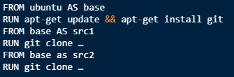

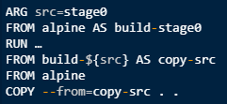

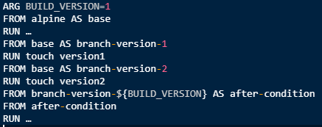
Multi-Build with Dockerfile
How to define in Dockerfile
Inheriting from a stage
Using images directly
Alias for a common image
Using build arguments in ` — from`
Conditions using build arguments
Apurva Bhandari

Slide 7
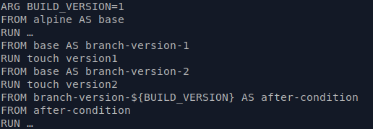
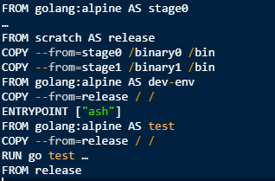
How to use Multi-Stage Build with Dockerfile
Example of Multi-Stage Build with options
Dockerfile with all app stages
Apurva Bhandari

Slide 8


Build Mounts
Examples of build mounts
Build secret
Build cache
Apurva Bhandari

Slide 9


Build Mounts
Build ssh
Apurva Bhandari

Slide 10
Thank You
Apurva Bhandari
Docker and Kubernetes Enthusiast
SRE @ Vuclip, Pune.
GitHub : https://github.com/apurvabhandari
LinkedIn : https://www.linkedin.com/in/apurvabhandari-linux
Email: apurvbhandari@gmail.com
Apurva Bhandari

