Slide 1


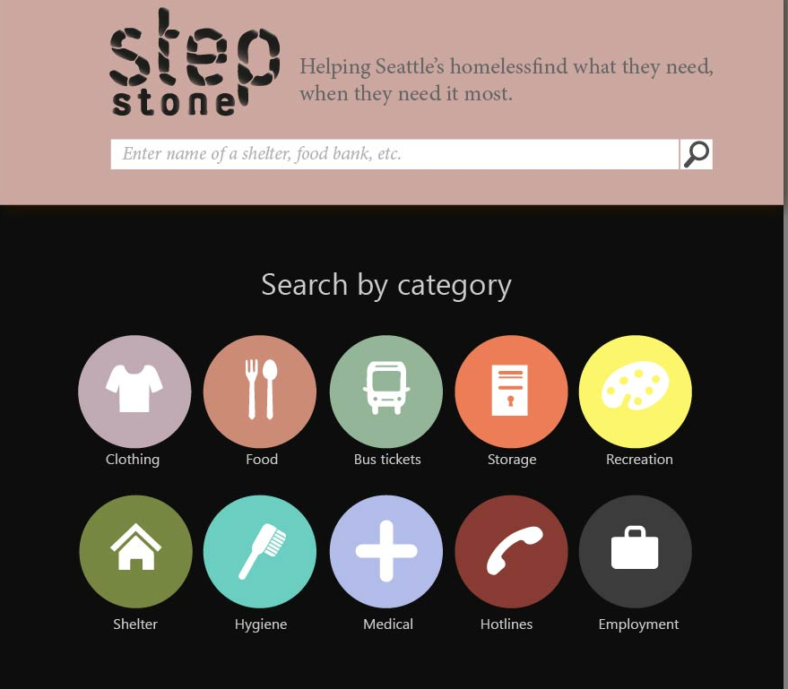
Nikki Nikkhoui Gino Clement
Cvetan Damyanov Daniel Nakamura
The Problem
Web App Highlights
Many organizations helping the homeless lack technological and monetary backing make it difficult to solicit themselves.
Information sources are not always available, hard to use, and prone to error.
It is difficult for the homeless to find the proper resources that are available to them.
Information Access
Easily Accessible
Easy to navigate and use site
Mobile friendly
Receive organization updates through email or text
Send information to yourself though email or text
Updated in real-time
Know how many beds are available at a shelter
Capacity Tracker
Landing Page Preview
The Population
Homeless Individual
Homeless Organization
Varying levels of literacy
Limited experience with technology
Many have cellphones, some have smartphones
Provide info ad hoc
Update Info
Special thanks to David Hendry and The Union Gospel Mission

