Slide 1

FedGX
Federated GWAS Across Cohort Sites
Nordic Biobank × NVIDIA Hackathon
1

Slide 2
The problem
Genome-wide association studies need large, diverse cohorts to find real signal
Privacy, governance, legal restrictions
Result: most GWAS run on a single biobank, missing ancestries it doesn't have
Question: Can we analyze across sites without centralizing the raw genotypes?
2

Slide 3
What we built
FedGX — a federated GWAS pipeline where each site:
1. Keeps its genotypes local, always
2. Runs its own association analysis (REGENIE)
3. Sends only summary statistics to a central server
4. Gets combined via meta-analysis (GWAMA)
Built on NVIDIA FLARE, extending the FedGen hackathon scaffolding.
3

Slide 4
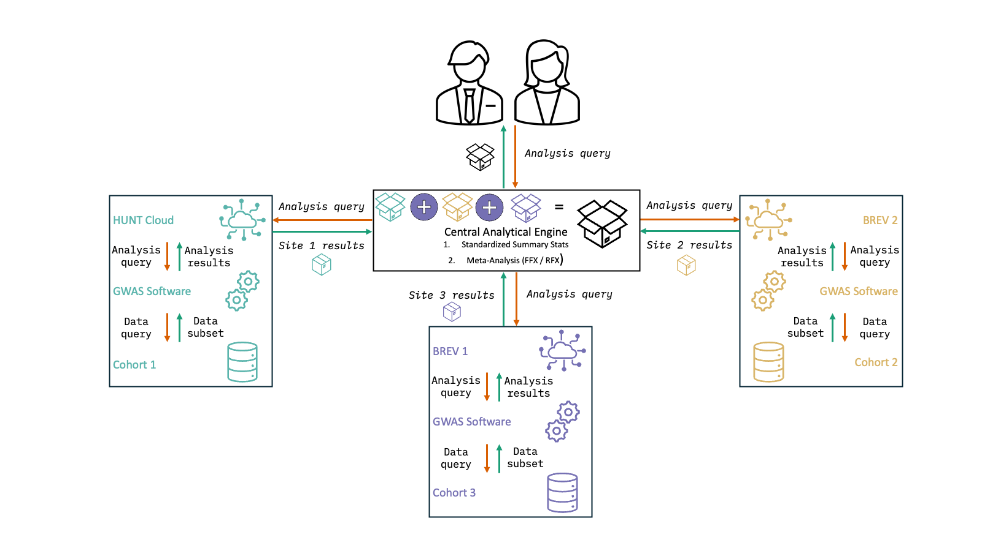
Architecture
3 sites, 1 ancestry proxy each (EUR / EAS / AFR) — nothing but summary statistics ever
4

Slide 5
Pipeline, stage by stage
Stage
What happens
1. Synthetic data
LDAK generates 3 sites' genotypes + phenotypes locally
2. Per-site GWAS
REGENIE step 1 + 2, then QC/standardize to GWAMA format
3. Federation
NVFLARE client sends the standardized file to the server
4. Meta-analysis
GWAMA combines all sites — fixed and random effects
5. Visualization
Matched Manhattan plots + an interactive dashboard
5

Slide 6
Synthetic data: not just random noise
To make the meta-analysis meaningful, the 3 sites share a master SNP grid and:
12 causal variants shared across all 3 sites (with ancestry-scaled effect sizes)
8 causal variants unique to each site
Different MAF spectra per site (EUR/EAS/AFR proxy)
Different heritability, sample size, and population substructure per site
This produces realistic heterogeneity — the same signal, weakened or shifted by ancestry
— instead of a toy case where every site is identical.
6

Slide 7
Results & visualization
Matched Manhattan plots for fixed- and random-effects results, same axis scale, side
by side
An interactive dashboard (
fedx_dashboard.html
) built from real pipeline output —
no server needed, just open it in a browser
Full per-site QC trail: P-Z consistency, SE-vs-N consistency, QQ plots

Slide 8
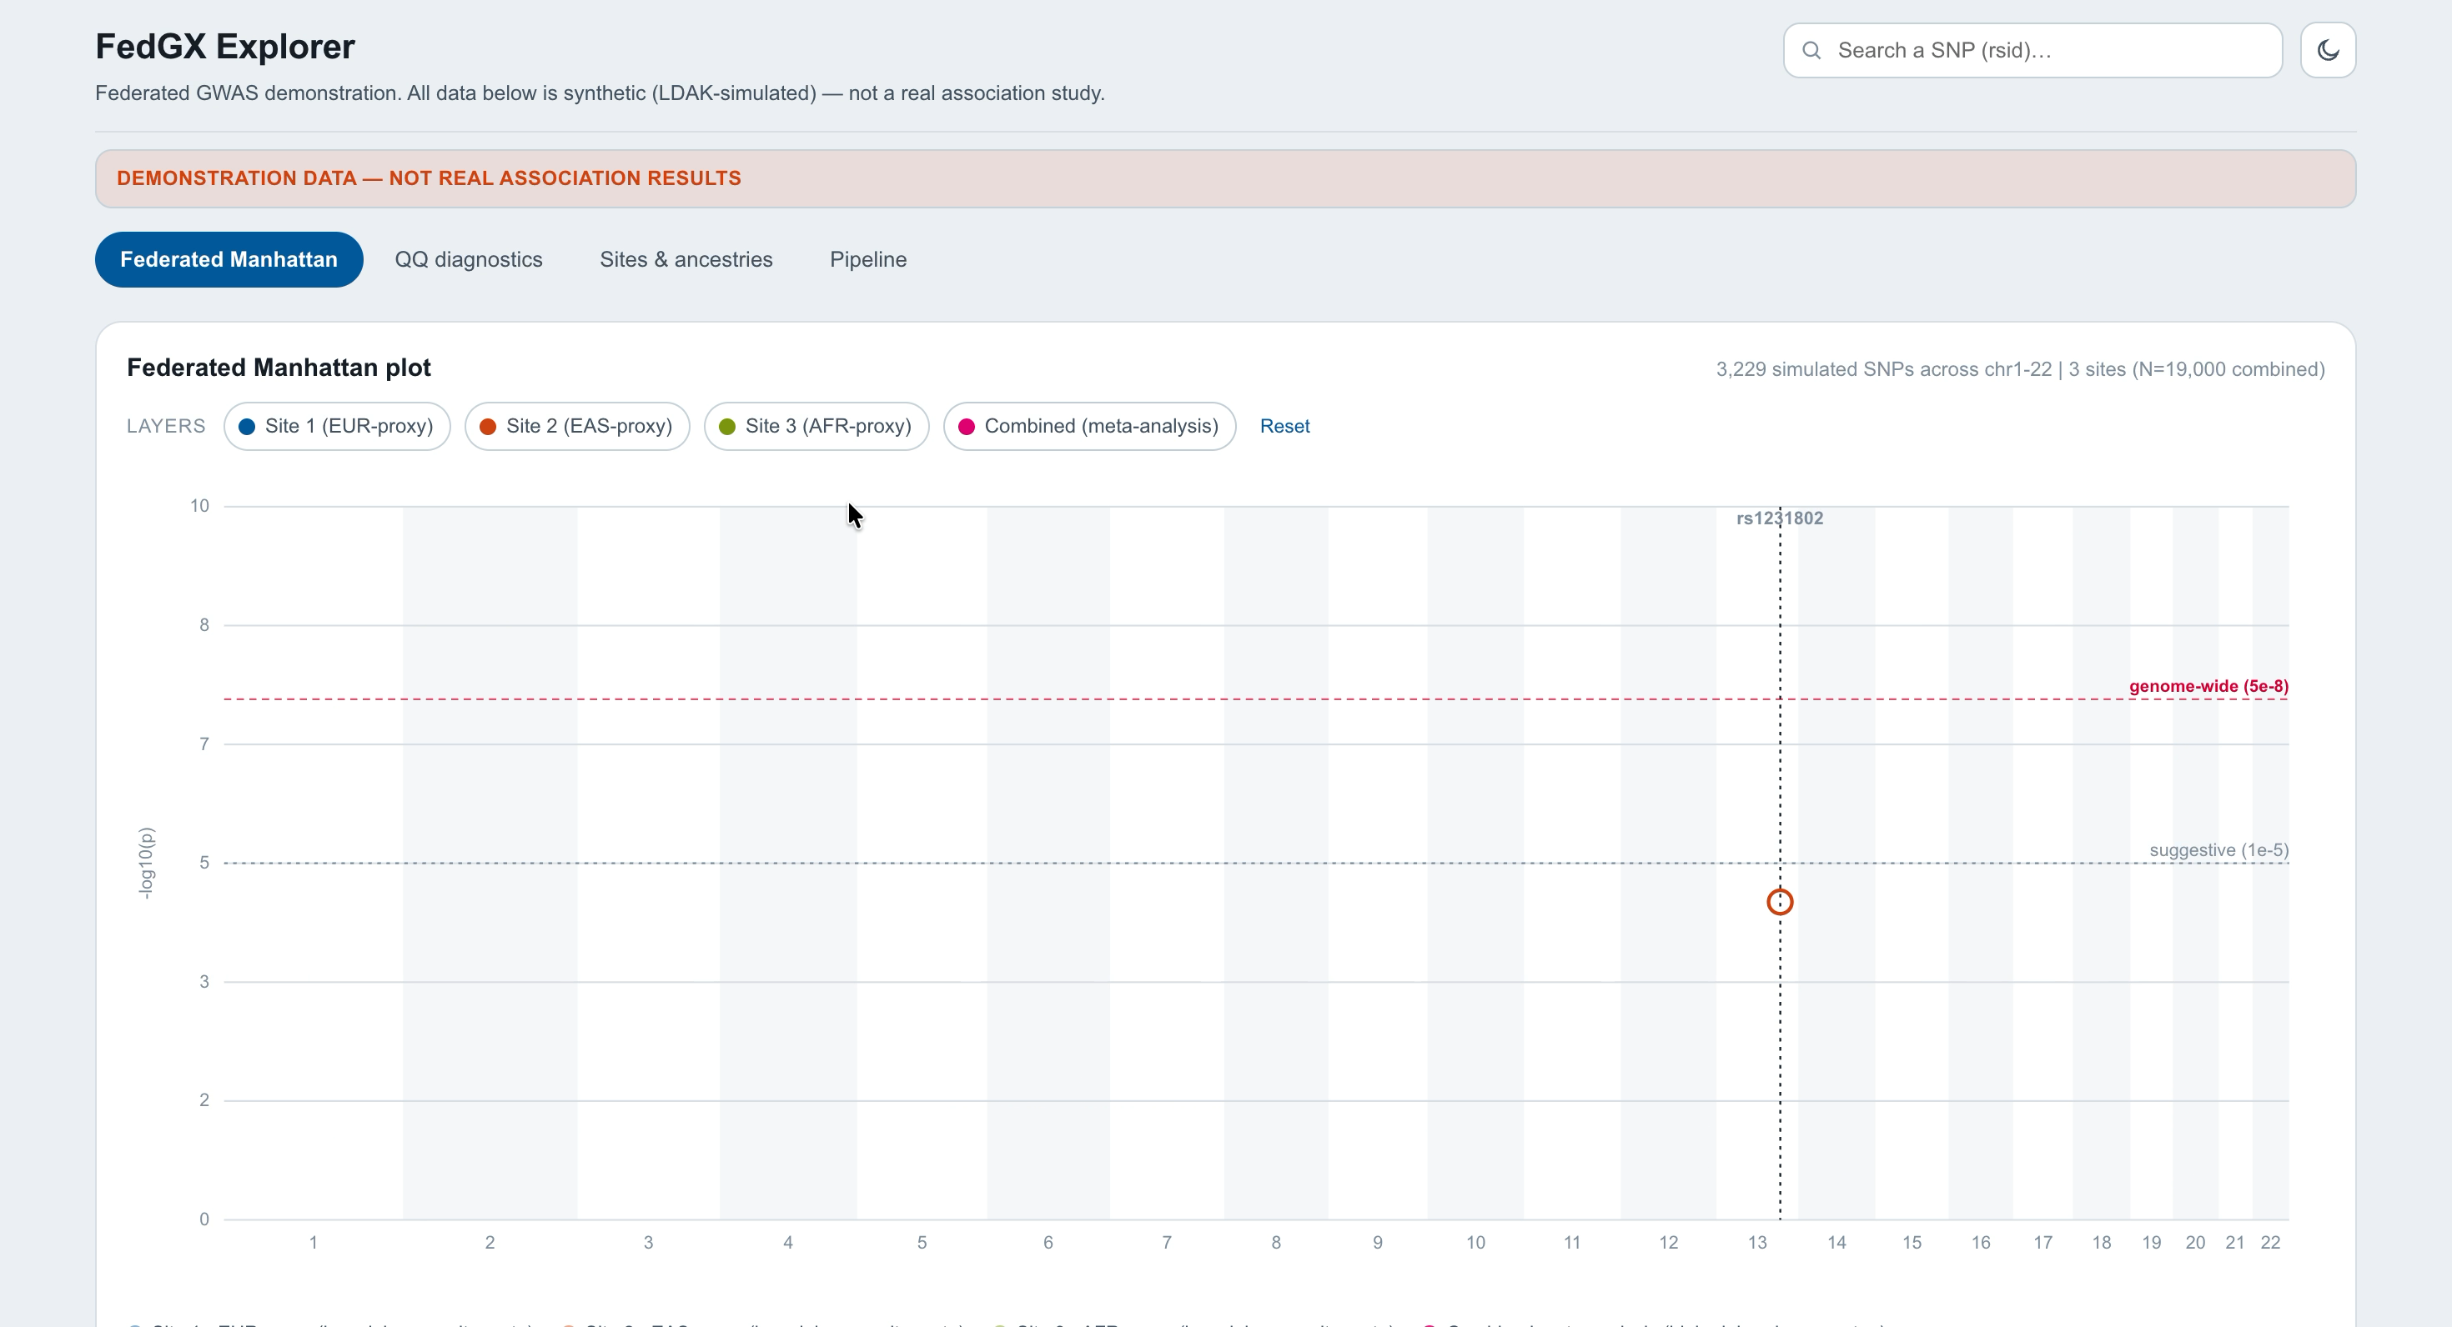

Slide 9
Technology stack
Data generation
LDAK
Per-site GWAS
REGENIE
Meta-analysis
GWAMA
Federated learning
NVIDIA FLARE
Compute
Brev, HUNT Cloud
Storage
AWS S3
9

Slide 10
What we delivered vs. the original plan
Planned
Status
Synthetic 3-site multi-ancestry data
Done
Per-site REGENIE client pipeline
Done
Central summary-stat standardization
Done
GWAMA meta-analysis — fixed effects
Done
GWAMA meta-analysis — random
Done (was flagged buggy at planning
effects
time)
Visualization (originally "bonus")
Done — plots + interactive dashboard
PLINK / GCTA / SAIGE site drivers
Scaffolded, not yet implemented
Polygenic risk scores (PRS)
Open question, out of scope this round
10

Slide 11
Try it yourself
git clone https://github.com/collaborativebioinformatics/FedGX
cd FedGX
./Scripts/generateData.sh 1 # no real cohort data needed
Full setup: README.md
11

Slide 12
Team
Marlene Rietz
Steno Diabetes Center Odense · UCPH · Karolinska Institutet
Allan Lind-Thomsen
OPEN, Odense University Hospital
Xiaoping Wu
University of Gothenburg
Moh Sallam
Aarhus University
Pravesh Parekh
J. Craig Venter Institute · University of Oslo
Built at the Nordic Biobank × NVIDIA Hackathon
12

Slide 13
Thank you
github.com/collaborativebioinformatics/FedGX
13

