Slide 1
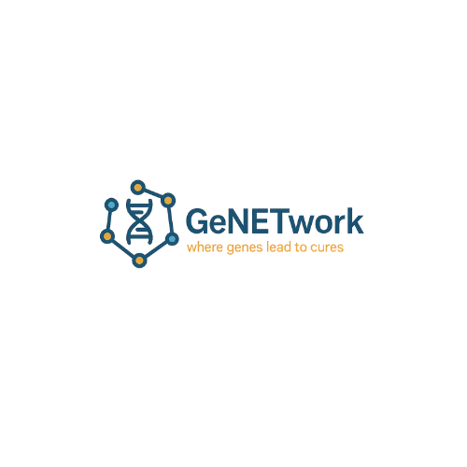
AWS Open Data Hackathon
October 1-3, 2025
Group 1

Slide 2
Project Outline and Goal
Essence: Build a knowledge graph connecting variants, drugs, and clinical evidence to identify therapeutic opportunities
Details: Use gene-centric somatic variants data from MTP and TCGA and link with drug targets from OncoDB, evidence-based variant interpretation from CIViC, biological context and functional relationships from MSigDB, and variant/allele metadata from HGNC reference. Attempt to also include protein interaction data from StringDB

Slide 3

Introduction to Technical Implementation
Use Neo4j in Docker as the graph database
Nodes: genes, variants, cancer_types, histological data, drug targets, pathways
Edges:gene_has_variant_src, ASSOCIATED_WITH_PATHWAY, TARGETED_BY_DRUG
Cypher queries for flexible retrieval and downstream analytics

Slide 4
Technical Methods
Data Processing
Download datasets (TSV, JSON)
Standardize schemas for each dataset as collected from different sources, using gene_name as primary key

Slide 5
Technical Methods
Knowledge Graph Construction
Define node types:
Define relationships:
Define properties
Convert datasets into triples compatible with Neo4j
Create ETL pipelines that automatically ingest data into Neo4j running on docker

Slide 6
Technical Methods
Analysis and Querying
Use Cypher
Use case: filter for specific cancer_type,
Extract drug_targets, pathway level insights
Visualization/Outputs
Graphs connecting genes-variants-drug targets-clinical interpretation-pathway level insight

Slide 7
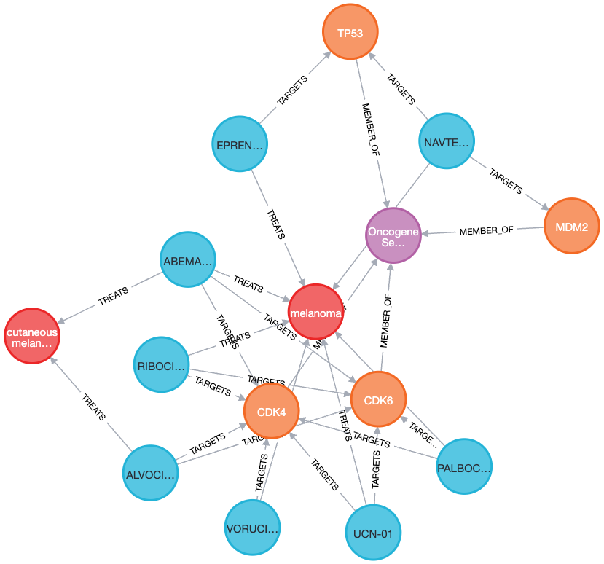
Pathway-centric query
Use case example
Oncogene Induced Senescence
in Melanoma
- is a tumor-suppressive mechanism; its dysregulation contributes to melanoma progression.
Genes highlight targets to restore or bypass senescence; linking them to drugs reveals repurposing, combinations, and new interventions.
Notes:
This query focuses on the pathway Oncogene Induced Senescence in melanoma.
Senescence is a natural tumor-suppressive mechanism, and when it fails, melanoma progresses.
By mapping the genes in this pathway, we can identify molecular targets that could restore or bypass senescence.
When we connect these targets to drugs, we immediately see opportunities for repurposing existing therapies, designing new combinations, and uncovering completely new points of intervention.
This pathway-centric view is powerful for drug discovery, because it links disease biology directly to therapeutic options.

Slide 8
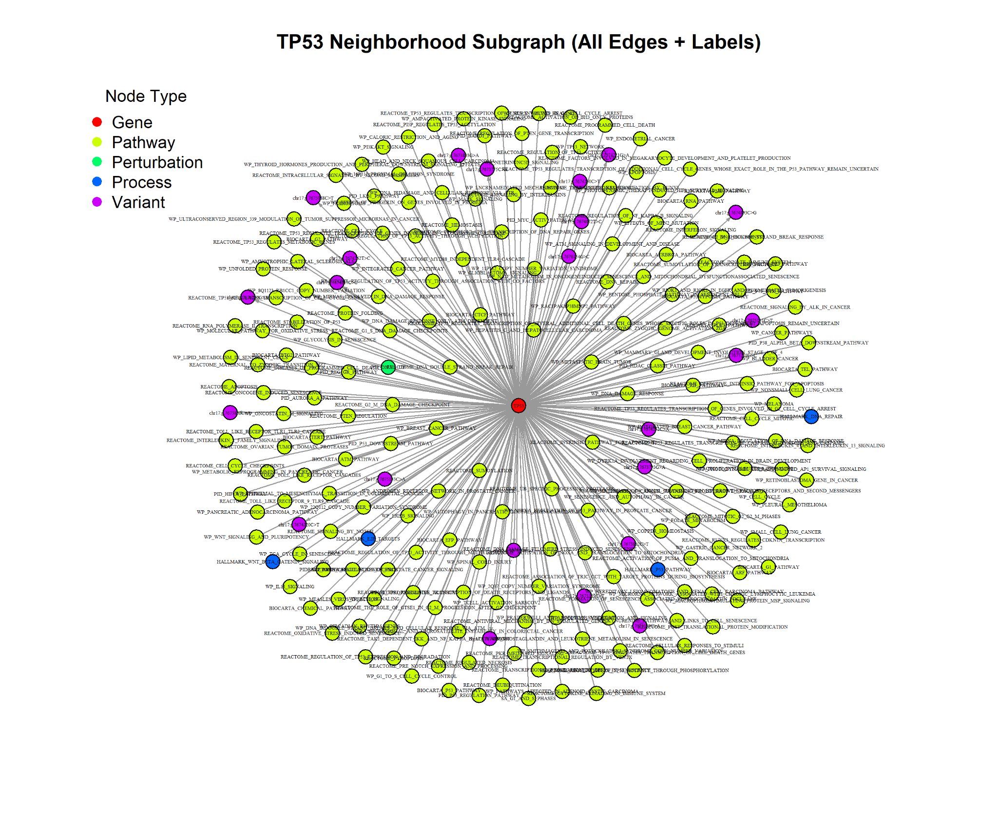
Creating Induced Subgraphs
Induced subgraphs can be created given any set of nodes.
Subgraph includes neighboring nodes and their inner connections.
Can be used for downstream ML model training and inference.
TP53 Subgraph (genes+variants+pathways+processes+perturbations)

Slide 9
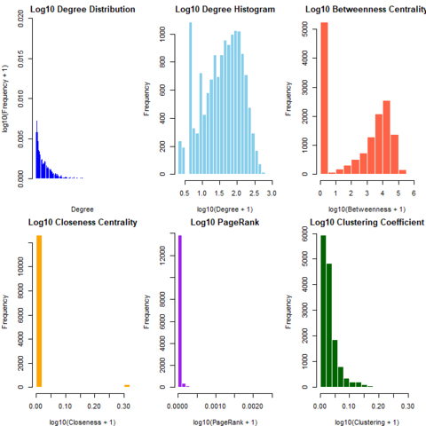
Statistics on the GeNETwork KG subgraph
Degree Distribution: connections per node
Degree Histogram: how often nodes with different numbers of connections appear
Betweenness Centrality: key bridges connecting different parts of the network
Closeness Centrality: shows how close each node is to all other nodes in the network
PageRank: shows the importance of nodes each one connects to
Clustering Coefficient: shows how tightly knit a node’s neighbors are
Induced subgraph of KG (CIViC, subsets of MSigSB, and GTEx co-expression
Notes:
Top Left – Degree Distribution
This panel shows how many connections each node in the network has. Most nodes have very few connections, while only a small number of nodes act as hubs with many connections. This kind of distribution is common in real-world networks.
Top Middle – Degree Histogram
Here we look at the same information in histogram form: how often nodes with different numbers of connections appear. The bulk of nodes have a moderate number of connections, but the network is skewed by a smaller group of high-degree hubs.
Top Right – Betweenness Centrality
This panel measures how often a node lies on the shortest path between other nodes. A few nodes have very high betweenness, meaning they act as key bridges that connect different parts of the network. Most nodes, however, rarely serve as intermediaries.
Bottom Left – Closeness Centrality
This shows how close each node is to all others in the network, based on shortest paths. Nearly all nodes cluster at low values, meaning they are far from many other nodes. Only a small fraction of nodes are more centrally placed.
Bottom Middle – PageRank
PageRank measures influence by considering not just the number of links a node has, but also the importance of the nodes it connects to. Most nodes have very low influence scores, while a few stand out as disproportionately influential.
Bottom Right – Clustering Coefficient
This panel captures how tightly knit a node’s neighbors are. Most nodes are in loosely connected neighborhoods, while a small number belong to highly clustered, community-like groups.

Slide 10
Future Directions
ClinicalTrials.gov integration
Add new data layers such as CNAs, gene fusions, drug sensitivity screens
Graph neural networks could predict novel drug-gene associations
Expand beyond cancer to include off-label therapeutic indications
Integrate gene-based GWAS to find new targets

Slide 11
Group Members
US folks:
Chantera Lazard
Sangeeta Shukla
Taha Ahooyi
Deanne Taylor
UK folks:
Christine Withers
Vivien Ho
Polina Rusina
Ben Wingfield
Seeta Ramaraju Pericherla
Kart Subramanian

