Slide 1
Haplohash
Team 11

Slide 2
Proposed index
DNA and variants
Haploblocks + purifying selections
Alphagene predictions
Aggregating those predictions to haploblocks
Checking with eQTLs
Results from haploblocks
Biological annotations
Hashing now
Trying to hack those hashes

Slide 3
Our task
Score all the variants in the haploblocks with Alphagenome atlas to help us to interpret how genetic variations impact biology at a molecular level
Annotate all the variants with additional biological information
Put those variants, AVI scores and functional annotations to hash for anonymisation
Try to reverse engineer the anonymisation, to see if it is secure

Slide 4
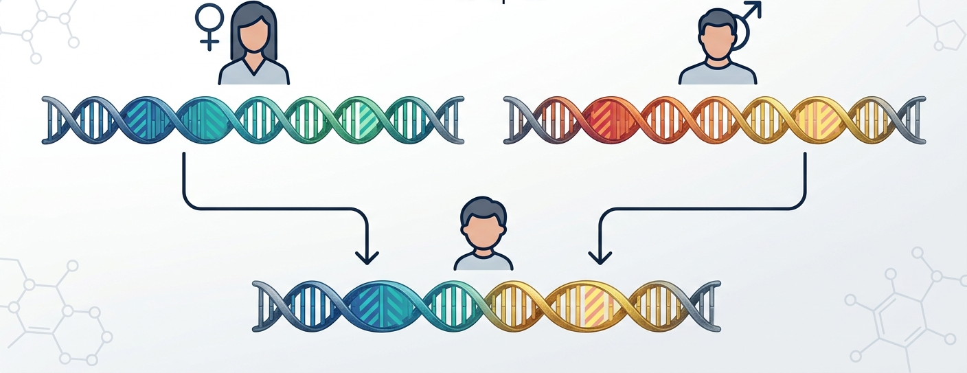
What are haploblocks

Slide 5
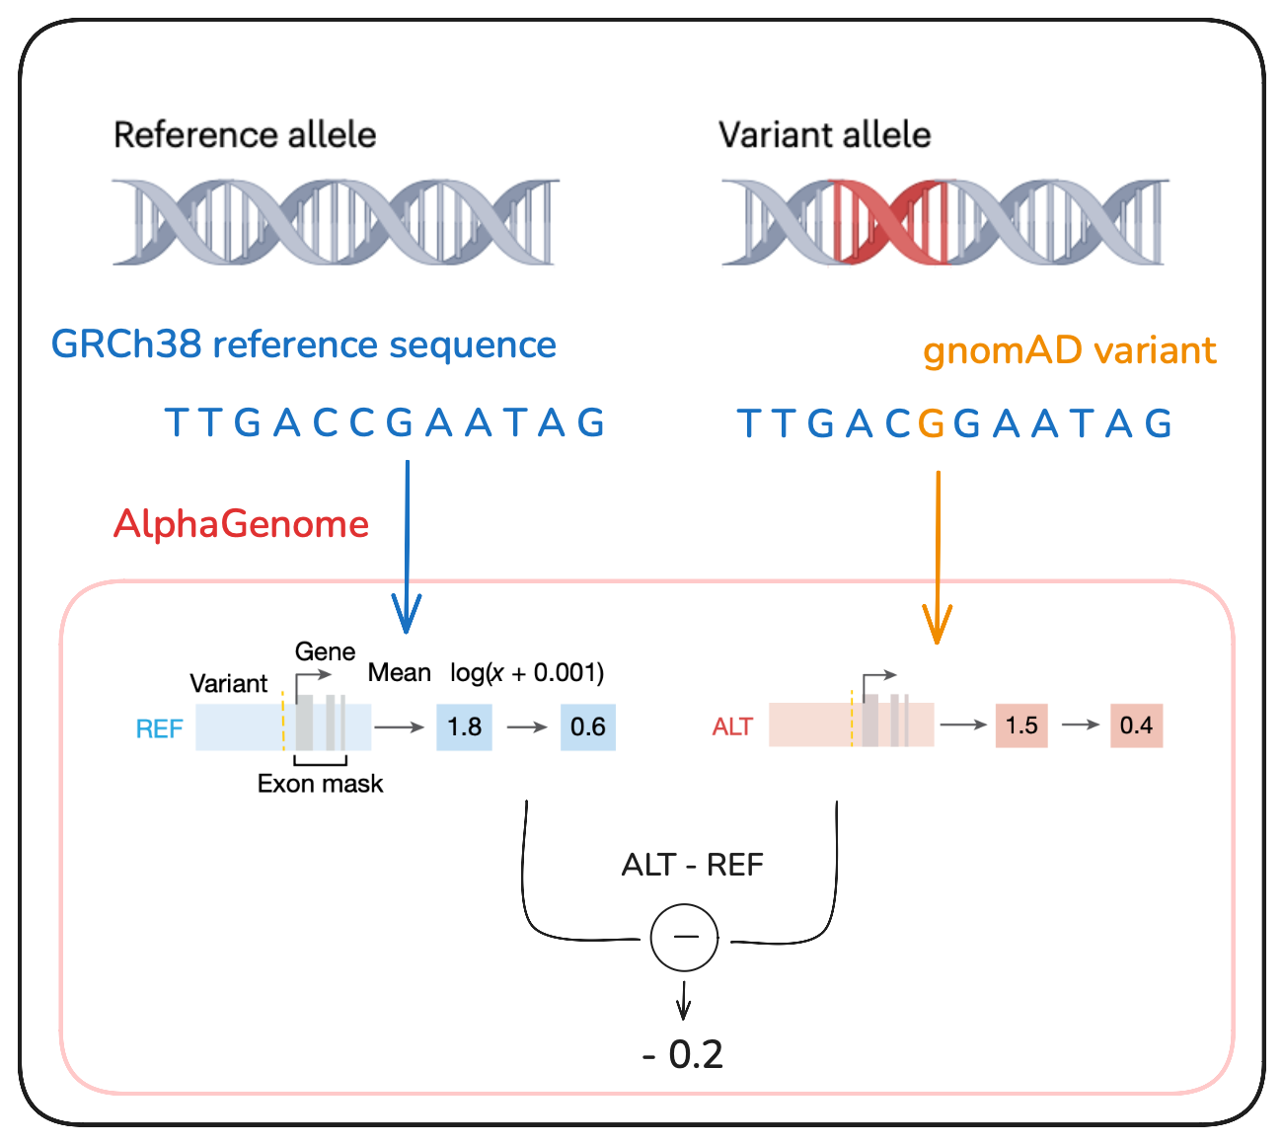
What is Alphagenome

Slide 6
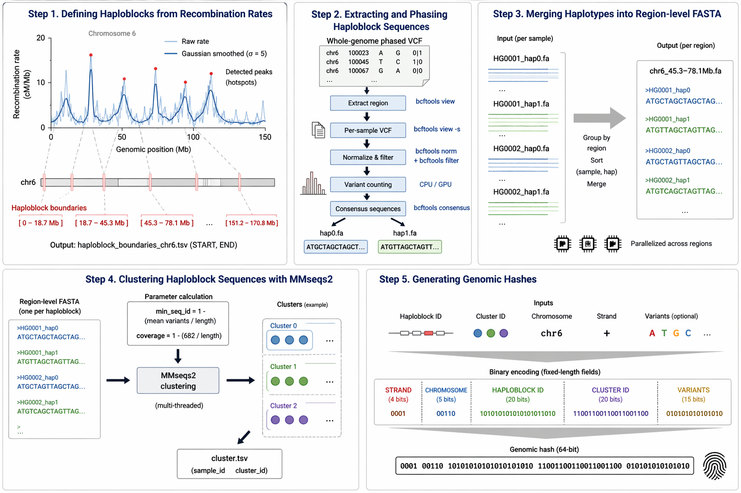
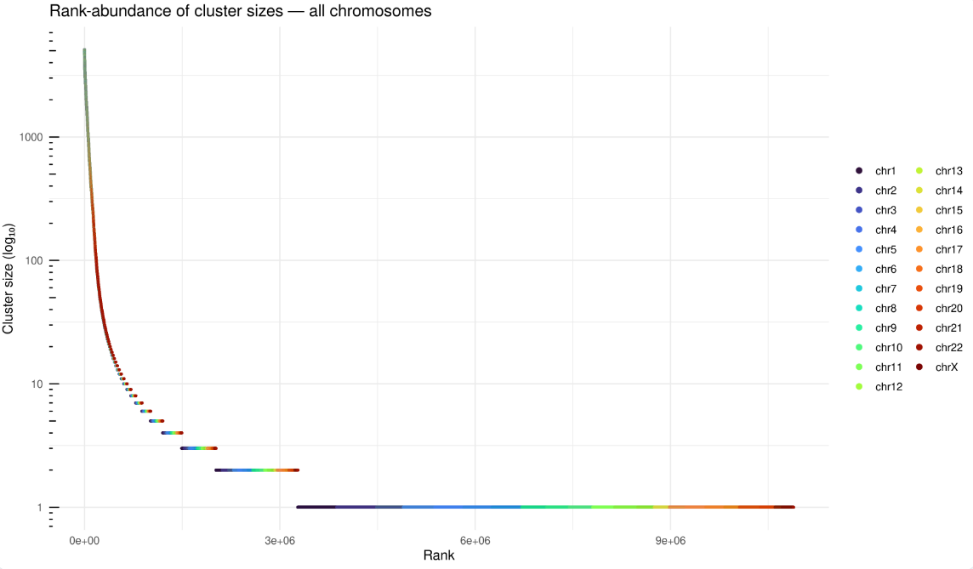
Introduction to Haploblocks
https://www.haploblocks.org/
Notes:
relationship flips before and after log transform
effect size is not

Slide 7
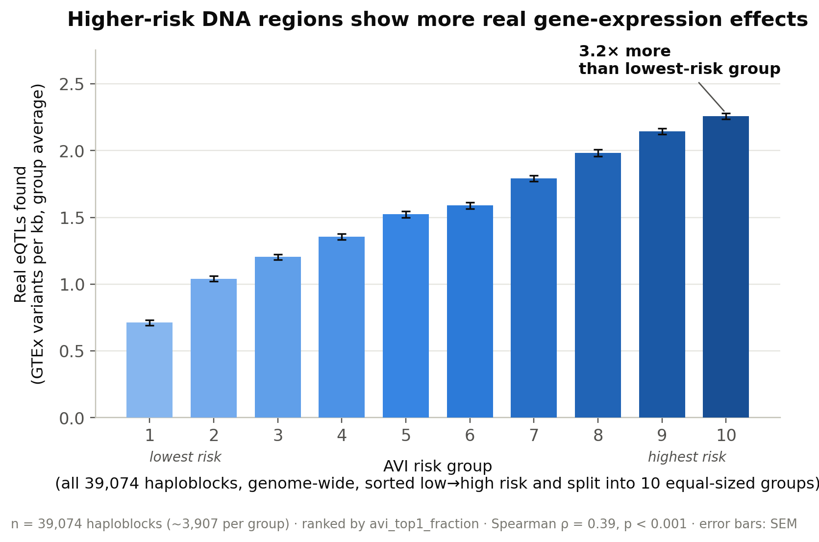
consistency check
How can we be sure that AVI scores from Alphagenome match real biology?
Notes:
X-axis: 10 equal-sized groups of haploblocks (genome-wide, not per-chromosome), sorted by AVI risk score.
Y-axis: real eQTL density (GTEx).

Slide 8
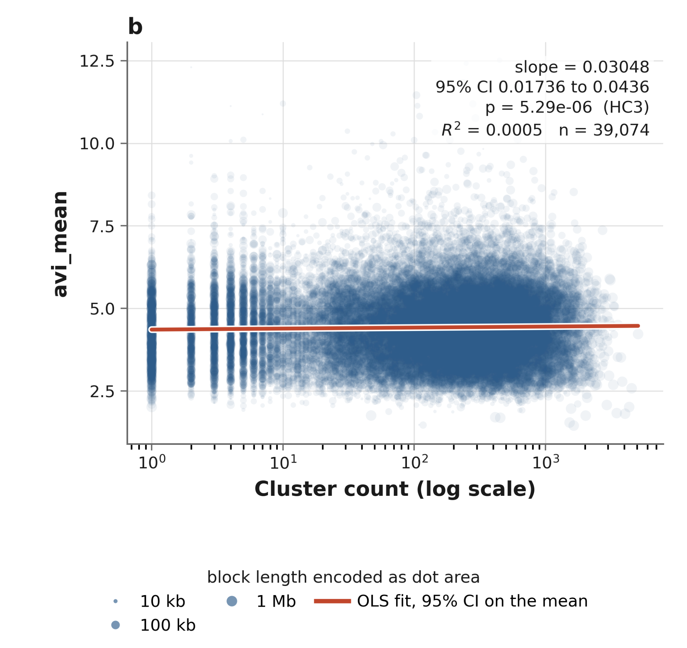
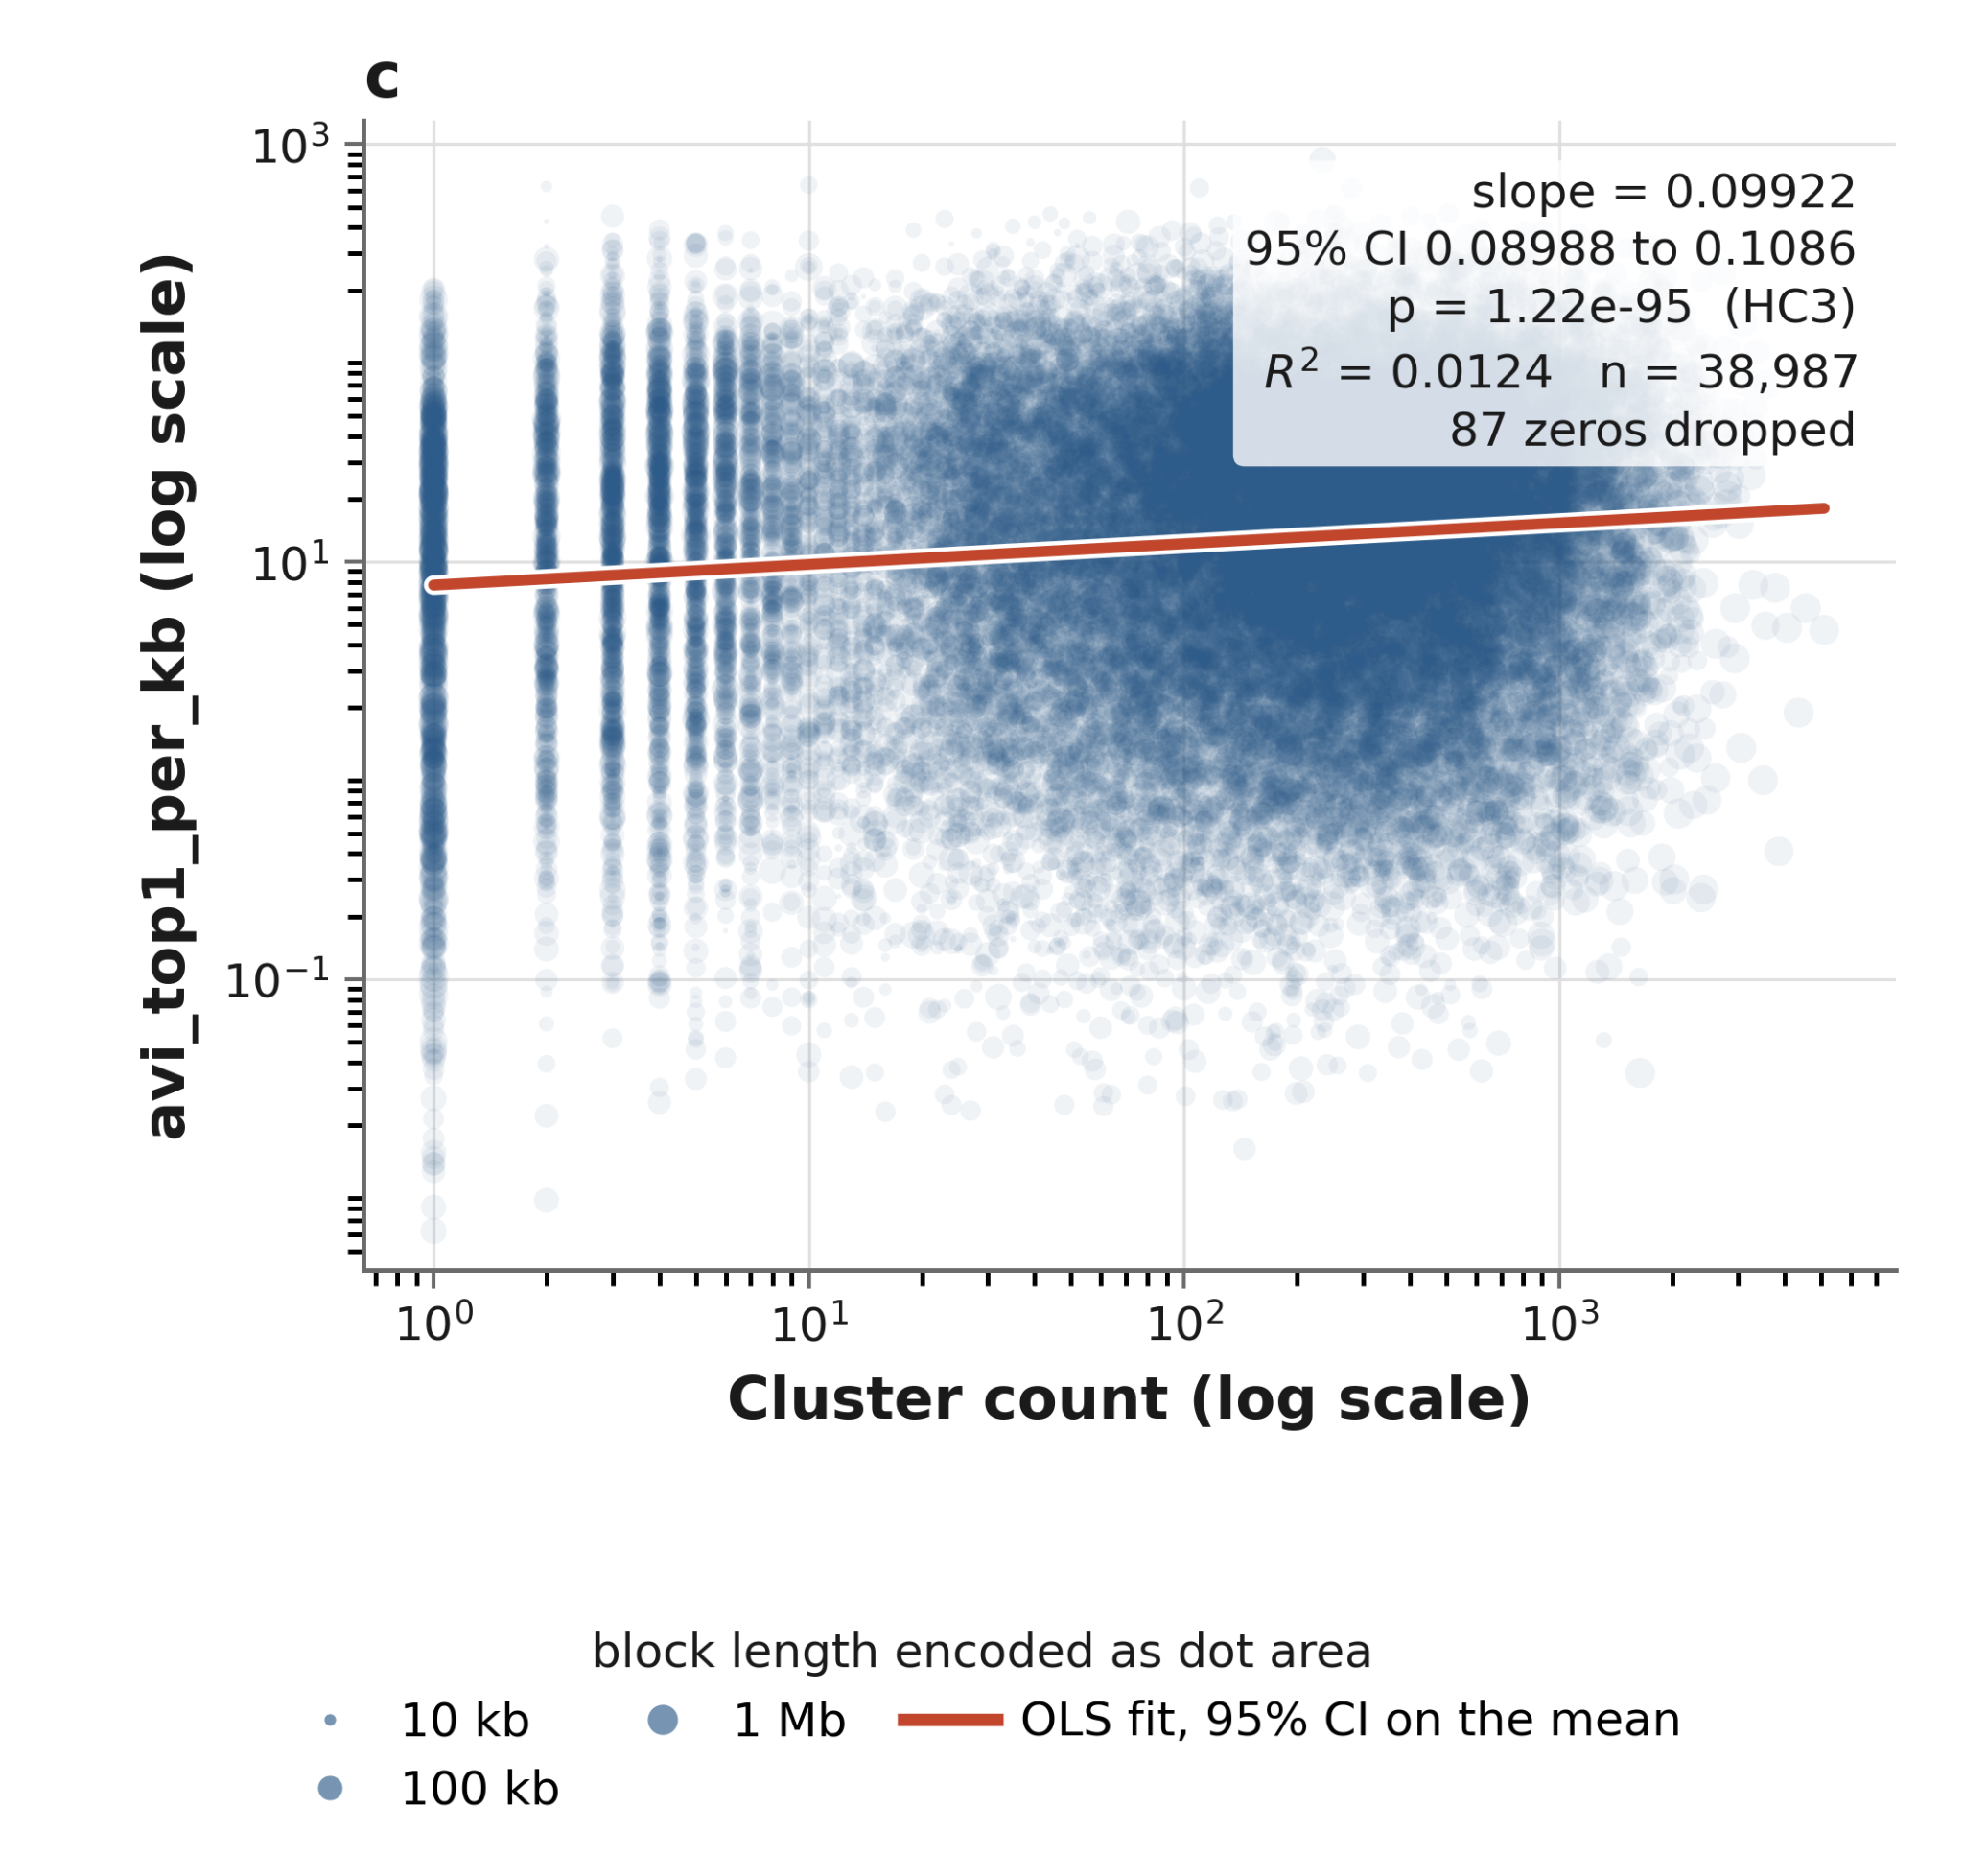
Genomic constraint negatively associated with AVI
Notes:
hypothesis: most constrained haploblocks are likely the most deleterious if mutated.
problem: the most constrained regions cna’t be interrogated in humans because there’s no natural variation.
method: we use alphagenome atlas to screen perturbations across haploblocks, including the blocks where no variation is empirically observed.
result: statistically significant across all specifications, with unclear effect size and opposite of expected sign.
quite a robust result: we try measuring block-level AVI score a few ways, and we always see a positive slope
discussion: It’s a non-meaningful findind, but not dispositive. It could mean that alphagenome is not well trained on variants where not much empirical variation is observed. allele frequency issue identified by marcus

Slide 9
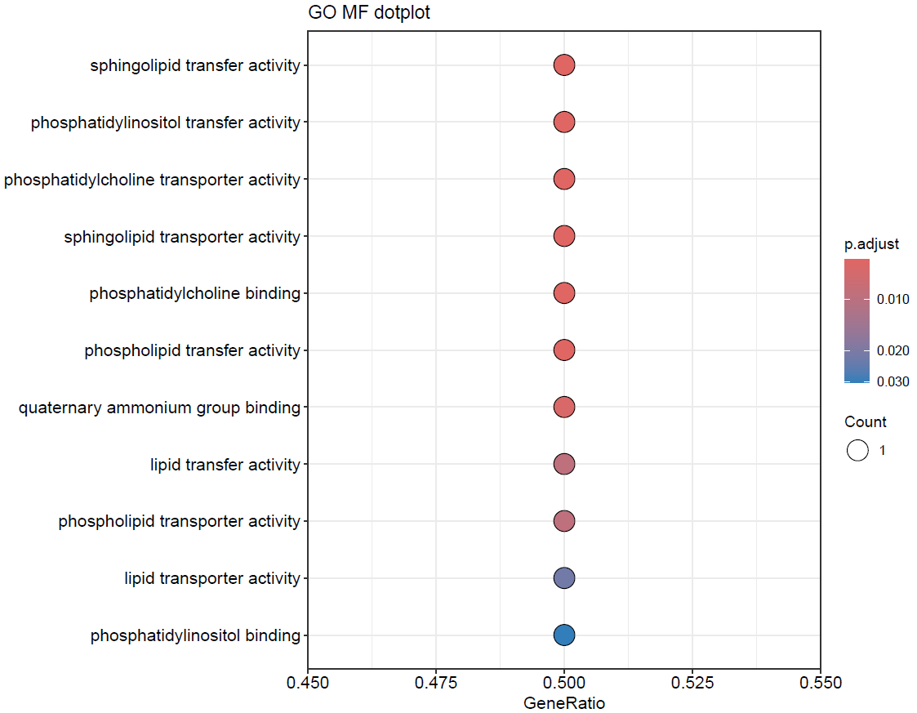
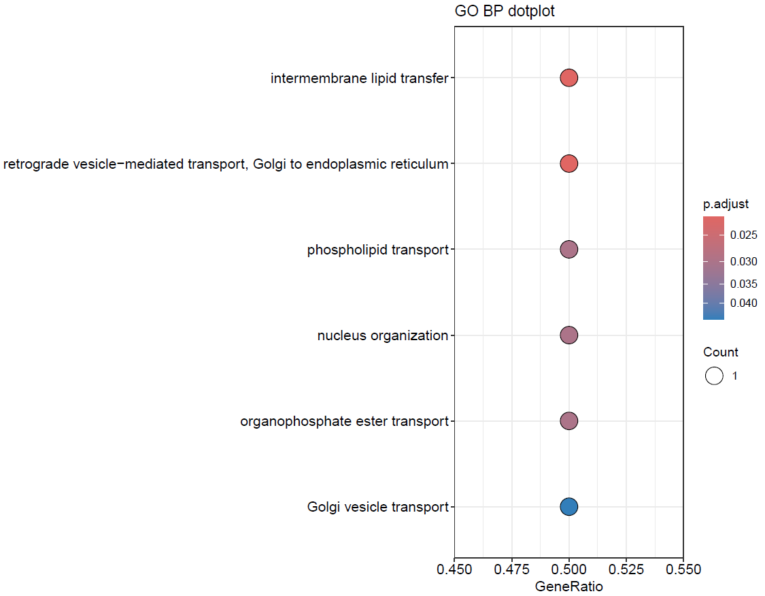
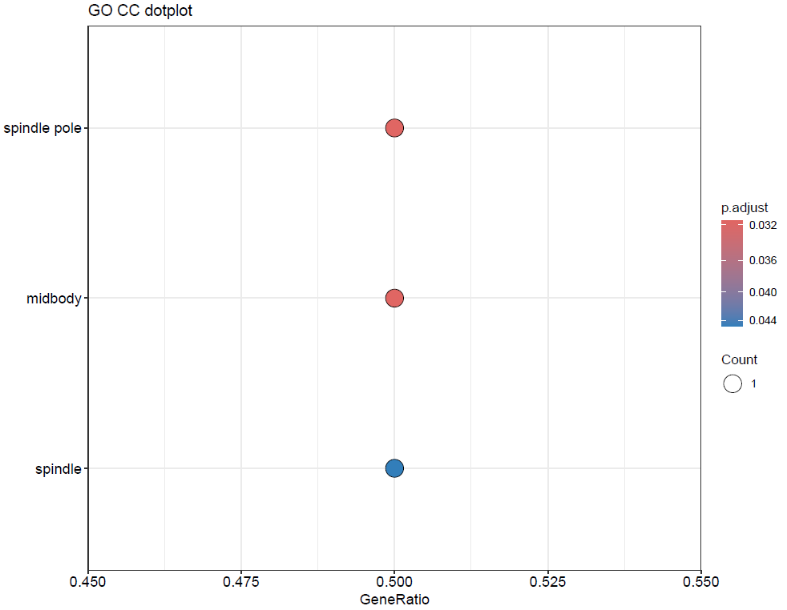
Biological annotations for haploblock regions
And functional analysis based on this annotations
Molecular function
Biological process
Cellular component

Slide 10
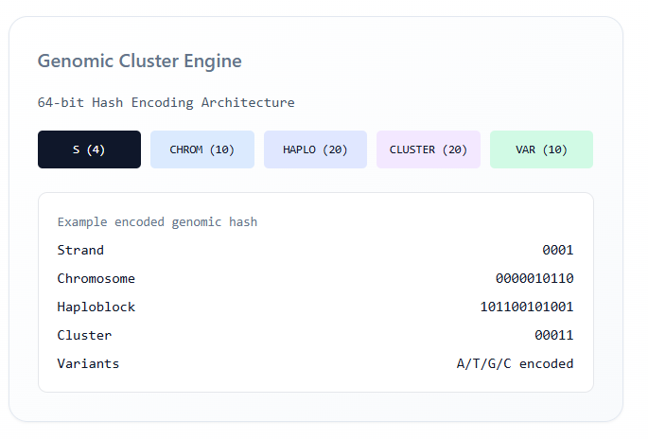
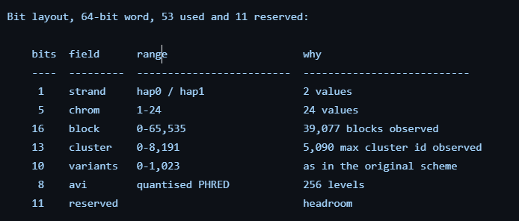
Hashing
39.000 blocks
2548 individuals
5096 haplotypes
7.7 M singletons clusters
91% blocks contains singleton
Suppression:
Top 5000 worst blocks -> 50% data loss
Eliminating Singletons -> 91 % data loss
Fix :
Optimized the hash
per-cluster k-anonymity, k=2
  (block, cluster)
3.9% of the dataset suppressed
AVI scores, and annotation are block level
Notes:
relationship flips before and after log transform
effect size is not

