Slide 1
Concordia
The bottleneck was never the learning.
Automated biobank-to-OMOP harmonisation for federated analysis
Project 5 · Nordic Biobank × NVIDIA Federated Learning Hackathon · Copenhagen 2026
github.com/collaborativebioinformatics/OMOP-federated-learning
Notes:
Concordia is Project 5 at the Nordic Biobank × NVIDIA Federated Learning Hackathon. One line: what keeps biobanks from training models together was never the learning, it is the data. We automated the data step.

Slide 2
Federated learning works. It almost never happens.
Federated learning lets many institutions train one model together. The data never leaves any of them.
It has worked for years, and is still rarely used.
The blocker is the data: every biobank stores it differently.
Converting one source into a common format by hand takes months, and every source needs its own.
CONCORDIA AUTOMATES THAT STEP
1 Raw biobank data in
2 Harmonised OMOP out
3 Quality controlled
4 Trained across sites
Nothing leaves the institution.
Collaboration stops being a technical problem. It becomes a choice.
Concordia · Project 5 · Copenhagen 2026
Notes:
Federated learning: several institutions train one model together. Each trains on its own data and shares only model weights. The tools exist, NVFlare for example. What is missing is harmonised data: every biobank stores its data differently, and a hand-built ETL (extract, transform, load) per source takes months. Concordia automates exactly that step: raw data in, harmonised OMOP out (OMOP is the common data model of the OHDSI community), quality controlled, then trained across sites. Nothing leaves the institution. Punchline: collaboration becomes a decision, not an engineering project.

Slide 3
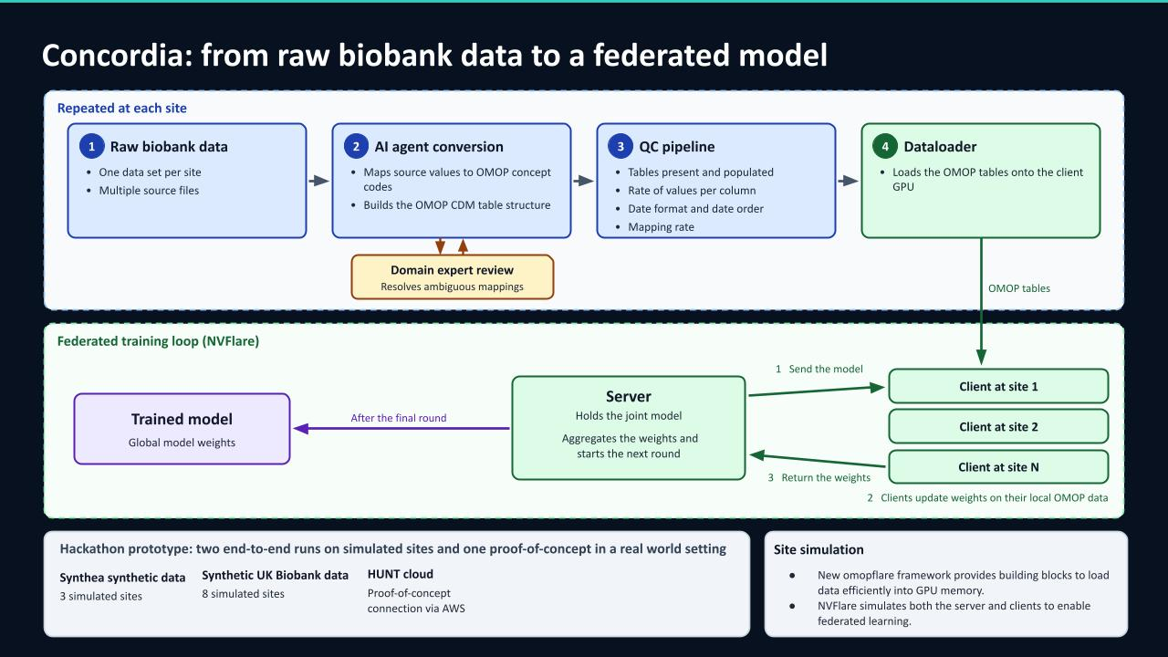
Notes:
The top half repeats at every site. 1: raw biobank data. 2: an AI agent profiles the raw files and writes the mapping, a recipe that says which source field becomes which OMOP field and which source code becomes which standard concept. A domain expert approves ambiguous mappings; the AI only proposes. 3: the QC gate checks the four OMOP tables: are they there, how complete is each column, are dates valid and in order, how much was mapped. 4: the dataloader, omopflare, streams the tables to the GPU. Bottom half: NVFlare runs the federated loop. The server sends the model, each site trains on its own OMOP data and returns only weights, the server averages them (FedAvg) and starts the next round. The only thing that crosses a boundary is a weight vector. Bottom box: two end-to-end runs on simulated sites, Synthea and synthetic UK Biobank, and a proof-of-concept connection to HUNT Cloud via AWS.

Slide 4
The agent's mapping matches the expert ETL
Blind test, 1,162 fresh Synthea patients: the agent saw only the data contract and a profile of the raw files.
99.996 %
of measurement values identical to OHDSI's ETL-Synthea (254,882 of 254,891)
0
differences in diagnoses
8 s
for 2.1 GB of raw data, no database server
8 / 8
UK Biobank centres pass the contract, mapped by the same skill
QC caught what both conversions let through: negative LDL values, and an HbA1c median of 3.9 % (real adults: about 5–6 %).
All 22 concept IDs in the contract were checked against the Athena vocabulary v5.0 (29 Aug 2026).
Concordia · Project 5 · Copenhagen 2026
Notes:
Blind test: we generated a fresh Synthea run with 1,162 patients and let the agent write the mapping without seeing any OMOP output, only the data contract and a profile of the raw files. Then we compared it with OHDSI's own expert-built conversion, ETL-Synthea. 254,882 of 254,891 measurement values are identical; the 9 differences are negative LDL values that ETL-Synthea leaves empty. Diagnoses: no differences. 11 person rows differ on race, and there the contract is right. 8 seconds for 2.1 GB, on DuckDB, no database server. The same skill maps the raw UK Biobank extract, and all eight assessment centres pass the contract. QC then caught what both conversions let through: negative LDL values, and HbA1c (long-term blood sugar) with a median of 3.9 %, well below real adults. That is a Synthea artefact, flagged before anyone trains on it.

Slide 5
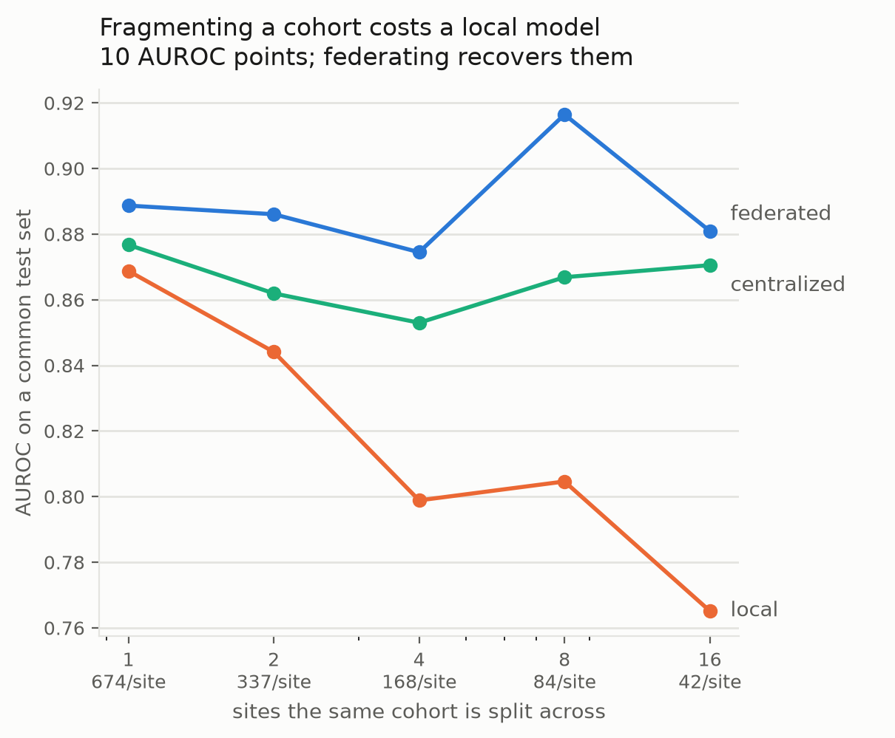
Federation recovers what fragmentation costs
964 patients
one real cohort, split across 1 to 16 sites
0.87 → 0.77
AUROC of a site that trains alone
0.87 – 0.92
AUROC federated, level with pooled training
Nobody shared a row.
Concordia · Project 5 · Copenhagen 2026
Notes:
Benchmark on one real cohort of 964 patients, split into 1, 2, 4, 8 and 16 sites. AUROC measures how well a model separates cases from non-cases: 0.5 is a coin flip, 1.0 is perfect. Orange: each site trains alone. It drops from 0.87 to 0.77 as the sites get smaller. Blue: federated. It holds between 0.87 and 0.92. Green, labelled centralized, is pooled training with all data in one place, the usual upper bound. Federated stays level with pooled, and no site shared a single row.

Slide 6
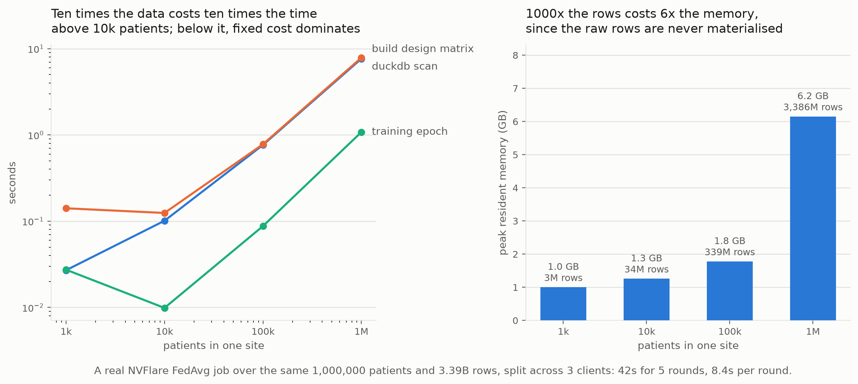
It scales to a million patients
1,000,000
patients at one site
3.39 billion
rows
7.9 s
to scan them
6.2 GB
peak memory
42 s
NVFlare, 5 rounds
Concordia · Project 5 · Copenhagen 2026
Notes:
Does it scale? One site grown to a million patients and 3.39 billion rows. Left, time: above about 10,000 patients, ten times the data costs ten times the time, so it grows linearly. Scanning a million patients with DuckDB takes 7.9 s, building the feature matrix 7.7 s, one training epoch 1.1 s. Right, memory: 1000 times the rows costs only 6 times the memory, 6.2 GB at a million patients, because the raw rows are never all loaded at once. A real NVFlare FedAvg job over the same million patients, split across three clients, takes 42 s for five rounds.

Slide 7
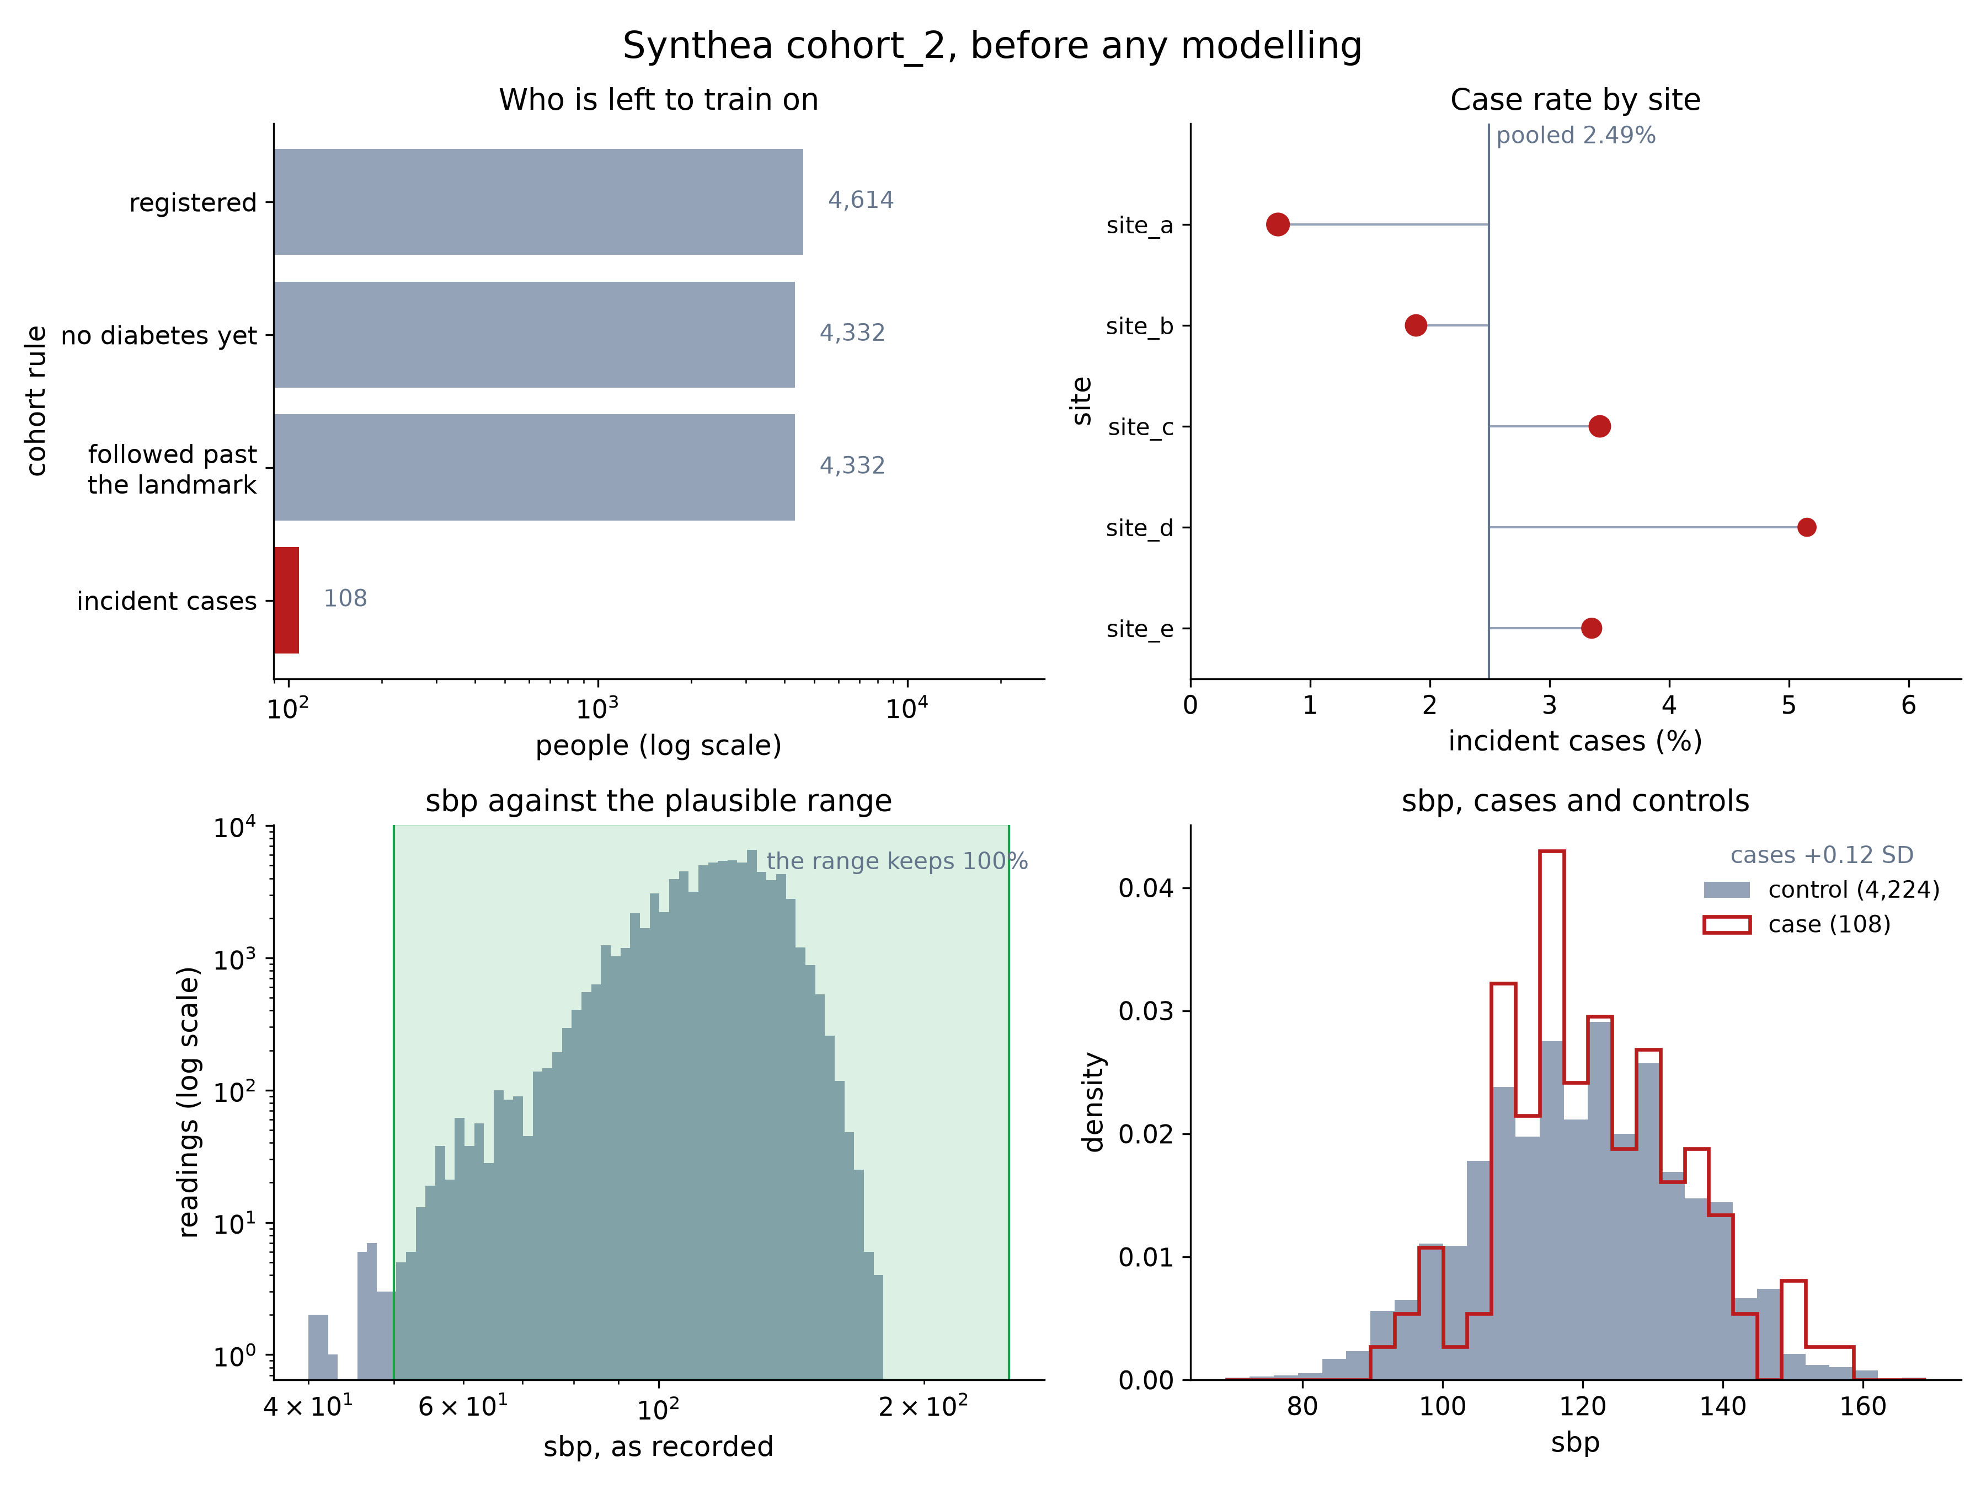
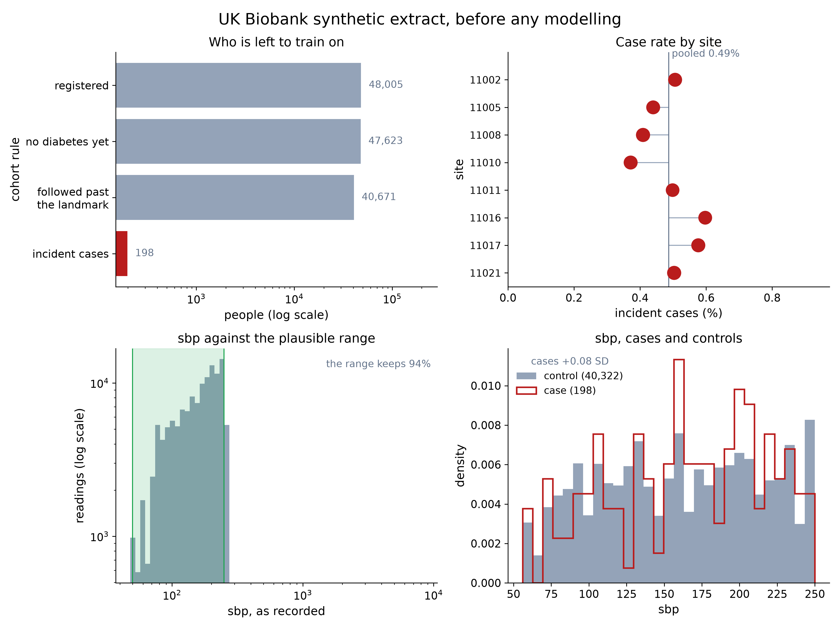
QC answers the question before the model does
Federation pays off only when the sites differ.
Synthea five sites that differ
UK Biobank eight centres, one cohort
Worth federating: the case rate varies 7.0× across sites; the most different site is 0.79 SD from the pooled mean.
Nothing to reconcile: the case rate varies 1.6×; every centre is within 0.03 SD of the pooled mean.
Concordia · Project 5 · Copenhagen 2026
Notes:
Before training anything, the QC plots show whether federating is worth it. Each panel: the cohort funnel (who is left to train on), the case rate per site, systolic blood pressure against the plausible range, and cases against controls. Synthea: the case rate differs 7-fold between sites, and the most different site is 0.79 standard deviations from the pooled mean. The sites genuinely differ, so federating adds something. Synthetic UK Biobank: the case rate varies only 1.6-fold, and every centre is within 0.03 standard deviations of the pooled mean, effectively eight copies of one cohort. Nothing to reconcile. Standard deviation measures spread; 0.03 SD means practically identical.

Slide 8
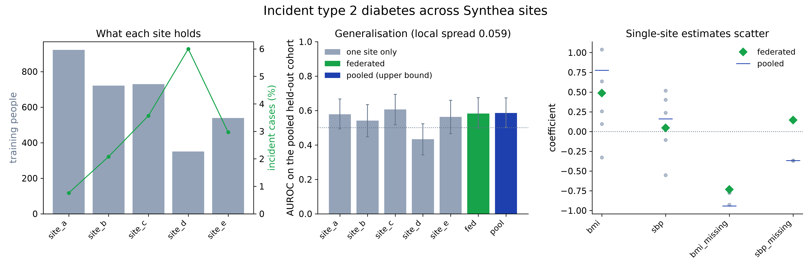
Five Synthea sites: federated matches pooled
0.582
federated AUROC
0.586
pooled AUROC, the upper bound
0.433
smallest site on its own, worse than chance
Concordia · Project 5 · Copenhagen 2026
Notes:
Task: predict new (incident) type 2 diabetes. Left: what each site holds. Sizes and case rates differ a lot. Middle: AUROC on the pooled held-out cohort. Federated 0.582 against pooled 0.586, practically identical. The smallest site alone scores 0.433, worse than chance. Right: coefficients estimated by single sites scatter widely; the federated estimate sits close to pooled. Honest caveat: only 23 held-out cases, so the intervals overlap. This supports federated matching pooled, not a significant gap between single sites and federated.

Slide 9
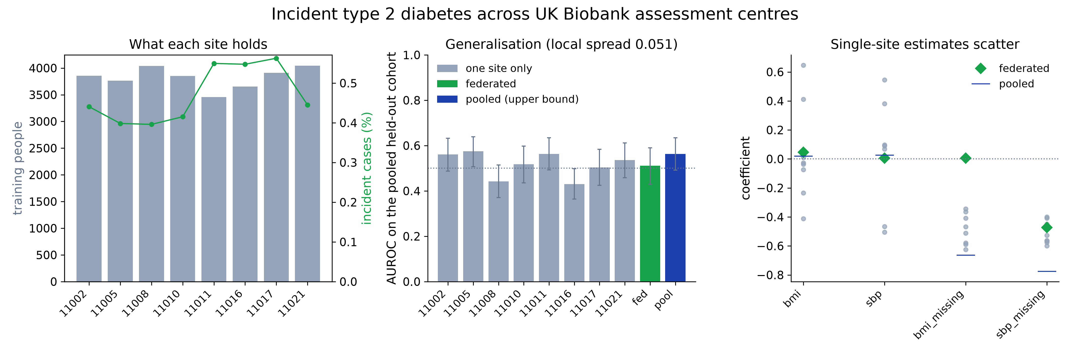
UK Biobank: the negative control holds
40,671
people in eight centres, 198 incident cases
0.430–0.575
single centres: apparent signal that is not there
0.511
federated: every interval covers 0.5, chance
Concordia · Project 5 · Copenhagen 2026
Notes:
The negative control. In synthetic UK Biobank data the fields are generated independently, so there is no real signal to find. 40,671 people in eight assessment centres, 198 new diabetes cases. A sound method must not invent a signal, and none does: every interval covers 0.5, which is chance. Single centres on their own show apparent signal between 0.430 and 0.575, noise from small samples. Federated lands at 0.511. Federation does not manufacture results; it averages the noise out.

Slide 10
Try it yourself
omop_skill/ | Subproject 1: raw data to OMOP, and the checks
src/omopflare/ | Subproject 2: OMOP dataloader and federated learning with NVFlare
examples/ | End-to-end runs and the benchmarks
contract/ | The data contract both subprojects hand over on
synthea_cohorts/ | Synthetic cohorts
presentation/, docs/ | Slides and project page
Subproject 1: one site's raw Synthea data to OMOP, checked against the contract
pip install -r omop_skill/requirements.txt
python omop_skill/scripts/run_mapping.py \
--mapping omop_skill/mappings/synthea_3.3.0.yaml \
--source synthea_cohorts/cohort_2/data/source_compact/site_a \
--out omop_skill/output/site_a
python omop_skill/scripts/validate_contract.py \
omop_skill/output/site_a \
--contract omop_skill/contract_rev1.yaml
Subproject 2: federated training over the five sites of cohort_2
pip install -e .
python examples/omop_t2dm/run.py \
--sites synthea_cohorts/cohort_2/data/omop
Any coding agent: start at AGENTS.md, which points to the one instruction file, omop_skill/SKILL.md.
github.com/collaborativebioinformatics/OMOP-federated-learning
A full NVFlare job is in src/omopflare/README.md.
Concordia · Project 5 · Copenhagen 2026
Notes:
Everything is in the public repository. omop_skill is subproject 1: raw data to OMOP, and the checks. omopflare is subproject 2: the dataloader and federated learning with NVFlare. The commands on the right reproduce the Synthea run: map one site, validate it against the contract, then train federated over the five sites. Any coding agent starts at AGENTS.md, which points to the single instruction file omop_skill/SKILL.md.

Slide 11
Limits and next steps
Where we are
Proof of concept: synthetic data, simulated sites, one real cohort for the benchmark.
An AI drafts every mapping. A person approves every mapping.
Four OMOP tables so far: person, observation period, measurement, condition.
Tested on two source families: Synthea and UK Biobank.
Next
HUNT Cloud over AWS
Real infrastructure and a real institutional boundary.
The prototype already connects there as a proof of concept.
Concordia · Project 5 · Copenhagen 2026
Notes:
Honest limits. It is a proof of concept: the data is synthetic, the sites are simulated, and the federated benchmark uses one real cohort. The AI drafts every mapping, but a person approves every mapping, by design. Four OMOP tables so far, and two source families. Next: HUNT Cloud over AWS, real infrastructure and a real institutional boundary. The prototype already has a proof-of-concept connection there.

Slide 12
Concordia
Raw biobank data in. Harmonised OMOP out.
Quality controlled. Trained across sites.
Collaboration stops being a technical problem. It becomes a choice.
TEAM
charles · solvi · lukas · maria · max · nik · mia · kev
github.com/collaborativebioinformatics/OMOP-federated-learning
Notes:
Summary: raw biobank data in, harmonised OMOP out, quality controlled, trained across sites, and nothing leaves the institution. With the technical barrier gone, collaboration becomes a decision. Thank you.

Slide 13
Terms (1/2): data and conversion
Biobank | A research collection of health data, and often samples, from many people.
OMOP CDM | Observational Medical Outcomes Partnership Common Data Model: one shared table layout and one set of standard codes for health data. The common language Concordia translates into.
OHDSI | Observational Health Data Sciences and Informatics, the open community behind OMOP and its tools.
ETL | Extract, transform, load: take data out of a source, convert it, and load it into the target format.
Harmonisation | Bringing differently stored data into the same structure and the same codes.
Mapping | The recipe that says which source field becomes which OMOP field, and which source code becomes which standard concept.
Concept ID | OMOP's number for one medical meaning, for example 3038553 for body mass index.
Athena | OHDSI's online dictionary of standard vocabularies, where concept IDs are looked up.
SNOMED, LOINC, ICD-10 | Coding systems: SNOMED and ICD-10 for diagnoses, LOINC for lab tests and measurements.
Synthea | An open-source generator of realistic but invented patient records.
Synthetic UK Biobank | A public data set in the UK Biobank format with invented values, no real participants.
ETL-Synthea | OHDSI's hand-built, expert conversion of Synthea data into OMOP. Our reference.
Data contract | The team's agreement on which tables, columns and codes the conversion delivers and the training reads.
Concordia · Project 5 · Copenhagen 2026
Notes:
Backup slide for questions: plain-language explanations of the terms used in the talk.

Slide 14
Terms (2/2): tools, learning and evaluation
Agent, skill | An AI assistant that runs commands, and the instruction file it follows.
DuckDB | A small database engine that runs inside Python, without a server.
QC | Quality control: automatic checks for missing values, impossible dates, unknown codes and implausible values.
Dataloader | The part that reads the OMOP tables and feeds them to the model in batches.
Federated learning | Training one model across several sites while each site keeps its data.
NVFlare | NVIDIA's open-source framework for federated learning.
FedAvg | Federated averaging: in every round the server averages the model weights the sites send back.
Weights | The numbers a model learns. The only thing the sites share.
Pooled training | Training on all data in one place. The upper bound federated learning is measured against.
AUROC | Area under the ROC curve: how well a model separates cases from non-cases. 0.5 is chance, 1.0 is perfect.
Standard deviation (SD) | How spread out values are. 0.03 SD from the mean means practically the same.
Negative control | A test on data known to hold no signal, to show the method does not invent one.
Concordia · Project 5 · Copenhagen 2026
Notes:
Backup slide for questions: plain-language explanations of the terms used in the talk.

