Slide 1
Mapping-vs-Assembly for Structural Variant Calling
Group 7
Baylor SV Hackathon 2023
September 1, 2023

Slide 2
Group 7 Team Members
Qian Zeng (Labcorp)
Ayan Malakar (Columbia University)
Colin Diesh (University of California, Berkeley)
Peiming (Peter) Huang (Baylor College of Medicine)
Seung Jae Lee (University of Southern California)
Sagayamary Sagayaradj (BASF)

Slide 3
Structural Variant Calling from NGS Data
Background:
SV calling is important
Multiple SV calling tools available
Performance assessment needed
Major Goals:
Build a generalized framework for SV calling performance evaluation
Compare mapping-based vs assembly-based SV callers
Data Used:
GIAB HG002 (from Ashkenazim trio son NA24385)
2x250bp BAM/FASTQ (WGS data, 70x coverage)
SV truth data set

Slide 4
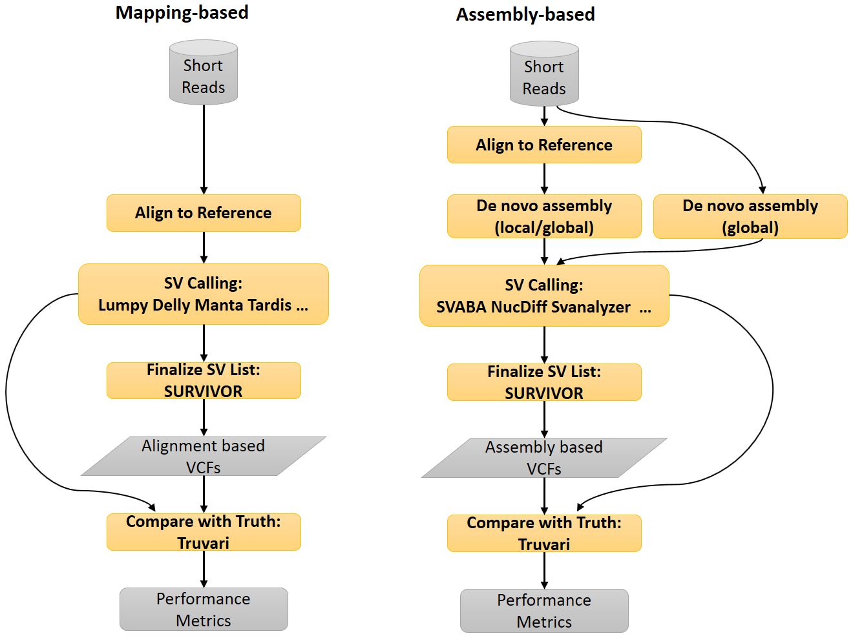
Structural Variant Analysis Overview (“SV-Genie”)

Slide 5
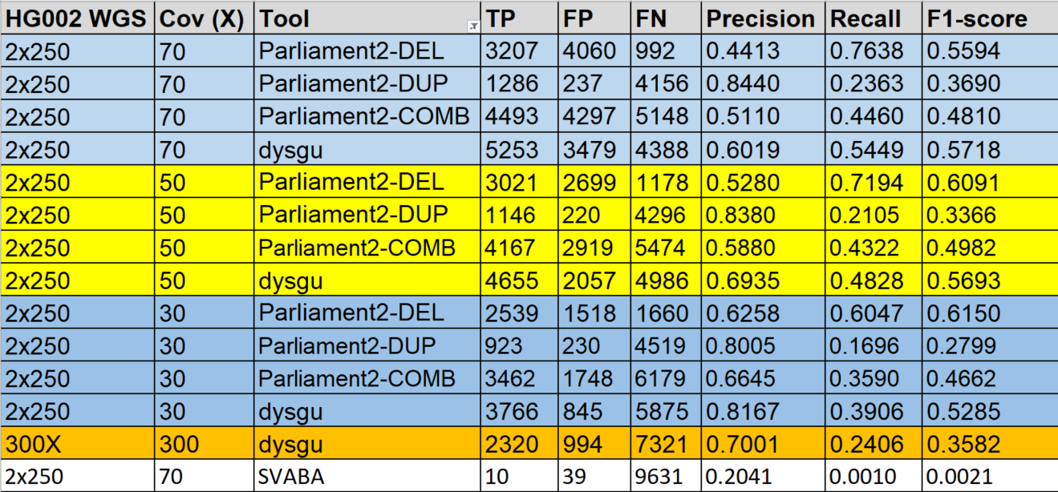
Results: Truvari

Slide 6
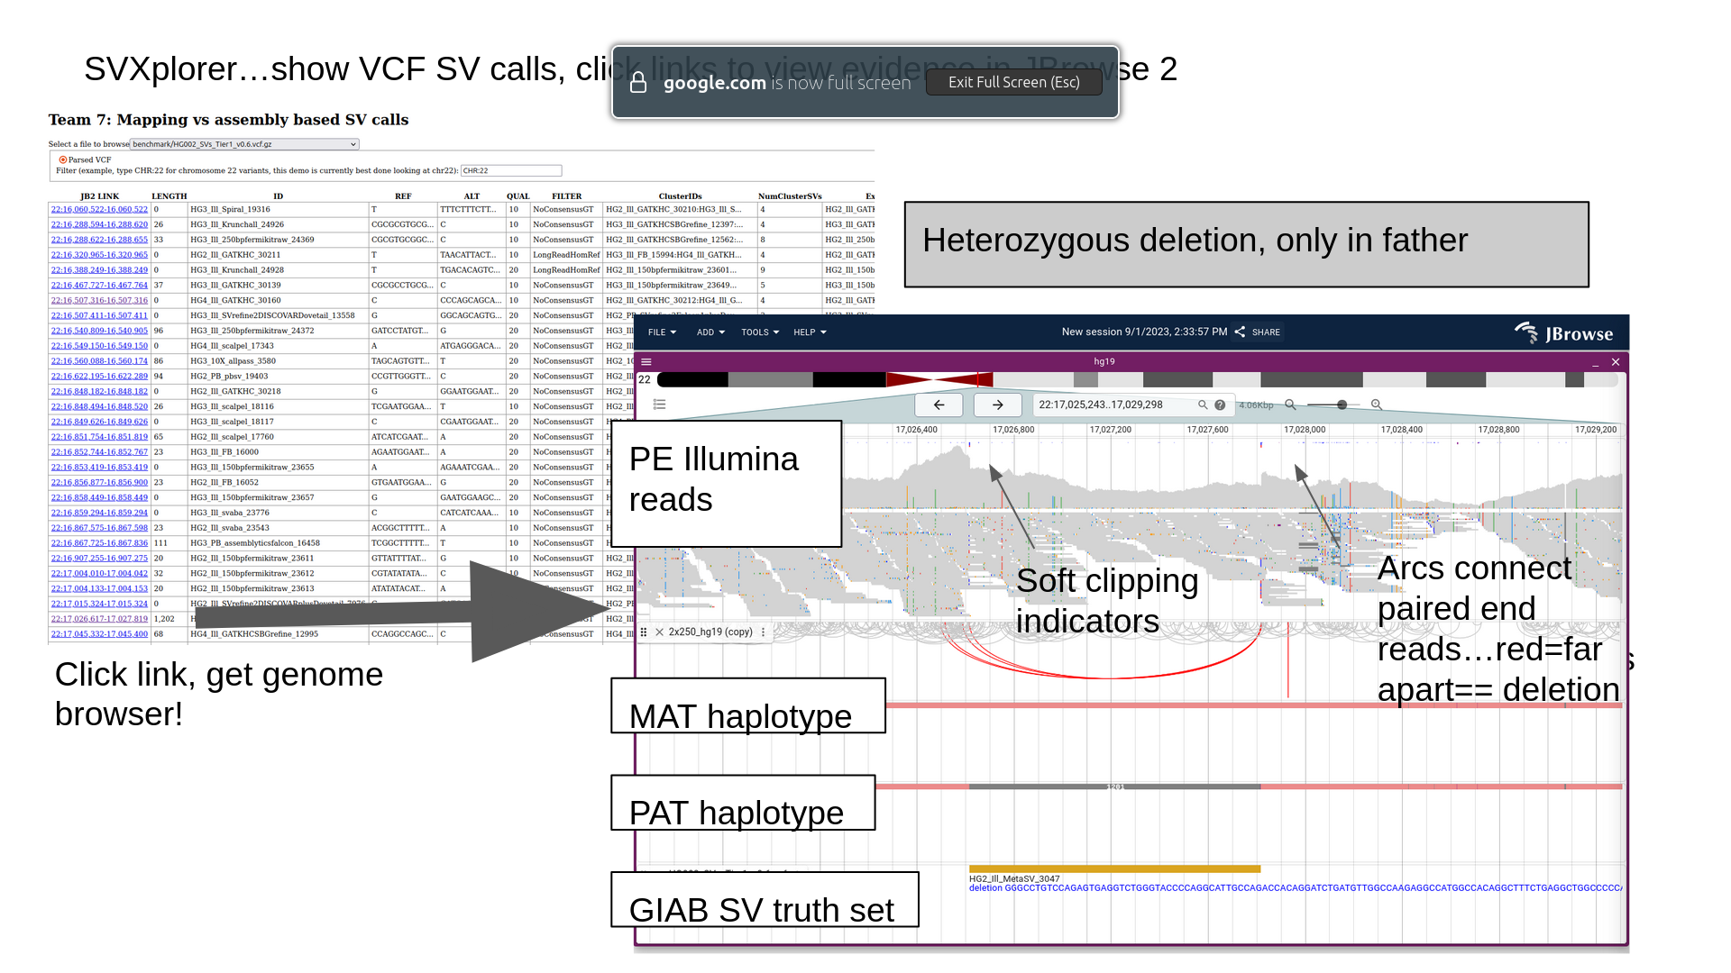
Results: Colin’s Test

Slide 7
Summary
Conclusions
The Mapping-vs-Assembly SV calling testing framework is in place
Mapping-based callers are good
Assembly-based callers can be better
Use Colin’s test to check for false positives
Future work (to be revised)
Mix-and-match
Docker package for the framework

Slide 8
Acknowledgement
Fritz
Ben
BCM
All Hackathon participants

