Slide 1

Team Members:
Jean Monlong - Lead and Liaison
Rupesh Kesharwani - Sysadmin and code developer
Pranav Khade - Data Guru
Weiyu Zhou - App Developer
Ahmad Al Khleifat - Writer and guide

Slide 2


Background: GeneVar app
GeneVar
Annotate all known structural variants (SVs) in dbVar.
Gene name -> all SVs around that gene
No way to upload/search custom user data ??
Functional enrichment ??
https://github.com/collaborativebioinformatics/GeneVar
Clinical_SV app
Upload user’s VCF
Gene Annotation
Clinically-relevant SVs
Enriched Disease Ontology and Pathways
VCF parse and Visualization
Download annotated VCF, Reports, and Plots

Slide 3
Goal
Find and annotate clinically relevant structural variants (SVs) in a patient.
Contribute to the combined clinical report
+ provide an interactive way of exploring the results
OMOP
Database
(team 1)
Annotated SVs
Genes/pathways
Graphs
RNA seq
Patient’s omics
Clinical report
(team 6)
Visualization
DNA seq
BAM file
SV calling
SVs
VCF file
Annotation in R
TCR data
R Shiny app
Interactive app

Slide 4
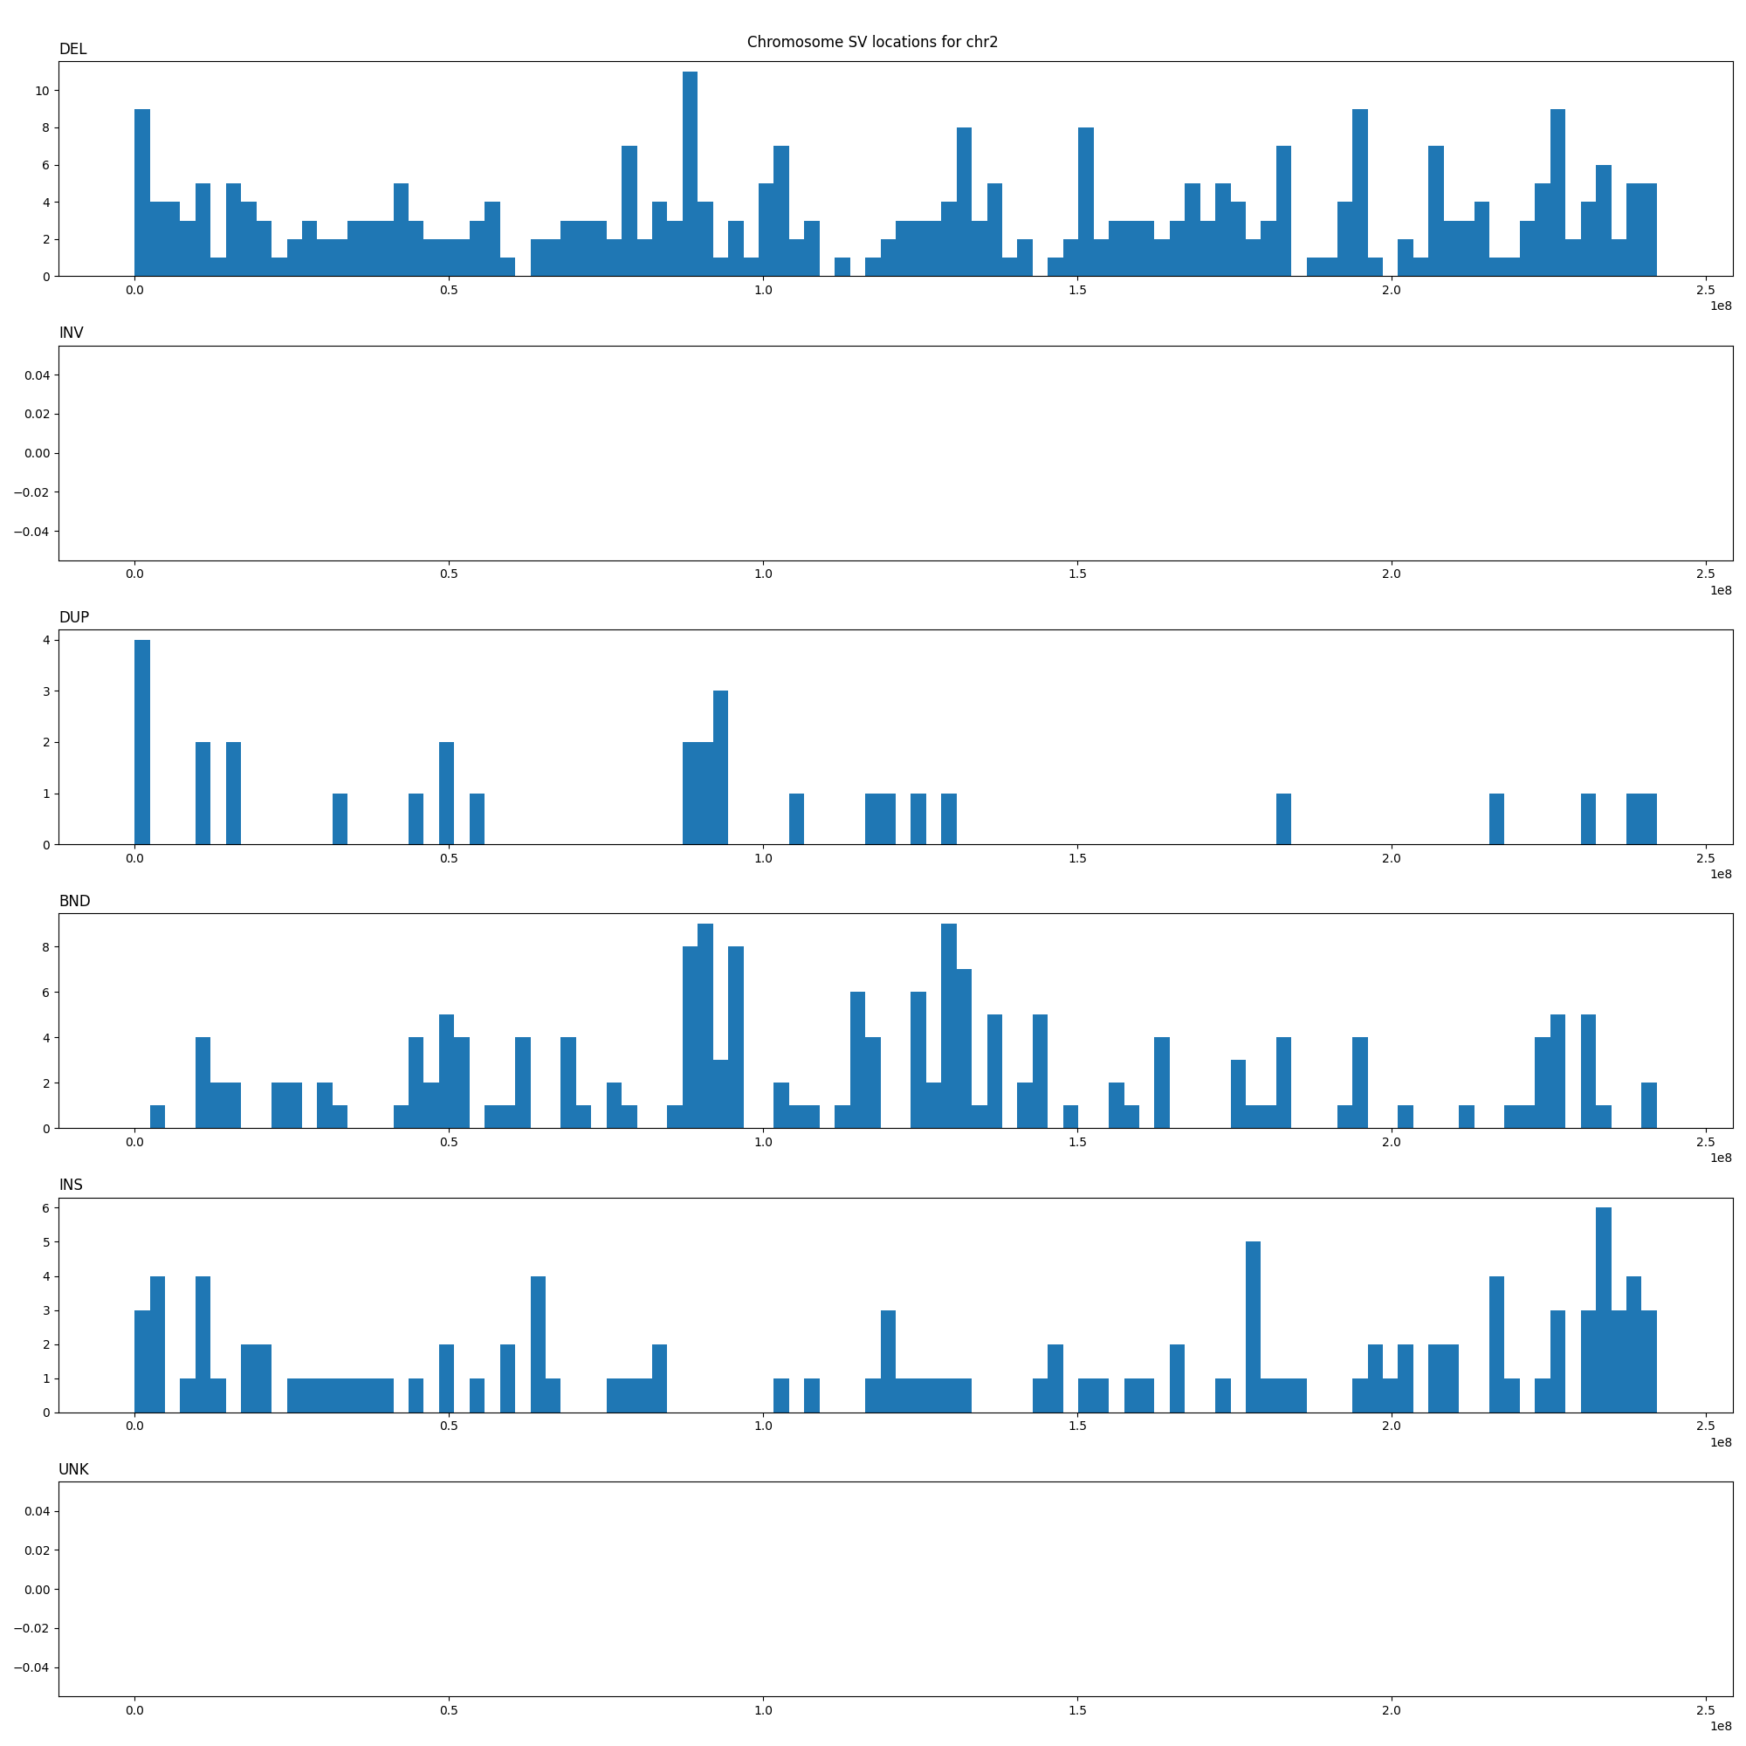
SV calling and visualization of the SV distribution
Parliement2 calling SVs from a sample from 1000GP -> realistic test data
VCF parser and SV visualization:
Input: VCF file with SV calls + chromosome + bin size + minimum SV length
Output: location of SVs for each SV type
Number of SV
Position in chromosome

Slide 5
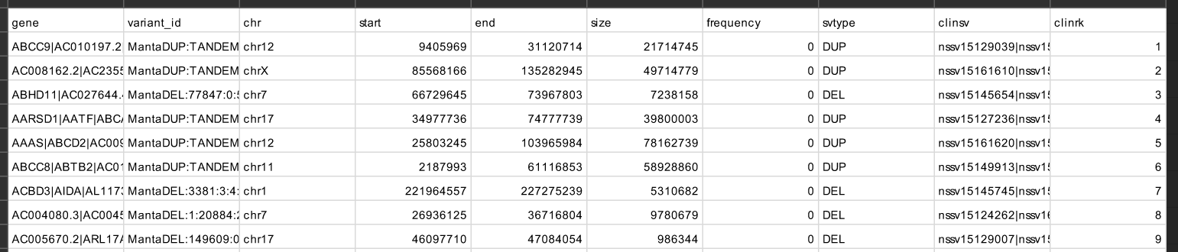
Annotation of clinically relevant SVs
Select, annotate and rank SVs that:
Impacts a gene
  Inc. loss-of-function intolerant genes
  Inc. OMIM genes
Is rare (gnomAD-SV)
Matches known clinical SVs (dbVar)

Slide 6
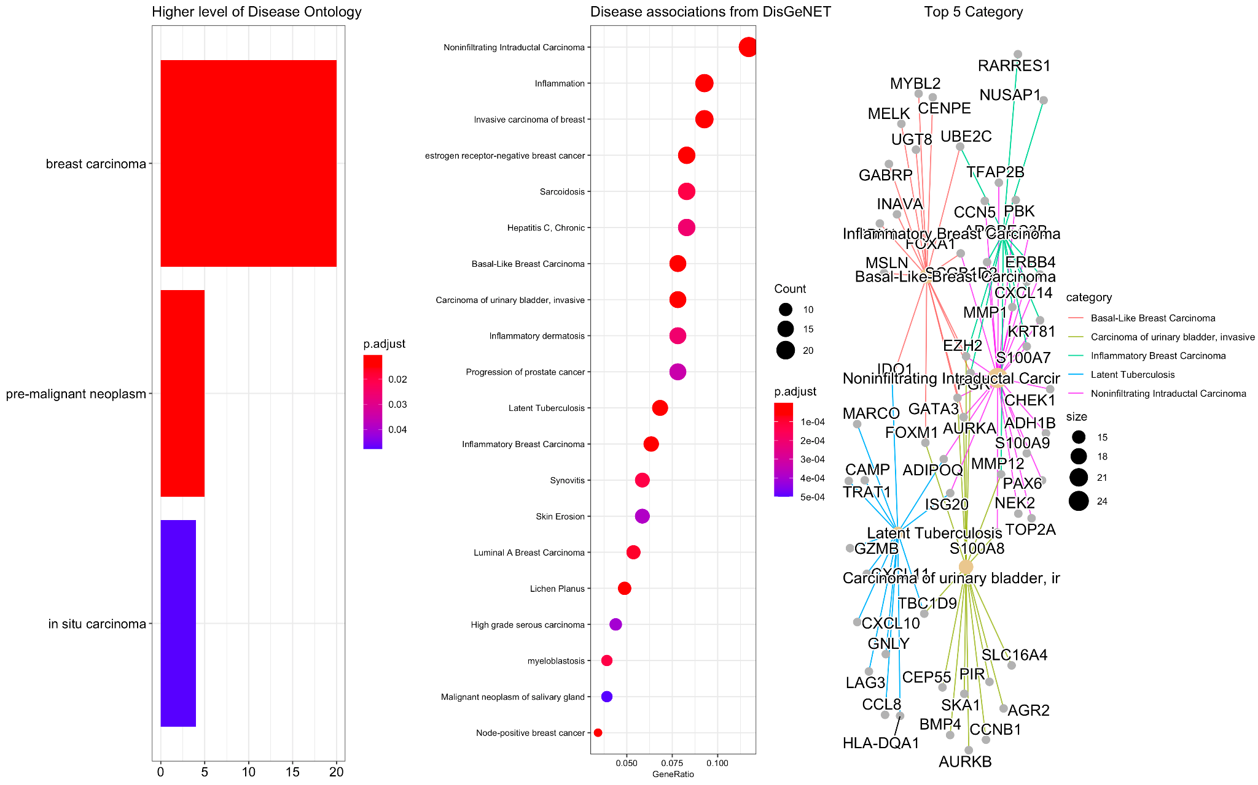
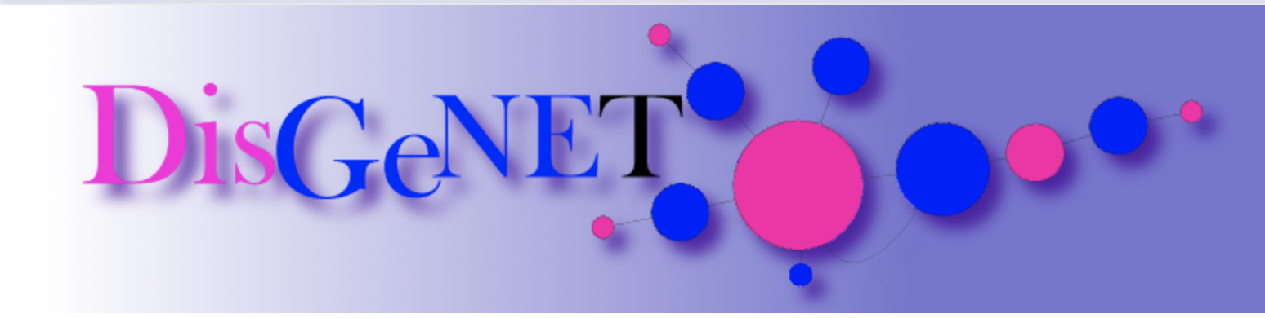
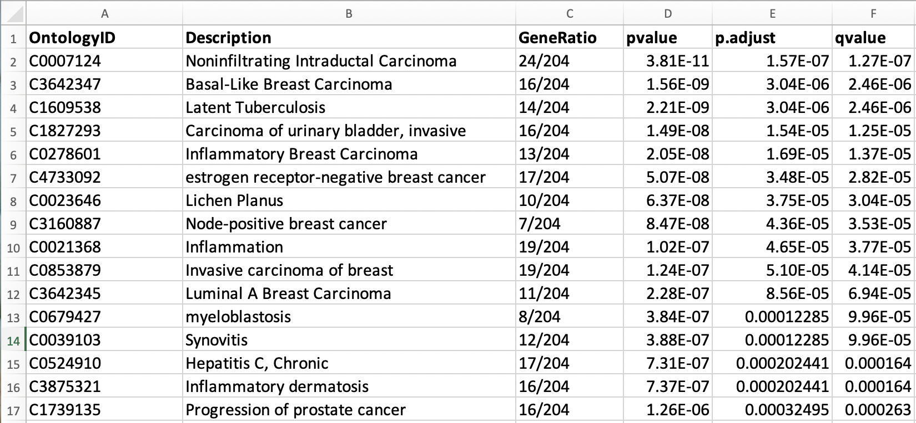
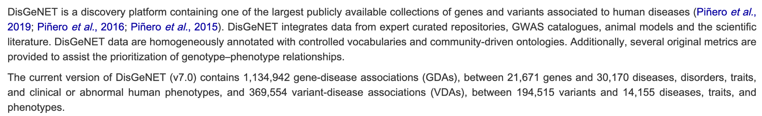
Disease Ontology: hit by clinical SVs types (DUP, INS, DEL, TRA, INV)

Slide 7
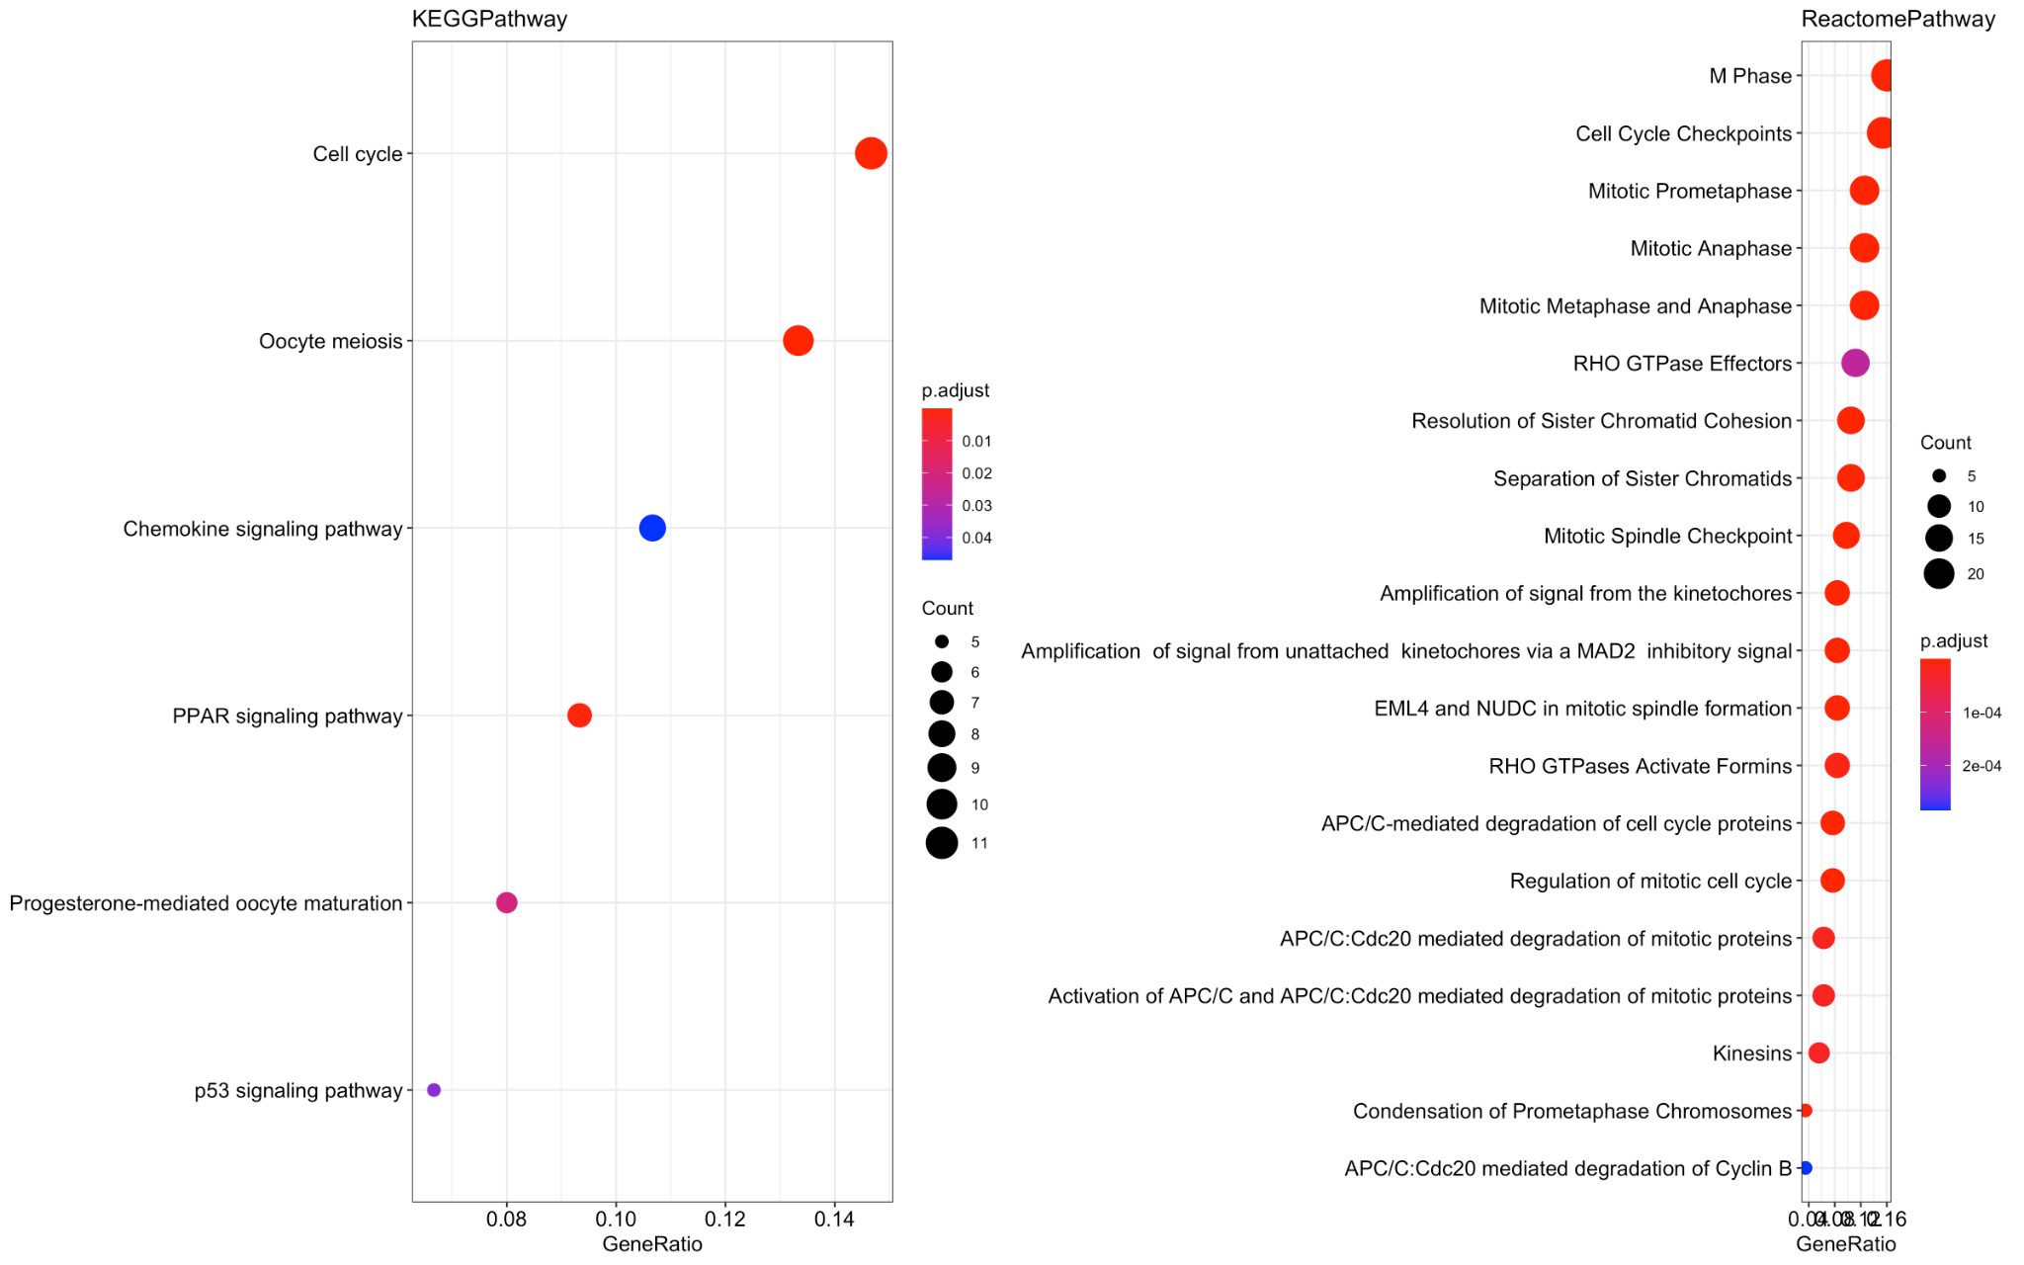


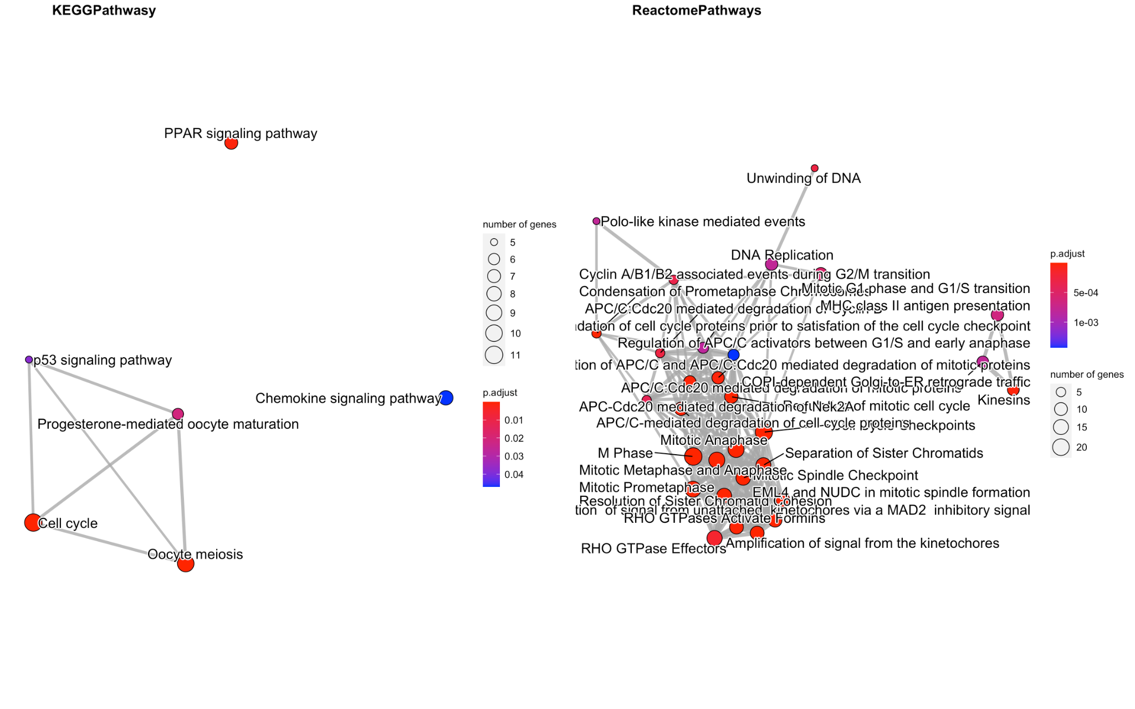
Enrichment Pathways: hit by clinical SVs types (DUP, INS, DEL, TRA, INV)

Slide 8
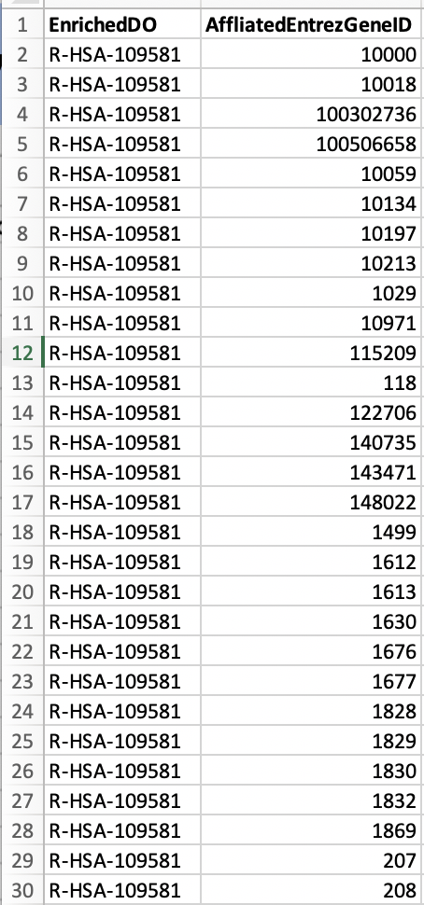
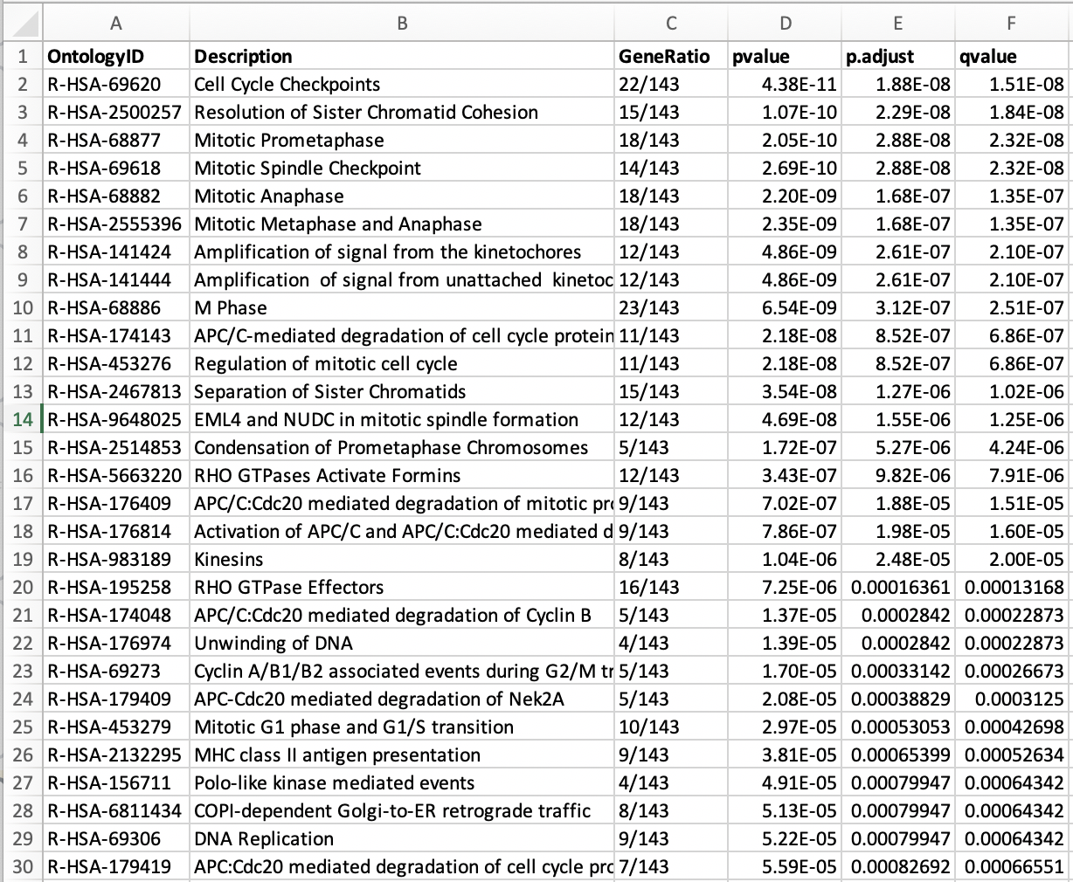
Enrichment Pathways: hit by clinical SVs types (DUP, INS, DEL, TRA, INV)

Slide 9
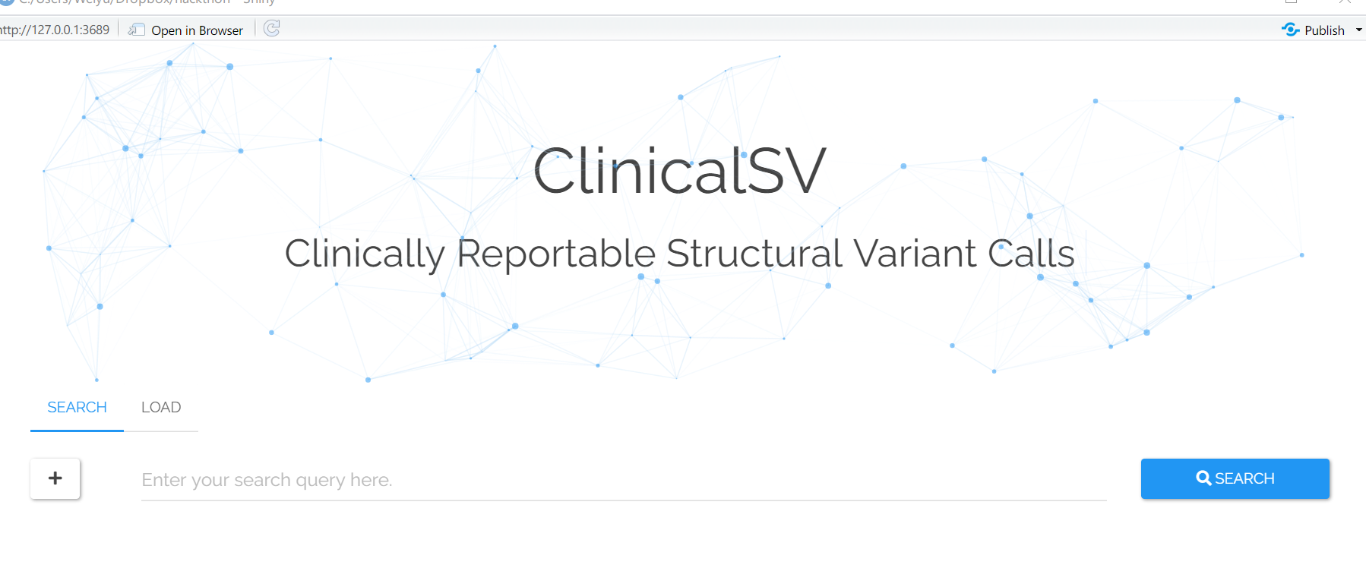
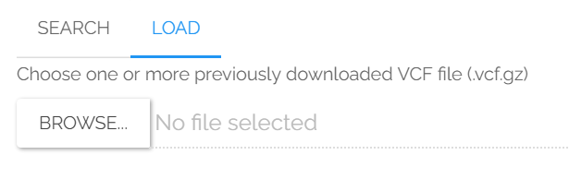

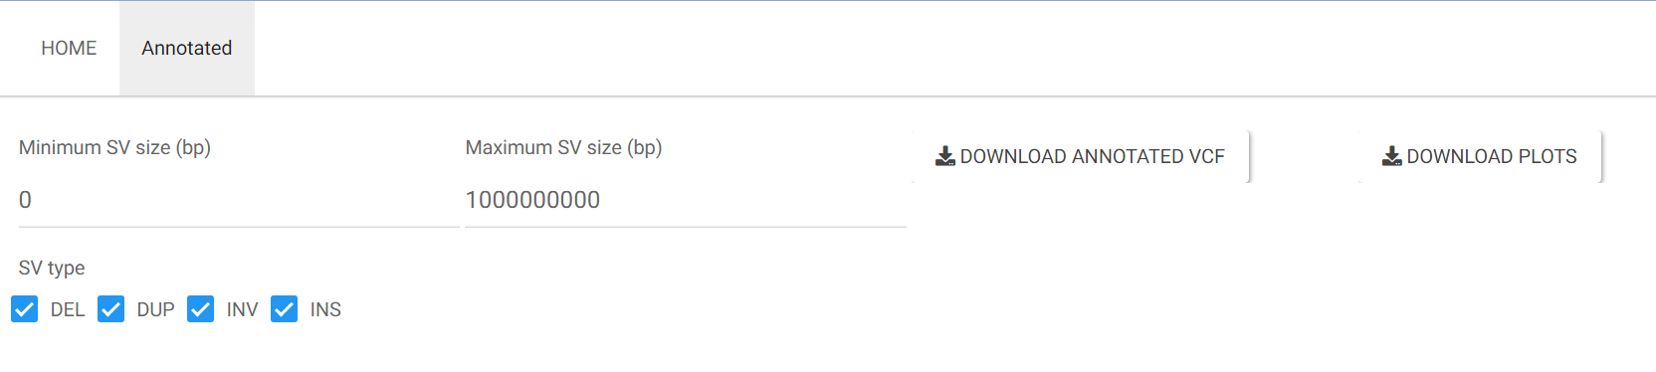
Standalone App to annotate VCF and explore clinical SVs

Slide 10

Standalone App to annotate VCF and explore clinical SVs
WINDOWS
LINUX
Fixed 5 mins ago!
Problems merging user interface with annotation code on the server side

Slide 11

Acknowledgement
Team:
Jean Monlong
Rupesh Kesharwani
Pranav Khade
Weiyu Zhou
Ahmad Al Khleifat
Organizers:
Melanie Gainey
Ahmad Al Khleifatt
Kym Pagel
Ames Ma
Ben Busby

Slide 13
Day 3

Slide 14
Day 3 - Methods and updates
BAM -> VCF with SV calls
  Ran parliament2 workflow in DNAnexus on 1000GP WGS seq sample
VCF -> annotated VCF + CSV
  First simple workflow and tables created
Standalone Shiny App to annotate VCF and explore clinical SVs
  New UI and features, need to integrate the annotation
  Gene Enrichment plots and table
Visualization of the SV calls

Slide 15
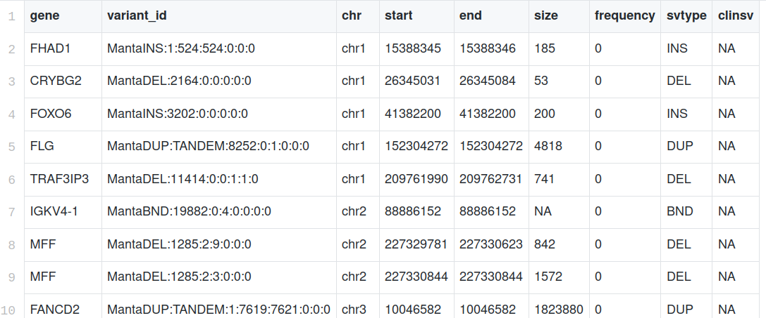
VCF -> annotated VCF + CSV
First set of annotation modules integrated in a master R script
See example of output CSV for Team 16: NA19461.clinicalsv.csv
Next: finish more modules
  Gene enrichment with the clusterProfiler package, needs to be integrated
  Annotation of known cancer SVs from COSMIC?

Slide 16
Disease Ontology: hit by clinical SVs types (DUP, INS, DEL, TRA, INV)
Next: New tab in the Shiny app and new table to share with Team 1,6

Slide 17
Enrichment Pathways: hit by clinical SVs types (DUP, INS, DEL, TRA, INV)

Slide 18
Enrichment Pathways: hit by clinical SVs types (DUP, INS, DEL, TRA, INV)

Slide 19
Standalone Shiny App to annotate VCF and explore clinical SVs
Started a nicer UI than GeneVar
New feature: “Load” button to upload input VCF
Next: integrate the annotation code on the server side

Slide 20
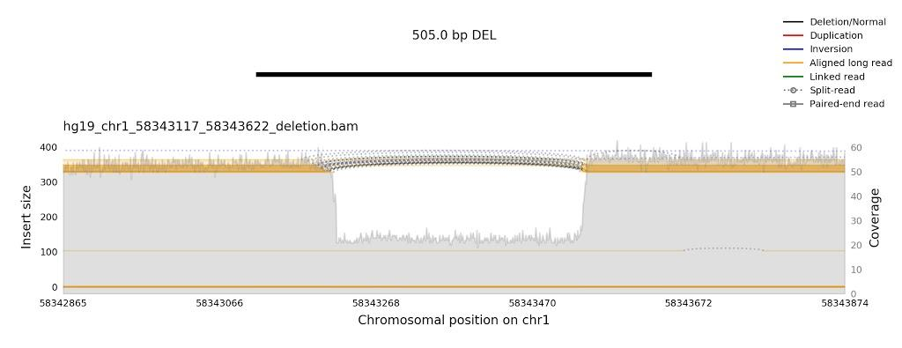
Visualization of the SV calls
Distribution of SVs across the genome
Next: SV-oriented read coverage plot from samplot to assess confidence

Slide 21
Day 2

Slide 22

Workflow of the SV module
Implemented in GeneVar
Frequency
New feature
File
Gene impact
Known clinical SV
manta
parliament2
SV calling
VCF with SVs
Links to GeneVar
Annotated VCF with SVs
Priority score
Groups 1,6 for
combined report
Gene in enriched pathway
Standalone Shiny app?
BAM file
QC images for (some) SVs
Visualization of a SV call
samplot

