Slide 1
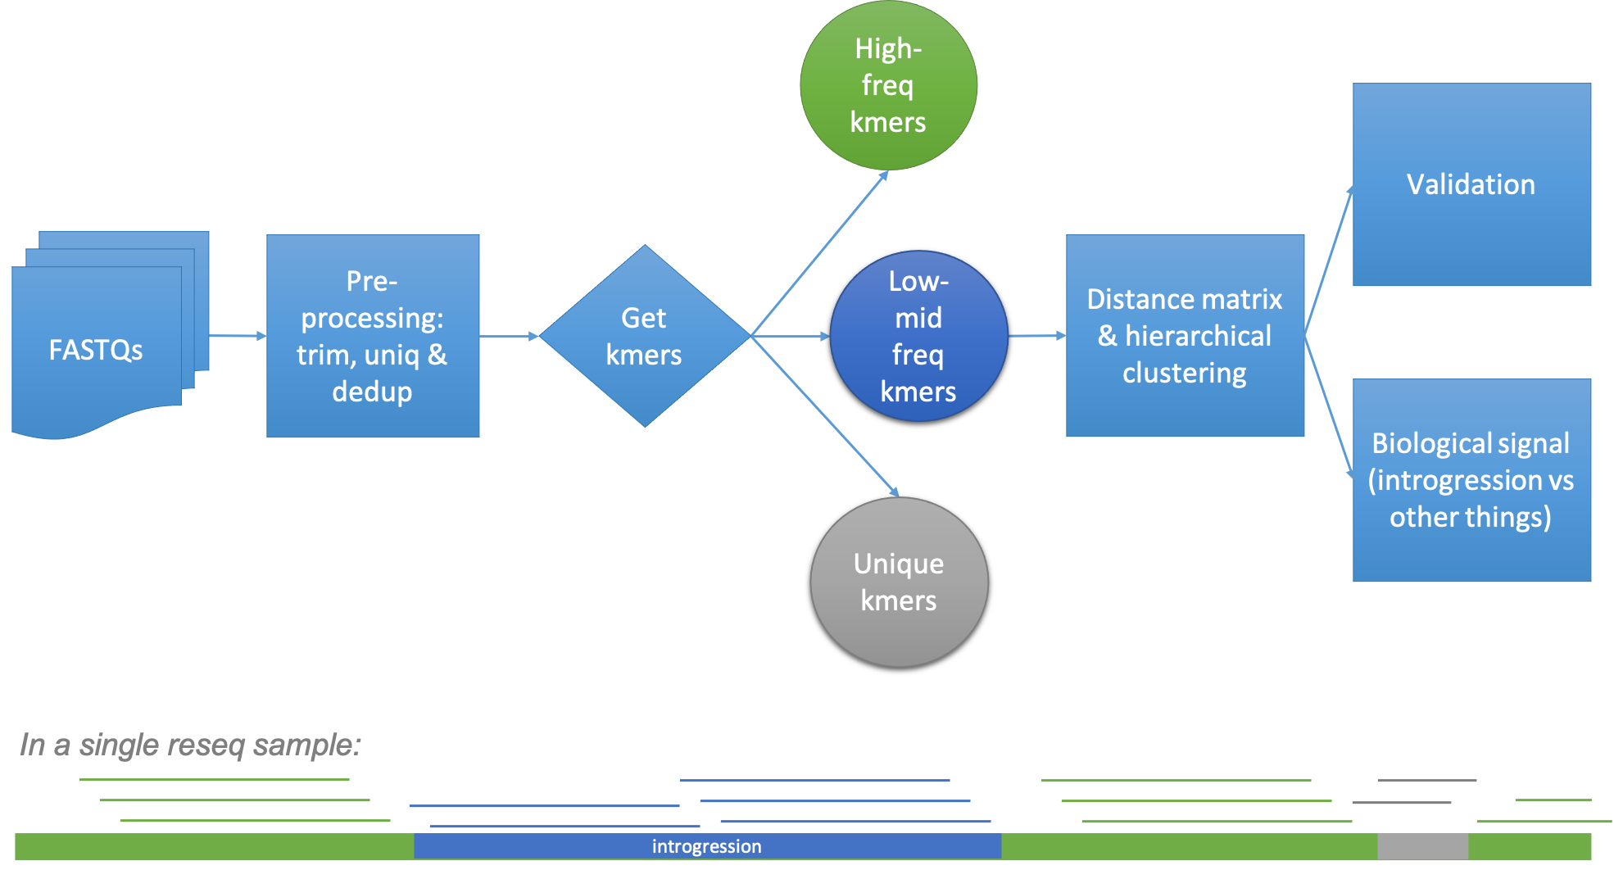
Group 3- pipeline
12 Oct

Slide 2
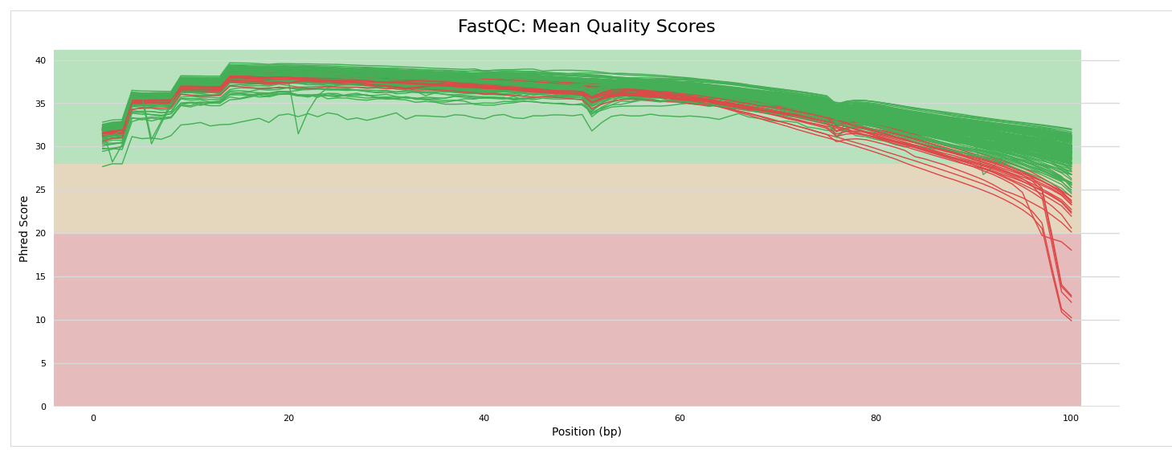
Progress
Downloaded short reads 84 tomato lines sra_fastq_importer
Quality control of reads fastqc
Trimming flexbar_fastq_read_trimmer (5base,q>20N)

Slide 3
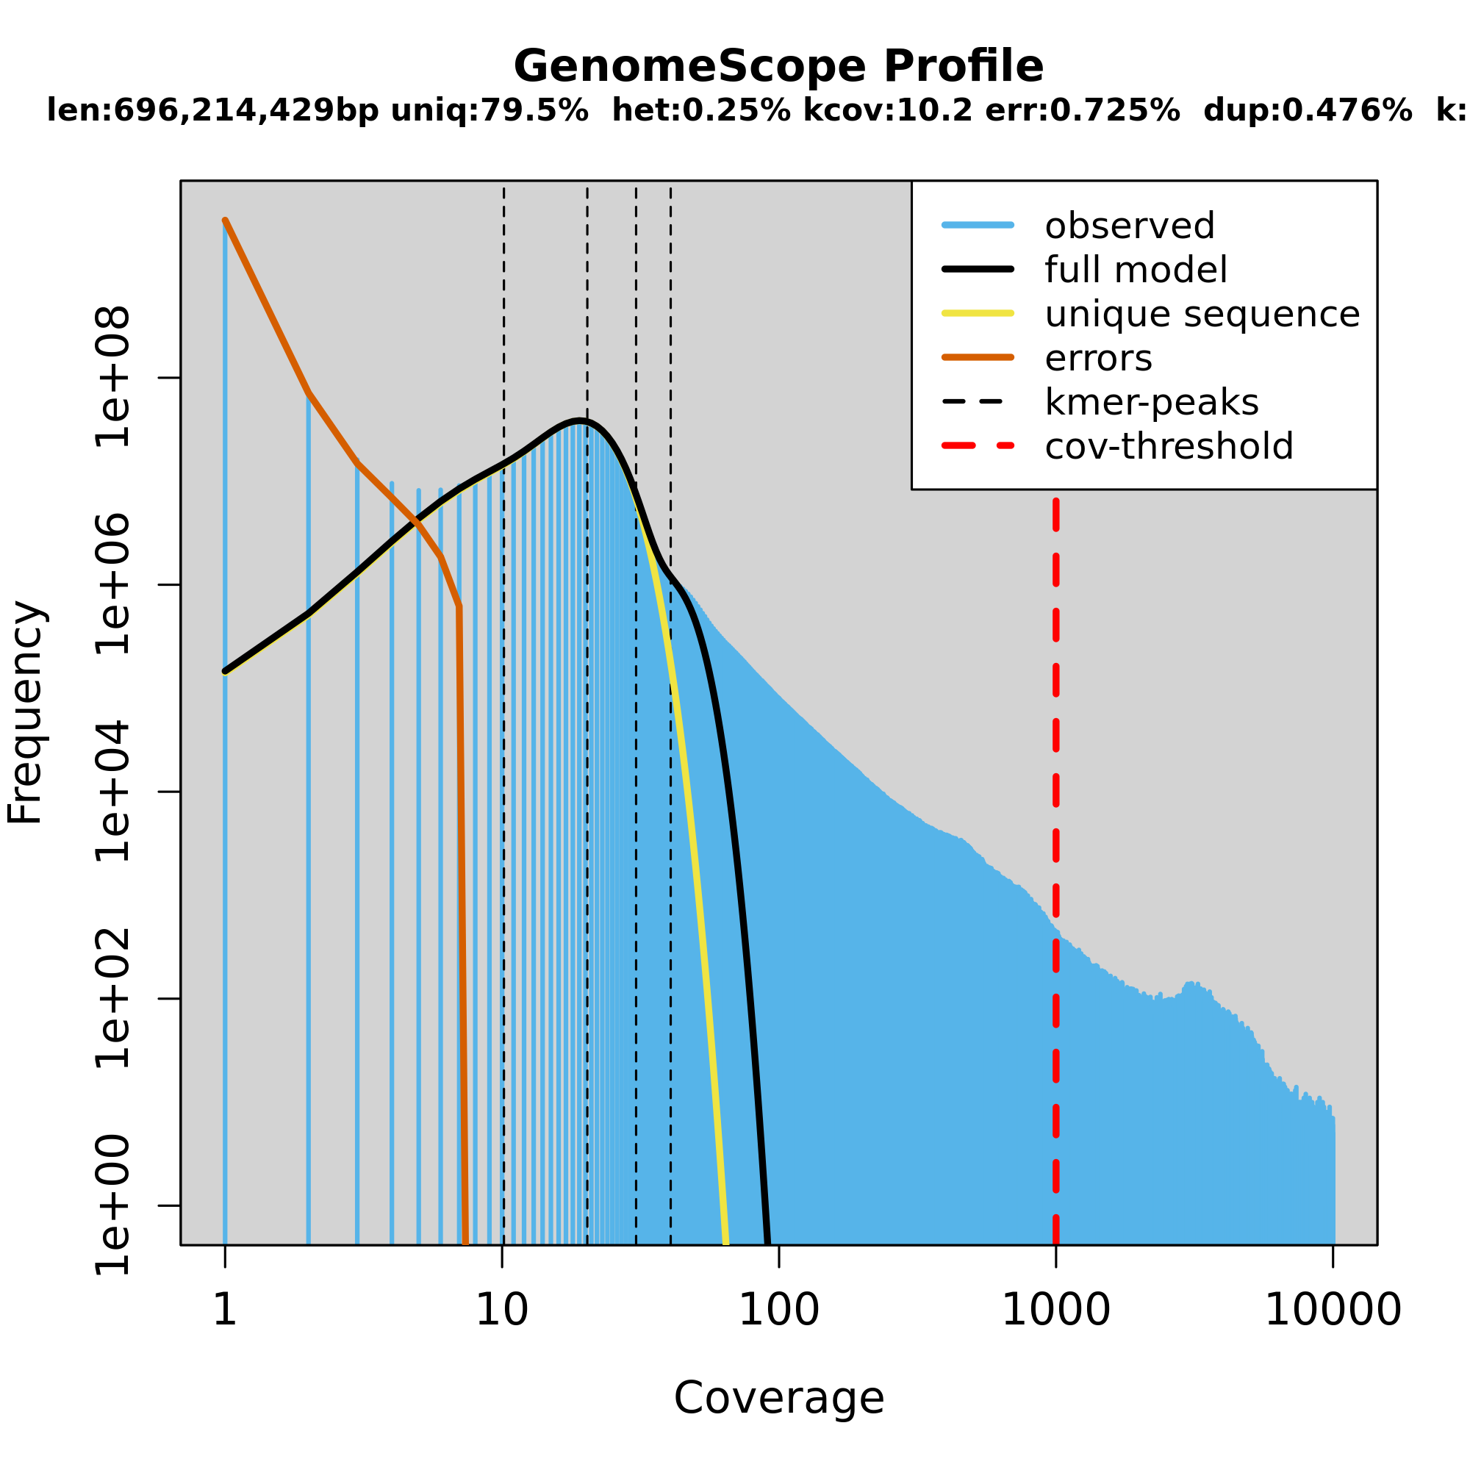
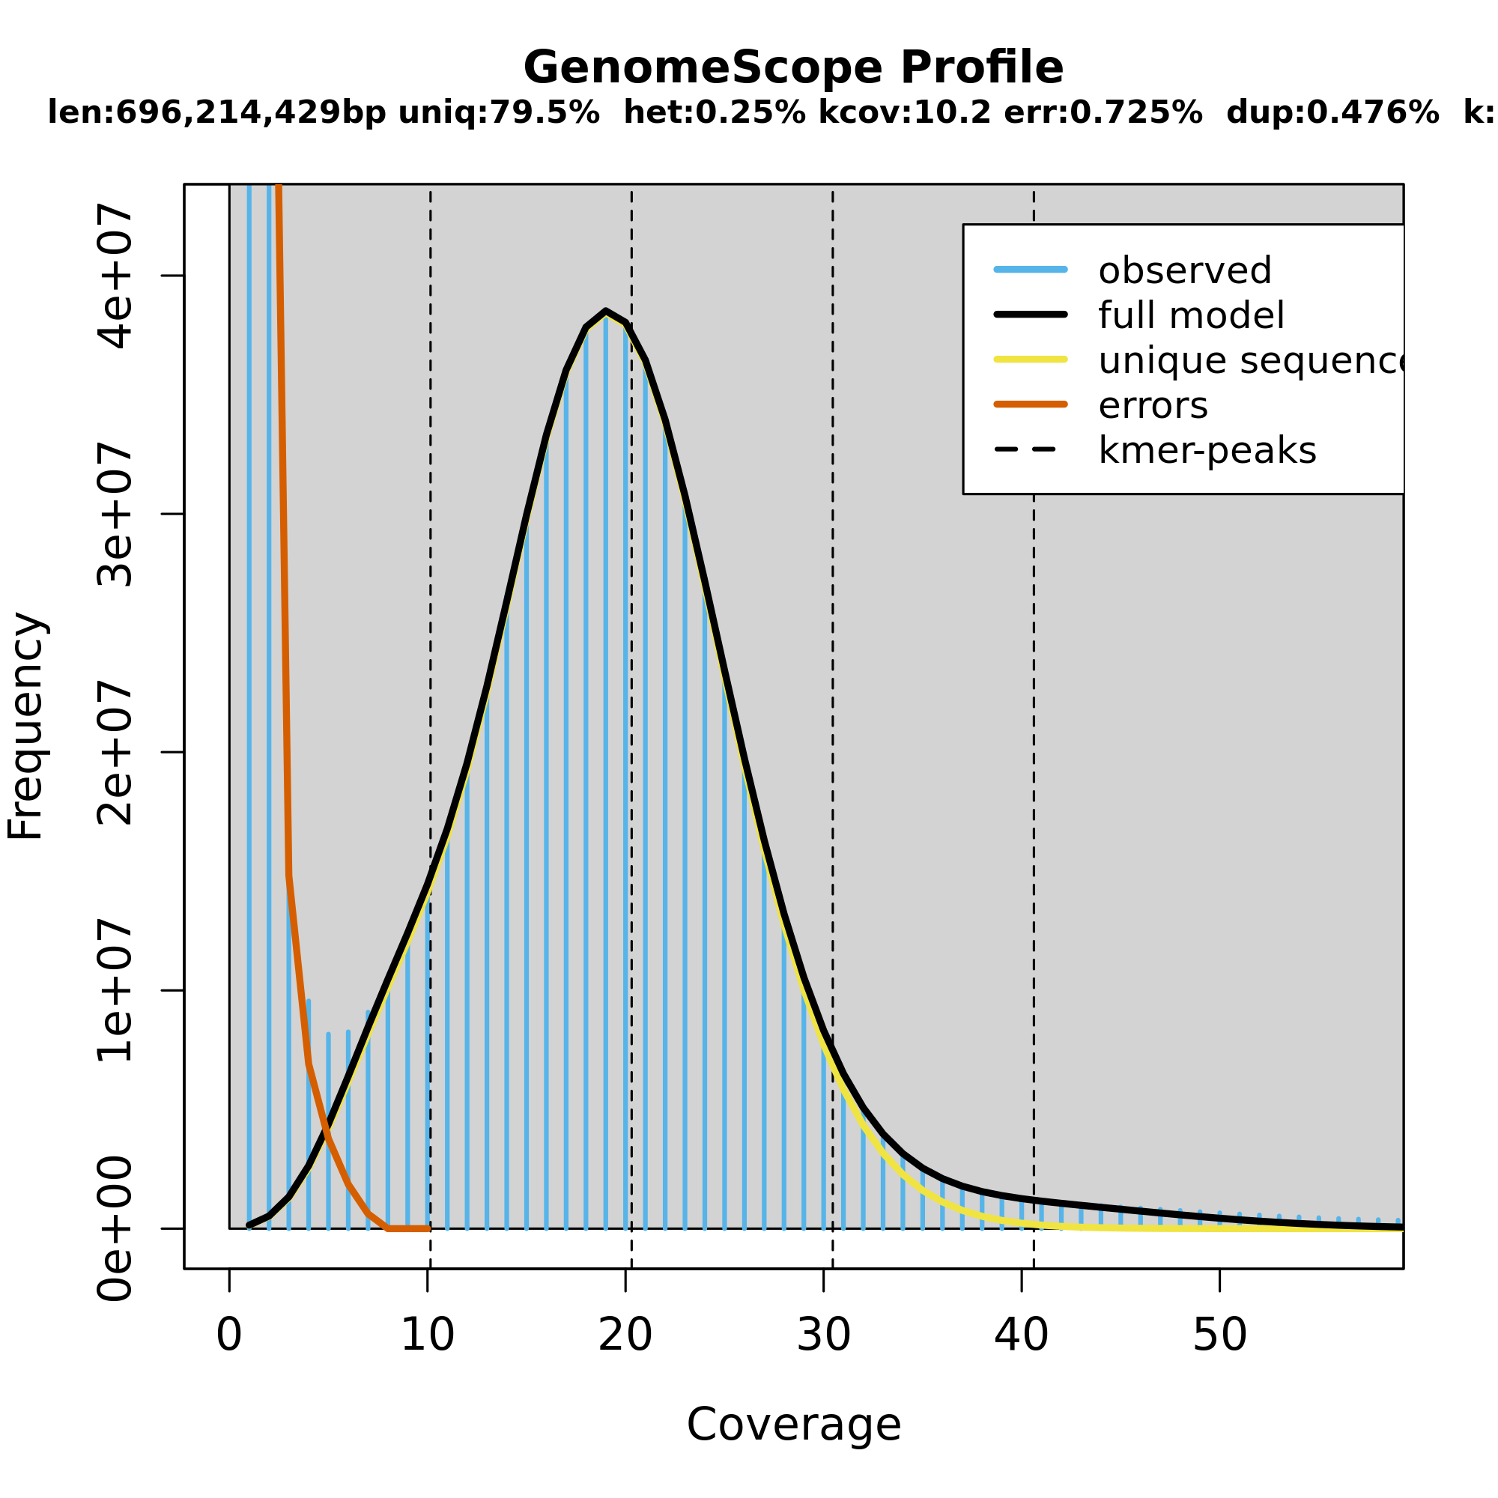
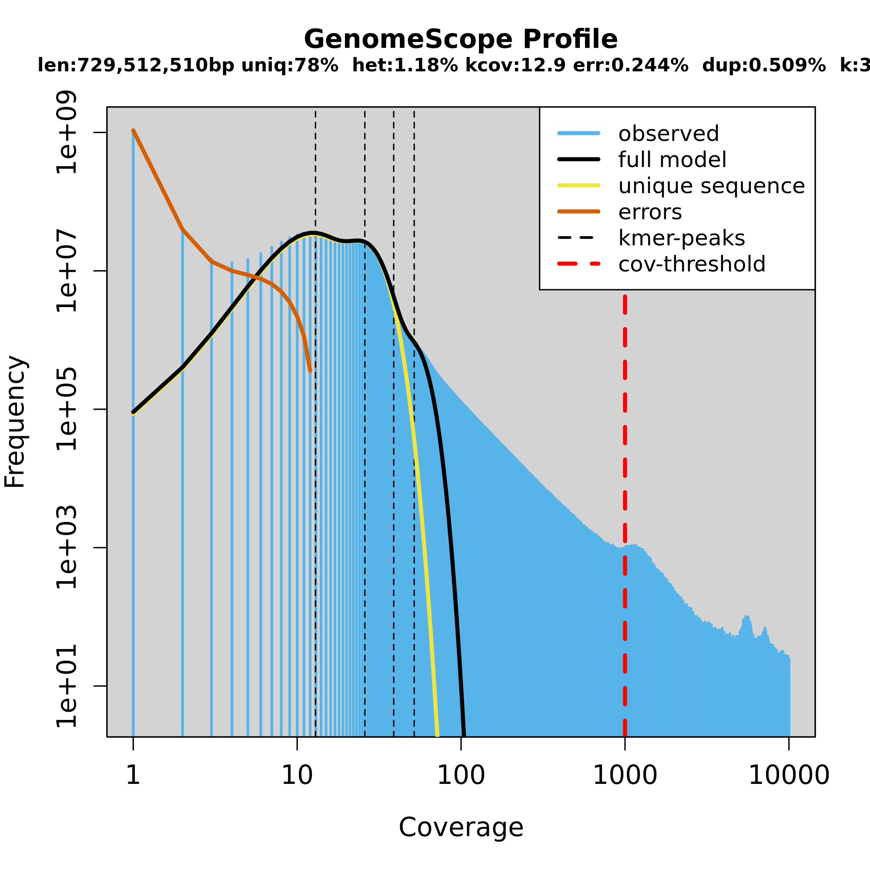
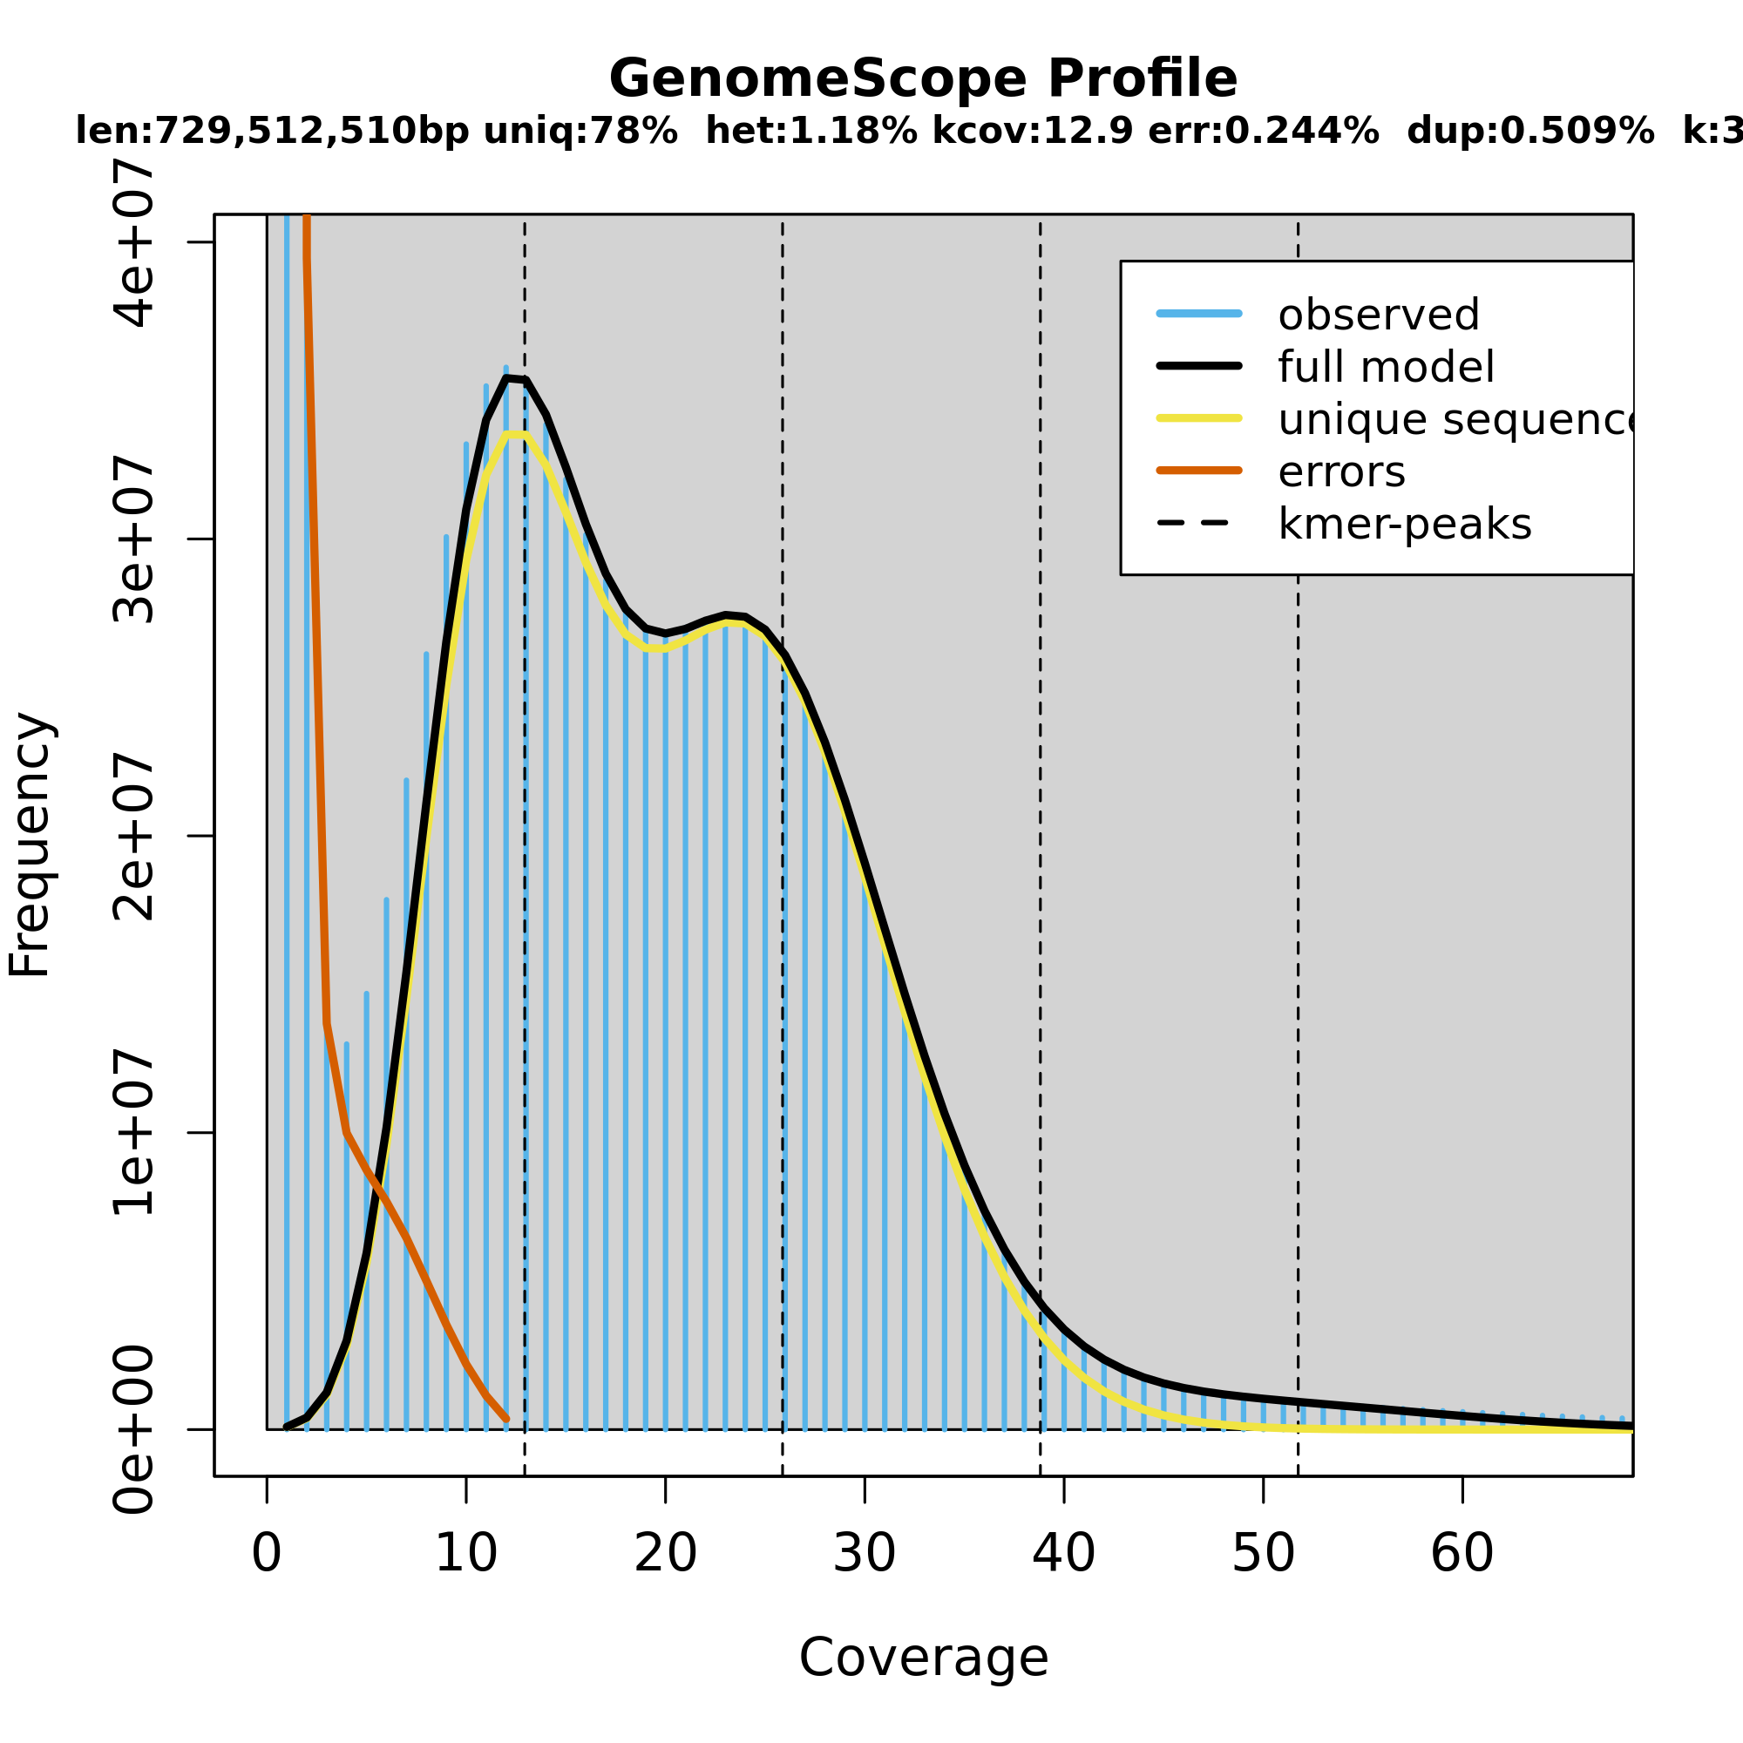
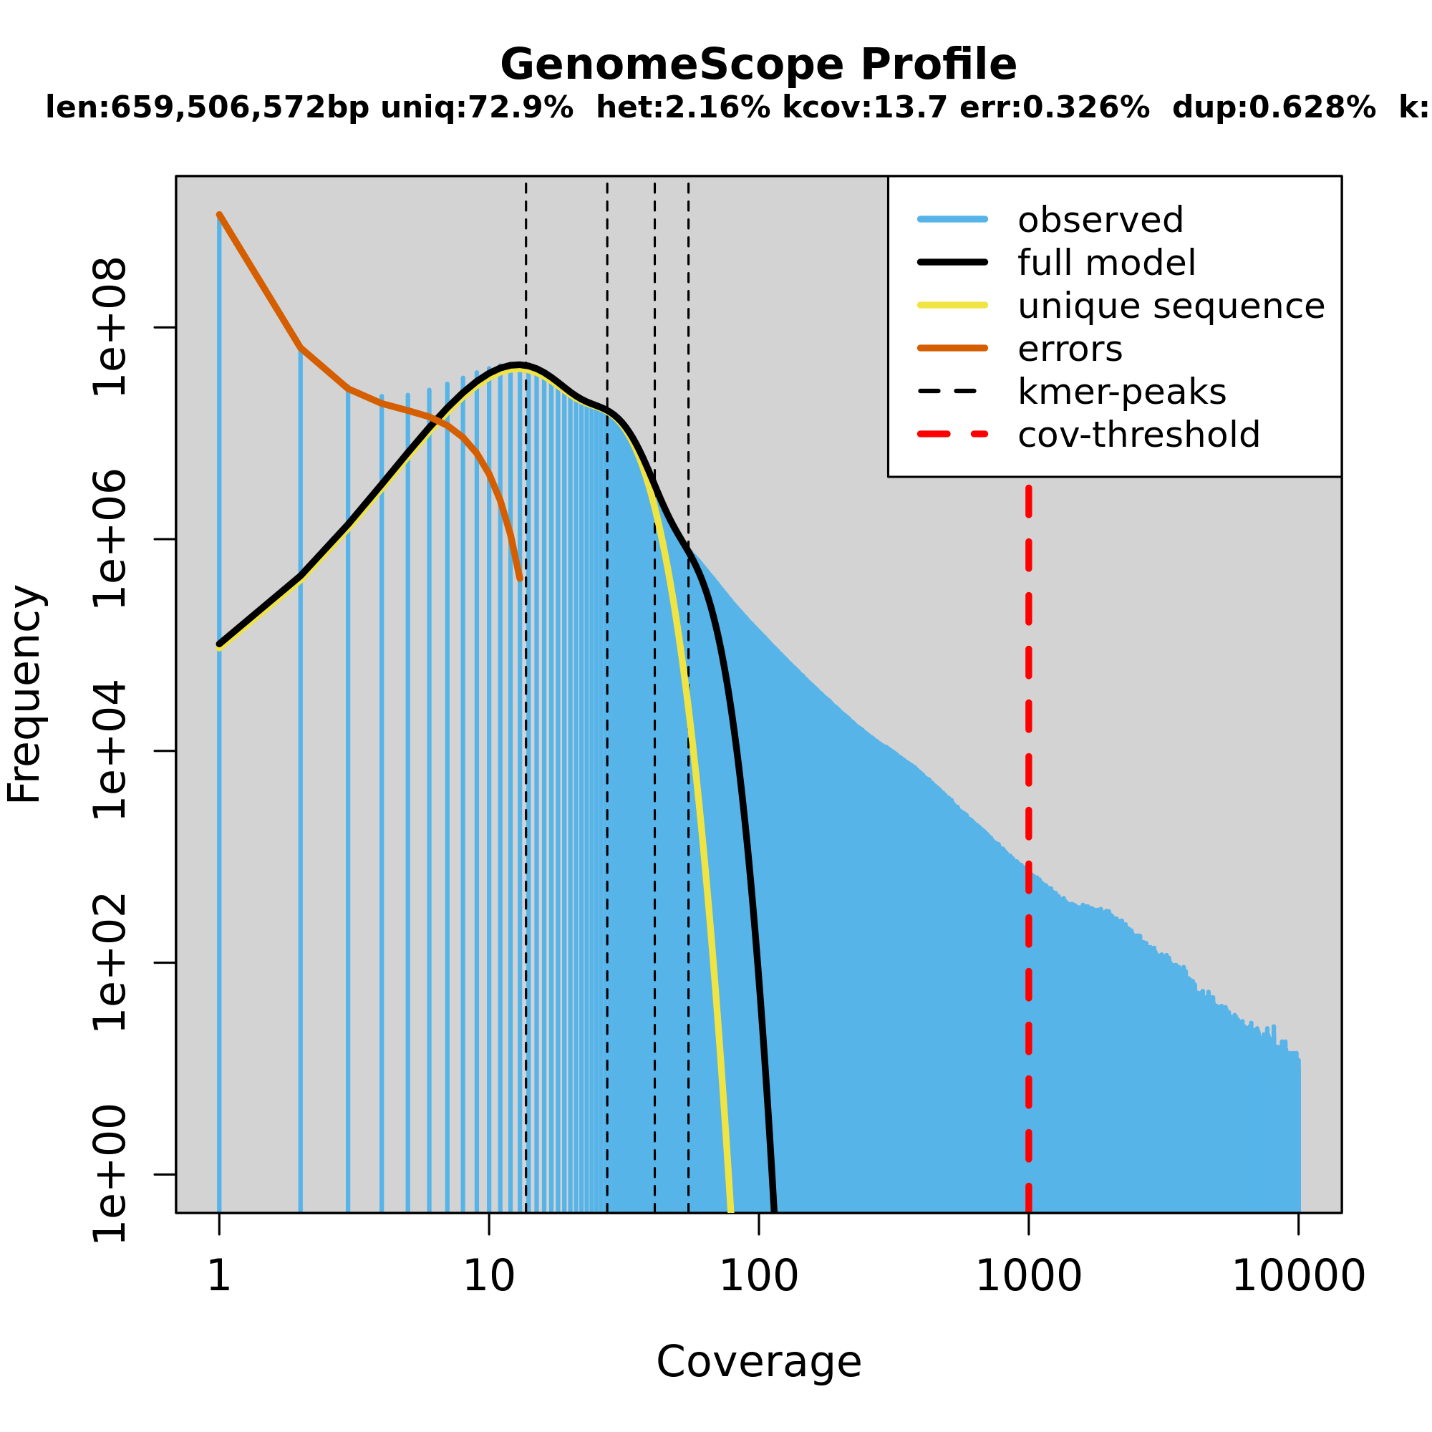
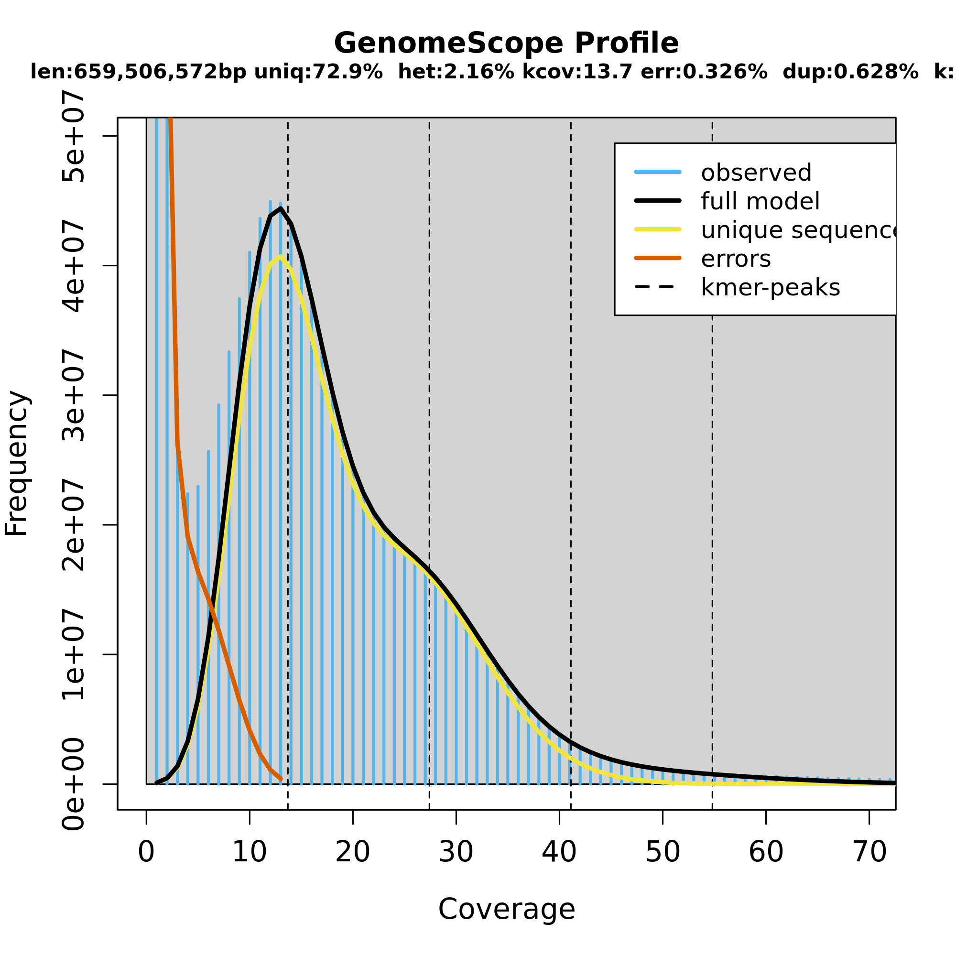

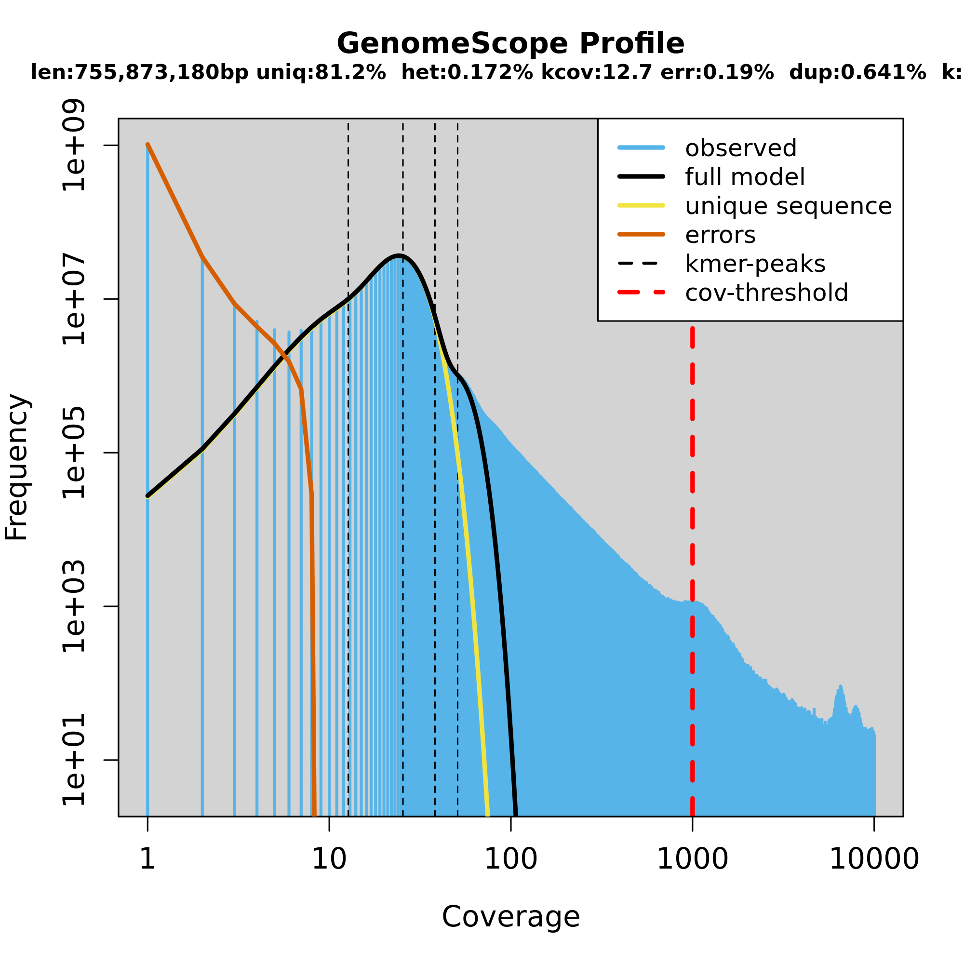
Jellyfish jellyfish_and_genomescope
ERR418040 (S. lycopersicum-elit)
ERR418100 (S. habrochaites-wild)
ERR418108 (S. huaylasense-wild)
ERR418099 (S. habrochaites-wild)

Slide 4
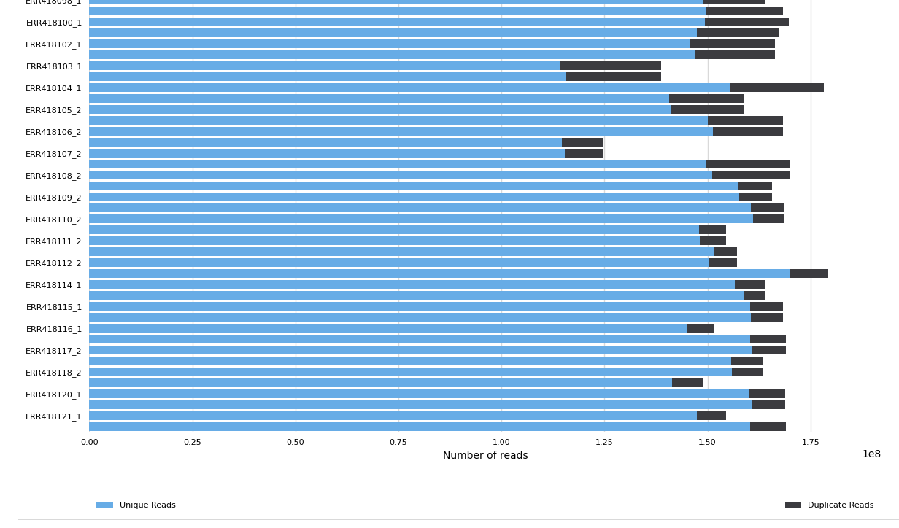
Subsampling all samples SwissArmyKnife-> seqtk

