Slide 1


Slide 2
Sample Data Preparation
HPRC Release 2 → chr21 smoke-test interval
① HPRC Release 2
Public data, no access request
② Select Haplotypes
HG00673, HG00733 + GRCh38
③ Extract chr21
minimap2 interval mapping
④ Smoke Interval
chr21:20M–21M (~1 Mb)
Why chr21?
1 Mb
≥20
0.90
Smallest human autosome (~47 Mb) — fast to iterate on
Real, well-characterized structural variation
Cheap enough to smoke-test before scaling genome-wide
smoke interval
min MAPQ
min query coverage
Cloud Environment
Pipeline Scripts
DNAnexus Cloud Workstation (mem3_ssd1_v2_x16) — dxpy / dx CLI — project Group11_2026
fetch_hprc_index.py → download_hprc.py → prepare_reference.sh → map_chromosome.py → prepare_sequences.py

Slide 3
Baseline vs. Parallel Graph Construction
Pangenome Graph Building (PGGB) builds our graphs
Pairwise — 5 vs. 5
Linear — 5 vs. 1 Reference
N × (N−1)
N
every sample cross-compared to every sample
each sample compared only to the reference
Reassembly: 5 SV Call Graphs → 1 Graph
SV Graph 1
SV Graph 2
SV Graph 3
SV Graph 4
SV Graph 5
Merged SV Graph
Each SV call graph welds only to its neighbor via shared overlap sequence — 5 graphs need 4 welds, not all-pairs comparison. Status: stitch algorithm designed, implementation in progress.

Slide 4
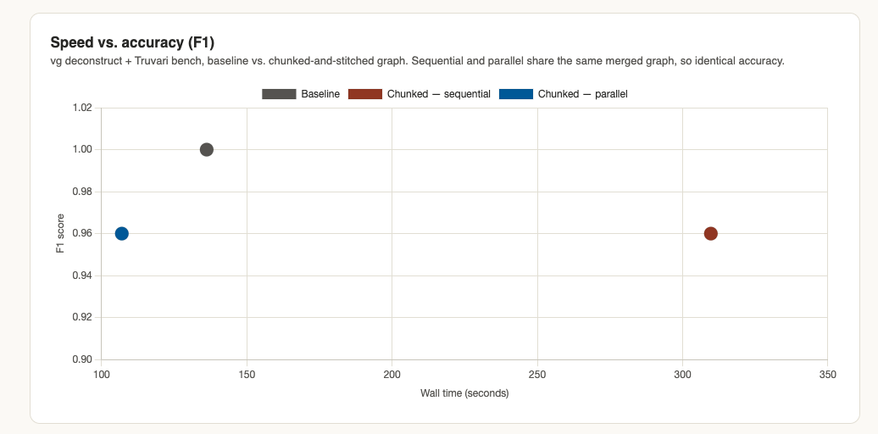
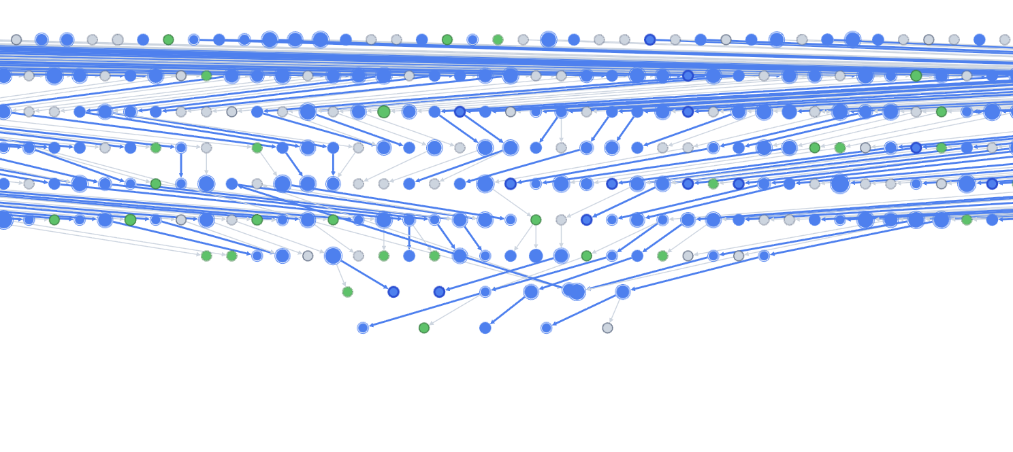
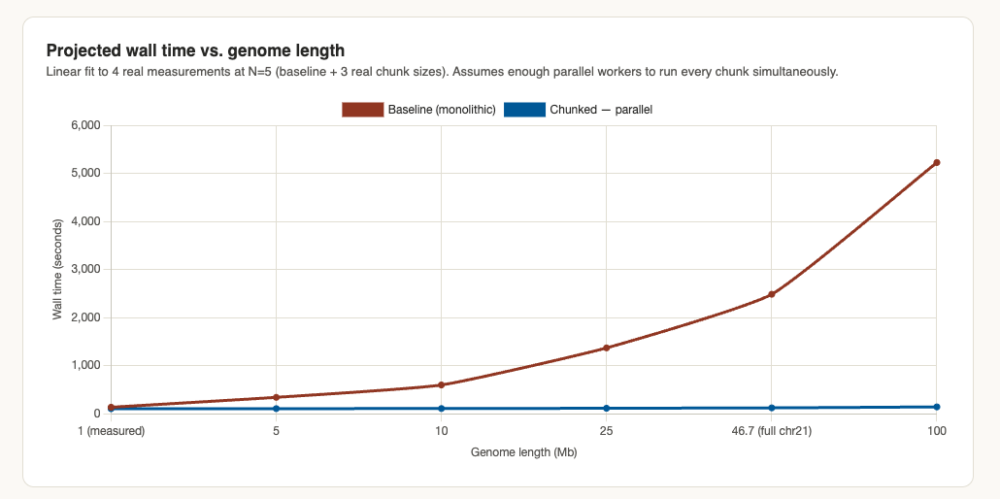
Benchmarking results
Sample graph

Slide 5
Validation & Benchmarking
Confirming equivalence with the baseline graph, and browsing the result
VALIDATION GOAL
Benchmarking Pipeline
Preserve haplotype paths, topology, sequence content, and variant calls — relative to the monolithic baseline graph.
vg deconstruct
Truvari
Precision /
Recall / F1
dipcall
assembly vs GRCh38
55
Graph Explorer (Web)
Next.js + React dashboard. Loads compact JSON summaries — not raw GFA — for fast browser rendering of merged pangenome graphs.
automated tests passing (2 skipped)
GFA parsing · chunking · merge · interval mapping · provenance · orchestration
Status: initial version live
Current status: baseline benchmarking is wired up; full parallel-vs-baseline equivalence is pending the stitch algorithm (see previous slide).

Slide 6
Results from smoke_test
Run | Sequences | Input bp | Wall time | Peak mem | Nodes | Edges | Graph bp
all (5 together) | 5 | 5,006,733 | 129s | 868.0 MiB | 10,397 | 14,197 | 1,006,575
pairwise · HG00673#1 | 2 | 2,001,738 | 108s | 895.0 MiB | 5,497 | 7,449 | 1,004,196
pairwise · HG00673#2 | 2 | 2,001,667 | 110s | 855.0 MiB | 5,816 | 7,885 | 1,004,255
pairwise · HG00733#1 | 2 | 2,001,586 | 110s | 846.4 MiB | 6,061 | 8,214 | 1,004,282
pairwise · HG00733#2 | 2 | 2,001,742 | 109s | 849.8 MiB | 6,060 | 8,212 | 1,004,410
cumulative · ref+1hap | 2 | 2,001,738 | 109s | 888.8 MiB | 5,497 | 7,449 | 1,004,196
cumulative · ref+2hap | 3 | 3,003,405 | 116s | 837.7 MiB | 8,049 | 10,957 | 1,005,478
cumulative · ref+3hap | 4 | 4,004,991 | 128s | 965.9 MiB | 9,623 | 13,118 | 1,006,187
cumulative · ref+4hap | 5 | 5,006,733 | 129s | 865.6 MiB | 10,397 | 14,197 | 1,006,575

