Slide 1
SV -> Clinic

Slide 2

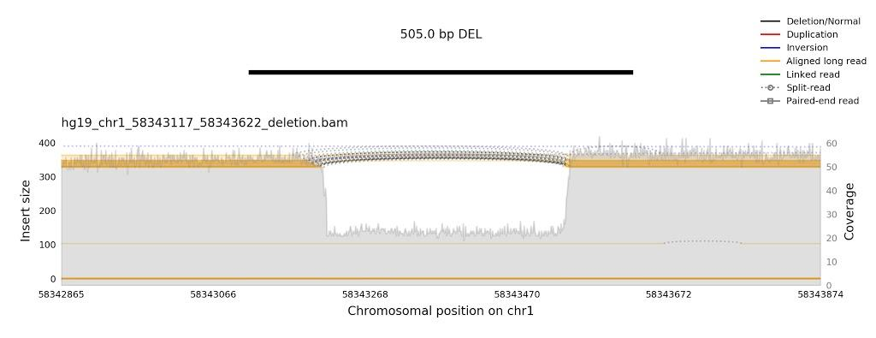
Workflow of the SV module
Implemented in GeneVar
Frequency
New feature
File
Gene impact
Known clinical SV
manta
parliament2
SV calling
VCF with SVs
Links to GeneVar
Annotated VCF with SVs
Priority score
Groups 1,6 for
combined report
Gene in enriched pathway
Standalone Shiny app?
BAM file
QC images for (some) SVs
Visualization of a SV call
samplot

Slide 3
Day 3 - Methods and updates
BAM -> VCF with SV calls
  Ran parliament2 workflow in DNAnexus on 1000GP WGS seq sample
VCF -> annotated VCF + CSV
  First simple workflow and tables created
Standalone Shiny App to annotate VCF and explore clinical SVs
  New UI and features, need to integrate the annotation
Visualization of the SV calls

Slide 4
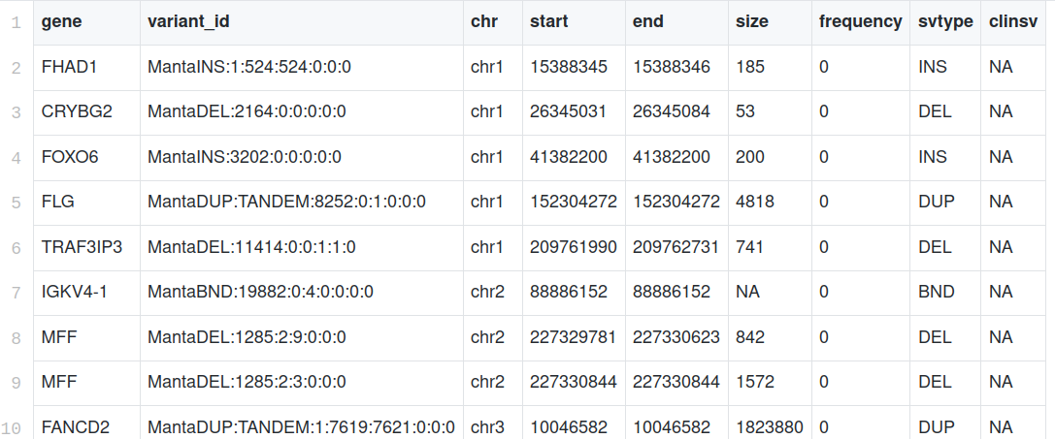
VCF -> annotated VCF + CSV
First set of annotation modules integrated in a master R script
See example of output CSV for Team 16: NA19461.clinicalsv.csv
Next: finish more modules
  Gene enrichment with the clusterProfiler package, needs to be integrated
  Annotation of known cancer SVs from COSMIC?

Slide 5
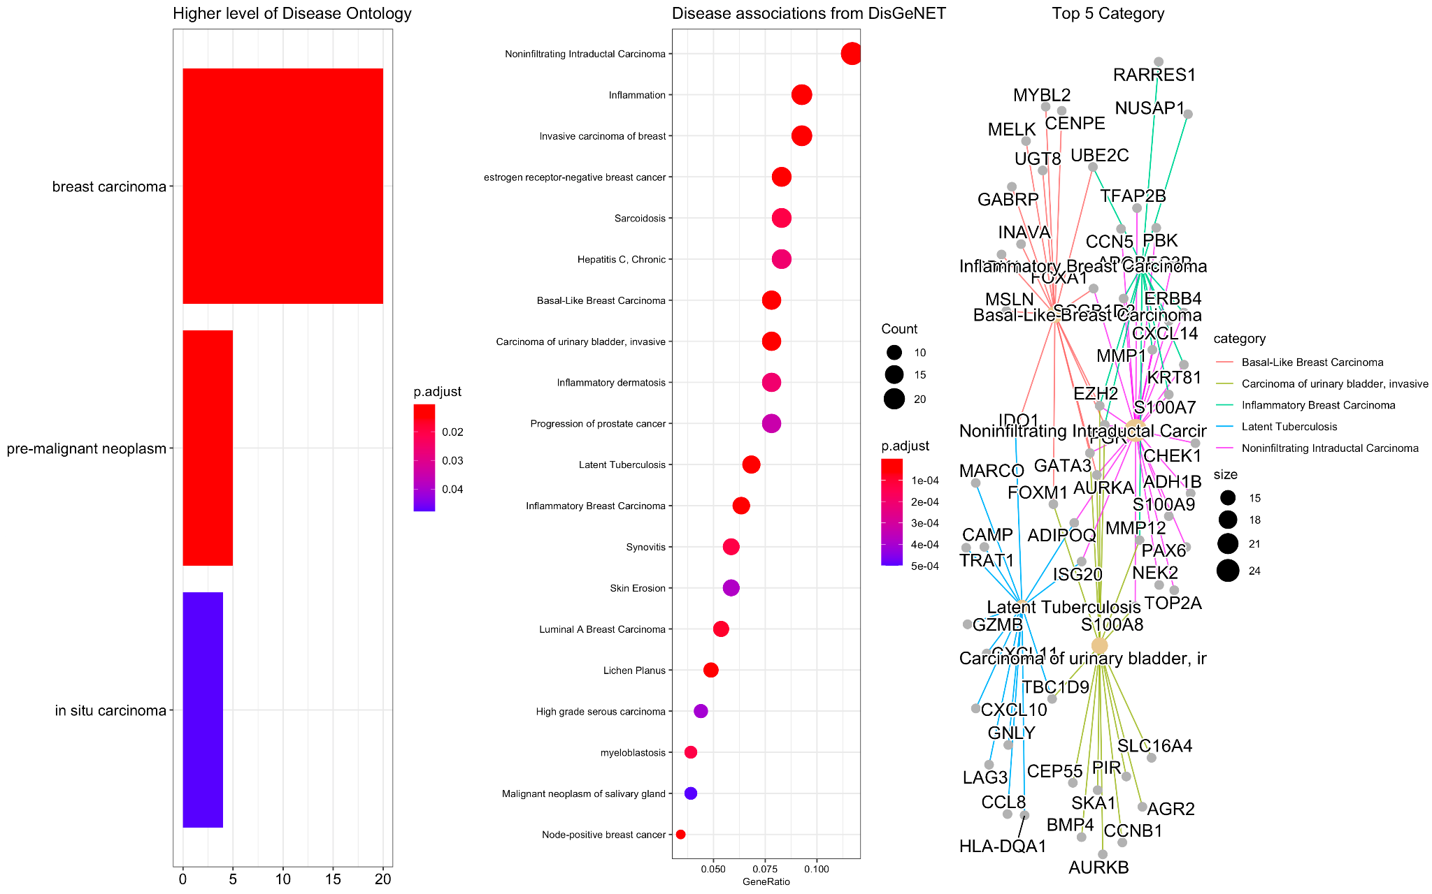
Enrichment of genes hit by clinical SVs
Using the clusterProfiler BioConductor package
Next: new tab in the Shiny app and new table to share with Team 16

Slide 6
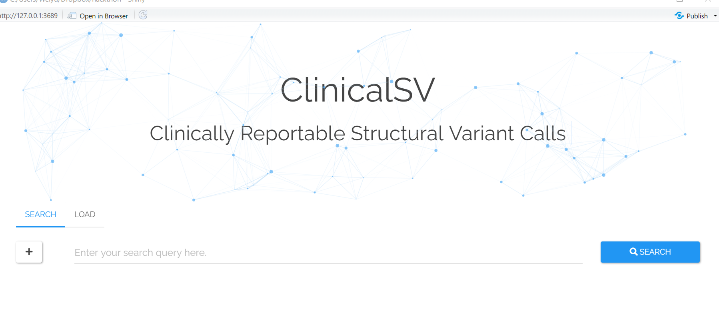
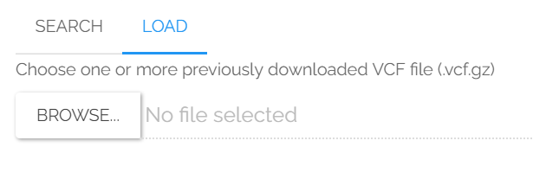
Standalone Shiny App to annotate VCF and explore clinical SVs
Started a nicer UI than GeneVar
New feature: “Load” button to upload input VCF
Next: integrate the annotation code on the server side

Slide 7
Visualization of the SV calls
Distribution of SVs across the genome
Next: SV-oriented read coverage plot from samplot to assess confidence

