Slide 1
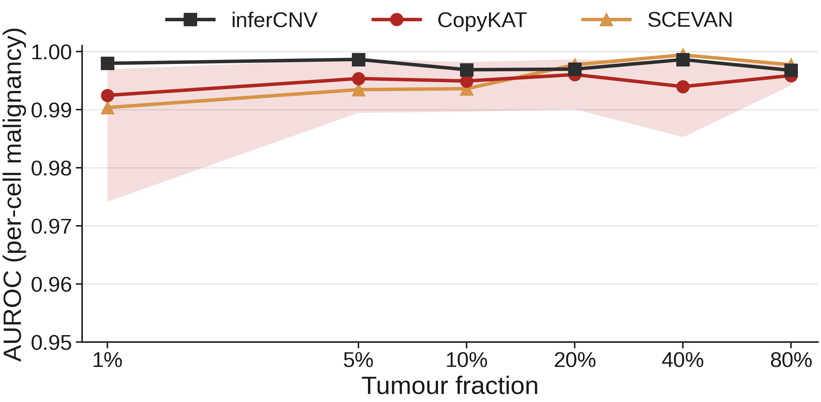
01 · DISCRIMINATION
Discrimination holds across tumour purity
Purity-resolved benchmark of single-cell CNV callers. SEQC2 HCC1395 / HCC1395BL, GRCh38. Expression arm (10x): inferCNV, CopyKAT, SCEVAN; allele arm (C1): Numbat.
All three expression callers reach AUROC ≥ 0.990 at every tumour fraction.
inferCNV is most stable, ≥ 0.997 across 1% to 80% (mean 0.998); band = CopyKAT replicate range.
Group 9 · scOnco-scorer
1 / 15

Slide 2
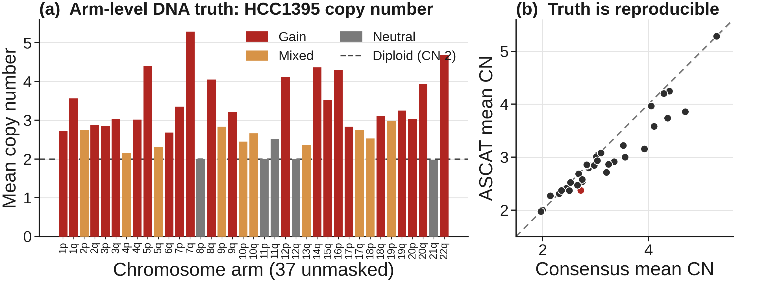
02 · DNA TRUTH FOUNDATION
The benchmark rests on validated DNA truth
Arm-level truth from matched WGS: 22 gain, 10 mixed, 5 neutral of 37 unmasked arms.
Two orthogonal callers concur: consensus and ASCAT agree on 36 of 37 arms (97.3%).
Copy-number estimates track tightly between callers; only 1p differs (gain vs mixed).
Group 9 · scOnco-scorer
2 / 15

Slide 3
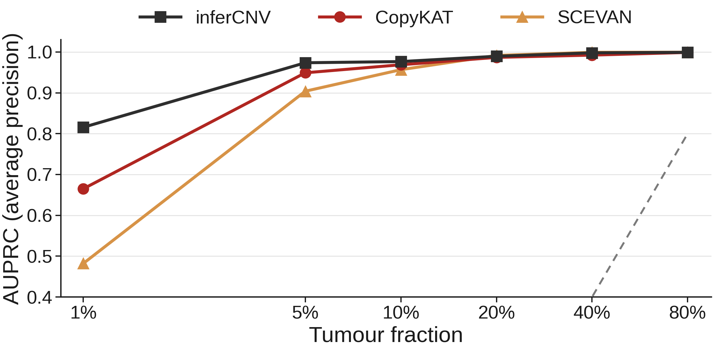
03 · LOW-PURITY DETECTABILITY
Detectability collapses at 1%, recovers by 5%
inferCNV holds precision-recall best at 1% purity (AUPRC 0.816).
SCEVAN falls hardest at 1% (0.482); CopyKAT intermediate (0.665).
All recover to ≥ 0.90 by 5% and ≥ 0.99 by 40%; dashed grey = AP chance.
Group 9 · scOnco-scorer
3 / 15

Slide 4
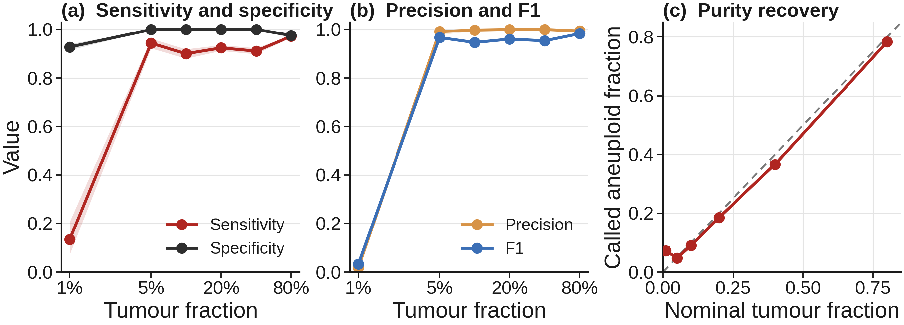
04 · OPERATING POINT · 95% CI
Decision metrics and purity recovery, with CIs
At the fixed threshold, sensitivity and precision are low at 1% but jump to ≥ 0.94 by 5% (F1 0.03 to 0.97).
Specificity stays ≥ 0.93 throughout; ribbons are cluster-bootstrap 95% CIs.
Called aneuploid fraction tracks nominal tumour fraction along the identity line.
Group 9 · scOnco-scorer
4 / 15

Slide 5
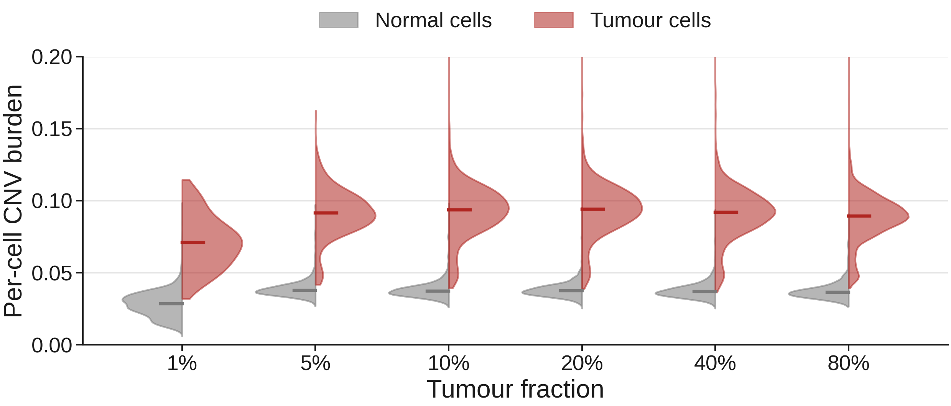
05 · PER-CELL SEPARATION
Malignant and normal cells separate by burden
Tumour-cell CNV burden sits well above normal at every purity, even at 1% (medians 0.071 vs 0.028).
This separation is why per-cell AUROC stays near 1.0 across the purity range.
Split violins pool 10 seeded replicates per fraction; median marked.
Group 9 · scOnco-scorer
5 / 15

Slide 6
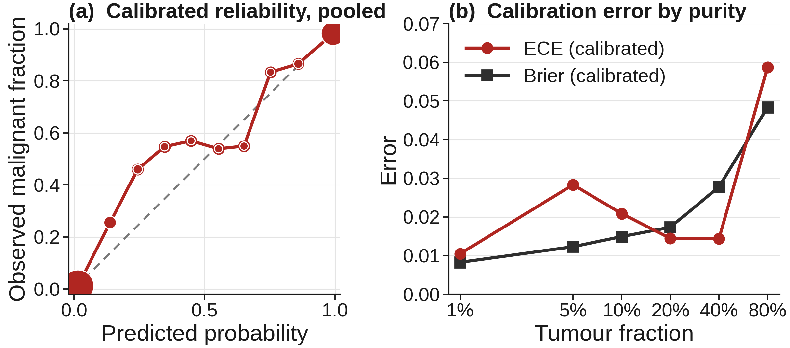
06 · CALIBRATION QUALITY
Probabilities are well calibrated
CopyKAT is the best-calibrated caller: pooled ECE 0.009, Brier 0.022.
Calibrated reliability tracks the diagonal across the probability range.
Per-fraction ECE stays ≤ 0.029 to 40%, rising to 0.059 at 80%.
Group 9 · scOnco-scorer
6 / 15

Slide 7
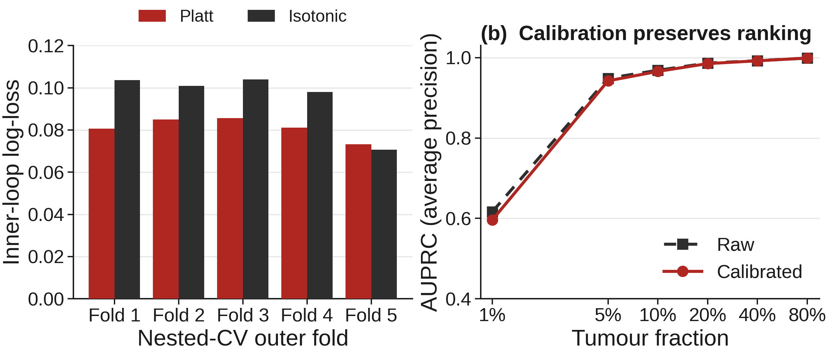
07 · CALIBRATOR SELECTION · NESTED CV
Calibration is chosen by group-aware nested CV
Platt scaling wins the inner loop in every outer fold; folds are grouped by source cell, so no cell leaks across folds.
Calibrated and raw AUPRC are nearly identical, so calibration preserves ranking.
Decision thresholds are set on training folds to target PPV 0.95 and NPV 0.98.
Group 9 · scOnco-scorer
7 / 15

Slide 8
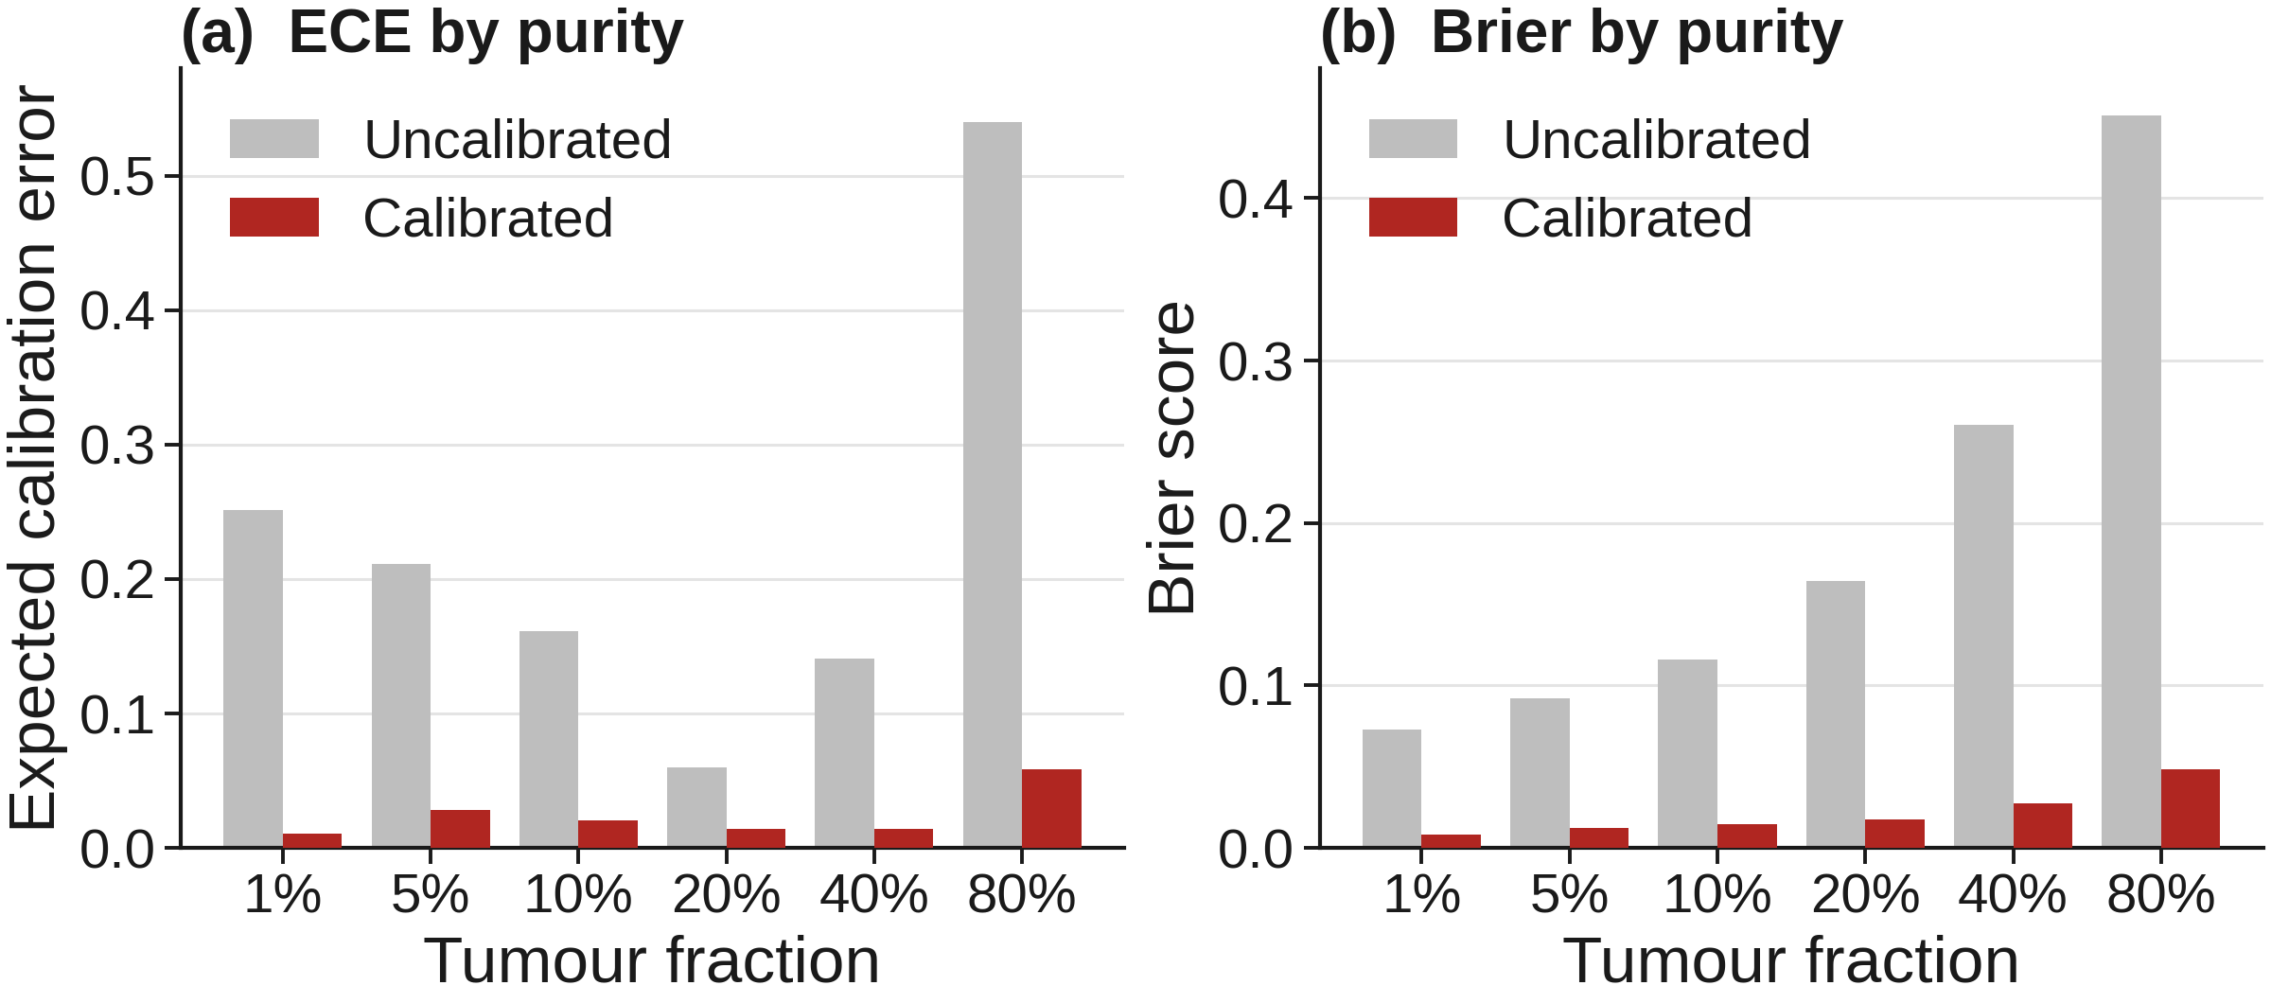
08 · CALIBRATION DRIFT
Calibration drift grows with purity
The uncalibrated score is overconfident, worst at 80% (ECE 0.54, Brier 0.45).
Calibration corrects it at every fraction; the gain is largest at 80% (Brier down 0.40).
After calibration, ECE and Brier stay low across 1% to 80%.
Group 9 · scOnco-scorer
8 / 15

Slide 9
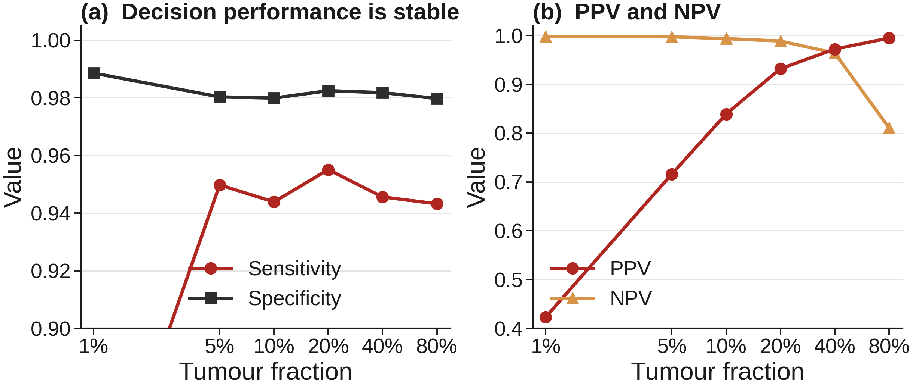
09 · DECISION QUALITY
Calibrated decisions are stable across purity
Determinate sensitivity holds at ~0.95 and specificity at ~0.98 across 1% to 80%.
PPV rises 0.42 to 0.99 and NPV falls 0.998 to 0.81 with prevalence; a base-rate effect, not drift.
Every cell receives a determinate call; the indeterminate fraction is zero.
Group 9 · scOnco-scorer
9 / 15

Slide 10
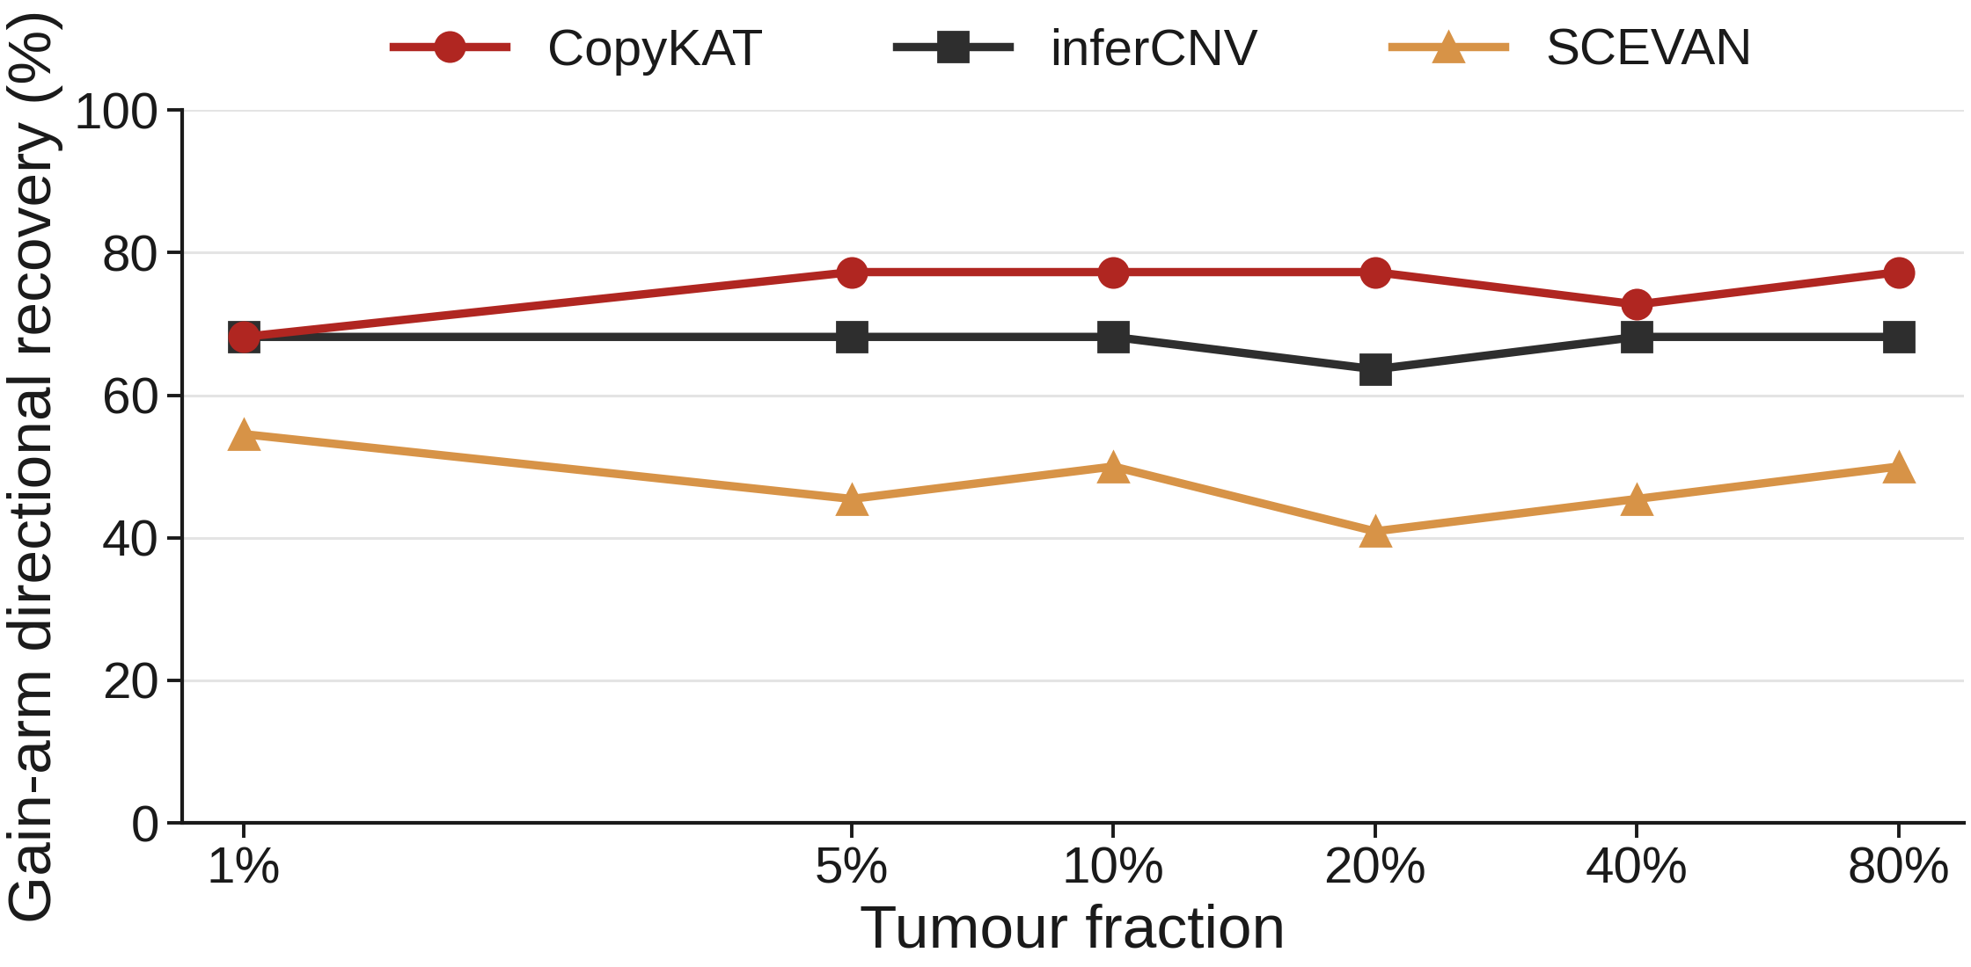
10 · GENOMIC FIDELITY
Gain-arm direction recovery by caller
CopyKAT recovers gain-arm direction best: 77.3% at 80% (17 of 22 gain arms).
inferCNV is flat at ~68.2% across all fractions; SCEVAN trails at 41% to 55%.
Loss is not evaluable: SEQC2 truth has no unmasked loss-dominant arms (22 gain, 0 loss).
Group 9 · scOnco-scorer
10 / 15

Slide 11
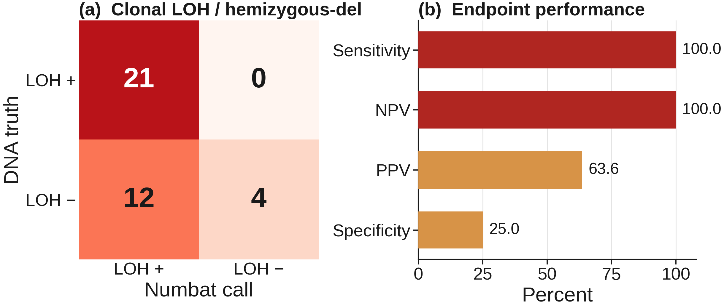
11 · ALLELE ARM · C1 / NUMBAT
Haplotype-aware LOH concordance on C1
Per-cell malignancy is perfectly resolved on C1: AUROC 1.00 (expression, allele, joint).
Clonal LOH concordance is complete: 21 of 21 truth-LOH arms, including 17q (100% sensitivity).
The permissive LOH-or-del endpoint over-calls neutral arms (specificity 25%).
Group 9 · scOnco-scorer
11 / 15

Slide 12
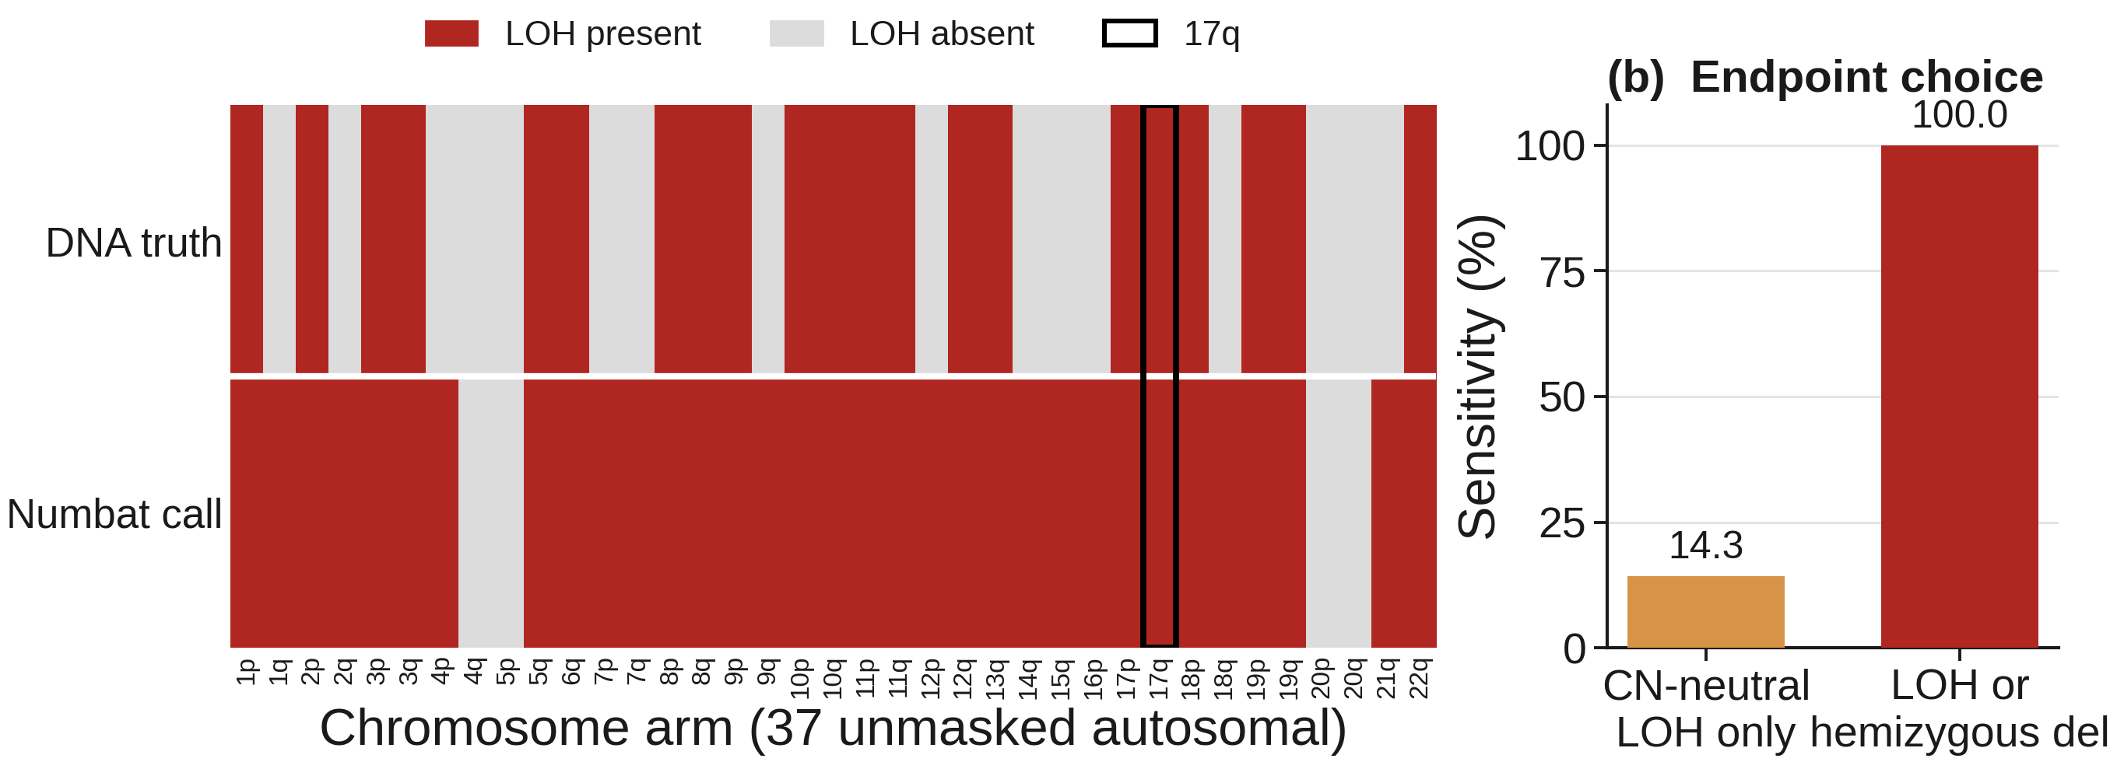
12 · ALLELE ARM · PER-ARM CONCORDANCE
Numbat recovers LOH genome-wide, including 17q
All 21 truth-LOH arms are recovered, including 17q; the few over-calls fall on non-LOH arms.
The endpoint matters: LOH-or-hemizygous-deletion reaches 100% sensitivity, copy-neutral-LOH-only 14.3%.
HCC1395 loses heterozygosity largely through deletion, which the allele model captures.
Group 9 · scOnco-scorer
12 / 15

Slide 13
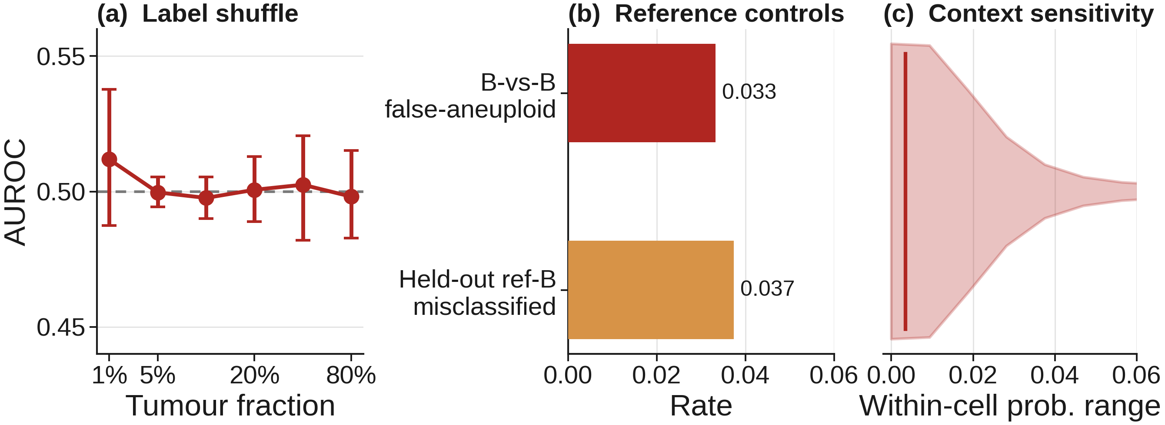
13 · CONTROLS
Negative controls all behave
Label-shuffle AUROC collapses to chance (~0.50) at every fraction.
B-vs-B false-aneuploid 0.033; held-out reference-B misclassification 0.037; barcode match 1.00.
Scores are stable to cohort: median within-cell probability range 0.003, 1.5% cross a boundary.
Group 9 · scOnco-scorer
13 / 15

Slide 14
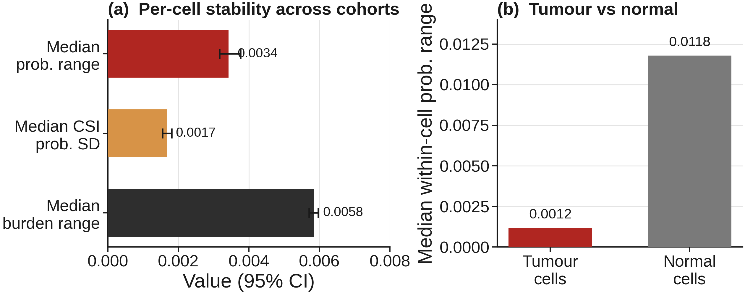
14 · CONTEXT SENSITIVITY · 95% CI
Per-cell scores are robust to cohort composition
Median within-cell probability range is 0.003 (95% CI 0.003 to 0.004); burden range 0.006.
Only 1.5% of cells cross a decision boundary across cohorts (95% CI 1.1% to 1.9%).
Tumour cells are the most stable (0.001); normal cells vary slightly more (0.012) but stay negligible.
Group 9 · scOnco-scorer
14 / 15

Slide 15
15 · SYNTHESIS
Synthesis: best caller per axis
Axis | Metric | Best | Result
Discrimination | AUROC, per-cell | inferCNV | ≥ 0.997 all fractions (mean 0.998)
Low-purity detectability | AUPRC at 1% | inferCNV | 0.816 (≥ 0.90 by 5%)
Calibration | ECE / Brier, pooled | CopyKAT | 0.009 / 0.022
Decision quality | Determinate sens / spec | CopyKAT | ~0.95 / ~0.98 all fractions
Genomic fidelity | Gain-arm direction | CopyKAT | 77.3% at 80% (17 of 22)
Allele / LOH (C1) | Clonal LOH concordance | Numbat | 21 of 21 arms, 100% sensitivity
Per-cell (C1) | AUROC, expr / allele / joint | Numbat | 1.00
DNA truth | Consensus vs ASCAT | 2 callers | 36 of 37 arms agree (97.3%)
Controls + context | Shuffle / B-vs-B / stability | all pass | 0.50 / 0.033 / range 0.003
In progress: physical-mixture demultiplexing (experimental 5% and 10% mixtures) and the Nextflow pipeline.
Group 9 · scOnco-scorer
15 / 15

