Slide 1
Patients, non-specialist clinicians genetic test report

Slide 2

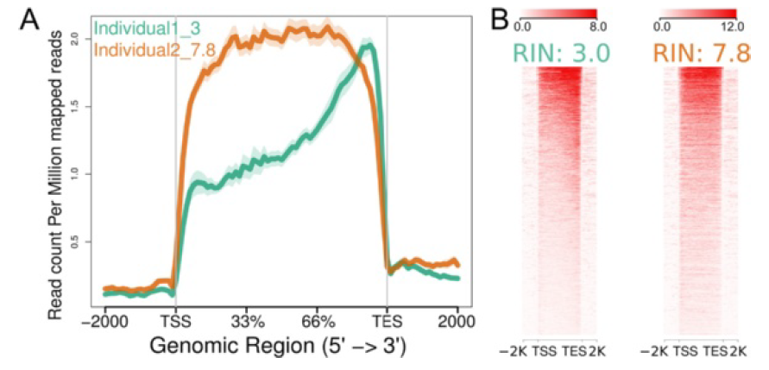

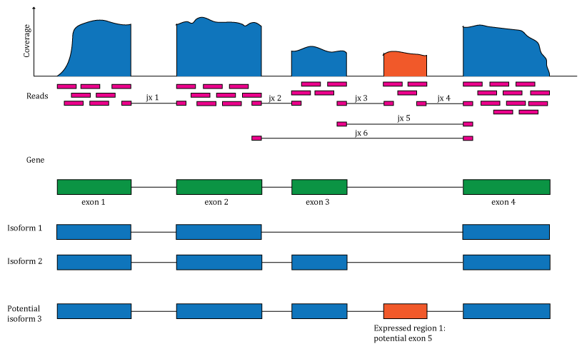
Genetic Test Report
Name
DOB
Sex
Sample Type
Results
Patient details
Name | Date of Birth | Episode | Sequence analysis | classification | Conclusion
Test ordered by
Name
Doctor identification number
Hospital
Report
Reason for test
Lab information
Next steps
Test done by
Telephone
Date received
Date reported
Lab ID number
Processing pipeline
Alignment
Sequencing planform
Sequencing libraries
List of bioinformatics tools
About the test
About the genetic variant
Quality Control
What this results means for you
Genetic tests sometimes reveal information that could be relevant to your family such as a health risk that might run in the family, or that family relationships are different from what you expected.
RIN Score
Active clinical trials related to the gene
For more information please scan this QR code
Coverage
More readings
Notes:
2

Slide 3
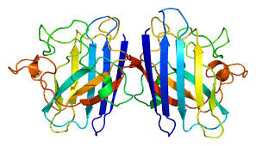
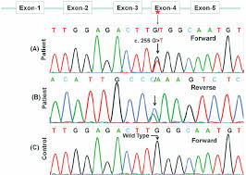
Genetic Test Report
Name
DOB
Sex
Sample Type
Variant Details
Patient details
Gene identified
Gene ID | Phenotype | Frequency in controls | Frequency in cases | Gene variants | Classification
Test ordered by
Name
Doctor identification number
Hospital
Reason for test
Lab information
Test done by
Telephone
Date received
Date reported
Lab ID number
Processing pipeline
Alignment
Sequencing planform
Sequencing libraries
List of bioinformatics tools
RIN Score
Coverage
Notes:
3

Slide 4
Genetic Test Report
Name
DOB
Sex
Sample Type
Information
Patient details
Finding a health risk in genetic testing often does not mean that a patient will go on to develop the health problem in question.
Genetic tests might report false positives (artefacts) and negative results in genetic tests might be false negatives.
Test ordered by
Name
Doctor identification number
Hospital
Classification of reported variants
Reason for test
reported variants | Description
Pathogenic variant | Based upon previous reports in the scientific literature and information in gene variant databases, this variant is a recognized cause of some or all of the patient’s clinical signs and symptoms (the patient’s phenotype).
Likely pathogenic variant | This is a novel (previously unreported) variant, however, based on its gene location and the predicted effect on protein function, it is likely to be the cause of some or all of the patient’s phenotype.
Benign variant | Based upon previous reports in the scientific literature and information in gene variant databases, this variant is recognized as a benign (not harmful), neutral variant and is not responsible for the patient’s phenotype.
Likely benign variant | This is a novel variant, however, based on its gene location and predicted lack of effect on protein function, it is likely to be benign and not responsible for the patient’s phenotype.
Variant of uncertain significance (VUS) | Based on current evidence, it cannot be determined if this variant is pathogenic or benign. Some VUSes have been previously reported in the scientific literature but the evidence associating them with disease may be conflicting. Other VUSes are novel variants whose effect on protein function cannot be predicted.
Lab information
Test done by
Telephone
Date received
Date reported
Lab ID number
Processing pipeline
Alignment
Sequencing planform
Sequencing libraries
List of bioinformatics tools
Limitations
Molecular genetic testing has several limitations, the quality of sequencing depends on the used sequencing methods and the available information about the identified gene variants. In some variants it is not clear if the they are likely benign or pathogenic mutations. The interpretation of test results in the context of the whole family history is important.
This report has been reviewed and approved by:
Lab certificate number:
Notes:
4

Slide 5
Specialist researcher and clinician genetic test report

Slide 6
Genetic Test Report-FOR RESEACH ONLY
Sample ID
DOB
Sex
Sample Type
Results
Patient details
Name | Date of Birth | Episode | Sequence analysis | classification | Conclusion
Test ordered by
Name
Doctor identification number
Hospital
Report
Reason for test
Lab information
Next steps
Test done by
Telephone
Date received
Date reported
Lab ID number
Processing pipeline
Alignment
Sequencing planform
Sequencing libraries
List of bioinformatics tools
About the test
About the genetic variant
More readings
For more information please scan this QR code
Notes:
6

Slide 7
Genetic Test Report-FOR RESEARCH ONLY
Sample ID
DOB
Sex
Sample Type
Quality Control
Patient details
Sex check
Test ordered by
Name
Doctor identification number
Hospital
Reason for test
RIN Score
Lab information
Test done by
Telephone
Date received
Date reported
Lab ID number
Processing pipeline
Alignment
Sequencing planform
Sequencing libraries
List of bioinformatics tools
Coverage
PCA
Notes:
7

Slide 8
Genetic Test Report-FOR RESEARCH ONLY
Name
DOB
Sex
Sample Type
Variant Details
Patient details
Gene identified
Gene ID | Phenotype | Frequency in controls | Frequency in cases | Gene variants | Classification
Test ordered by
Name
Doctor identification number
Hospital
Reason for test
Lab information
Test done by
Telephone
Date received
Date reported
Lab ID number
Processing pipeline
Alignment
Sequencing planform
Sequencing libraries
List of bioinformatics tools
Notes:
8

Slide 9
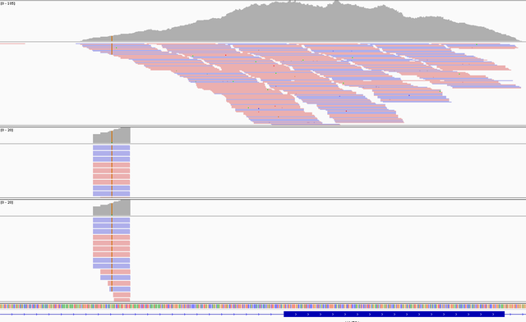
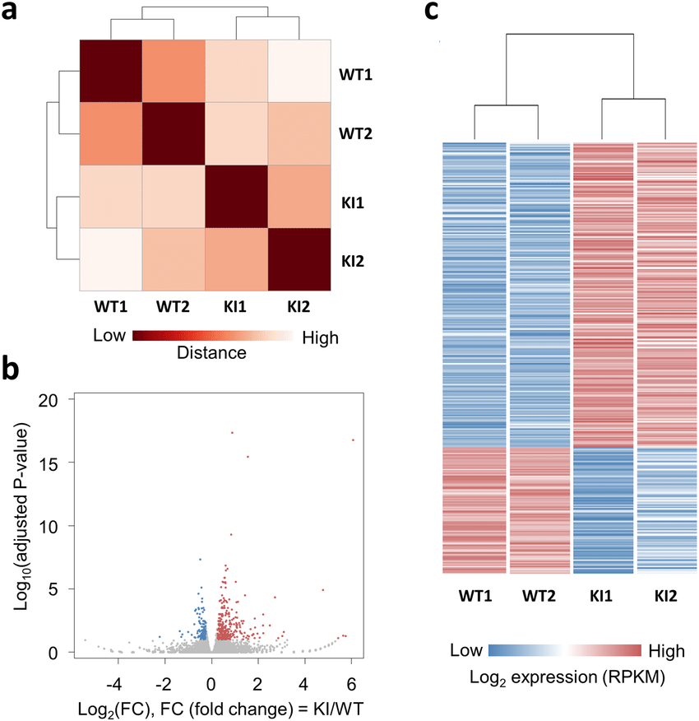
Genetic Test Report-FOR RESEARCH ONLY
Name
DOB
Sex
Sample Type
Variant Details
Patient details
Haplotype Analysis
Test ordered by
Name
Doctor identification number
Hospital
 | Start | End | Coverage
Haplotype | RS116-HG19 | RS122-HG19 | 110KB
Reason for test
Lab information
Test done by
Telephone
Date received
Date reported
Lab ID number
Processing pipeline
Alignment
Sequencing planform
Sequencing libraries
List of bioinformatics tools
RNA differential expression analysis
Notes:
9

Slide 10
Genetic Test Report-FOR RESEARCH ONLY
Name
DOB
Sex
Sample Type
Variant Details
Patient details
Drug Targets
Test ordered by
Name
Doctor identification number
Hospital
Reason for test
Lab information
Test done by
Telephone
Date received
Date reported
Lab ID number
Processing pipeline
Alignment
Sequencing planform
Sequencing libraries
List of bioinformatics tools
Notes:
10

