Slide 1

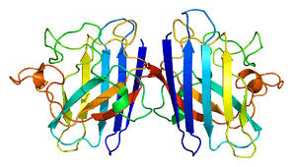
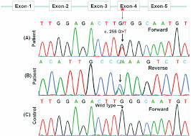
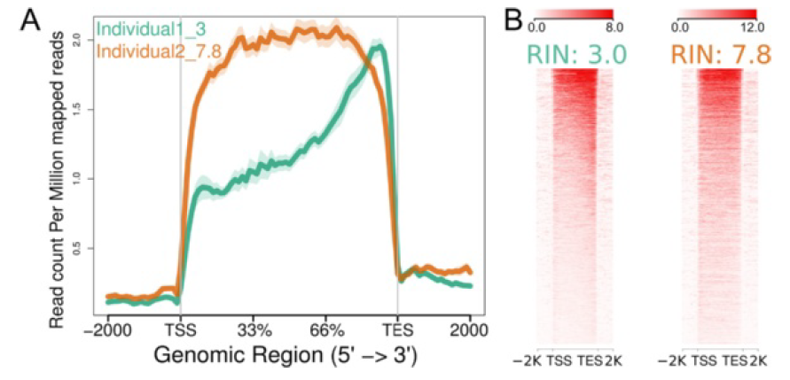

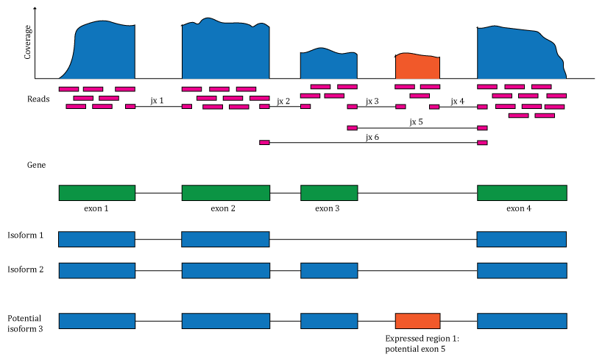
Genetic Test Report
Name
DOB
Sex
Sample Type
Results
Patient details
Gene ID | Phenotype | Frequency in controls | Frequency in cases | Gene variants | Classification
Test ordered by
Name
Doctor identification number
Hospital
Reason for test
Lab information
Test done by
Telephone
Date received
Date reported
Lab ID number
Processing pipeline
Alignment
Sequencing planform
Sequencing libraries
List of bioinformatics tools
About the test
About the genetic variant
Quality Control
What this results means for you
RIN Score
More information
For more information please scan this QR code
Coverage
More readings
Notes:
1

Slide 2
Genetic Test Report-FOR RESEARCH ONLY
Sample ID
DOB
Sex
Sample Type
Results
Patient details
Gene ID | Phenotype | Frequency in controls | Frequency in cases | Gene variants | Classification
Test ordered by
Name
Doctor identification number
Hospital
Reason for test
Lab information
Test done by
Telephone
Date received
Date reported
Lab ID number
Processing pipeline
Alignment
Sequencing planform
Sequencing libraries
List of bioinformatics tools
About the test
About the genetic variant
Quality Control
What this results means for you
RIN Score
More information
For more information please scan this QR code
Coverage
More readings
Notes:
2

