Slide 1

HEALTH CLINIC LOCATOR “Your Health ally!”
Team Members:
Seth Emery
Shreyan Reddy Gangwar
Lavanya Ghanathey
Ankitha srirama reddy

Slide 2
ABSTRact
Welcome to our Health Clinic Locator, your personalized healthcare companion! Enter your postal code, and we'll guide you to top-rated hospitals tailored to your needs. Uncover essential details such as insurance acceptance, convenient opening hours, and the availability of emergency services. Our goal is to empower you with the information needed to make informed healthcare decisions. Your well-being is our priority – type in your postal code and embark on a journey to optimal healthcare.

Slide 3
OBJECTIVE
Our objective is to guide individuals to top-rated hospitals that align with their specific needs. We strive to offer a comprehensive overview, including insurance acceptance, convenient opening hours, and the availability of emergency services, ensuring users make informed decisions about their healthcare choices. Through this platform, our goal is to enhance accessibility and facilitate well-informed healthcare decisions for all users.

Slide 4
Data COLLECTION

Slide 5
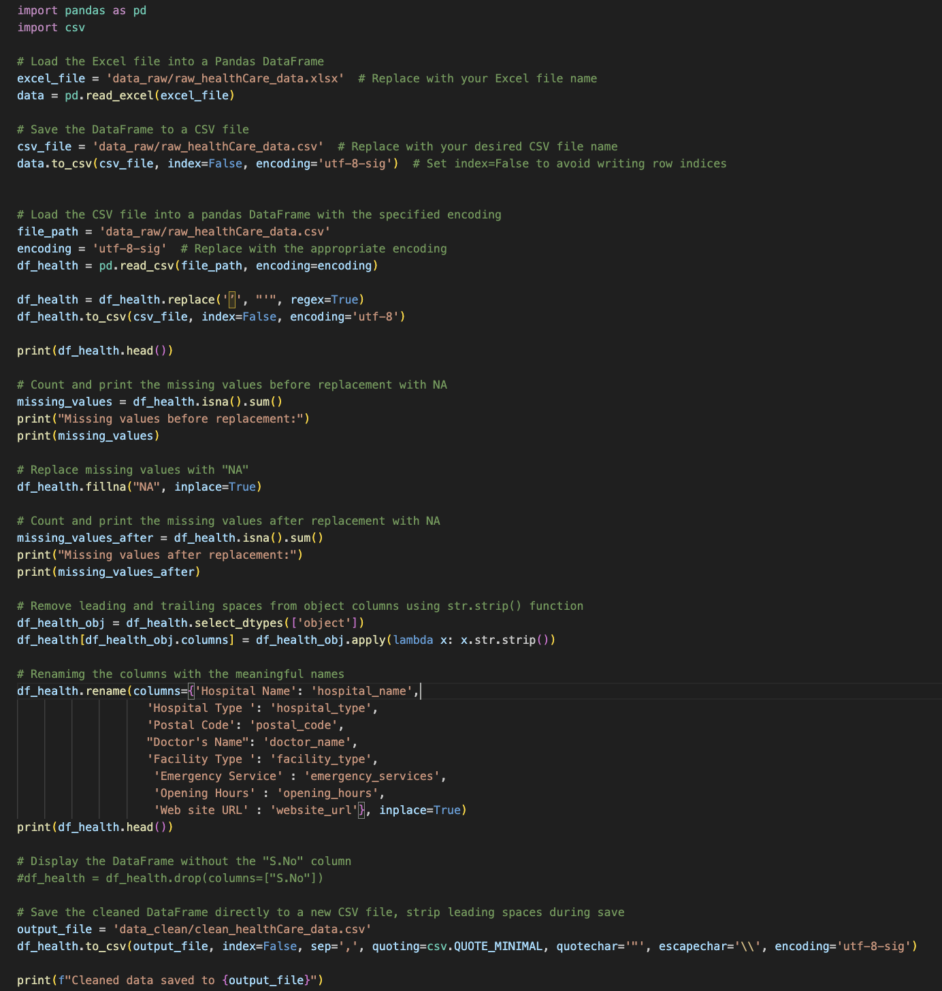
Data Preprocessing

Slide 6
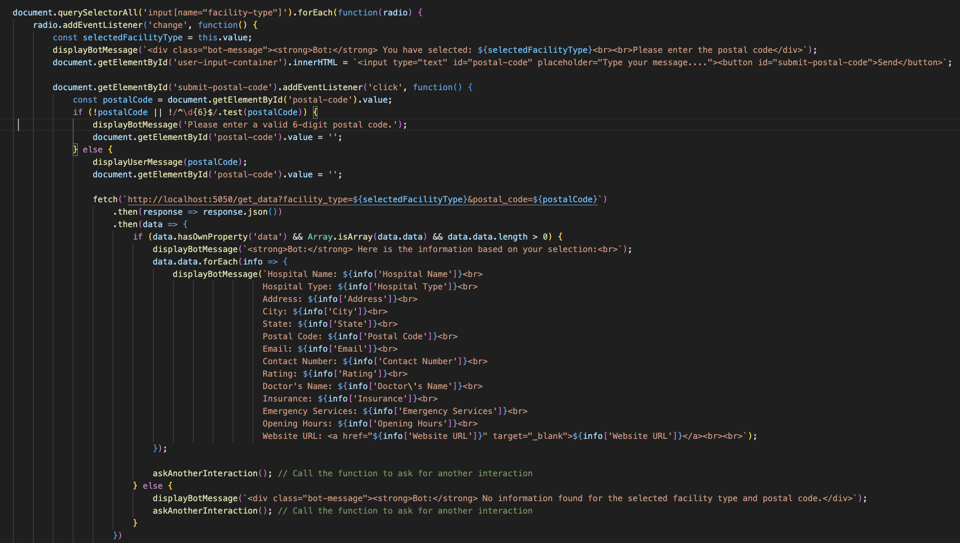
BOT functionalities

Slide 7
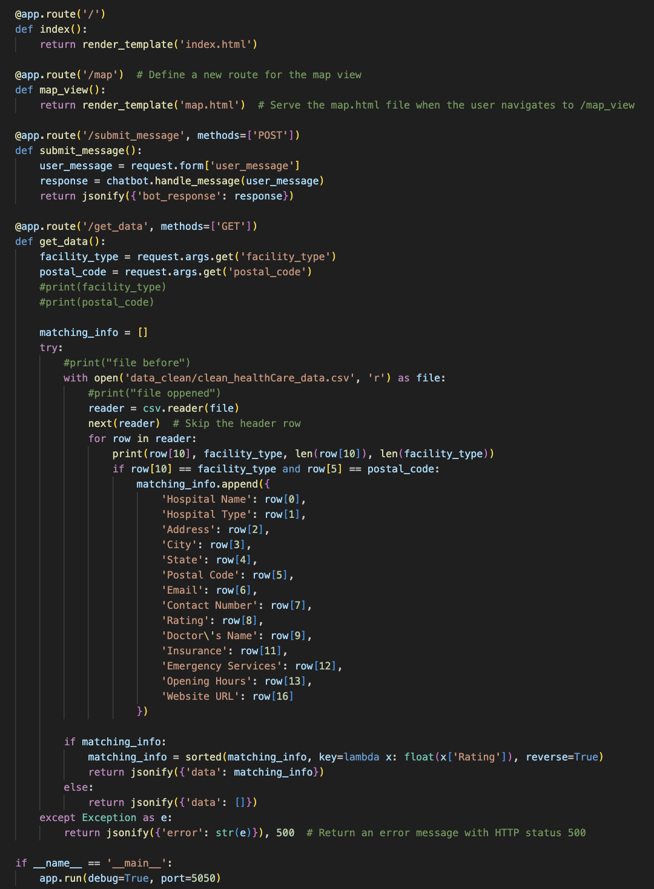

Slide 8
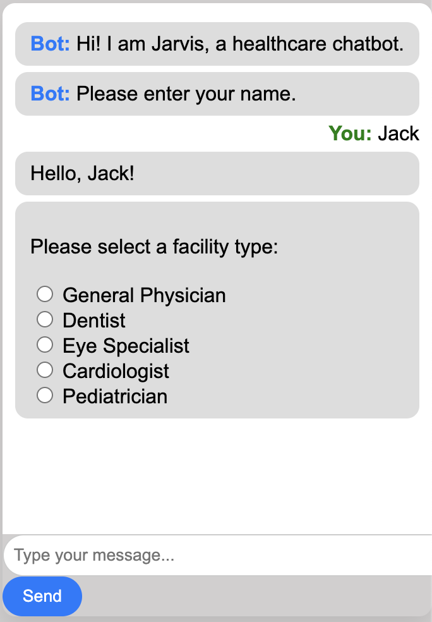
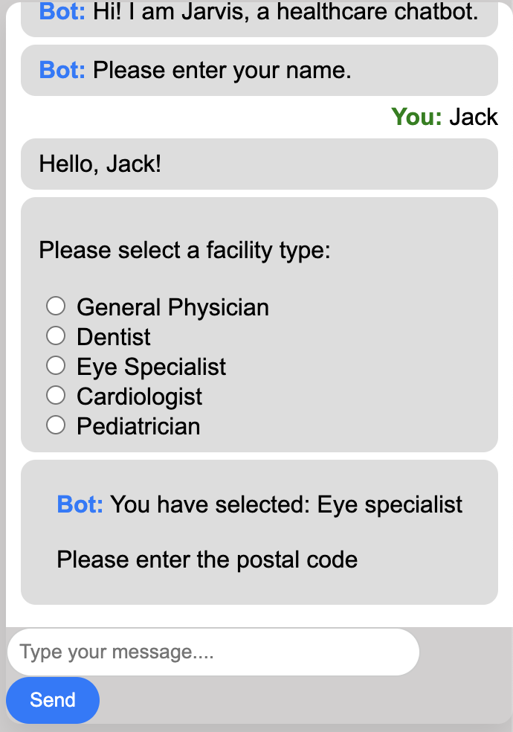
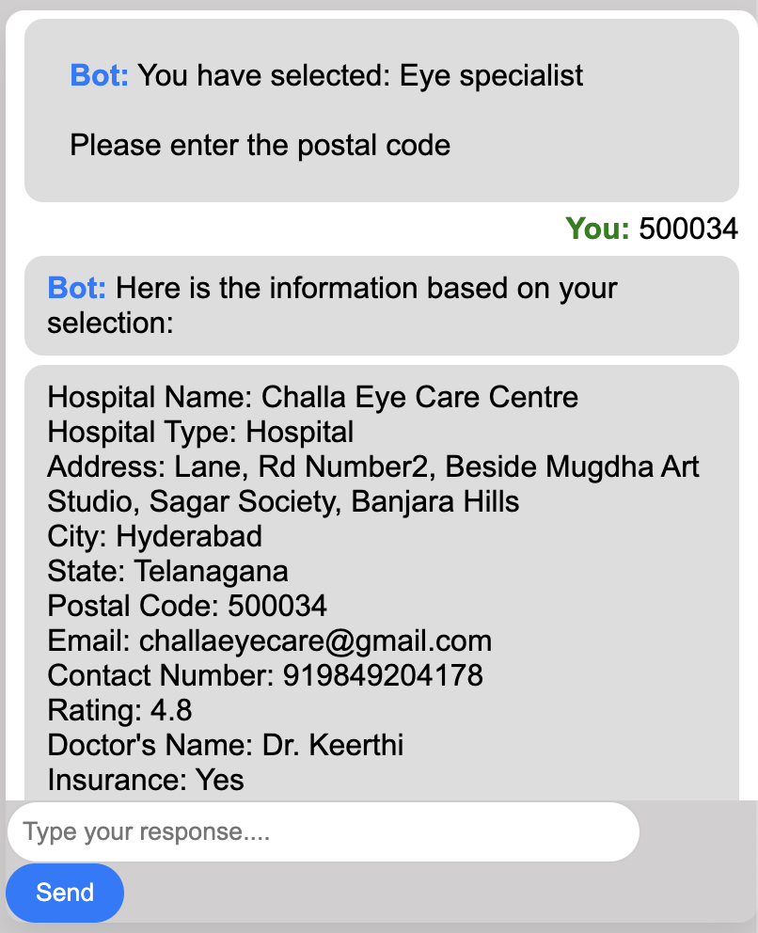
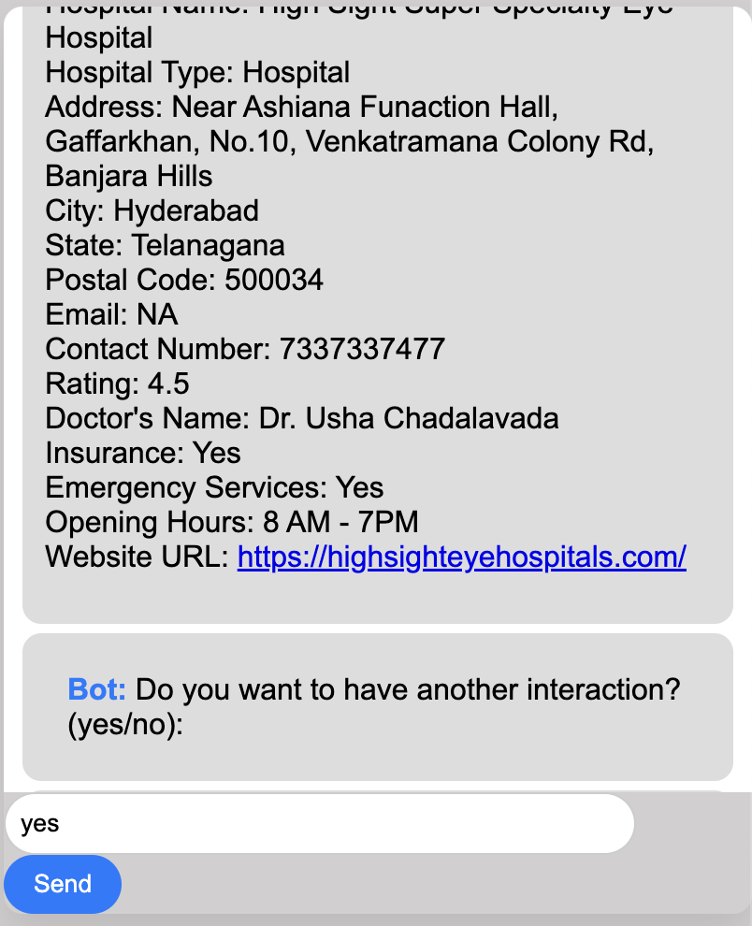
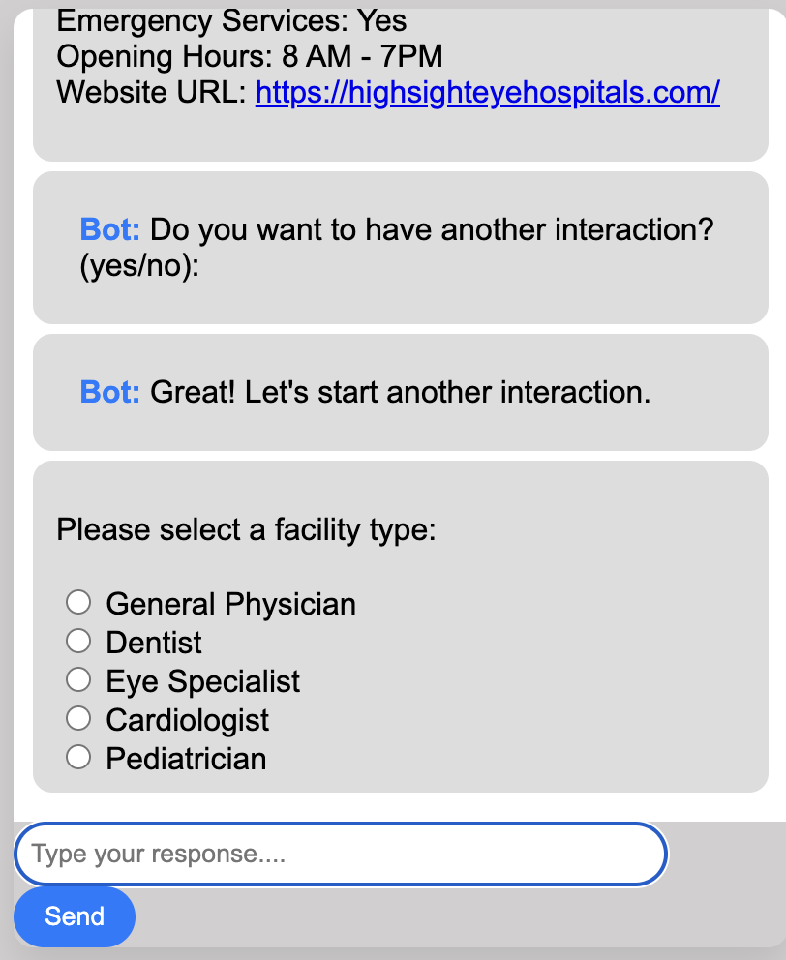
Results

Slide 9
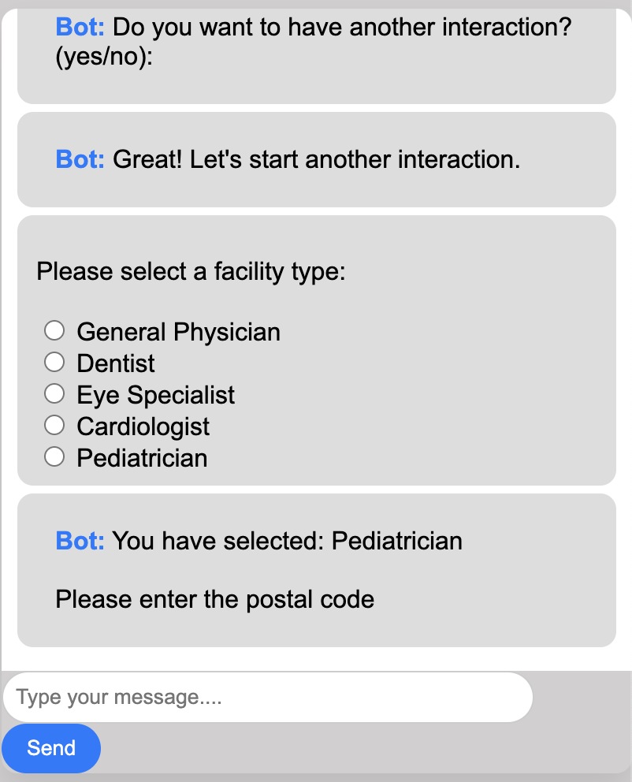
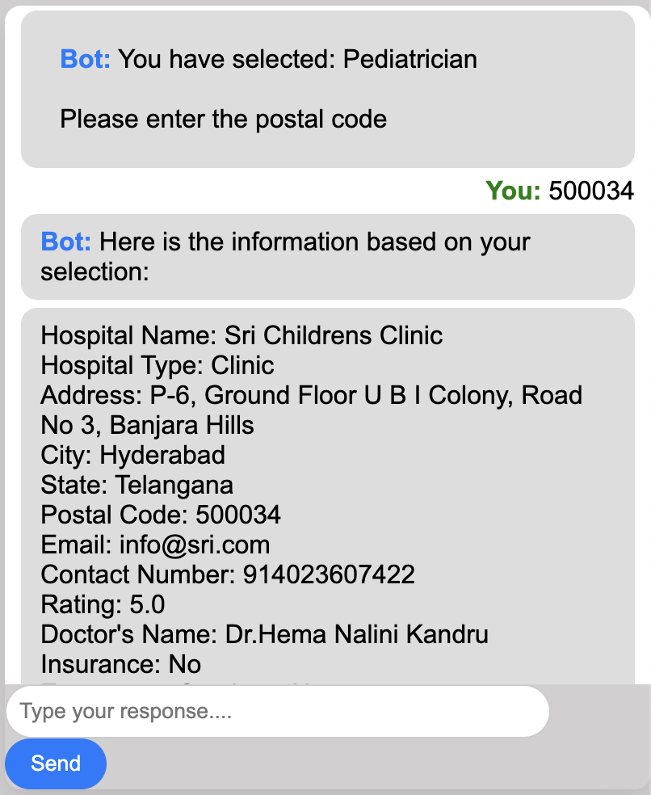
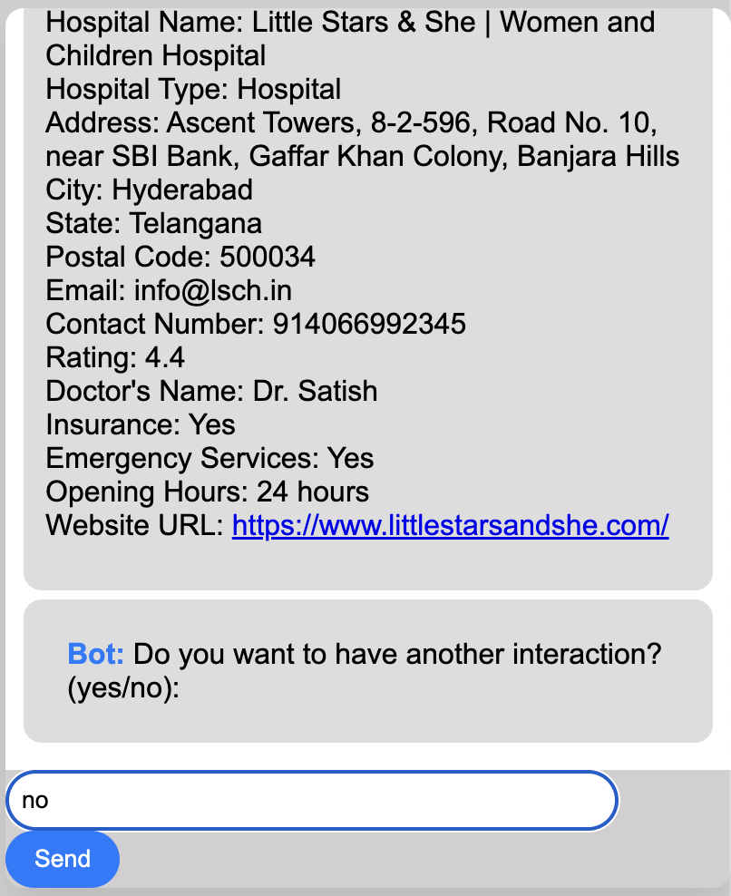
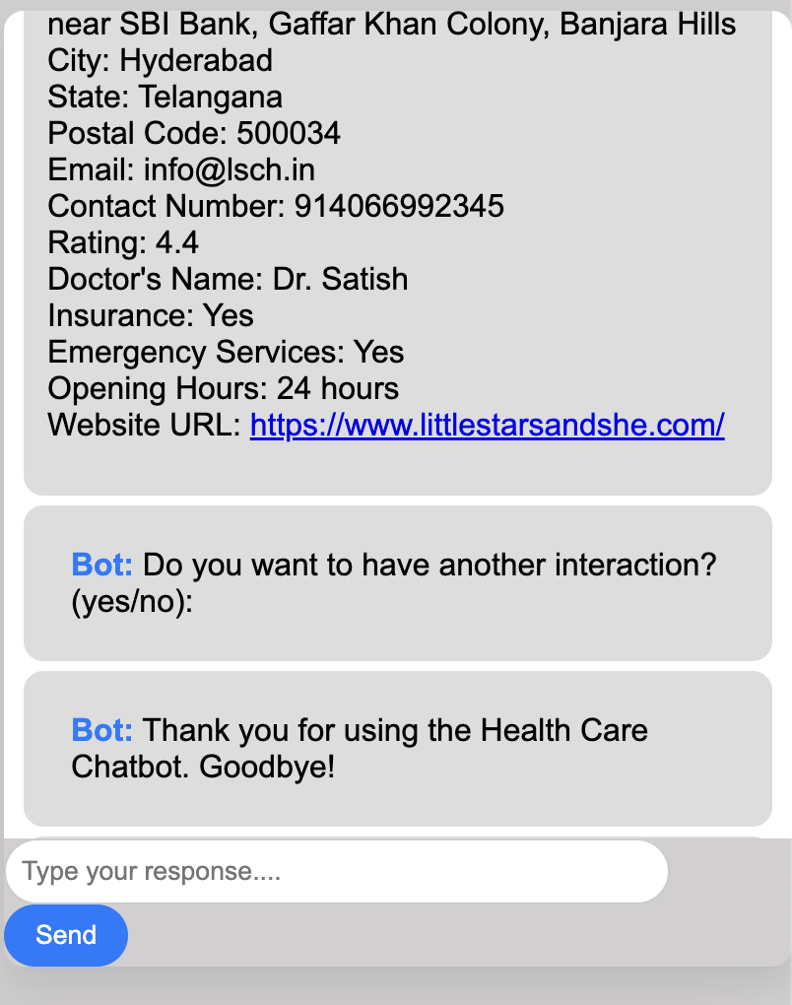

Slide 10
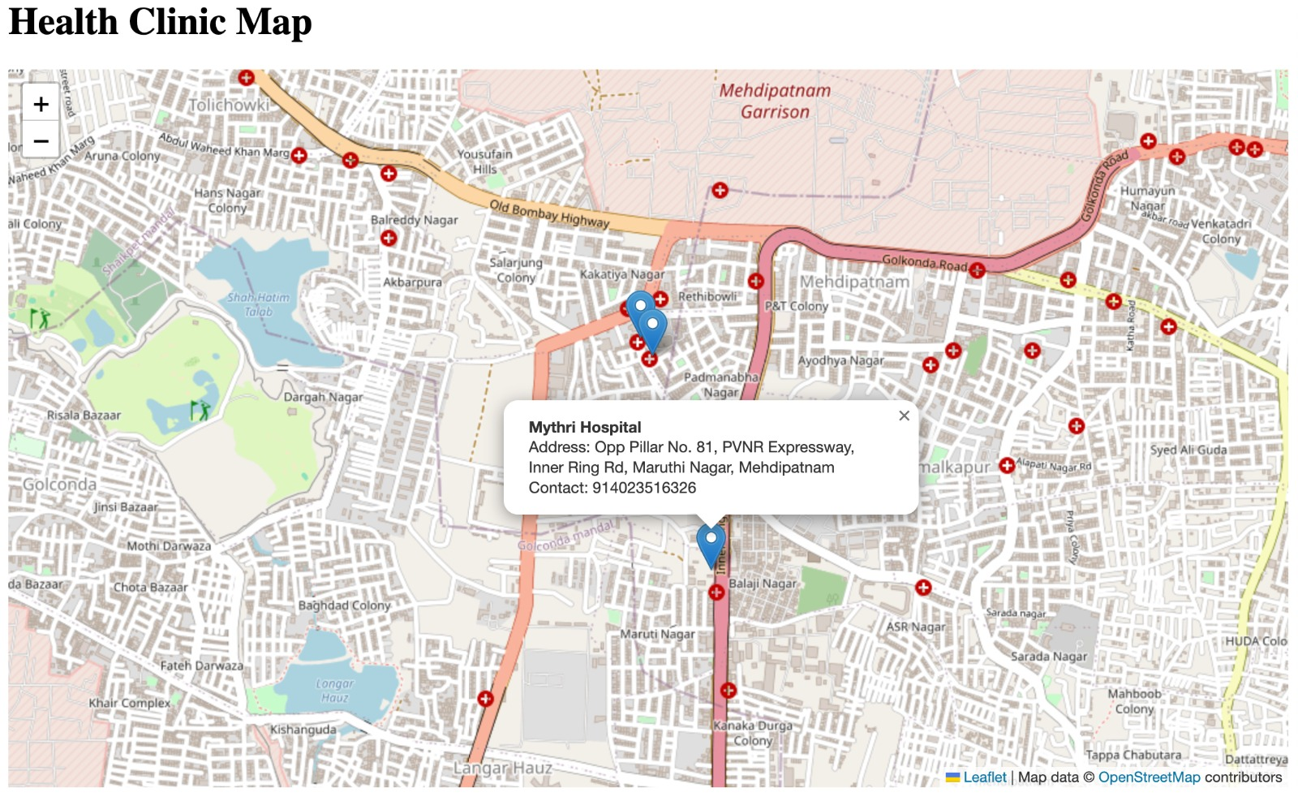

Slide 11
Future Scope
Appointment Booking
Medication Suggestions

Slide 12
THANK YOU!!!

