Slide 1

CollectionSpace
Services Overview
June 2009 Face-to-face
Patrick Schmitz, Aron Roberts,
Richard Millet, Sanjay Dalal
U.C. Berkeley IST/Data Services
Notes:
Lots of talk about SOA, lots of investment in SOA, we’ve heard promises about easy integration, re-use across variant enterprise. SOA makes many of the same promises that OOP and other SW methodologies made, and it is worth remembering that we are still waiting for these promised benefits. So I'm here to tell a story from the trenches, make some observations, and describe how we - at Berkeley and on CollectionSpace – are trying to address the issues we've identified.

Slide 2
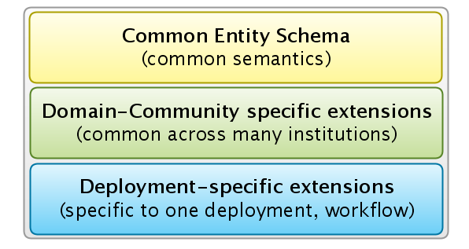
Schema Extension Model
Schema model for a customized service deployment

Slide 3
Service Contracts and Schema
Contracts, APIs
  Note: SOA != SOAP. We like ROA/REST.
  Main services expose entities (most of the work)
    Also a fair number of utilities
    Some task-level services
  Most of contract is in the schema (XSD)
    Exploring sparse payloads for simpler, more flexible API
    Extensions stored/returned (searched?), have no semantics
Entity schemas roughly correspond to data model
  But: not fixed for application – custom per museum
  Follow something like an implements interface model
Notes:
Show diagram of interface model (3-layer first, then decompose?)

Slide 4
Configuration and Customization
Configuration of existing services, schemas
  Which services are of interest for this deployment
  Which fields in schemas to use, how to label them
  Validation rules, patterns, for field values
  Roles, access policies, for pages, fields, etc.
  Vocabularies, name authorities, etc.
Customization of schemas, application
  Pageflow, graphics, look and feel of application
  Local schema extensions
  Application extensions to integrate other services, etc.
Notes:
This is our view of things – just for context

Slide 5
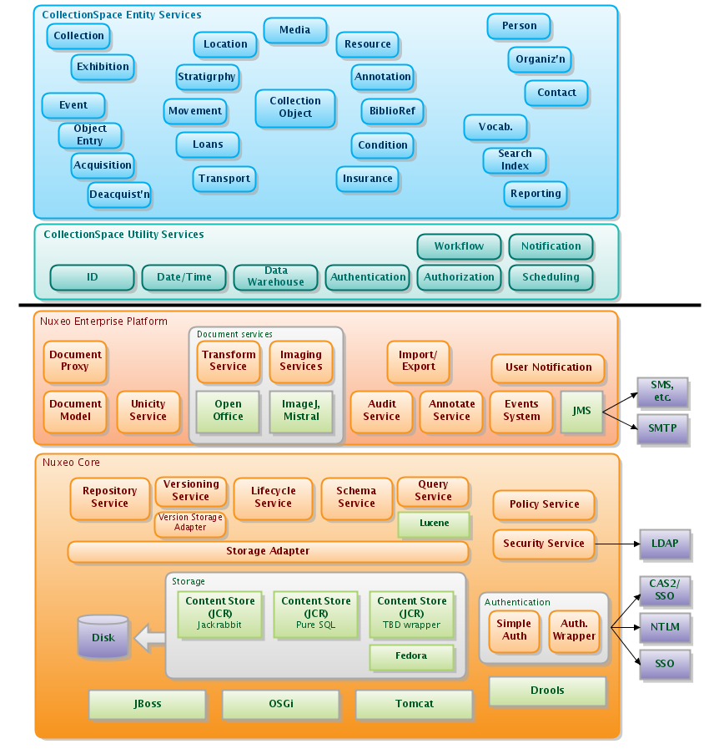
Services stack
C-Space
Services
Nuxeo Platform
Services
Notes:
Need to explain SOA in our context, and what it actually means in practice (core logic of model semantics is largely the same. What’s different is how we integrate code, how we expose APIs, how we link entities in the model).

